Slide 1
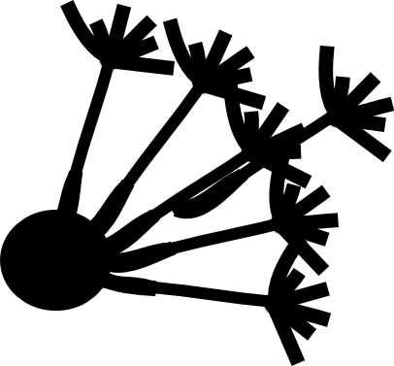
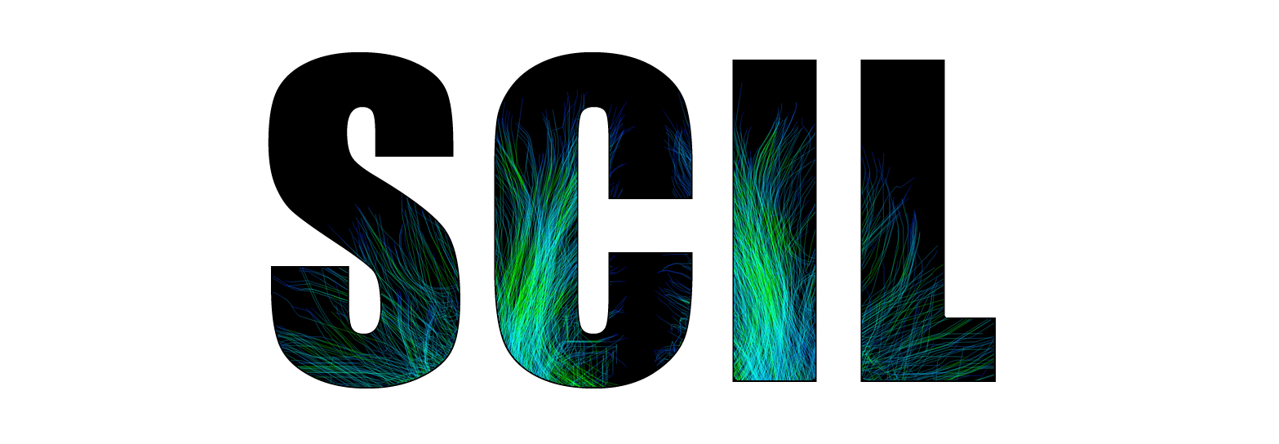
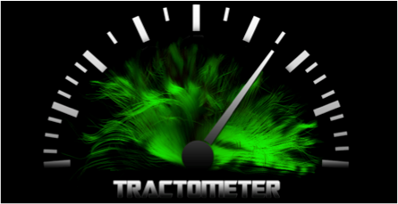


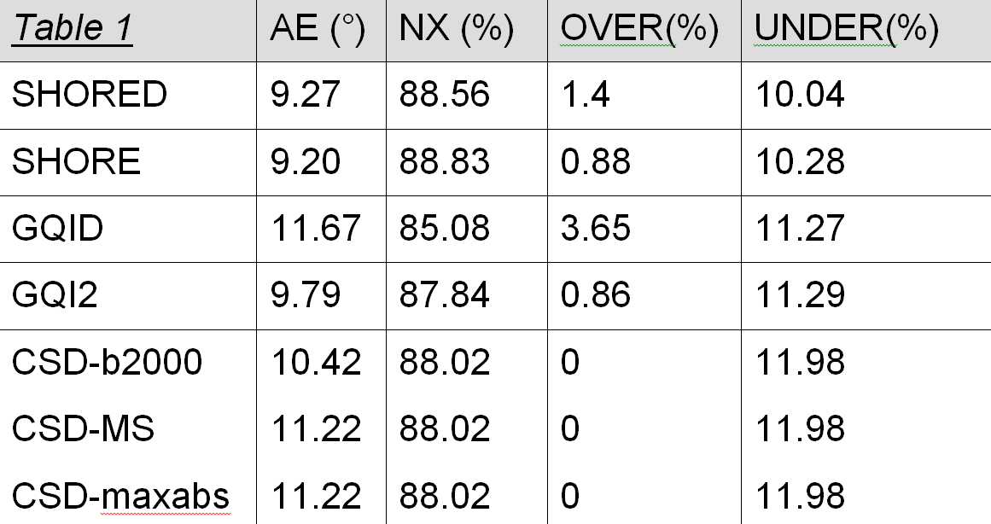
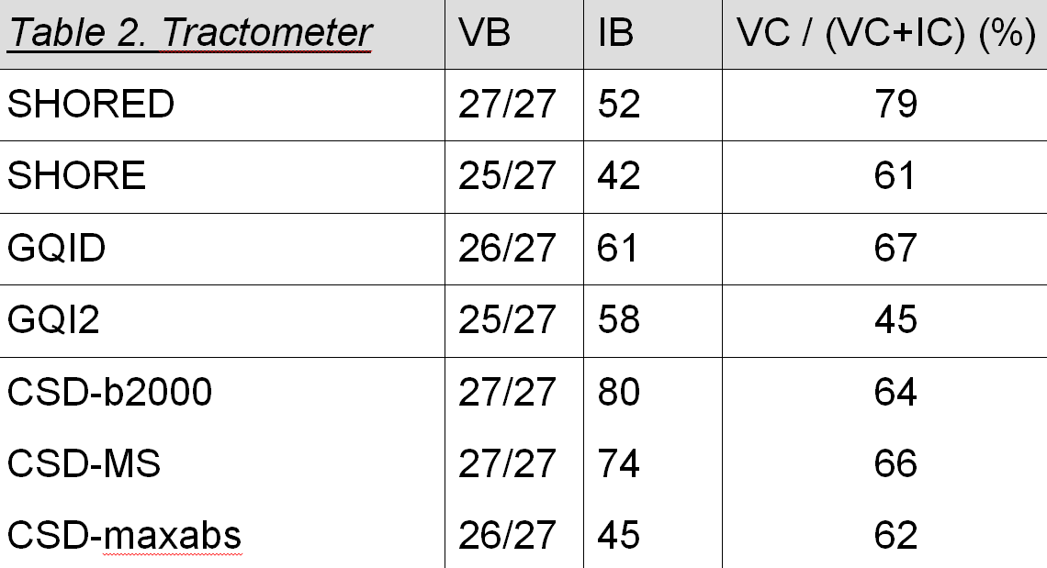
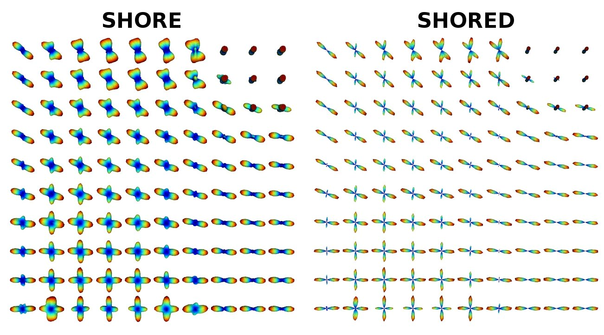

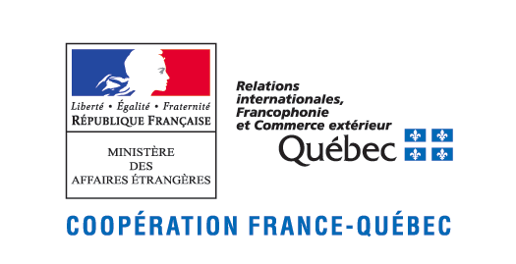

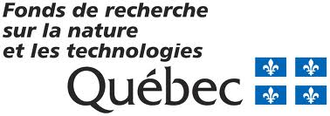

How to perform best ODF reconstruction from the
Human Connectome Project sampling scheme?
Eleftherios Garyfallidis^{1,4}, Mauro Zucchelli³, Jean-Christophe Houde¹ and Maxime Descoteaux^{1,2}
¹Sherbrooke Connectivity Imaging Lab(SCIL), Computer Science, Université de Sherbrooke
²Sherbrooke Molecular Imaging Center (CIMS), Centre de Recherche CHUS
³University of Verona, ⁴Diffusion Imaging in Python (dipy.org)
Introduction & Problem
How should one estimate ODFs from this multi-shell data and can traditional streamline tractography algorithms be used as is on these datasets? The HCP proposes a solution based on a multi-shell extension of the FSL ball-stick model [2]. The purpose of this work is to compare and extend other recent state-of-the-art single-shell and multi-shell local reconstruction techniques for the HCP sampling scheme consisting of three-shells. We are interested in the best ODF reconstruction quantified locally with angular error (AE) and correct number of fiber compartments but most importantly, on the ODF reconstruction that lead to best overall tractography output evaluated by the Tractometer [3].
Methods & Experiments
The HCP human brain dMRI dataset [1, 2] uses q-space sampling with 3 shells of b = 1000, 2000, 3000 s/mm 2 (270 non-collinear directions)
and 18 b=0 images. For the simulations, we use the exact same sampling scheme but with the underlying ISBI 2013 HARDI Challenge phantom [4]. This phantom is created using a local hindered and restricted diffusion signal generation and a set of fiber bundles with complex configurations (branching, crossing, kissing), different radii, geometry and partial volume effects. Several multi-shell (MS) reconstruction techniques were proposed in the last several years [5-8], showing improved angular resolution than single-shell ODF. In this work, we first extend the constrained spherical deconvolution (CSD) technique [9] to handle multi-shell datasets. In summary we are comparing the following methods:
CSD-ms (averaging all the SH coefficients from the 3 shells, CSD-maxabs (fuse SH using a maximum-absolute strategy) [10], GQI2 [11] and
SHORE [8, 12]. Since GQI2 and SHORE reconstruct the diffusion ODF and this diffusion ODF is a smoothed version of the fiber ODF [13] which we can generate their sharpened version [13] which we call GQID and SHORED respectively.
Results
Table 1 shows the local reconstruction results. We calculate the percentage of correctly identified number of crossings (NX), the percentage of over-determined (OVER) and under-determined (UNDER) crossings versus the ground truth peaks. We also calculate the minimum average angular error (AE) in degrees. All methods perform similarly. Overall, SHORE and SHORED have a slight advantage in terms of trade-off between %NX/OVER/UNDER and AE. For CSD, it impressively performs best when using the b=2000 s/mm² shell although MS extensions perform almost equally well. Finally, for GQI, deconvolution increases the number of spurious peaks (bigger OVER %) and is reflected in a poorer AE.
Table 2 Tractometer [3] evaluation based on global connectivity performances over more than 3,000 streamline tracking algorithms launched on the ODFs of Table 1. Table 2 shows the best tractography output configuration for each local reconstruction method. First, we see that only two of the six methods, SHORED and CSD-ms were able to generate 27 of the 27 valid bundles (VB). However, SHORED created less invalid bundles (IB) (false positives), had the best trade-off between percentage of valid connections (VC) and invalid connections (IC). See [8] for a complete explanation of these novel global connectivity measures. We also note that CSD-b2000 was able to find 27/27 bundles and performed similarly as its MS extensions but producing a larger number of invalid bundles/connections.
M1
putamen
References
All methods shown here are available in Dipy!
[1] Ugurbil et al. Neuroimage 2013. [2] Sotiropoulos et al. NeuroImage 2013. [3] Cote et al. MEDIA 2013. [4] http://hardi.epfl.ch/static/events/2013_ISBI/data_format.html. [5] Assemlal et al. MEDIA 2009. [6] Yeh et al TMI 2010. [7] Descoteaux et al. MEDIA 2011. [8] Merlet et al MEDIA 2013. [9] Tournier et al. Neuroimage 2007. [10] Khachaturian et al MRM 2007, [11] Ian Nimmo-Smith et al. ISMRM 2013. [12] Ozarslan et al. Neuroimage 2013. [13] Descoteaux et al. TMI 2009. [14] Garyfallidis et al. Frontiers 2014.

