Slide 1

Clustering streamlines
generated from dMRI data
Eleftherios Garyfallidis, PhD
Sherbrooke Connectivity Imaging
Laboratory (SCIL)
Computer Science Department
Université de Sherbrooke
http://scil.dinf.usherbrooke.ca
Notes:
Merci Gilles Kahn

Slide 2

Tractography
Tractography is the the process of reconstruction of the neuronal pathways of the brain or other fiber-like tissue and it is often represented with a set of streamlines.

Slide 3
Streamlines
So, what are those streamlines that we want to group together?
A streamline is a curve that is always tangent to the velocity vector of the flow.
It shows the direction of a fluid element will travel at any point in time.
In dMRI we produce orientation distribution fields which allow for multiple directions of movement from each point in 3D space.
Finally, a streamline is a just an ordered set of line segments.

Slide 4



Slide 5
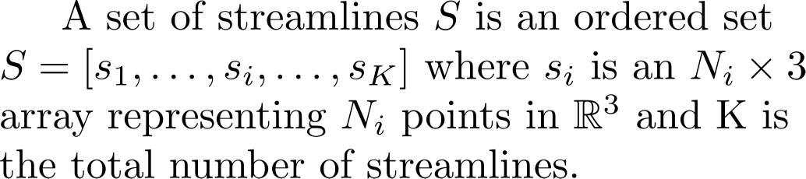
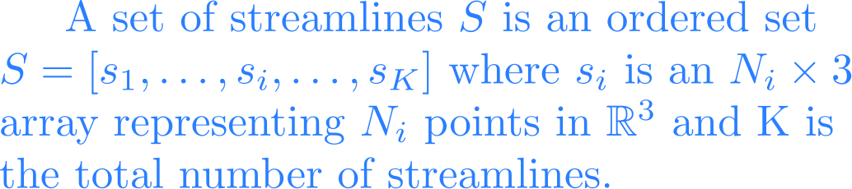
Representation

Slide 6
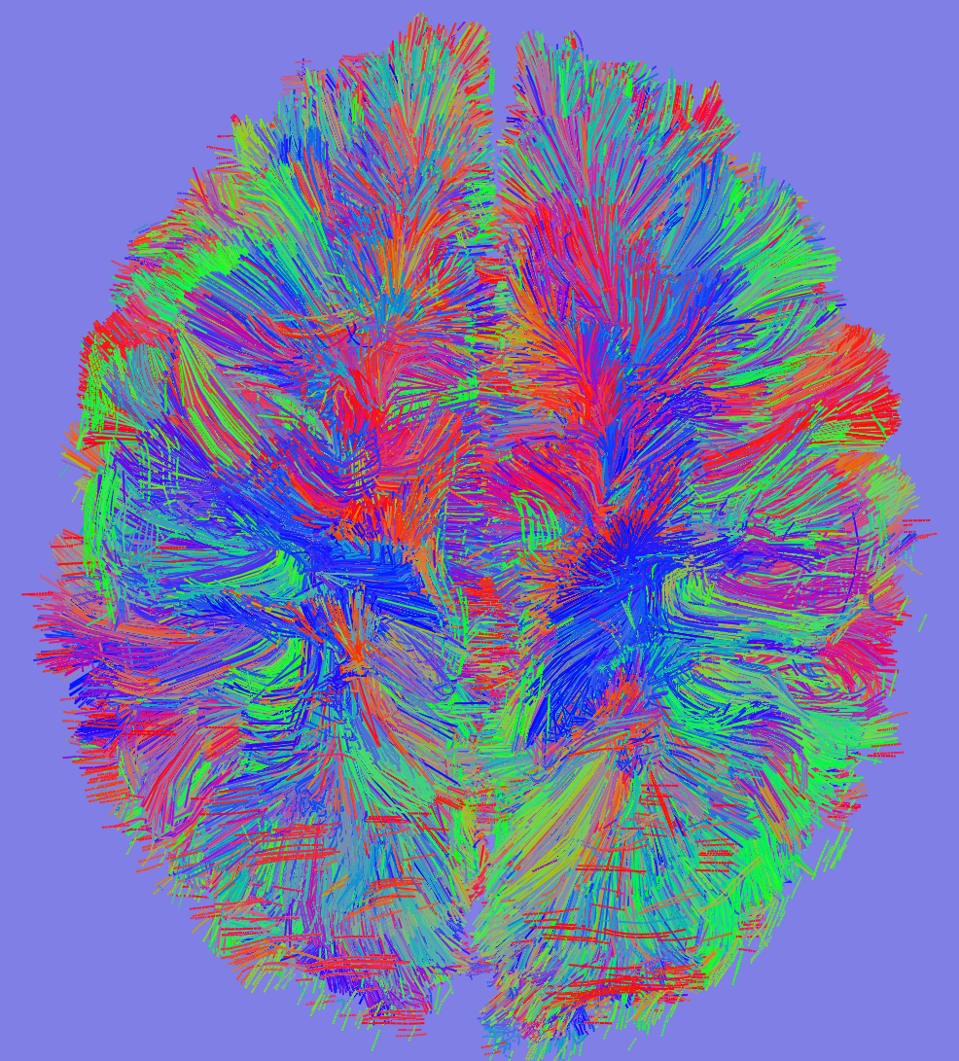
The problem
Diffusion MR datasets produce very large numbers of streamlines which are hard to visualize, interact with and interpret in a clinically acceptable time scale.
100K to 1M
streamlines!

Slide 7
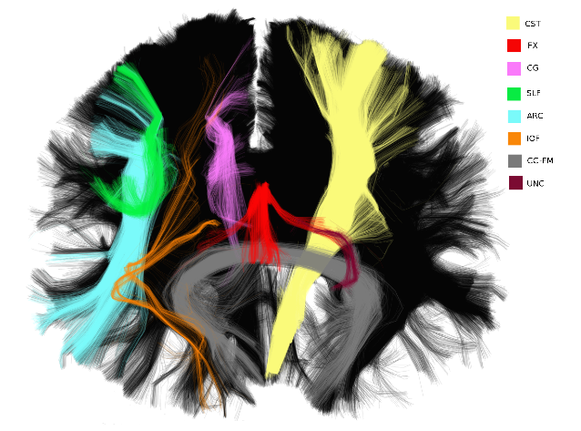
Bundles
We can have 3 types of bundle definitions
Real bundles: created by nature
Anatomical bundles: manually segmented by a neuroanatomist
Automated bundles:
streamlines in close proximity
according to a streamline-based
distance, therefore, they have
similar spatial and shape chara-
cteristics and not necessarily
direct correspondence to
anatomical bundles.

Slide 8
Trying to group streamlines... a quick overview.
Supervised
Expert neuroanatomists have provided anatomical labels for a set of manually segmented streamline bundles (training set). The task then is to identify similar structures amongst the unlabeled streamlines (test set).
Unsupervised
No expert knowledge is added directly and the focus is to create a partition (or clustering or segmentation) of the streamlines without knowing the labels.

Slide 9
Trying to group streamlines... a quick overview.
Most clustering (unsupervised learning algorithms) are in the best case of complexity O(N^2) where N the total number of streamlines: they require the calculation of all pairwise distances between streamlines in order to create a distance matrix.
We found that most authors tried to create these distance matrices as input to hierarchical clustering (see Moberts et al., 2005; Zhang and Laidlaw, 2005; Tsai et al., 2007; Zhang et al., 2008; Jianu et al., 2009;Guevara et al., 2010, 2012; Visser et al., 2011) or spectral clustering (see Jonasson et al., 2005; O’Donnell and Westin, 2007; O’Donnell et al., 2009; Ziyan et al., 2009) or affinity propagation (see Leemans and Jones, 2009; Malcolm et al., 2009).

Slide 10
Trying to group streamlines... a quick overview.
However, they had to restrict themselves to only a subset of the complete dataset because the calculations were heavy and the distance matrix too big for computers with standard memory capacity.
For example, O’Donnell and Westin (2007) used only 10,000 streamlines (∼10% of the initial tractography) and Visser et al. (2011) used recombinations of 10,000 streamlines.
For just 100,000 streamlines 38 GBytes are required, and for 1 million streamlines 3.6 TBytes of memory are required (4 bytes floating point precision)

Slide 11
Trying to group streamlines... a quick overview.
Other clustering methods have also been proposed that use graph theoretic approaches (see Brun et al., 2004; Gerig et al., 2004; El Kouby et al., 2005), k-nearest neighbors (see Ding et al., 2003; Moberts et al., 2005), Gaussian processes (see Wassermann et al., 2010), hierarchical dirichlet processes (see Wang et al., 2011), currents (see Durrleman et al., 2009, 2011), adaptive mean shift (see Zvitia et al., 2008, 2010), k-means (see El Kouby et al., 2005), and expectation maximization (see Maddah et al., 2008).
None of the papers covered in this literature review provide a solution for this issue of efficiency and most of the methods would require from many hours to many days to run on a standard sized dataset.

Slide 12
QuickBundles
Simplify large datasets of streamlines
Efficient on memory and cpu usage
Stay linear on the number of streamlines
Clusters can be represented by a single centroid
Collectively these centroid streamlines can be taken as an effective representation of the streamlines (complete set)
Single distance threshold
Garyfallidis et al., (2012) Frontiers in Neuroscience

Slide 13
Centroid example
Clustering of the CST

Slide 14
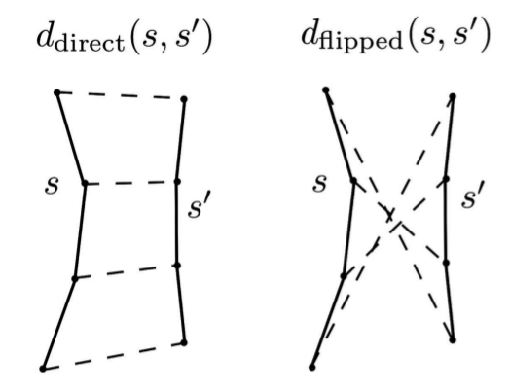
Distance metric
Minimum Direct Flipped
min(d_direct, d_flipped)
Fast to compute
Symmetric
All streamlines have the same no. of points

Slide 15
QB Algorithm
1. First streamline becomes the first cluster
2. For each remaining streamline
                i) calculate MDF distance between streamline and the centroids of all clusters
                ii) if any of the MDF values are smaller than a threshold then add the streamline to the closest cluster or create a new one.

Slide 16
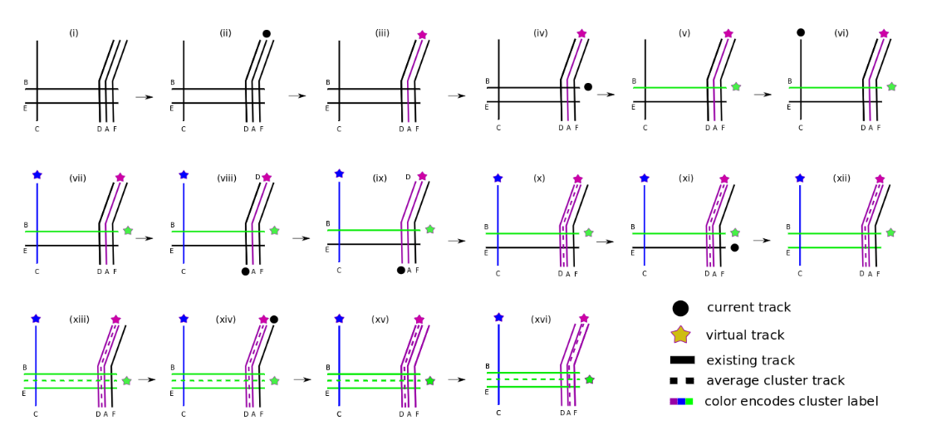
QB Algorithm
An example with 6 simplified streamlines

Slide 17
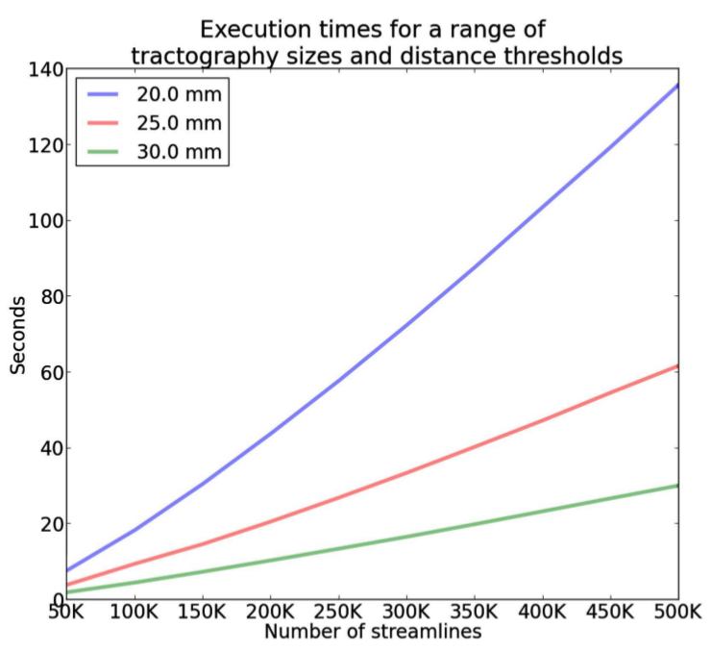
Results: Linear Time!

Slide 18
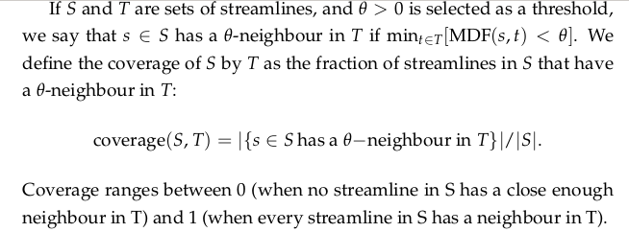
Results: Comparisons
Coverage

Slide 19
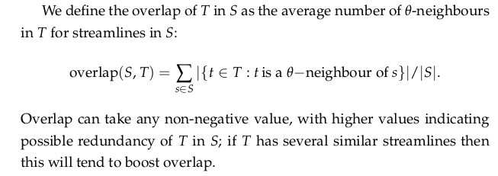
Results: Comparisons
Overlap

Slide 20
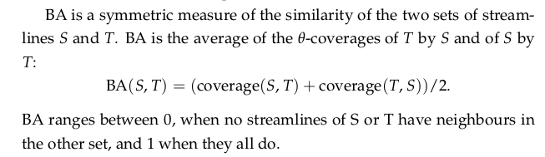

Results: Comparisons
Bundle Adjacency

Slide 21
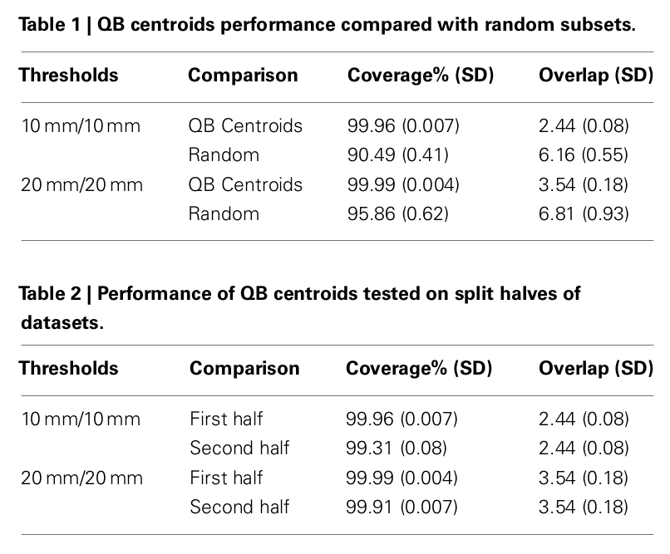
Results: Comparisons

Slide 22
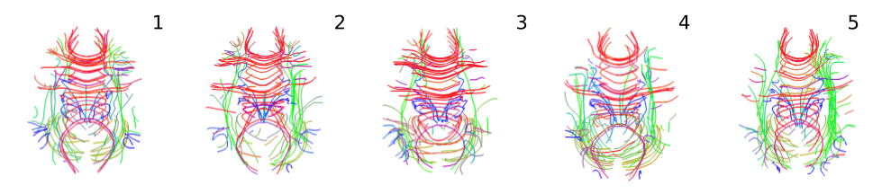
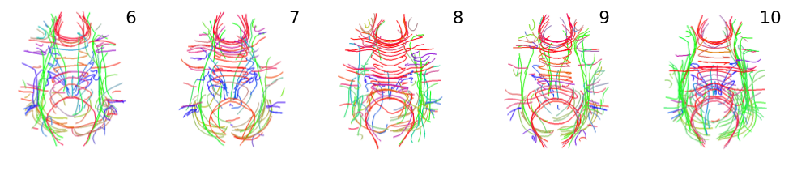
Results: Landmarks
Centroids for biggest 100 clusters for 10 subjects.

Slide 23
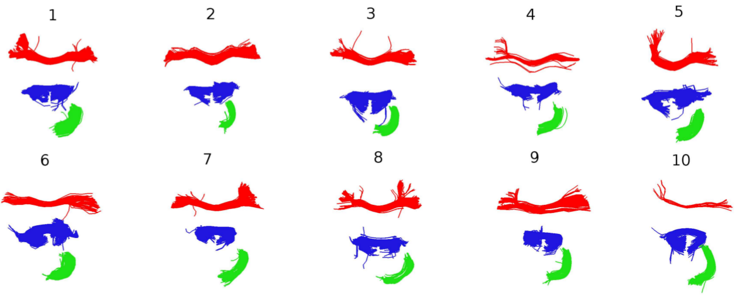
Results: Correspondence
The correspondence is established by finding the centroids in subjects 2–9 that are nearest to the three centroids for subject 1.

Slide 24
Results: Demo time
Show a demonstration of QuickBundles for interacting with large datasets of streamlines.

Slide 25
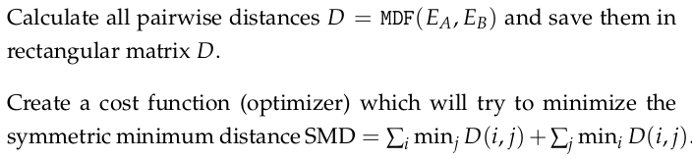
Results: Registration
Use centroids for direct registration of streamlines.
Use modified Powell's method to minimize SMD over rigid rotations.

Slide 26
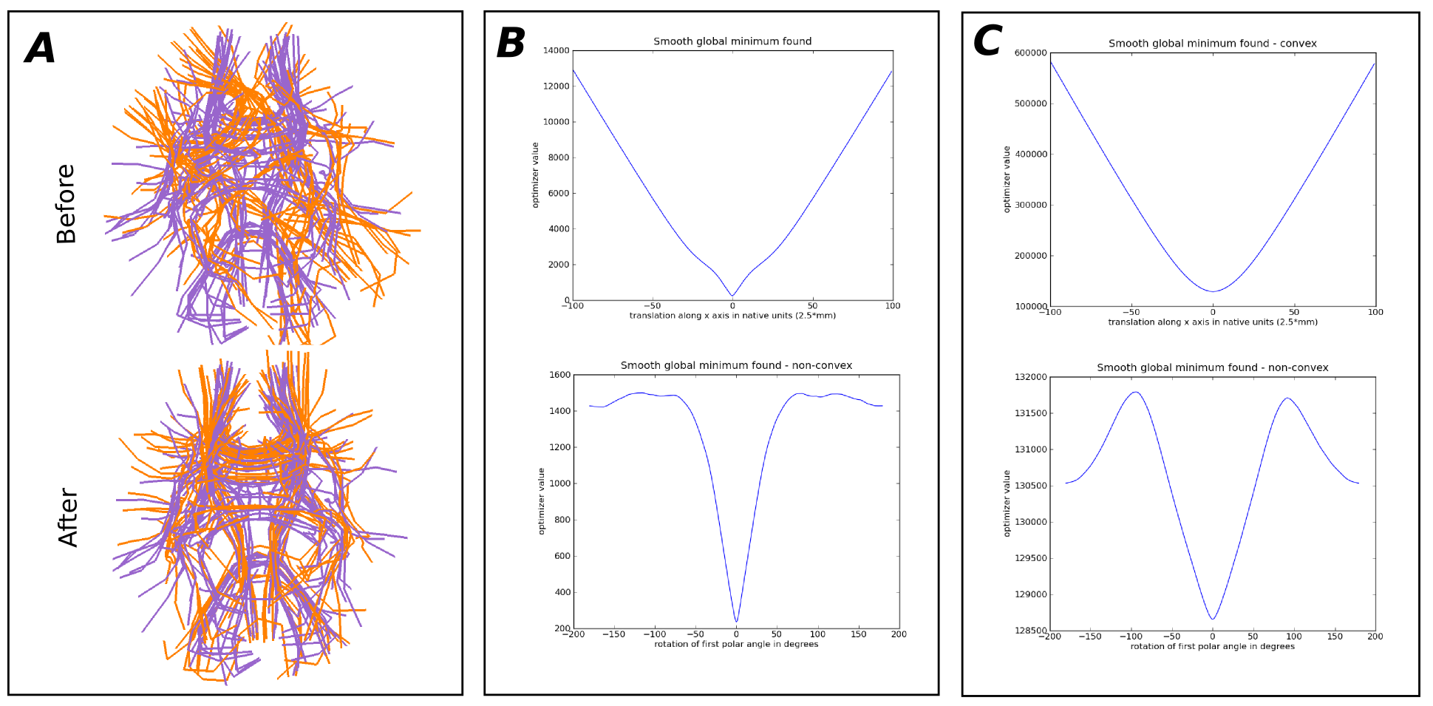
Results: Registration
Use centroids for direct registration of streamlines.
Garyfallidis, 2012, PhD thesis

Slide 27
Conlusion/Discussion
Clustering streamlines is a difficult problem as the streamlines are densely packed creating a “continuous” space.
QuickBundles focuses on creating a simplification of the initial dataset in order to reduce the size of the streamlines and allow other more heavy algo- rithms perform easily.
Additionally, it has many direct applications from interaction to registration.

