Slide 1
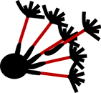
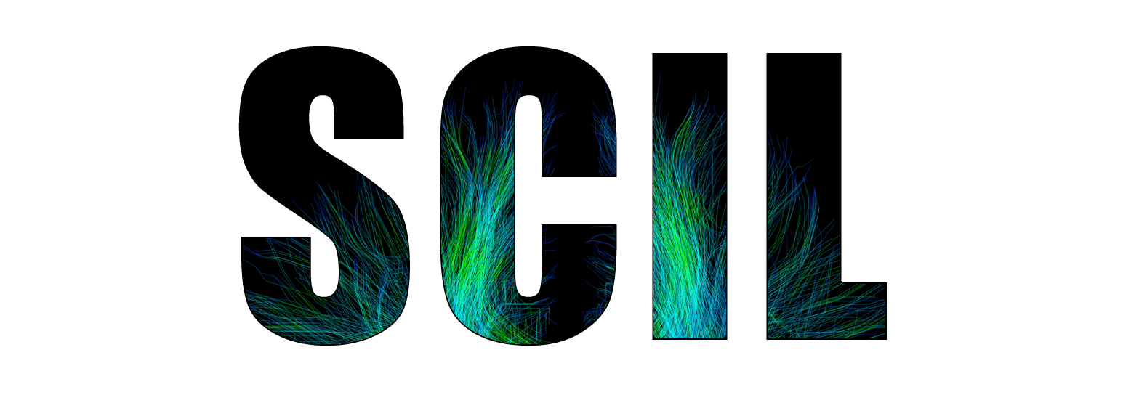

Diffusion Imaging in
Python Seminar
Eleftherios Garyfallidis and Michael Paquette
Université de Sherbrooke, Quebec, Canada
http://scil.dinf.usherbrooke.ca

Slide 2
Outline
1. A quick overview of dMRI basics
2. Recent developments in Dipy
3. Tutorials/Examples

Slide 3
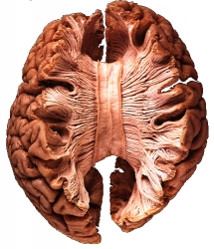
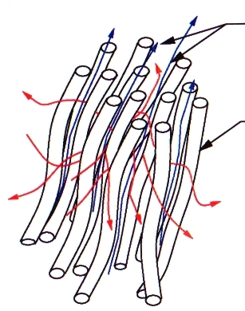
Anisotropic diffusion of H₂O in brain tissue
Water diffusion is sensitive to the underlying tissue microstructure and provides a unique method to assess its orientation

Slide 4
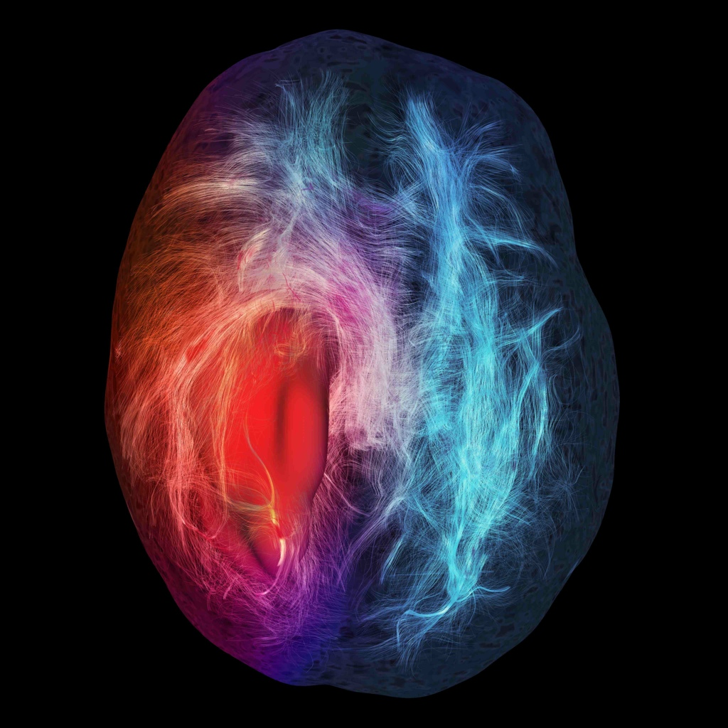
Why measure diffusion?
Can follow anisotropy in biological tissue
White matter wiring
Spinal cord imaging
Muscles, ligaments, heart
Brain development
Aging
Pathologies
Neurosurgical Planning
Human Connectome

Slide 5
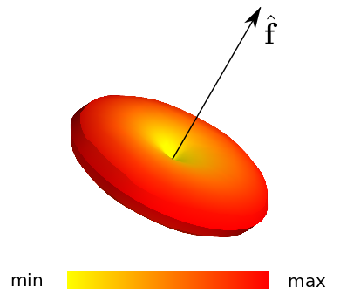
Diffusion Signal Property
Diffusion signal is lowest towards the direction of the fiber.

Slide 6
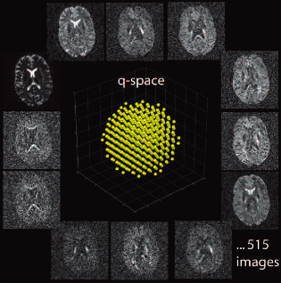
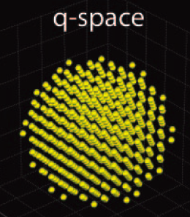
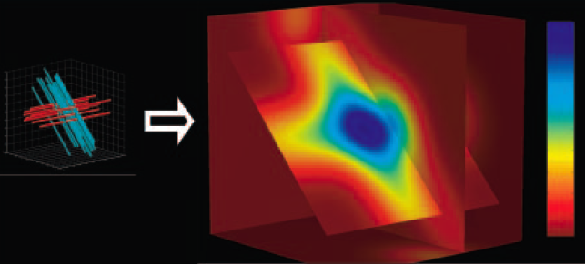
3D diffusion propagator P(r)

Slide 7

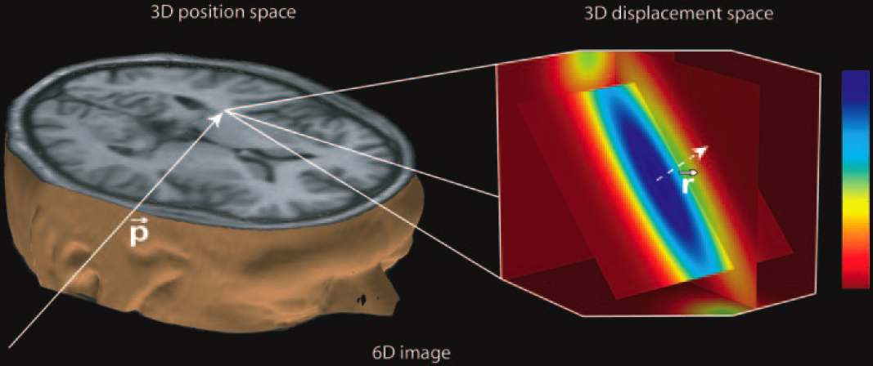
3D space (x,y,z)
3D diffusion propagator P(r)
Image from [Hagmann et al, Radiographics 2006]

Slide 8
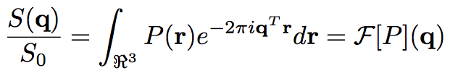

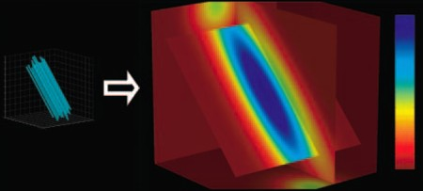
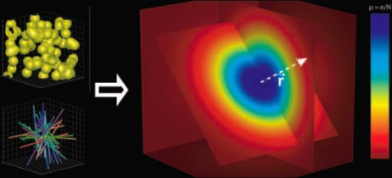
⁻¹
2 fiber
1 fiber
Isotropic

Slide 9
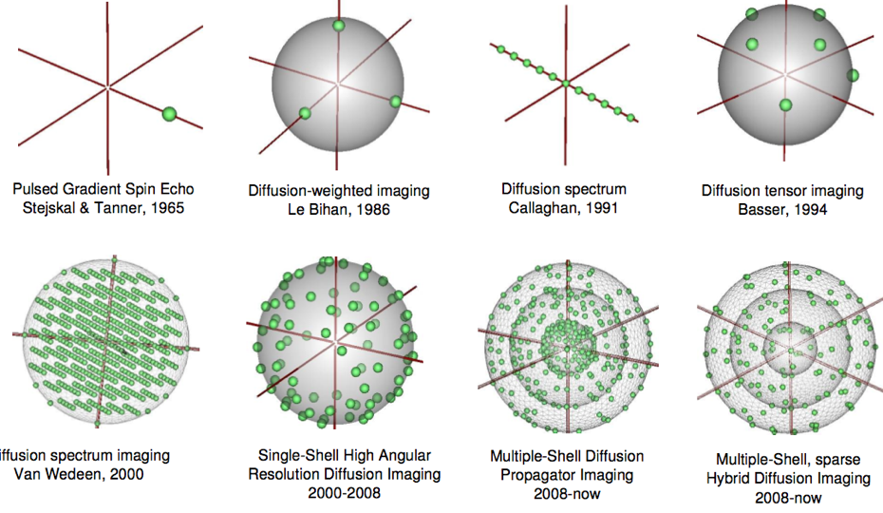
History of q-space sampling

Slide 10
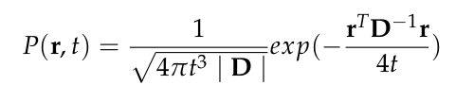
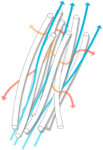

Tensor - Gaussian PDF
1 fiber
Isotropic

Slide 11
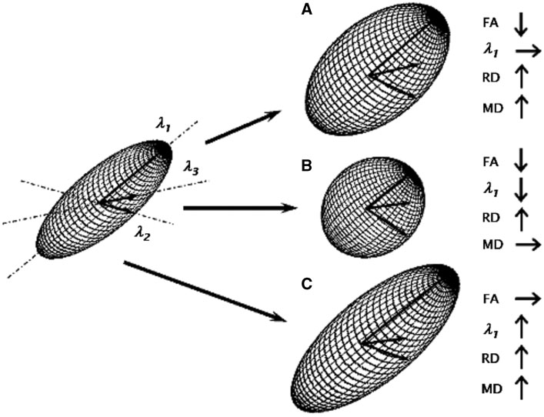
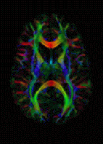
Tensor Metrics

Slide 12
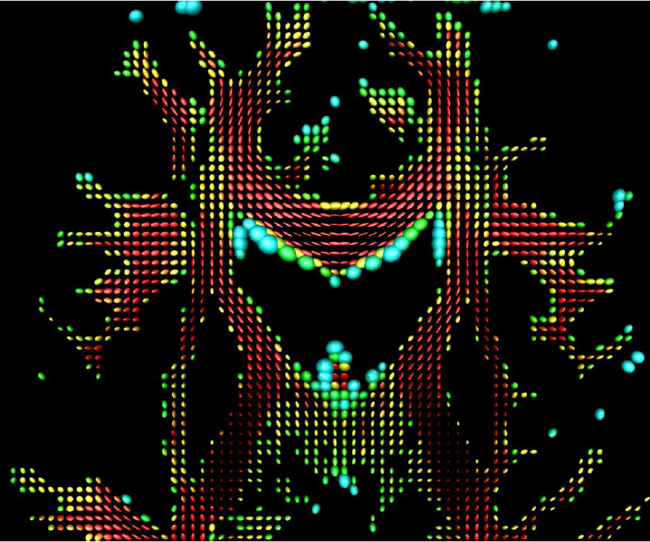
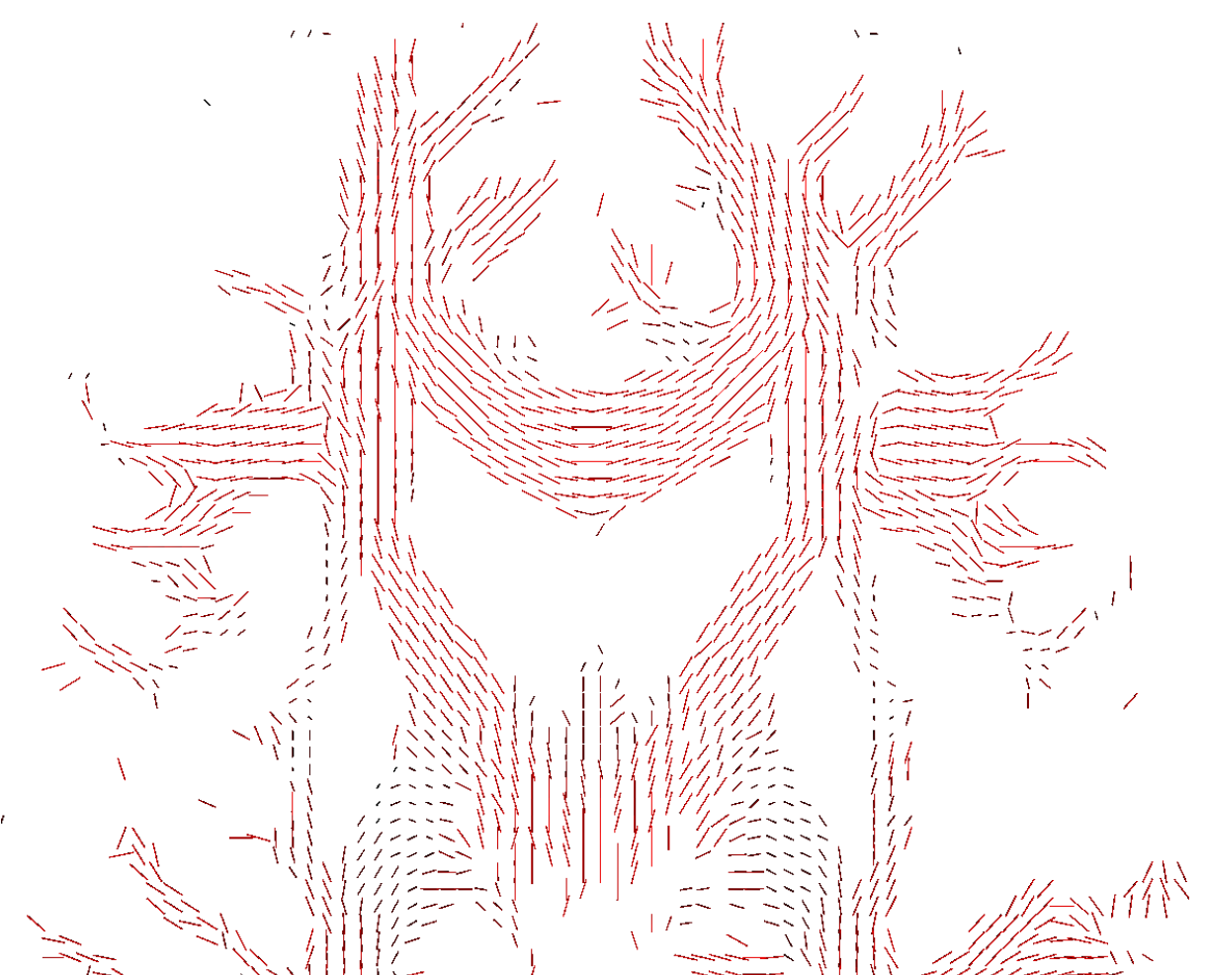
Tensor Fields

Slide 13



Slide 14
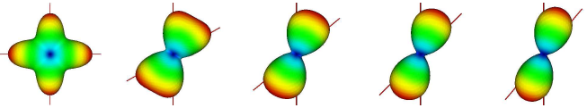
Fast Analytical Q-Ball
M. Descoteaux, MRM 2007

Slide 15
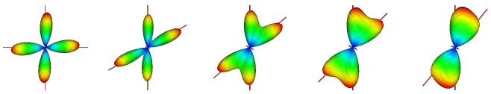
Constrained Spherical Deconvolution
Tournier et al., Neuroimage, 2007

Slide 16
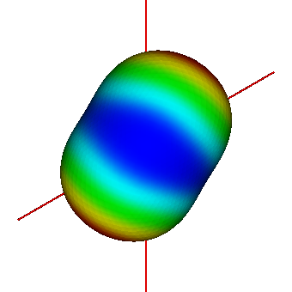
Limitations of the diffusion ODF
Multiple fiber compartments are averaged
when fibers cross at small angles
60° crossing
Diffusion ODF

Slide 17
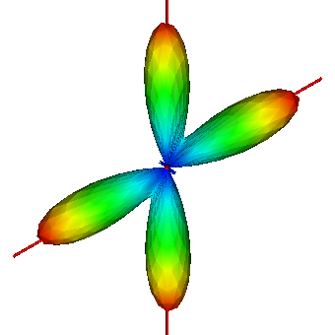
Improving angular resolution of q-ball imaging
Can we transform the diffusion ODF into a sharper fiber ODF?
Diffusion ODF
Fiber ODF
[Descoteaux et al TMI 2009]

Slide 18
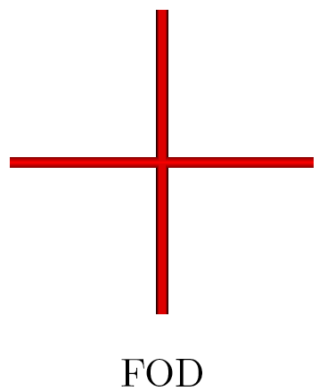
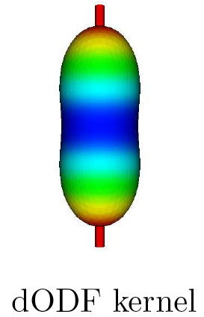
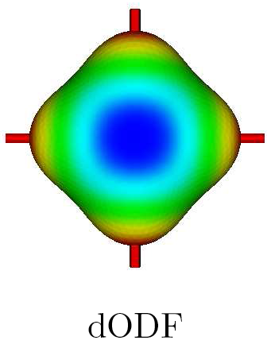
Sketch of the method
=
True fiber distribution
Single fiber
diffusion ODF
Estimated
diffusion ODF
Convolution assumption
[Spherical deconvolution, Tournier et al 2004]

Slide 19
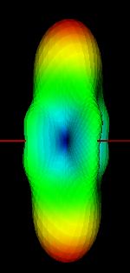
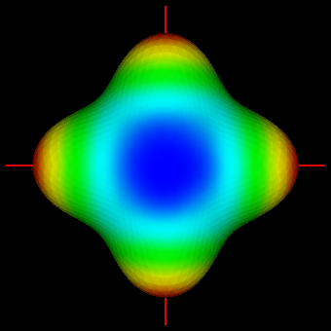
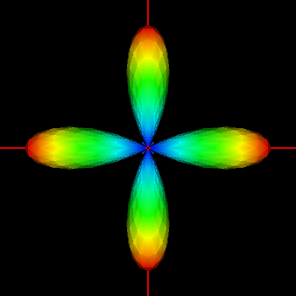
Sketch of the method
Analytical
QBI
Diffusion
ODF
HARDI Signal
Fiber ODF
Deconvolution
sharpening
transform

Slide 20
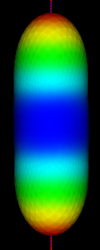





Diffusion ODF kernel for deconvolution
Estimate from real data
Take 300 voxels with highest FA
  Assumed to contain a single fiber population
Find average symmetric tensor D fitting the data
Diffusion ODF kernel is
Analytical ODF
[Tuch MRM 04
Descoteaux MRM 07]
where λ₁ > λ₂ are eigenvalues of D and t := cosθ

Slide 21

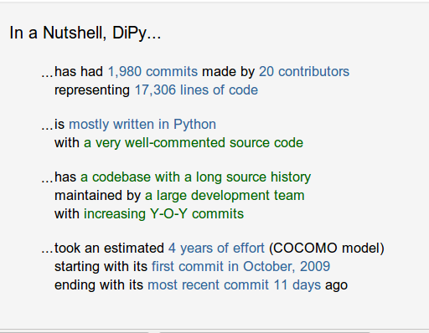
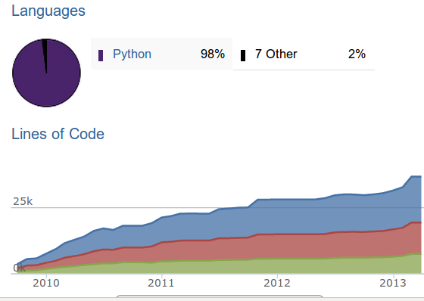
Dipy 0.6 is released!
- Major release
- Two years on the making

Slide 22


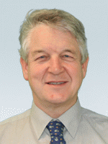

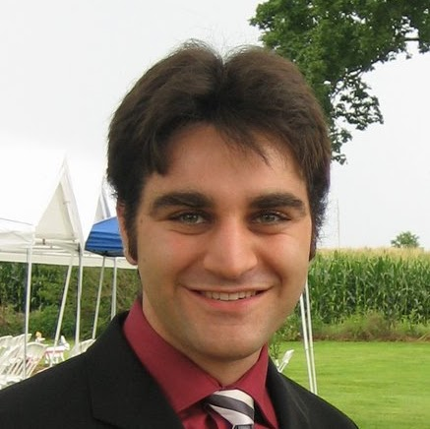
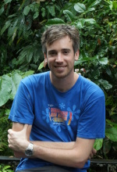
Dipy Developers (core team)
Matthew
Berkeley
Eleftherios
Cambridge, UK
Ian
MRC CBU, UK
Ariel
Stanford
Bago
UCSF
Stefan
South Africa

Slide 23
Dipy Developers (Full list)
- Eleftherios Garyfallidis, University of Sherbrooke, QC, CA
- Ian Nimmo-Smith, MRC CBU, Cambridge, UK
- Matthew Brett, University of California, Berkeley, CA, US
- Bago Amirbekian, University of California, San Fransisco, CA, US
- Ariel Rokem, Stanford University, CA, US
- Stefan Van der Walt, Stellenbosch University, ZA
- Maxime Descoteaux, University of Sherbrooke, QC, CA
- Michael Paquette, University of Sherbrooke, QC, CA
- Christopher Nguyen, University of California, Los Angeles, CA, US
- Emanuele Olivetti, NeuroInformatics Laboratory (NILab), Trento, IT
- Yaroslav Halchenco, PBS Department, Dartmouth, NH, US
- Samuel St-Jean, University of Sherbrooke, QC, CA
- Your name here

Slide 24
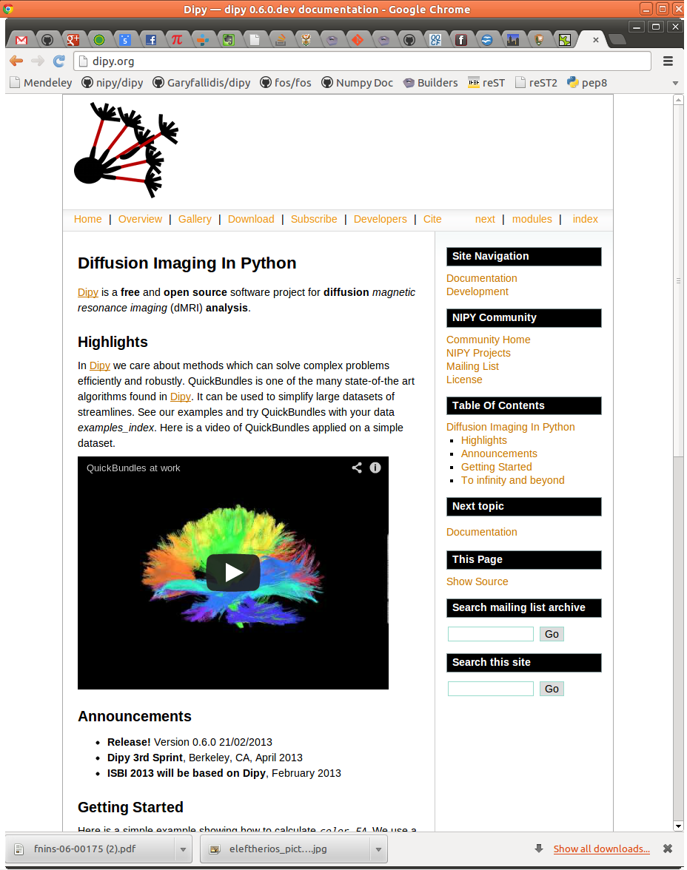
dipy.org

Slide 25
Mission
The purpose of dipy is to make it easier to do better diffusion MR imaging research.
- clearly written
- clearly explained
- a good fit for the underlying ideas
- a natural home for collaboration
We hope that, if we fail to do this, you will let us know and we will try and make it
better.
Dependencies
- Numpy
- Scipy
- Cython
- Nibabel
(Optional)
- Python vtk
- Pytables
True Open Source
- BSD License
- Documentation
- Unit tests
- Examples
- Tutorials
- Buildbots
- Git/Github
- Travis

Slide 26
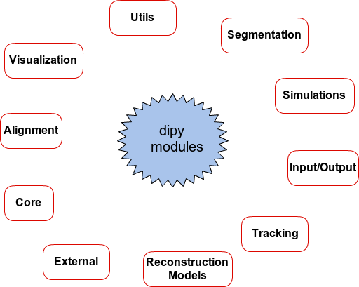

Slide 27
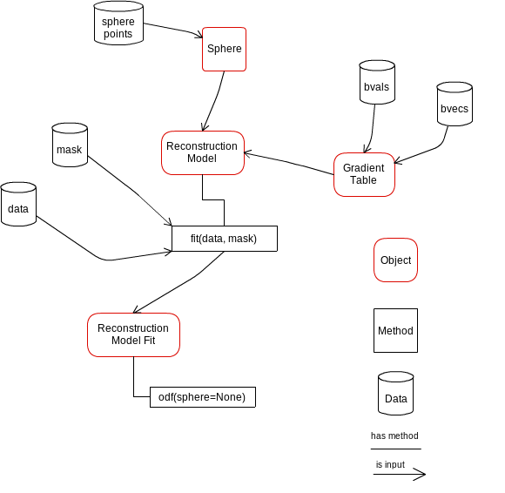
Design is important

Slide 28
Dipy 0.6.0 (Saturday, 30 Mar 2013) introduces many more algorithms and
design aspects both for analysis and visualization. Here are just some of the
new tools:
Modeling
* New reconstruction models API
* Diffusion Spectrum Imaging (DSI) (Wedeen et al.)
* DSI with deconvolution (Canales-Rodriguez et al.)
* Generalized Q-sampling Imaging 2 (GQI2) (Yeh et al.)
* Spherical Harmonic Models (Tristan-Vega, Aganj, Descoteaux, Tuch)
* Decorator for turning a SingleVoxelModel into a MultiVoxelModel
* Mrtrix and fibernavigator spherical harmonic bases
* Color FA and other tensor metrics
* Fit_tensor script
Tracking
* Modular fiber tracking (deterministic & probabilistic)
* Peak finding in ODFs (direct evaluation or optimization-based) with angular
similarity evaluations
Simulation
* Voxel simulation (Multi-tensor and Ball & Sticks)
* Software phantom generation

Slide 29
Data structures and handling
* Abstractions for commonly used data: Sphere, Gradients
* Fast volume indexing (a faster ndindex)
* Utilities for downloading example data sets
Visualization
* Visualization of spherical functions
* 2D sphere plotting
* Radial basis function interpolation on the sphere
Overall
* More examples, tutorials, tests and benchmarks
* Scripts for the ISBI 2013 competition
This has been a great collaborative effort.

Slide 30
Sprint
- correct more docstrings
- automate numpy doc testing
- add more examples
- refactor DTI Restore
- update tracking API
- make a PR for spherical deconvolution
- perhaps do some parametric fitting with PSO
- sketch Dipy Frontiers paper
- python 3
- eddy/motion correction
- deconvolution CSD and SDT

Slide 31
To be available soon
Desired features
- Non-local means denoising (Sam)
- Continuous dictionary learning (Sylvain)
- Spiral (Farshid)
- Generalized random sampling (Manu)
- Interactive visualization (Tim)
- Convex global tracking (Alessandro)
- Particle filtering tracking (Gab)
- Brain Extraction
- Non-linear registration
- TBSS like thingy
- More examples

Slide 32
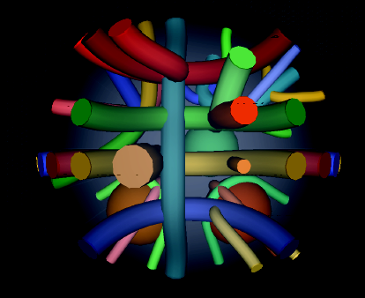
IEEE ISBI 2013 HARDI reconstruction challenge

Slide 33
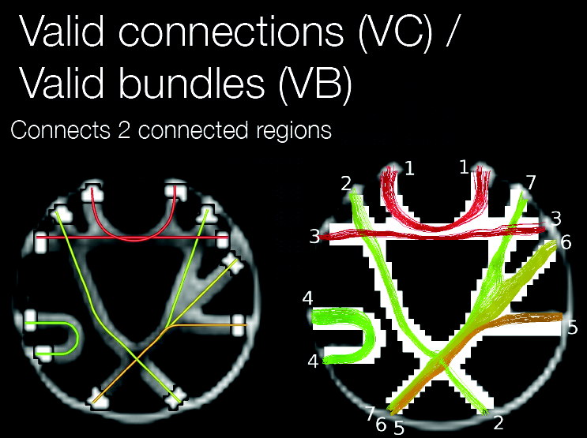
Tractometer evaluation

Slide 34
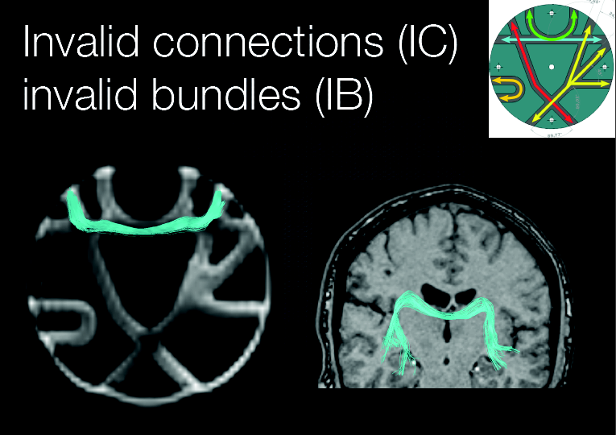

Slide 35
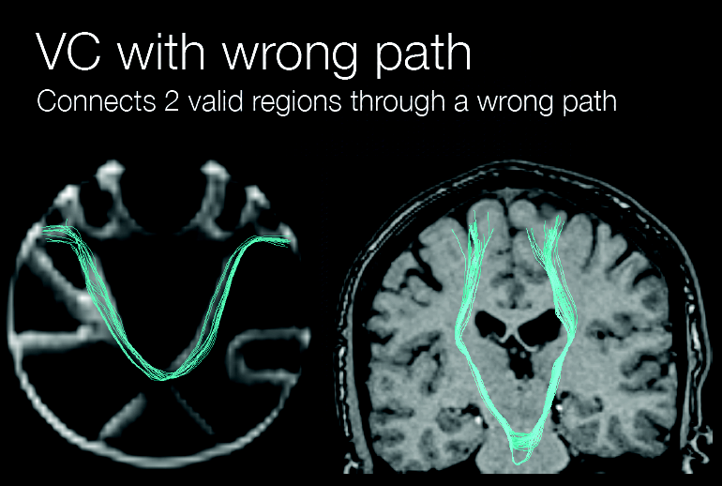

Slide 36
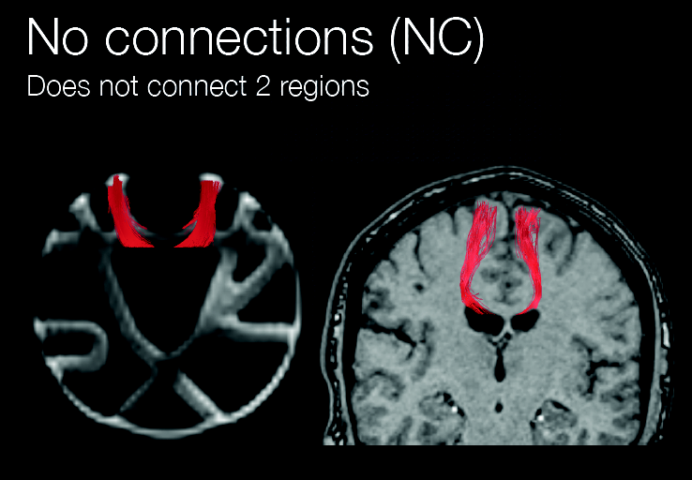

Slide 37
Training Set Flowchart
Data
Denoising
Manjon et al.
Descoteaux et al.
Local
Reconstruction
Method
Deterministic
Tracking
Connectivity
Matrix
Score

Slide 38

Denoising

Slide 39
CSD: Constrained Spherical Deconvolution
Tournier et al.
SDT: Spherical Deconvolution Transform
Descoteaux et al.
PSO: Multi-tensor with particle swarming
Paquette et al.
DSID: Diffusion Spectrum Imaging with Deconvolution
Canales-Rodriguez et al.
GQID: Generalized Q-sampling Imaging with Spherical Deconvolution
Garyfallidis PhD thesis
Local Reconstruction Methods
DTI/HARDI
Heavyweight

Slide 40

Get involved! Give feedback!
Thank you!

Slide 41
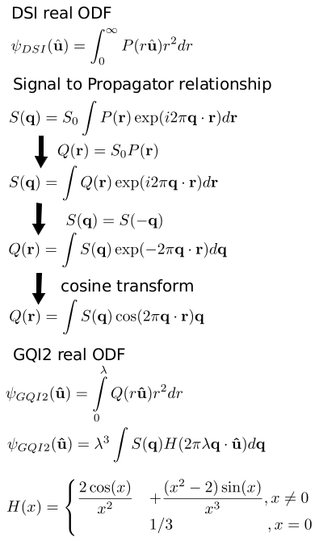

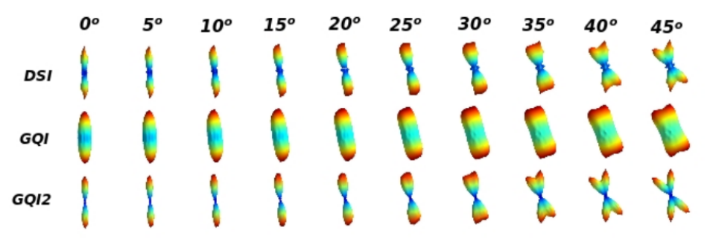
GQI
GQI2
DSI

Slide 42
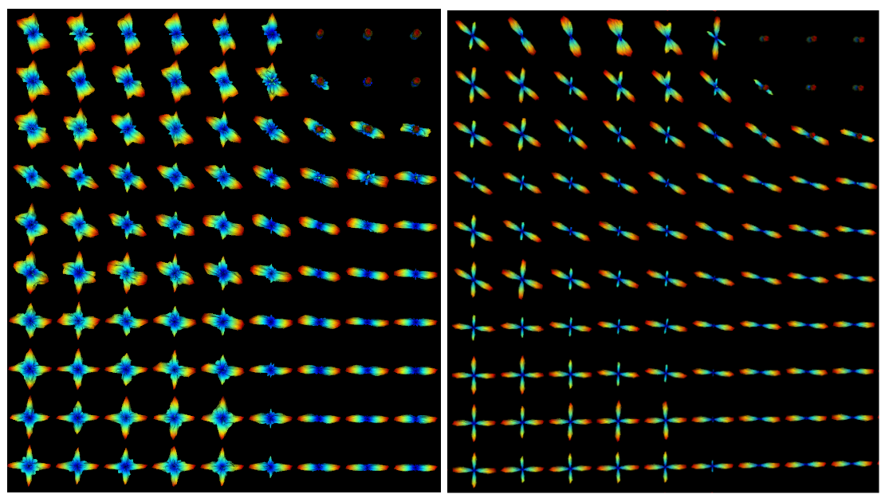
GQI2 vs GQID
(GQI2 with deconvolution)

