Slide 1
DIPY 0.8
Eleftherios Garyfallidis, PhD
University of Sherbrooke, QC, Canada
Diffusion Imaging in Python (dipy.org)

Slide 2
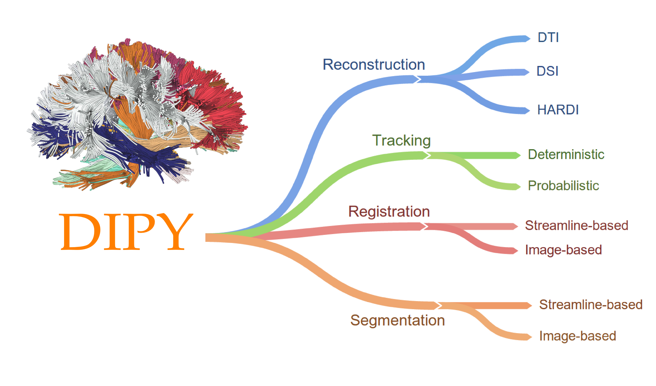
Main Components
With the combination of these components. For example using tracking and registration you can perform connectivity analysis etc!

Slide 3
Summary
We released on Tuesday, 6 January 2015
In summary, since January 2014 (version 0.7.1), we closed 388 issues and merged 155 pull requests. The project now has a total of more than 4000 commits and 29 contributors.
Which means …
We are now the largest project in Diffusion MRI in the world!!!
With the highest number of contributors and the largest API.

Slide 4
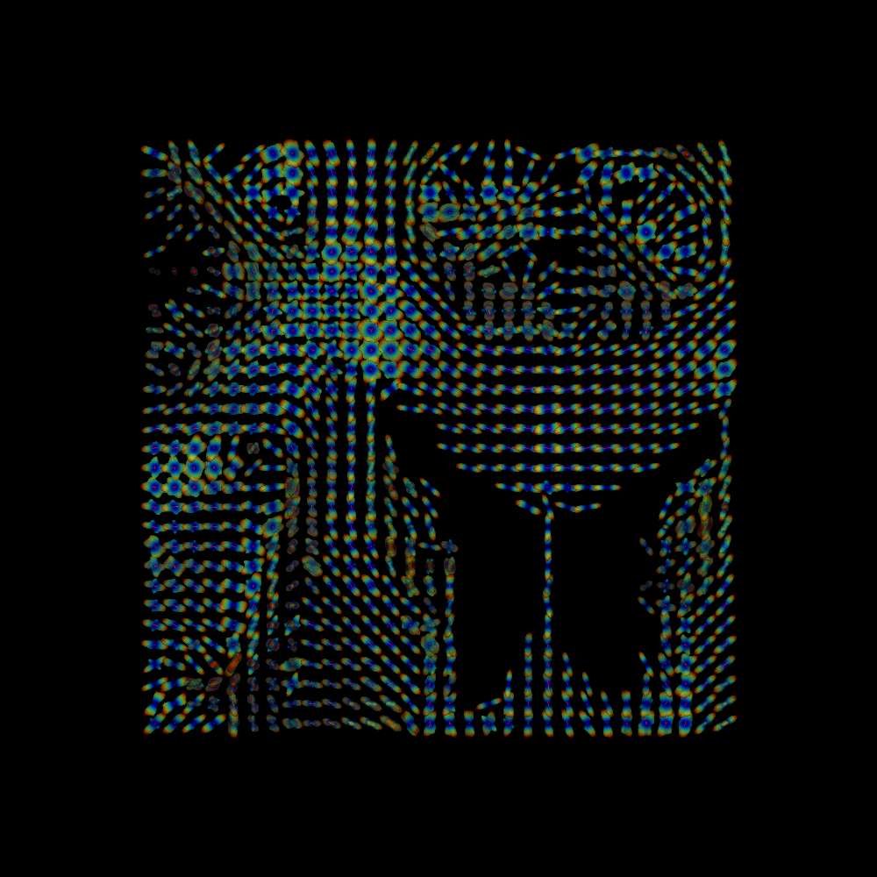
Signal reconstruction (SFM)

Slide 5
Image-based registration (SyN)
Moving
Evolution
Static (Reference)
Symmetric Normalization, Avants 2007
Diffeomorphic
Field
Diffeomorphic Field

Slide 6
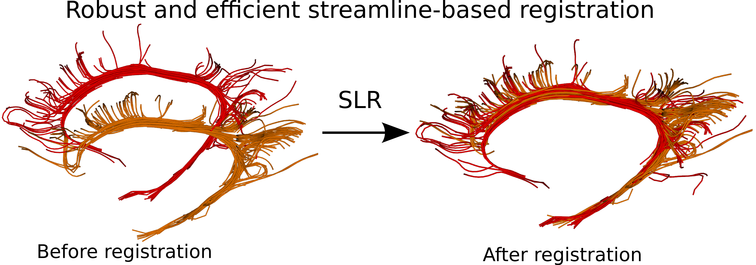
Streamline-based registration
Garyfallidis et al., “Robust and efficient registration of white-matter fascicles in the space of streamlines”, Neuroimage, (under review) 2014.
Garyfallidis et al., "Direct native-space fiber bundle alignment for group comparisons", ISMRM, 2014.

Slide 7
Streamline-based registration
Garyfallidis et al., "Direct native-space fiber bundle alignment for group comparisons", ISMRM, 2014.

Slide 8
Streamline-based registration

Slide 10
Summary of new things
1. Nonlinear Image-based Registration (SyN)
2. Streamline-based Linear Registration (SLR)
3. Linear Fascicle Evaluation (LiFE)
4. Sparse Fascicle Model (SFM)
5. Non-local means denoising (NLMEANS)
6. New modular tracking machinery
Many congratulations to all who helped!

Slide 11
What next?
Already 15 pull requests need reviewing.
We need to access more users.
Work on statistical analysis.
We lack methods for microstructure.
Improve what we already have.

