Slide 1
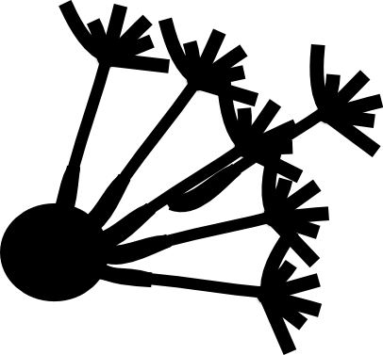
Diffusion Imaging in
Python
Eleftherios Garyfallidis, PhD
Université de Sherbrooke, Quebec, Canada
Sherbrooke Connectivity Imaging Lab
http://scil.dinf.usherbrooke.ca

Slide 2
Diffusion MRI is an amazing
challenge
We want to precisely infer the structural connectivity of the brain
when it is actually so densely packed and the signal provides low
resolution images.
But, wait a minute, this looks like a difficult multi-disciplinary problem.
How can we solve such a problem?
We need to work collectively!
But how do we do that? Using the Human Connectome Project?
No, there is a cheaper way.
And here it is … I present you ...

Slide 3
dipy.org
An international, free and open source project for the analysis of
dMRI data which brings together people with backgrounds in:
- computer science
- mathematics
- software engineering
- medicine
- psychology
with the common goal to extend our understanding of the structural
connectivity of the brain.

Slide 4
But why another software project?
Don't we have enough already?
Yes, there are plenty of projects which you can use to analyze dMRI data. But:
- Many closed source
- Many open source, but missing code readability
- Missing good documentation
- Lab specific policies
- Use restrictive licensing
- Have expensive licensing
- Not well tested
- Not multi-platform
So, how can we do better?

Slide 5
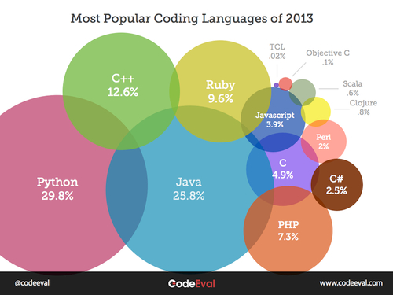
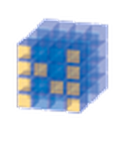


A great opportunity appeared with
the boost of scientific processing
in Python.
Numpy
Scipy
C speed
Python syntax

Slide 6
Dipy Mission
The purpose of dipy is to make it easier to do better diffusion MR
imaging research.
- clearly written
- clearly explained
- a good fit for the underlying ideas
- a natural home for collaboration
We hope that, if we fail to do this, you will let us know and we will
try and make it better.
Here is how we think that we can be faithful to our mission ...

Slide 7
True FOSS principles and standards
BSD License
- allows faster growth
- can be used by other free software and companies
Documentation
- Every function is documented with a docstring
Unit tests
- Every function is individually tested using automated testing
Tutorials
- More than 30 tutorials are now available
Buildbots
- Standalone machines with Linux, Windows, Macosx, Sparc
run any recent changes in the code base to make sure that
all is good across architectures.
Git/Github
- use the latest trends to share code online

Slide 8
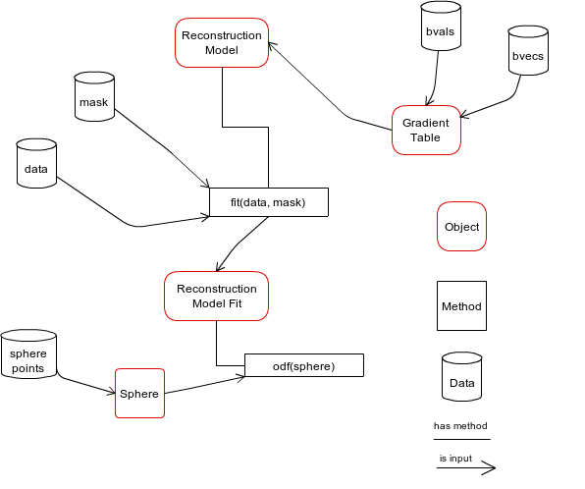
Design is important (OO)

Slide 9
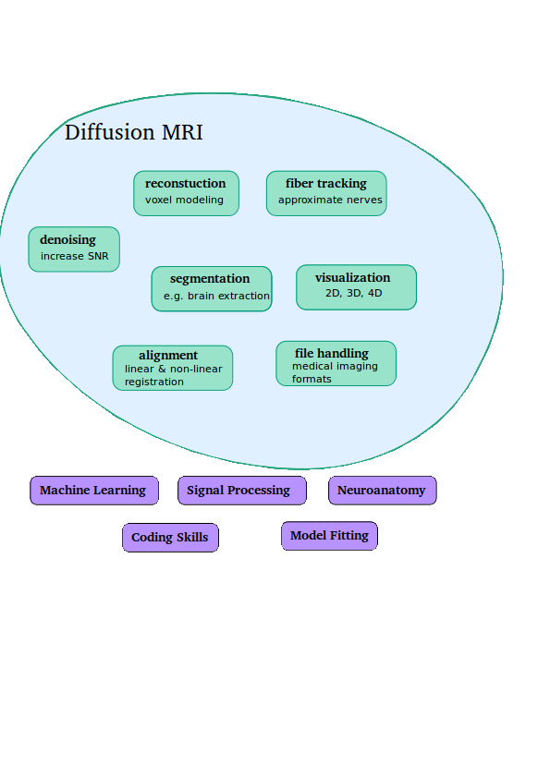


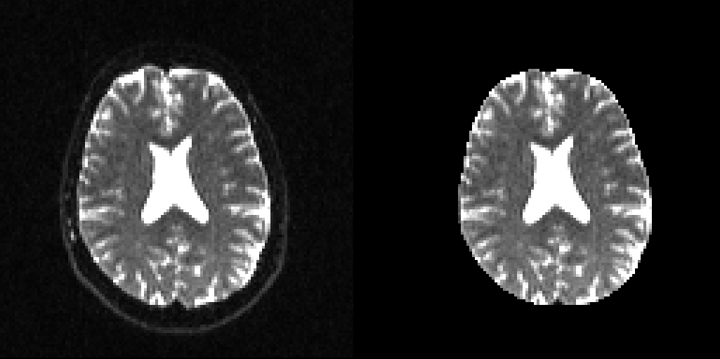
The challenges

Slide 10
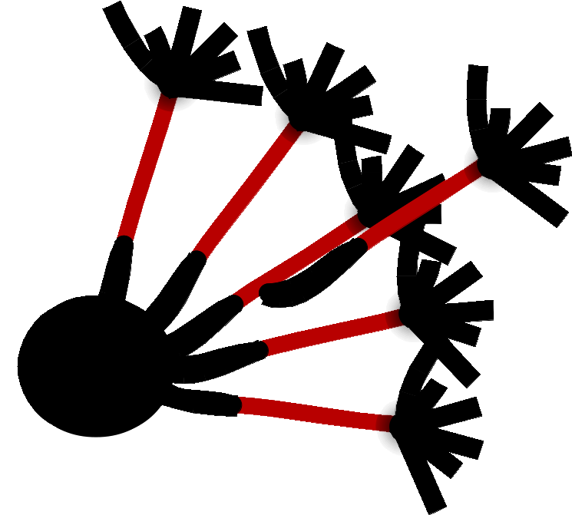
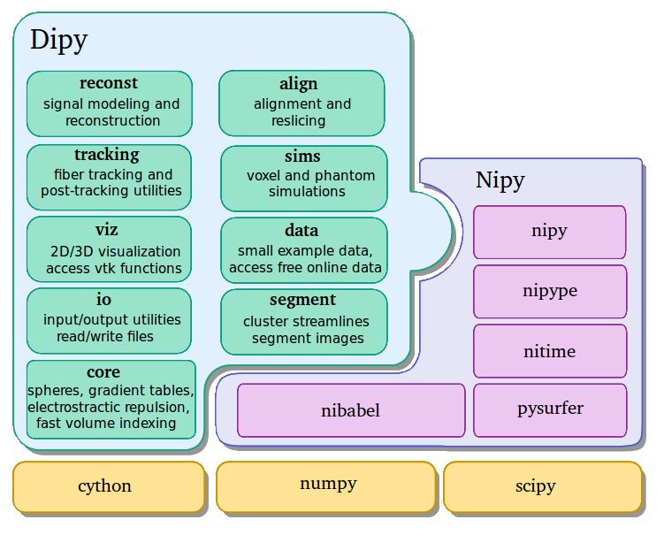
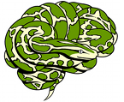
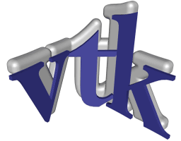

API and dependencies

Slide 11


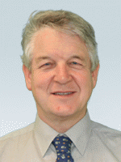

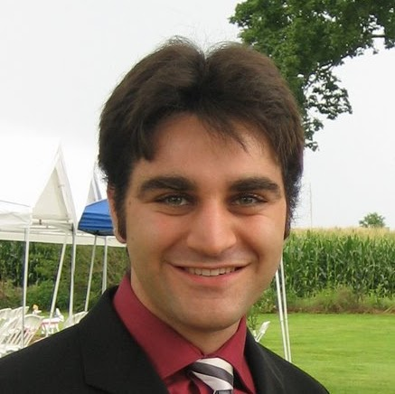

Dipy Developers
Matthew
Berkeley
Eleftherios
Cambridge, UK
Ian
MRC CBU, UK
Ariel
Stanford
Bago
UCSF
Stefan
South Africa

Slide 12
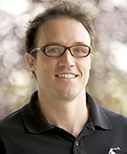
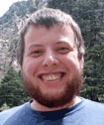

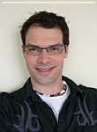
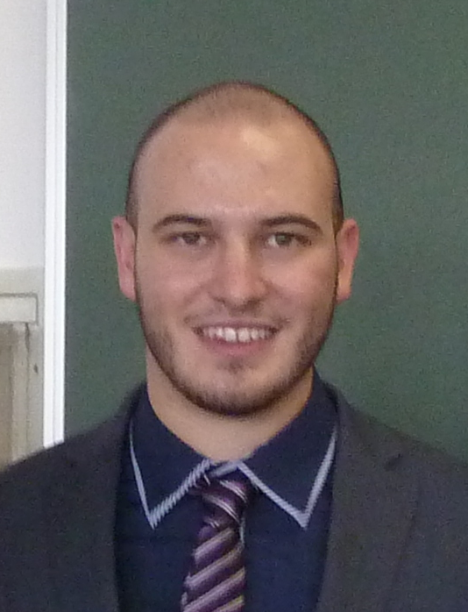
Dipy Developers (New members)
Prof. Maxime
Sherbrooke
Michael
Sherbrooke
Samuel
Sherbrooke
Gab
Sherbrooke
Mauro
Italy
- And the list goes on ...
- Christopher Nguyen, University of California, Los Angeles, CA, US
- Emanuele Olivetti, NeuroInformatics Laboratory (NILab), Trento, IT
- Yaroslav Halchenco, PBS Department, Dartmouth, NH, US
- Emmanuel Caruyer, University of Pennsylvania, US
- Omar Ocegueda, CIMAT, Mexico
- And your name here

Slide 13
So, what can we do?
- Input/Output
- Nift1, Analyze, Minc, and other Nibabel formats
- Npy, Npz and other
- Dicoms (only for Siemens)
- Text files (bvalues, bvectors)
- Pickle files (save entire objects or data structures)
- HDF5 (save huge arrays and treat them like they were in memory)
- Segmentation
- Quickbundles (can be used to simplify the representation of bundles or full tractographies)
- Median_otsu can be used for brain masking or other
background segmentation.

Slide 14
So, what can we do?
- Denoising
- Non-local means (NLMEANS) on raw data (T1 and dMRI)
- Reconstruction
Single Shell (SS), Multi Shell (MS), Spherical Grid (SG)
- DTI (LS, Weighted LS, RESTORE) (SS, MS, SG)
- Qball (Analytical, Constant Solid Angle) (SS, MS)
- DSI, DSI with LR deconvolution (PDF deconvolution) (SG)
- CSD (signal deconvolution) (SS, MS)
- SDT (ODF deconvolution) (SS, MS)
- GQI2 (MS, SG)
- SHORE (very general and model free) (MS, SG)
Metrics (FA, MD, Westin's Tensor metrics, GFA, MSD)

Slide 15
So, what can we do?
- Tracking
- Very efficient deterministic (EuDX) can be used with any of the reconstruction models (supports crossings etc.)
- Probabilistic (code available) but still experimental.
- Streamline analysis
- Lengths, curvature, additions and other operations
- Streamline interpolations (up/downsampling, splines)
- ROI intersections
- Connectivity matrices
- Density maps (like TDI)
- Streamline mappings (which streamlines go through which voxels).

Slide 16
So, what can we do?
- Gradients & spheres
- Provide a GradientTable class for all acquisition parameters (e.g. b-values, b-vectors, small delta)
- Sphere & Hemispheres & cached evenly distributed spheres
- Access to online data
- Fetch and read publically available data from code
- SNR estimation
- Reslicing
- Simulations
- MultiTensor

Slide 17
So, what can we do?
- Visualization (fvtk)
- points
- spheres
- slices
- volume rendering
- lines
- streamtubes
- save publication quality images
- simple 3D interactivity
- seamless integration with the Fibernavigator
- Parallel processing
- multi-processing (Python)
- multi-threading (OpenMP)
- cluster (with IPython)

Slide 18
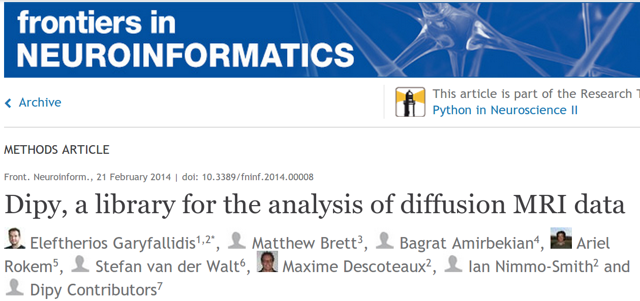
Are you lost?
- Read the paper
- Play with the tutorials
Click on gallery or directly go to :
http://dipy.org/examples_index.html

Slide 19
What can we not do?
- Eddy current correction
- Automatic group analysis
- Registration

Slide 20
What is coming soon?
- Registration
- Symmetric Diffeomorphic Registration
- Landmark based Registration
- Diffusion Kurtosis
- Signal prediction
- New tracking API with anatomical priors
- More command line scripts

Slide 21
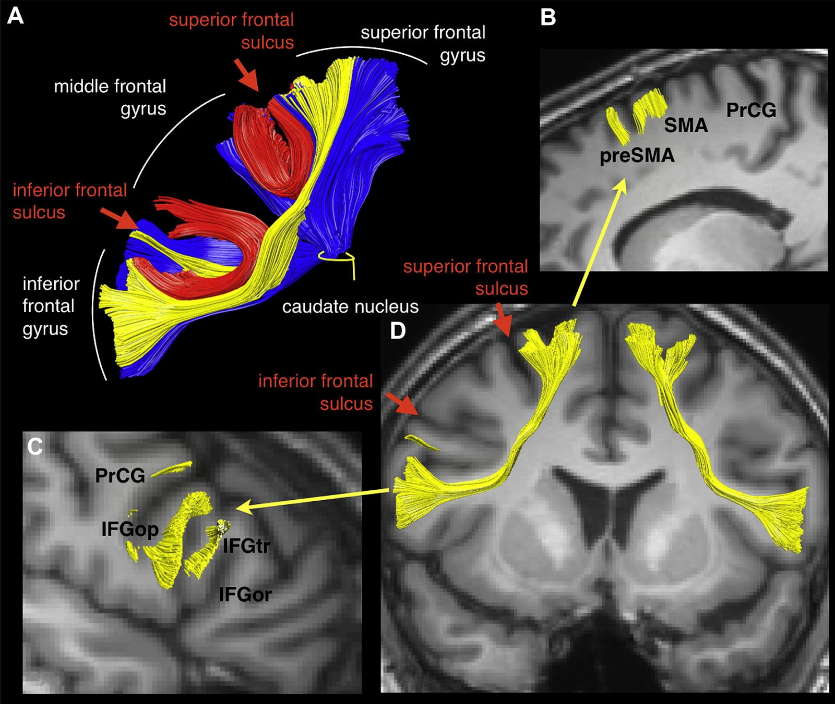
Discover new super- highways of information
A new bundle the “Aslant”
was discovered recently by
Catani et al. (2013)

Slide 22
Conclusion
Dipy provides a new way of analyzing dMRI data by allowing the scientists to go deeply into understanding the methods which they are using.
This is great for advancing dMRI, writing better papers and creating reproducible research.
Furthermore, it creates a platform for scientists to meet, discuss and share there code independently of the lab or the country they belong.
Read the paper, play with the tutorials, analyze your data and give us feedback.

Slide 23
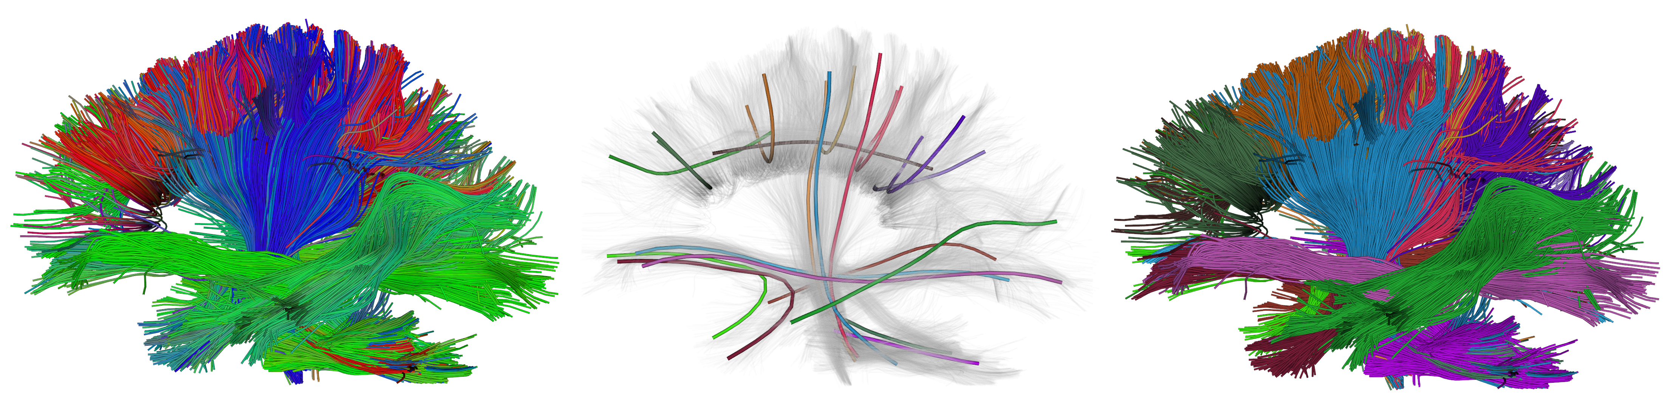
Streamline segmentation and visualization
Initial Cluster's Centroids Clusters
Garyfallidis et al. (2013) Front. Neuroscience

Slide 24
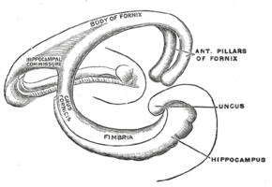
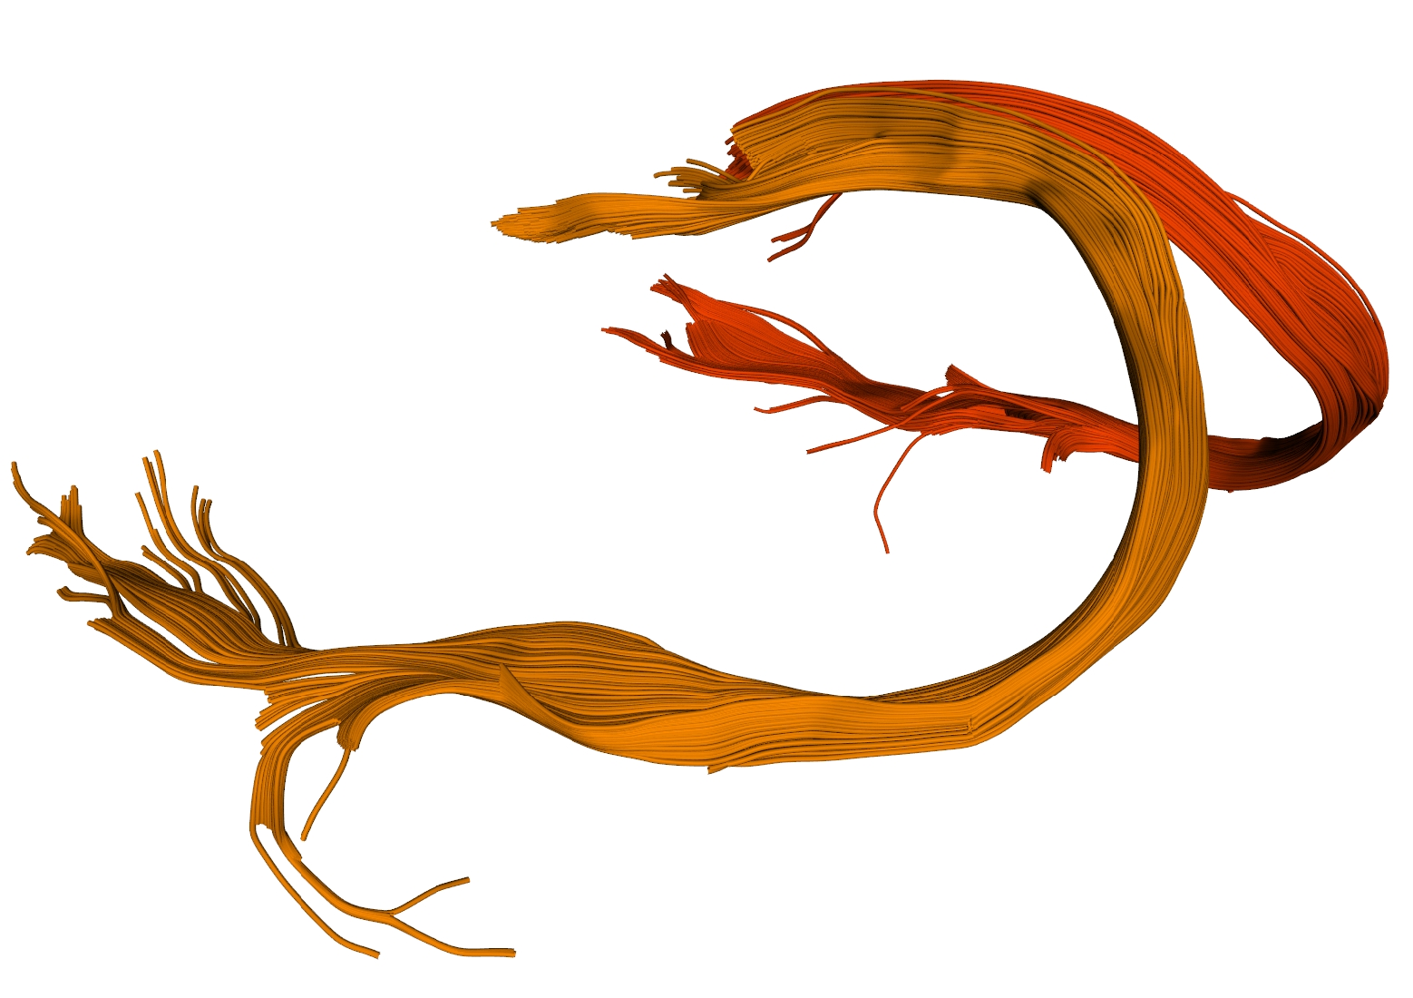
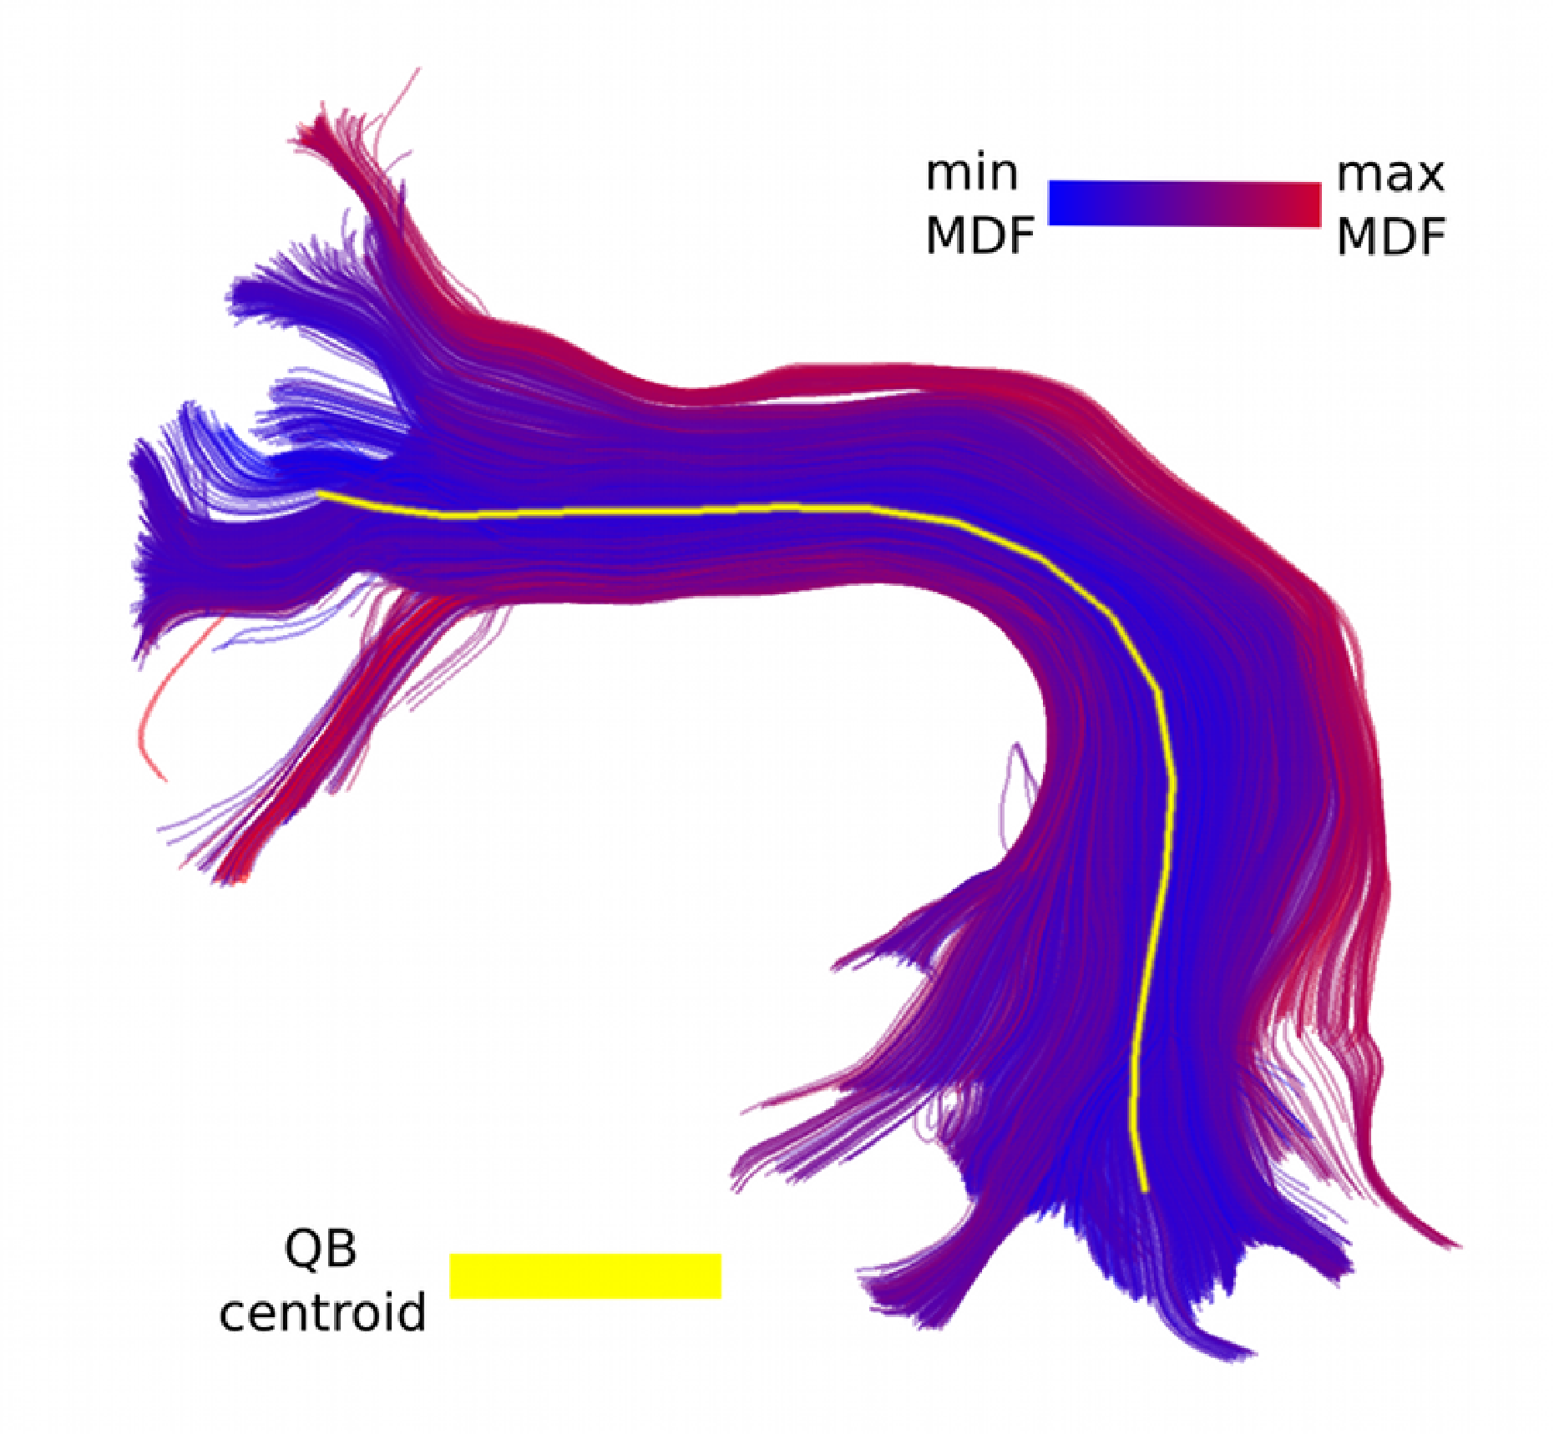
Fiber bundle analysis
Fornix
Wikipedia (Gray's anatomy)
Garyfallidis et al. (2013) Front. Neuroinformatics
Garyfallidis et al. (2013) Front. Neuroinformatics
Arcuate Fasciculus
Garyfallidis et al. (2013)
Front. Neuroscience

Slide 25

Get involved! Give feedback!
Thank you!

