Slide 1
Bundle
Recognition
Eleftherios Garyfallidis, PhD
University of Sherbrooke, QC, Canada
Diffusion Imaging in Python (dipy.org)

Slide 2
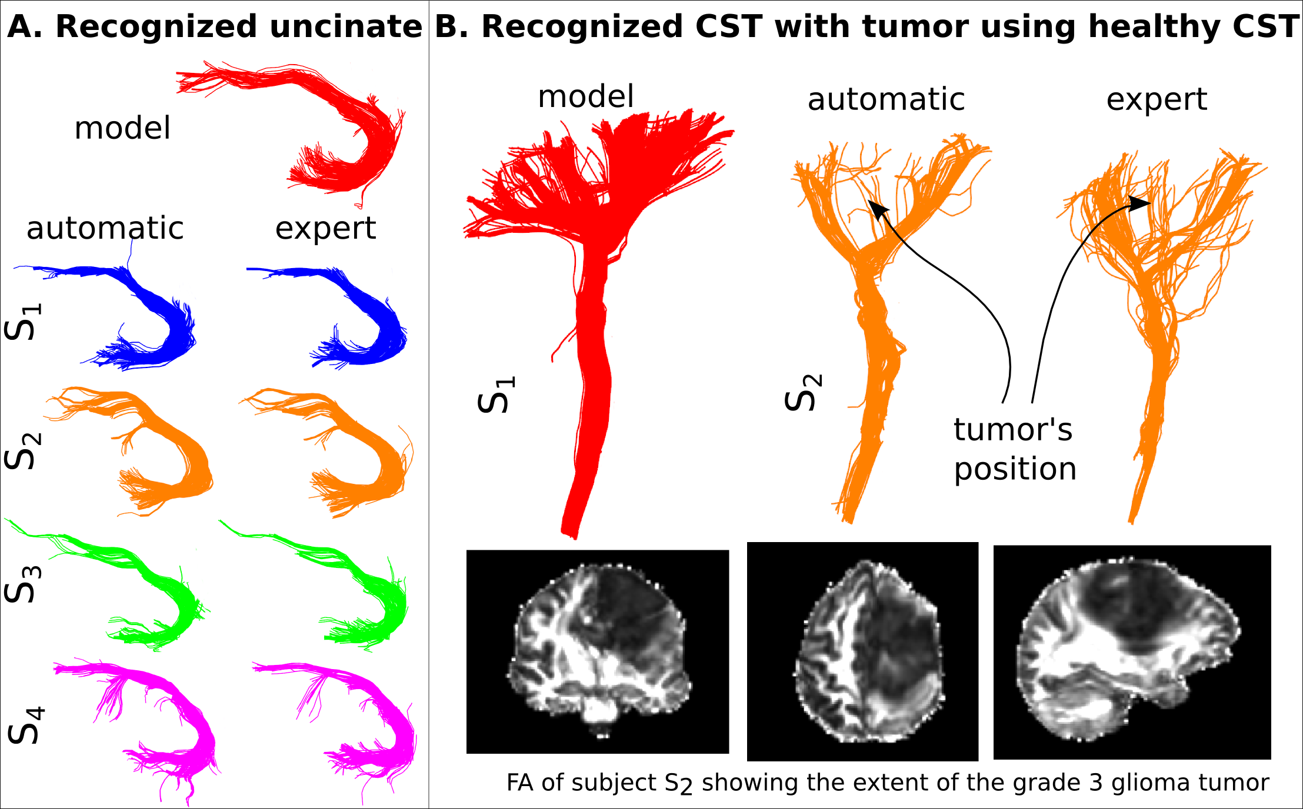
ISMRM 2015
Recognition of bundles in healthy and severely diseased brains

Slide 3
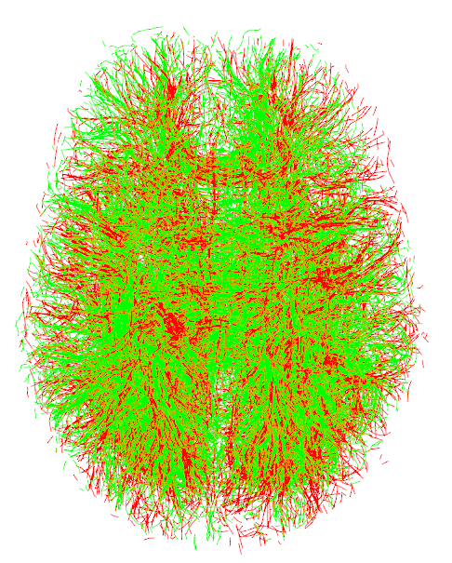
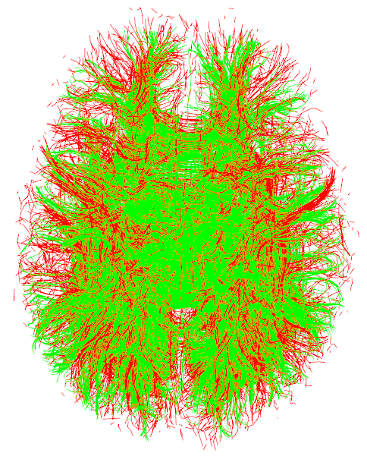
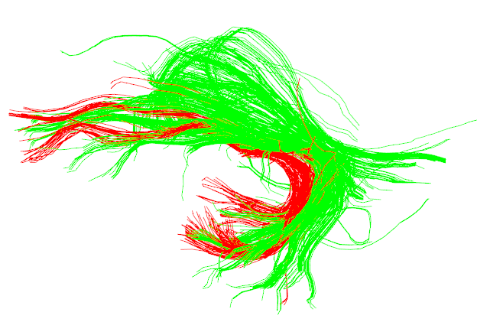
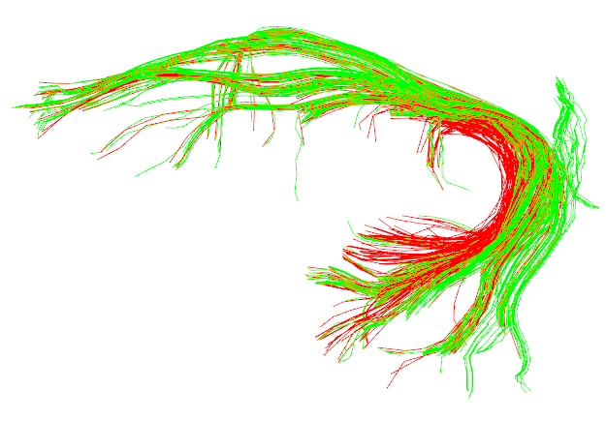
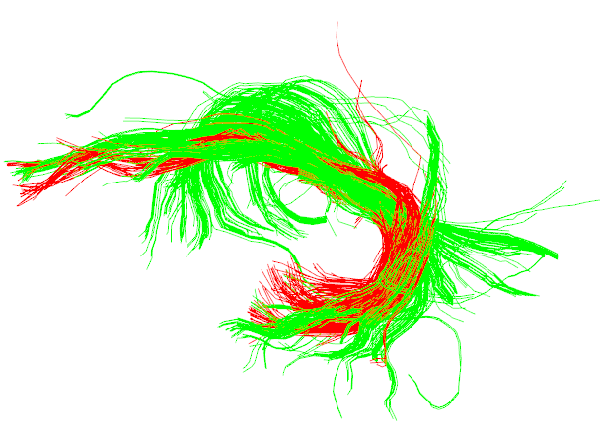
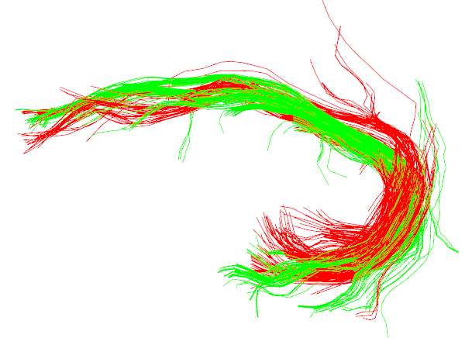
Concept
Example with right uncinate as the model
Linear Reg.
First Quickbundles.
Remove clusters with far centroids.
SLR NI 2015
Or FLIRT
SLR NI 2015
Or FLIRT
SAR + QB + SRR + MAM
SRR (Rigid)
Matching!
Expand with a different
distance.
Remove far
streamlines

