Slide 1



Tract-analysis and connectivity
Eleftherios Garyfallidis, PhD
Diffusion Imaging in Python
http://dipy.org
Sherbrooke Connectivity Imaging
Laboratory http://scil.dinf.usherbrooke.ca

Slide 2

Basic Principles
Streamlines are polylines (a series of line segments) where their points are in floating point coordinates.
These coordinates can be transformed to the image coordinates which are integer coordinates.
An affine transformation is needed to go from streamline coordinates to image coordinates. Given e.g. from the Nifti file.
Interpolation is also needed. Usually trilinear or nearest.
Most common file format is Trackvis (*.trk) or VTK (*.vtk).
Message: Make sure you understand the space of the streamlines in comparison to the space of the images and how to go from the one space to the other. Look at DIPY’s quick start tutorials.
Tract-analysis and connectivity - Eleftherios Garyfallidis (2015)

Slide 3
Basic Principles
TODO
Add figure of bundle and metric map showing the transformation from the one to the other.
Case 1 streamlines and metrics in the same space.
Case 2 streamlines and metrics in different space but still having the transformation from the one to the other.
By interpolating the metric values on the points of the streamlines you can address
Tract-analysis and connectivity - Eleftherios Garyfallidis (2015)

Slide 4
Table of contents for tract analysis
Segmentation of streamlines
Manual
Automatic
Semi-automatic
Registration
Image-based (old school) covered by Konstantinos
Streamline-based (new) brings many new capabilities
Subject level tractometry
Statistics of metrics along bundles
Perpendicular to bundles
Group level tractometry
Tract-analysis and connectivity - Eleftherios Garyfallidis (2015)

Slide 5
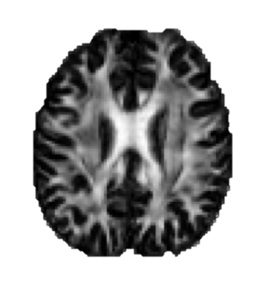
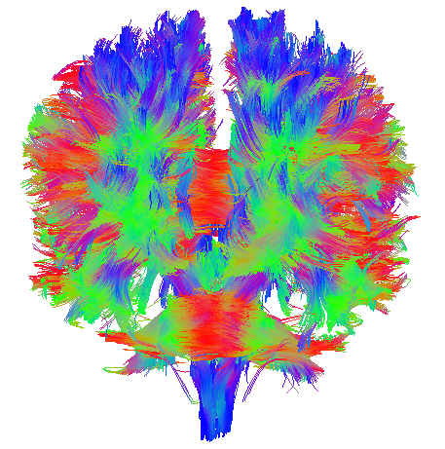
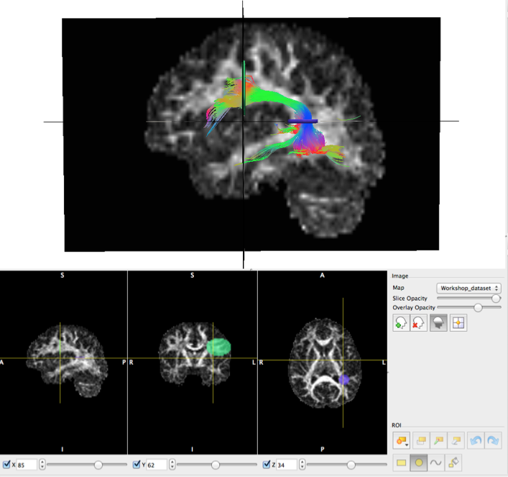
Manual segmentation
Types of ROIs:
Inclusion (logical “and” and “or”)
Exclusion (logical “not”)
How we use ROIs:
Termination Points (e.g. Cortical)
Waypoints (e.g. specific white matter region)
Volumetric (e.g. U-Shape)
Available tools:
Trackvis, Fibernavigator and MI-Brain
Tract-analysis and connectivity - Eleftherios Garyfallidis (2015)

Slide 6
Table of contents for connectivity
Cortical surface
Connect with cortical surface
Connect with sub-cortical areas
Connectivity
Understand the basics of graph theory.
Be critical with counting streamlines.
An example of good counting with the tractometer.
Tract-analysis and connectivity - Eleftherios Garyfallidis (2015)

Slide 7
Table of contents for connectivity
Cortical surface
Connect with cortical surface
Connect with sub-cortical areas
Alerts on how to measure connectivity
Graph theory
Tract-analysis and connectivity - Eleftherios Garyfallidis (2015)

Slide 8
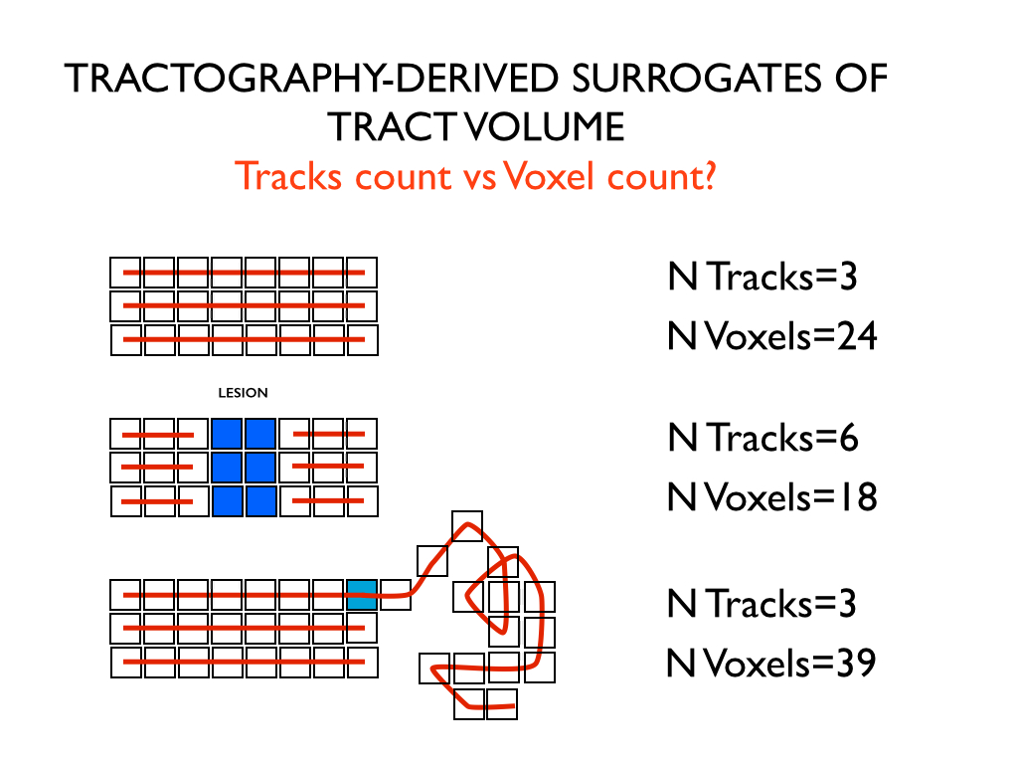
Be critical when counting
Courtesy of Marco Catani
Tract-analysis and connectivity - Eleftherios Garyfallidis (2015)

Slide 9
Be critical when counting
Courtesy of Marco Catani
Tract-analysis and connectivity - Eleftherios Garyfallidis (2015)

Slide 10

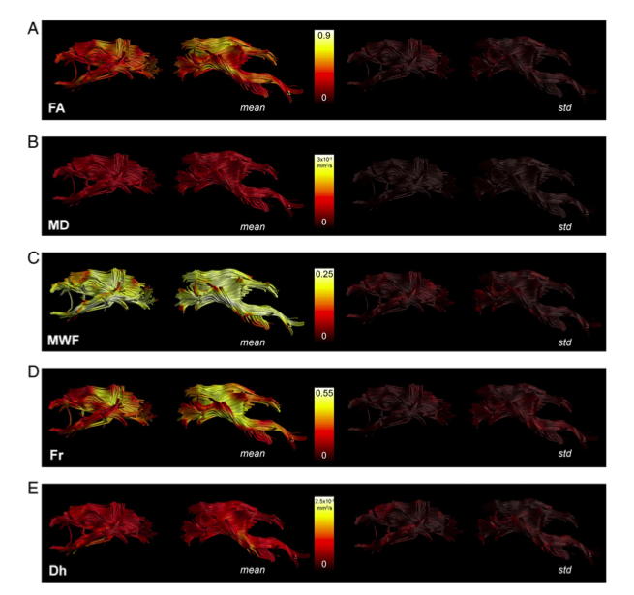
Tractometry
FA₅
FA_{n-1}
FA₄
FA₃
FA₂
FA₁
Bells et al. ISMRM 2012, Assaf et al. Neuroimage 2013,
Catani et al, PNAS 2007, Lebel & Beaulieu HBM 2009, Forkel et al Brain 2014
Tract-analysis and connectivity - Eleftherios Garyfallidis (2015)

