Slide 1



Direct native space bundle alignment for group comparisons
Eleftherios Garyfallidis, Ph.D.
Sherbrooke Connectivity Imaging
Laboratory (SCIL)
Computer Science department
Université de Sherbrooke, Canada
http://scil.dinf.usherbrooke.ca

Slide 2
The problem
We want to calculate statistics along bundles. For example along the AF or the CST.
Let’s assume that we have already segmented the bundles of interest using:
  Dipy with streamline ROI intersections
  Fibernavigator interactively
  Tract-querier where you can formally create queries using the white matter query language
[1] Wassermann et al. MICCAI 2013
http://tract-querier.readthedocs.org

Slide 3
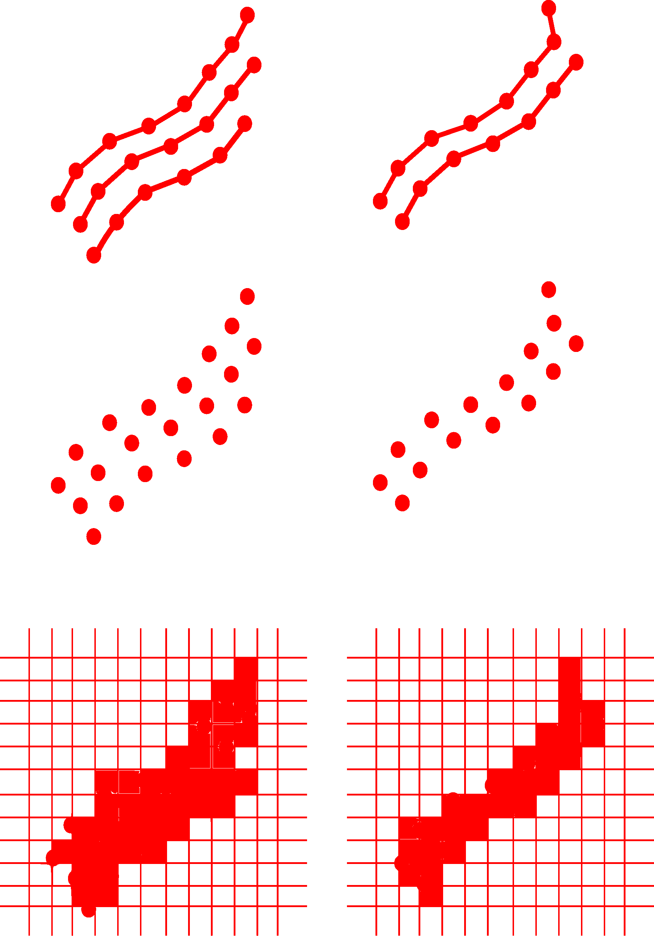
The current solutions
Most methods do not even use the streamlines and in some cases they discretize them to an image and usually register it to a common space using FA^{1,2}.
Let’s concentrate on single bundles.
Streamlines
  Hausdorff?
Points
  ICP
Image grid
  MI, CC
[1] AFQ, [2] TBSS

Slide 4
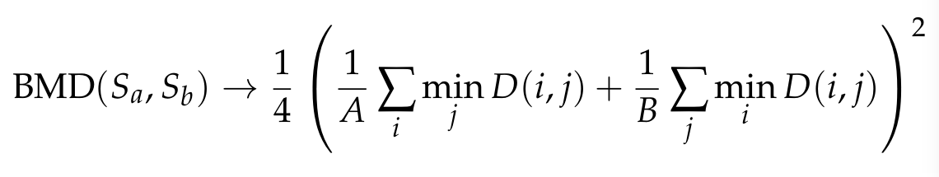
Our approach: StreamLineaR
We only use streamlines for registration by optimizing a metric based on the minimum direct flipped distance¹ (MDF).
The MDF distance is a true distance metric on the space of streamlines as shown in the QuickBundles paper² and it is very fast to compute. The optimization metric is:
where S are the two bundles, D is a pairwise distance matrix of MDF distances. BMD stands for Bundle Minimum distance.
[1] Garyfallidis et al., OHBM 2010, [2] Garyfallidis et al., Frontiers 2012

Slide 5
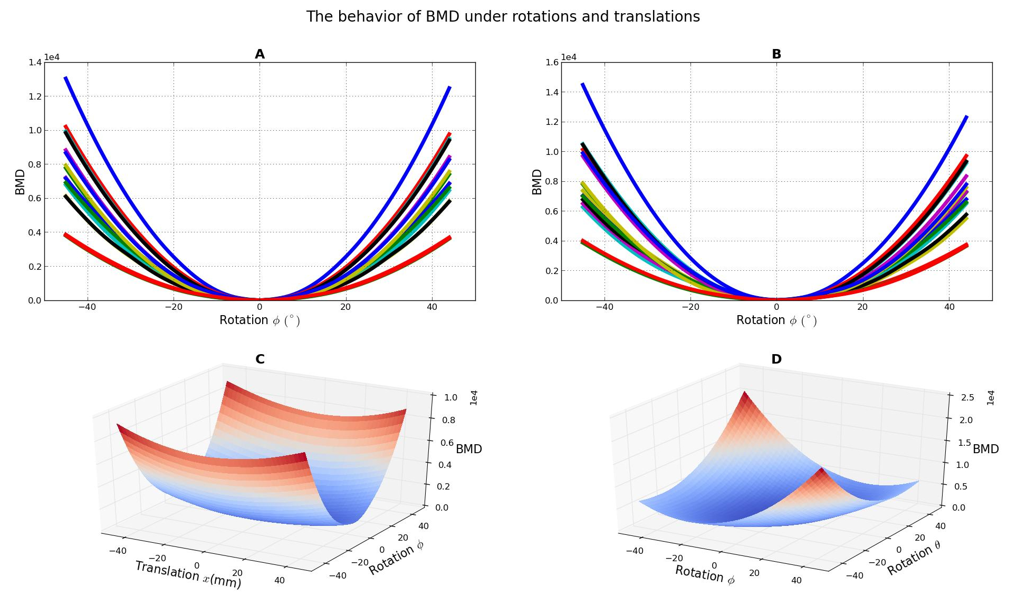
StreamLineaR: BMD cost
BMD is smooth and convex even with partial data!

Slide 6
StreamLineaR: Results
Demonstrations with rigid and affine registration with
partial data.

Slide 7
StreamLineaR: Results
Demonstrations with rigid and affine registration with bundles of different subjects.

Slide 8
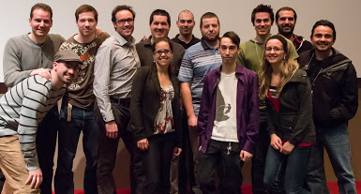
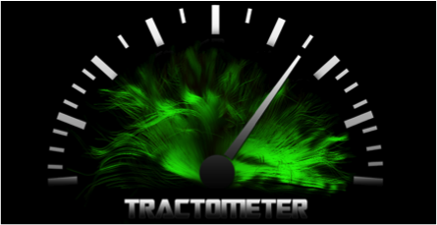



Thank you!
http://scil.dinf.usherbrooke.ca
http://tractometer.org
http://dipy.org

