Slide 1
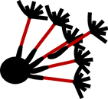
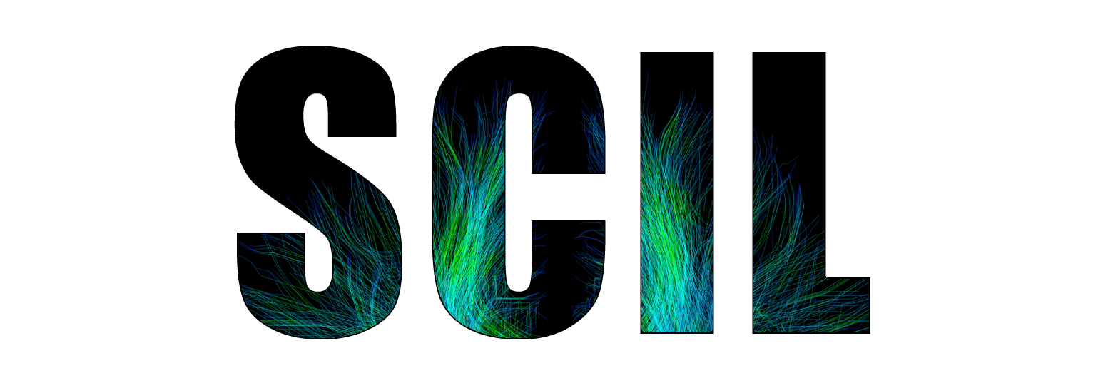

Recent advances in
Diffusion Imaging in
Python
Eleftherios Garyfallidis and Michael Paquette
Université de Sherbrooke, Quebec, Canada
http://scil.dinf.usherbrooke.ca

Slide 2

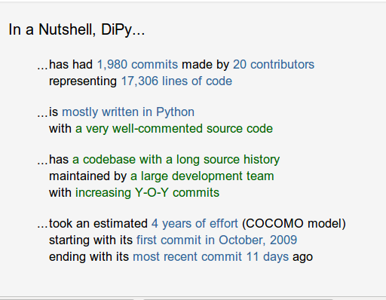
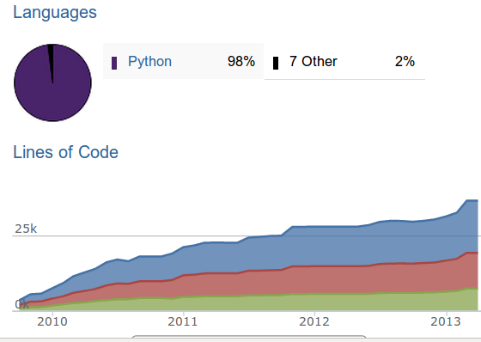
Dipy 0.6 is released!
- Major release
- Two years on the making

Slide 3
Dipy 0.6.0 (Saturday, 30 Mar 2013) introduces many more algorithms and
design aspects both for analysis and visualization. Here are just some of the
new tools:
Modeling
* New reconstruction models API
* Diffusion Spectrum Imaging (DSI) (Wedeen et al.)
* DSI with deconvolution (Canales-Rodriguez et al.)
* Generalized Q-sampling Imaging 2 (GQI2) (Yeh et al.)
* Spherical Harmonic Models (Tristan-Vega, Aganj, Descoteaux, Tuch)
* Decorator for turning a SingleVoxelModel into a MultiVoxelModel
* Mrtrix and fibernavigator spherical harmonic bases
* Color FA and other tensor metrics
* Fit_tensor script
Tracking
* Modular fiber tracking (deterministic & probabilistic)
* Peak finding in ODFs (direct evaluation or optimization-based) with angular
similarity evaluations
Simulation
* Voxel simulation (Multi-tensor and Ball & Sticks)
* Software phantom generation

Slide 4
Data structures and handling
* Abstractions for commonly used data: Sphere, Gradients
* Fast volume indexing (a faster ndindex)
* Utilities for downloading example data sets
Visualization
* Visualization of spherical functions
* 2D sphere plotting
* Radial basis function interpolation on the sphere
Overall
* More examples, tutorials, tests and benchmarks
* Scripts for the ISBI 2013 competition
This has been a great collaborative effort.
Next is the complete list of contributors.

Slide 5
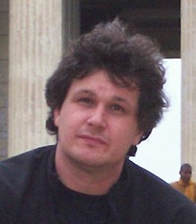
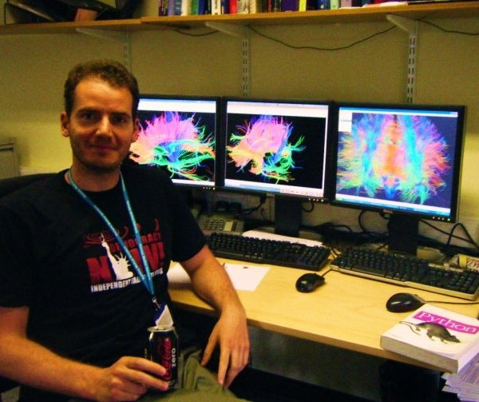
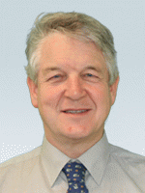
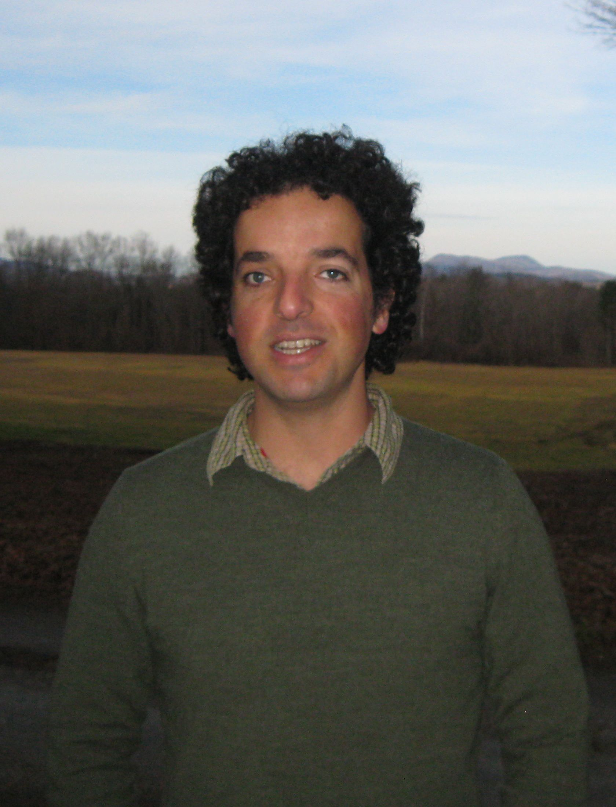
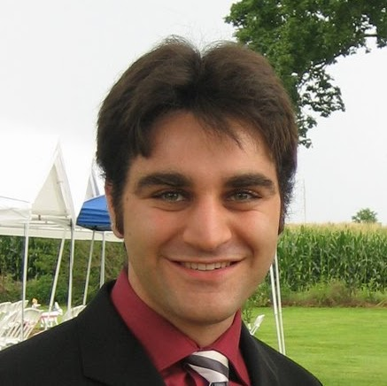
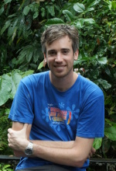
Dipy Developers (Core team)
Matthew
Berkeley
Eleftherios
Cambridge, UK
Ian
MRC CBU Cambridge, UK
Ariel
Stanford
Bago
UCSF
Stefan
South Africa

Slide 6
Dipy Developers (Full list)
- Eleftherios Garyfallidis, University of Sherbrooke, QC, CA
- Ian Nimmo-Smith, MRC CBU, Cambridge, UK
- Matthew Brett, University of California, Berkeley, CA, US
- Bago Amirbekian, University of California, San Fransisco, CA, US
- Ariel Rokem, Stanford University, CA, US
- Stefan Van der Walt, Stellenbosch University, ZA
- Maxime Descoteaux, University of Sherbrooke, QC, CA
- Michael Paquette, University of Sherbrooke, QC, CA
- Christopher Nguyen, University of California, Los Angeles, CA, US
- Emanuele Olivetti, NeuroInformatics Laboratory (NILab), Trento, IT
- Yaroslav Halchenco, PBS Department, Dartmouth, NH, US
- Samuel St-Jean, University of Sherbrooke, QC, CA
- Your name here

Slide 7
ISBI HARDI Competion

Slide 8
Training Set Flowchart
Data
Denoising
Manjon et al.
Descoteaux et al.
Local
Reconstruction
Method
Deterministic
Tracking
Connectivity
Matrix
Score

Slide 9
CSD: Constrained Spherical Deconvolution
Tournier et al.
SDT: Spherical Deconvolution Transform
Descoteaux et al.
PSO: Multi-tensor with particle swarming.
Paquette et al.
DSID: Diffusion Spectrum Imaging with Deconvolution
Canales-Rodriguez et al.
GQID: Generalized Q-sampling Imaging with Spherical Deconvolution
Garyfallidis PhD thesis
Local Reconstruction Methods
DTI/HARDI
Heavyweight

Slide 10
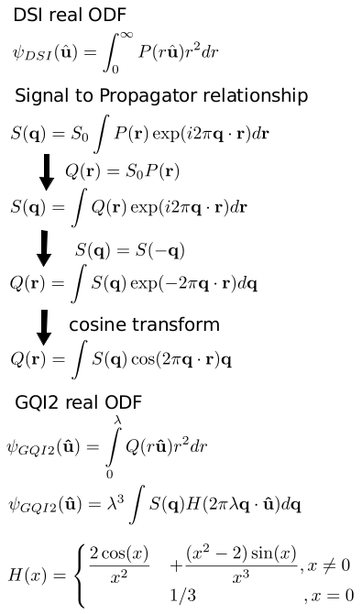
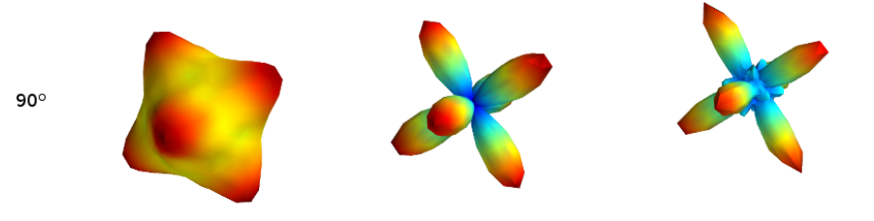
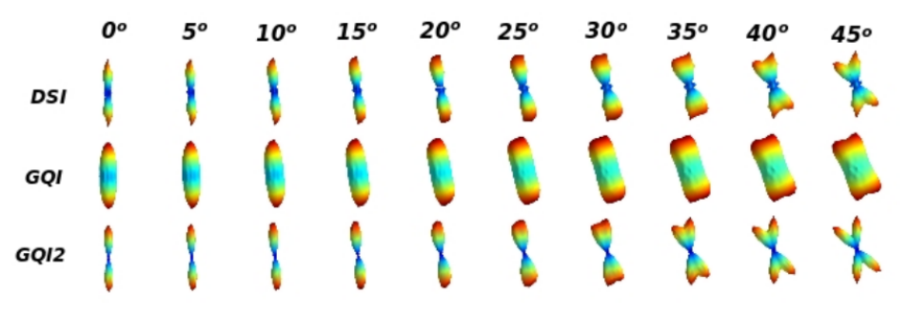
GQI
GQI2
DSI

Slide 11
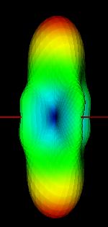
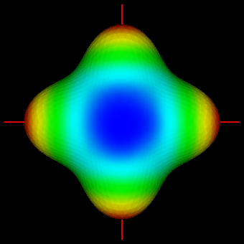
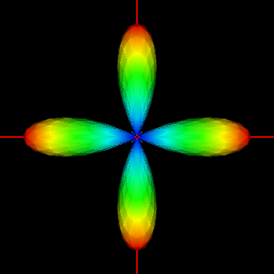
Spherical Deconvolution Transform
FRT
Diffusion
ODF
HARDI Signal
Fiber ODF
Deconvolution
sharpening
transform
c_{j}
2π P_{l(j)}(0)
1/ f_{j}

Slide 12
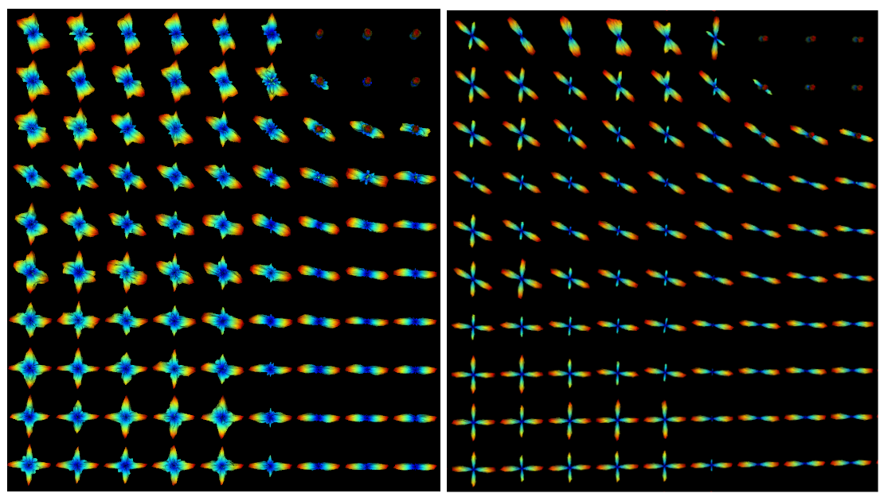
GQI2 vs GQID
(GQI2 with deconvolution)

Slide 13


Slide 14
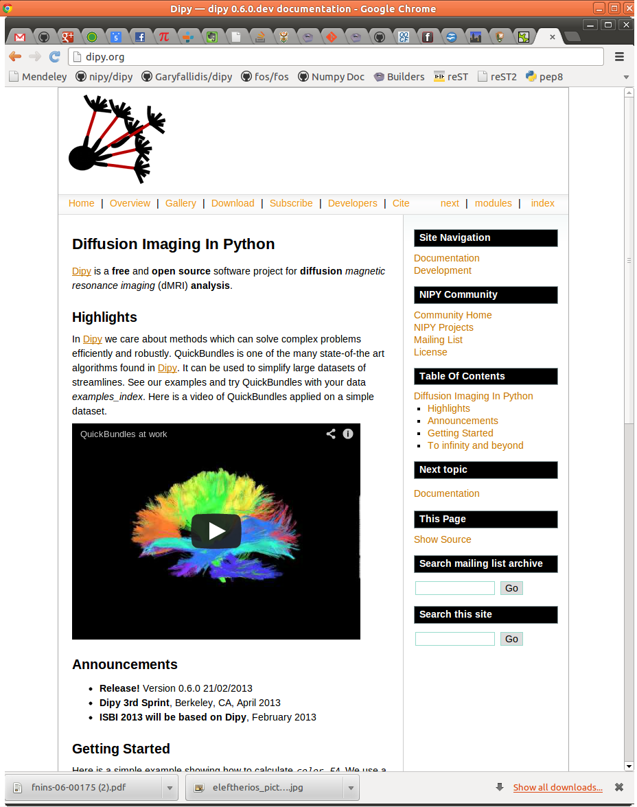
dipy.org

Slide 15
Mission
The purpose of dipy is to make it easier to do better diffusion MR imaging research.
- clearly written
- clearly explained
- a good fit for the underlying ideas
- a natural home for collaboration
We hope that, if we fail to do this, you will let us know and we will try and make it better.
Truly Open
BSD License
Documentation
Unit tests
Examples
Tutorials
Buildbots
Git/Github
Travis
Dependencies
Numpy
Scipy
Cython
Nibabel
(Optional)
Python vtk
Pytables

Slide 16
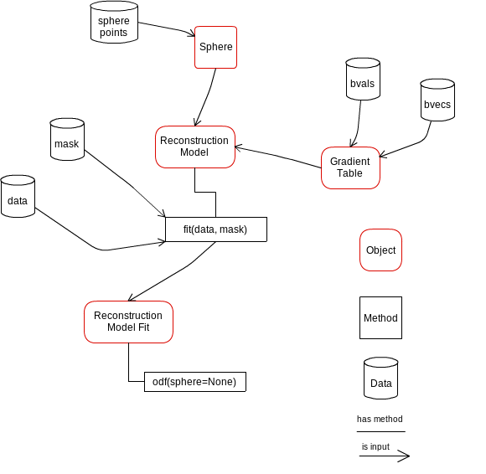
Design is important

Slide 17
List of algorithms
Reconstruction
- Diffusion Spectrum Imaging (Wedeen)
- Generalized Q-Sampling Imaging (Yeh)
- Diffusion Spectrum Imaging with Deconvolution (Canales-Rodriguez)
- Qball (Descoteaux)
- Constant Solid Angle (Aganj)
- Opdt (Tristan-Vega)
- Diffusion Tensor (Basser)
- Simulations
- ++ CSD + MultiTensor on their way.
Tracking
- Deterministic
- Probabilistic
- Statistics (length etc.)
- Streamline counts
Input / Output
- nifti
- dicom (partly supported)
- trackvis
- hdf5
- fast pickling
- numpy io

Slide 18
Segmentation
- QuickBundles
Volume
- Fast volume traversal (ndindex)
- Reslice volumes
Registration
- Warp streamlines
And your module here
List of algorithms

Slide 19
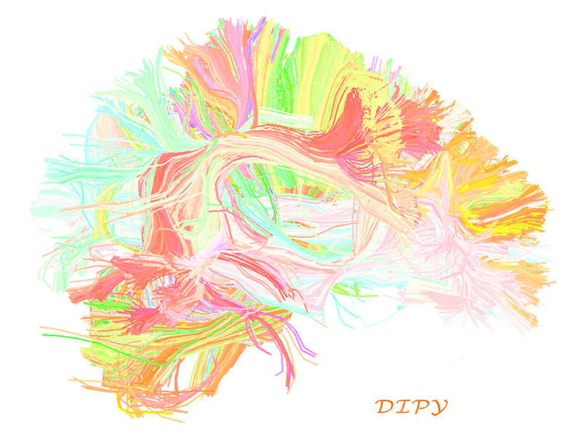
Get involved and share some code!
Thank you!

