Slide 1

diffusion MRI and tractography
@Brainhack Americas
Eleftherios Garyfallidis, PhD
University of Sherbrooke, QC, Canada
Diffusion Imaging in Python (dipy.org)

Slide 2
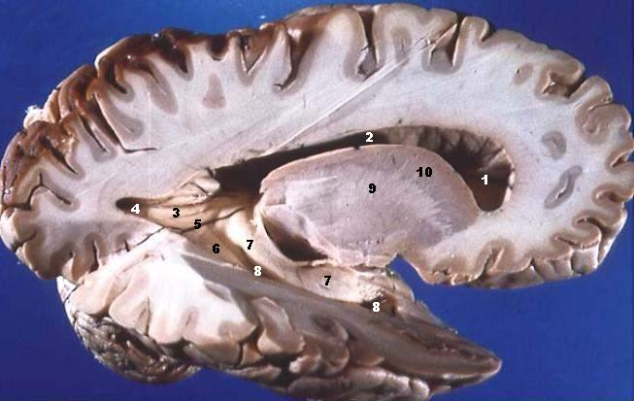
Here is a hard problem
Imaging having maps without streets!!!
We want to precisely infer the structural connectivity of the brain
when it is actually so densely packed.
But, wait a minute, this looks like a difficult multi-disciplinary problem.
How can we solve such a problem? Let's start with physics!

Slide 3
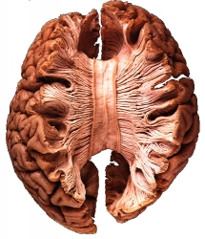
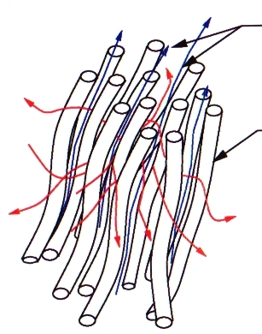
The main idea behind diffusion MRI
Water diffusion is sensitive to the underlying tissue microstructure and provides a unique method to assess its orientation when aligned
with a strong magnetic field.
Bundles of axons
(nerves aka
tracts)
cortex
(gray matter)
white matter

Slide 4
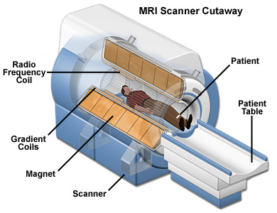
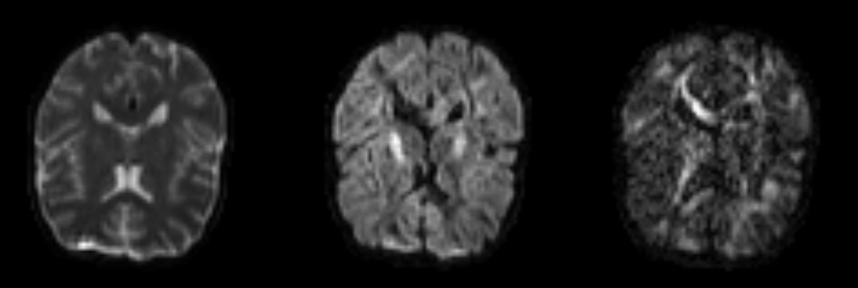
Diffusion MRI
(dMRI)
dMRI is the principal non-invasive
method that provides information
about the directional structure of fibrous tissue in the body using an MR scanner.
dMRI acquires one or more T2-weighted reference images, and a collection of diffusion-weighted images that attenuate the T2 signal according to the amount of diffusion along prescribed gradient directions.

Slide 5
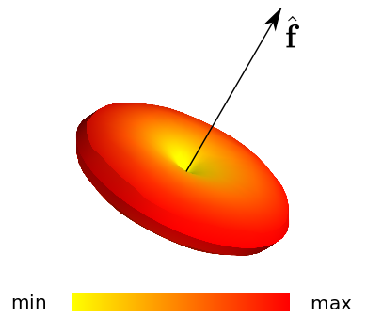
Diffusion Signal
Diffusion signal is lowest towards the primary direction of the underlying fiber distribution.
Underlying voxel structure
Ideally measured signal

Slide 6
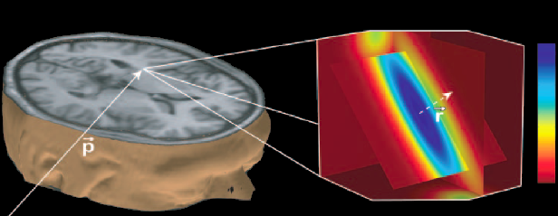
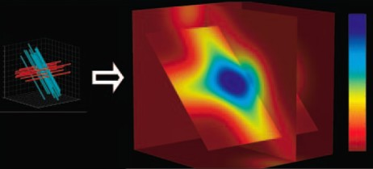
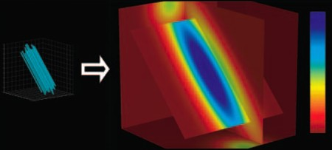
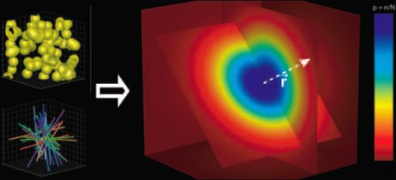
Diffusion Propagator (it's a PDF)
3D space (x,y,z)
3D diffusion propagator P(r)
Measured Signal S(q)
Hagmann et al. (2006) Radiographics
2 fiber
1 fiber
isotropic
In theory the diffusion signal S(q) has a direct Fourier relationship with the diffusion propagator P(r). In practice very long acquisition times are required to be
used in clinical practice and for this reason...

Slide 7
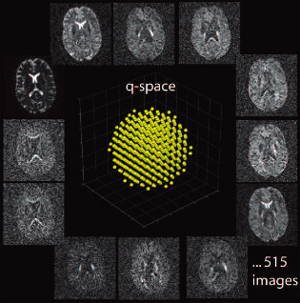
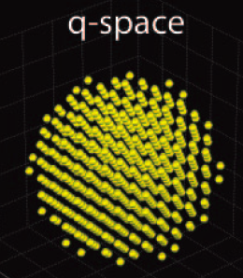

Q-space
3D diffusion propagator P(r)

Slide 8
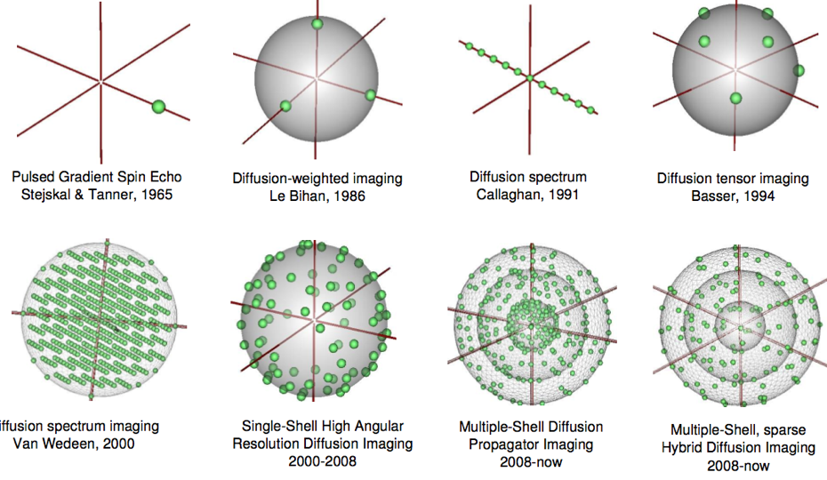
History of q-space sampling
Main acquisitions DTI, DSI and HARDI
DTI
DSI
HARDI

Slide 9
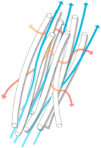

Tensor - Gaussian PDF
1 fiber
Isotropic

Slide 10
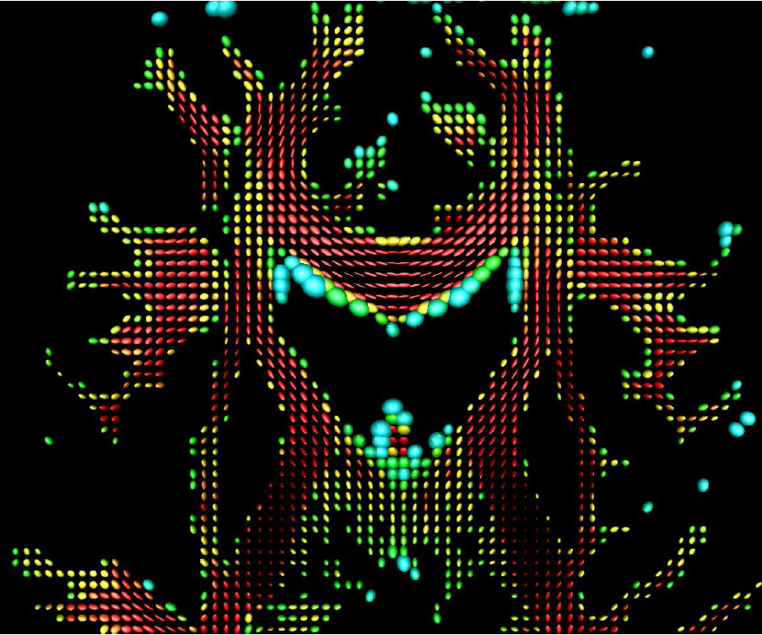
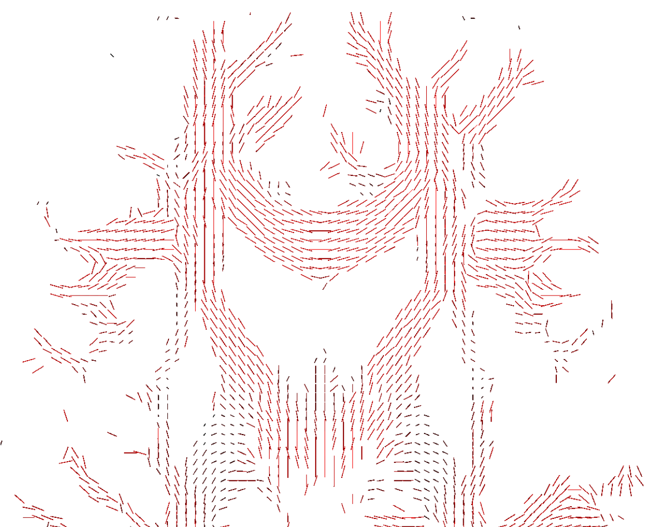
Tensor Fields (DTI)
Fields of primary directions
Fields of Ellipsoids

Slide 11
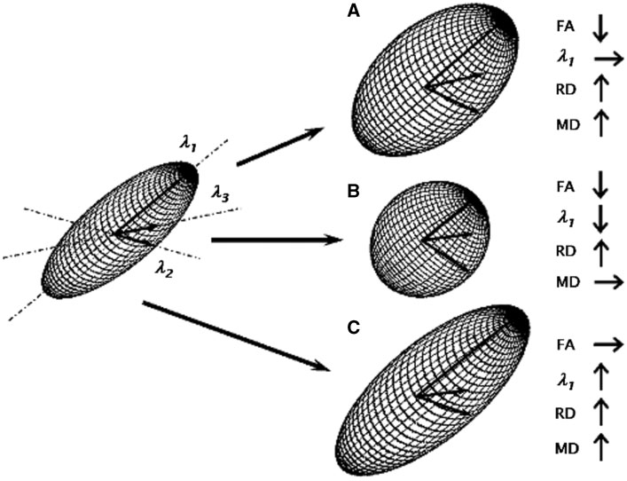
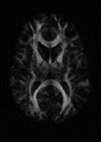
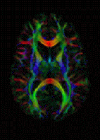
Tensor Metrics/Maps
Fractional Anisotropy (FA)
Sharp ellipsoid: FA close to 1.
Fat ellipsoid: FA close to 0.
FA
Color FA
R:L-R, G:F-B, B:U-D

Slide 12
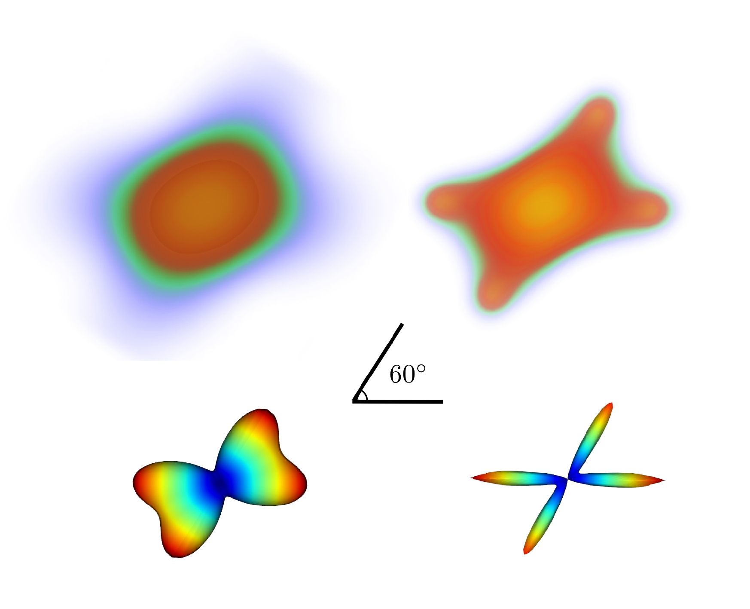
Advanced fields
Go beyond the Tensor. Orientation Distribution Functions
(spherical projections aka ODFs)
PDFs
ODFs

Slide 13
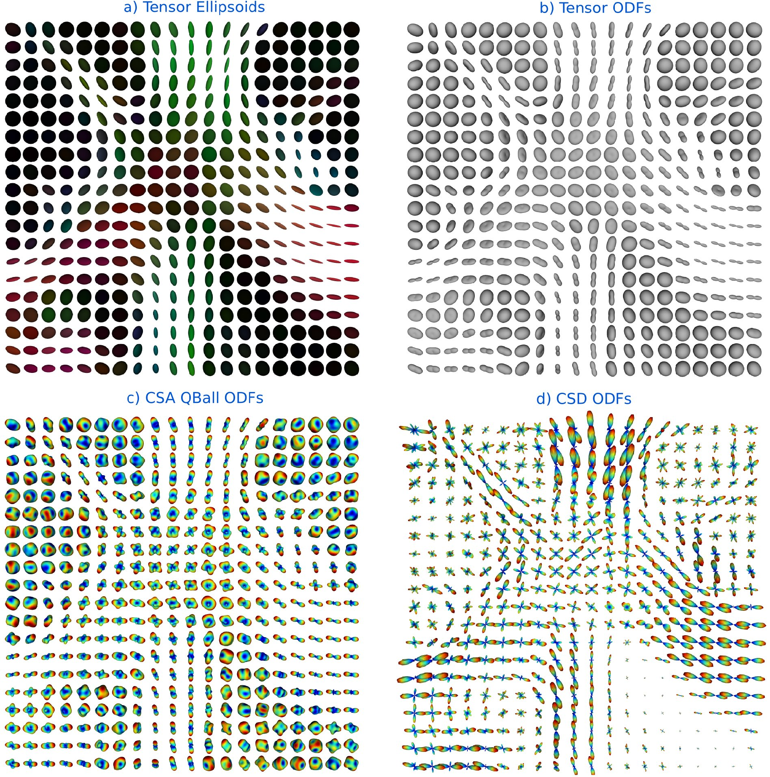
Tensors vs ODF fields
Crossings not found
Crossings found !

Slide 14


Fiber tracking aka Tractography

Slide 15
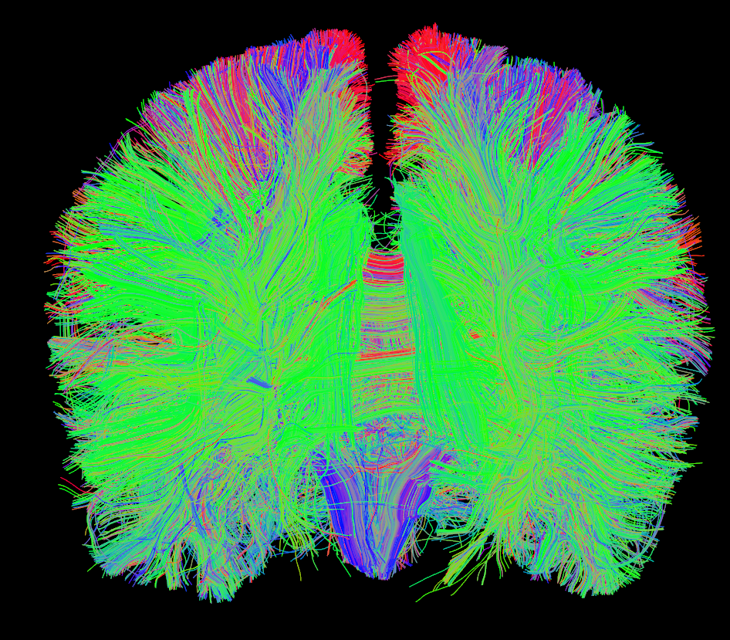

Fiber tracking (full brain)
Millions of streamlines!!!

Slide 16
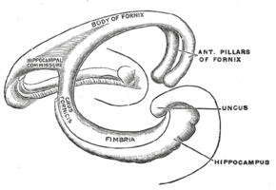
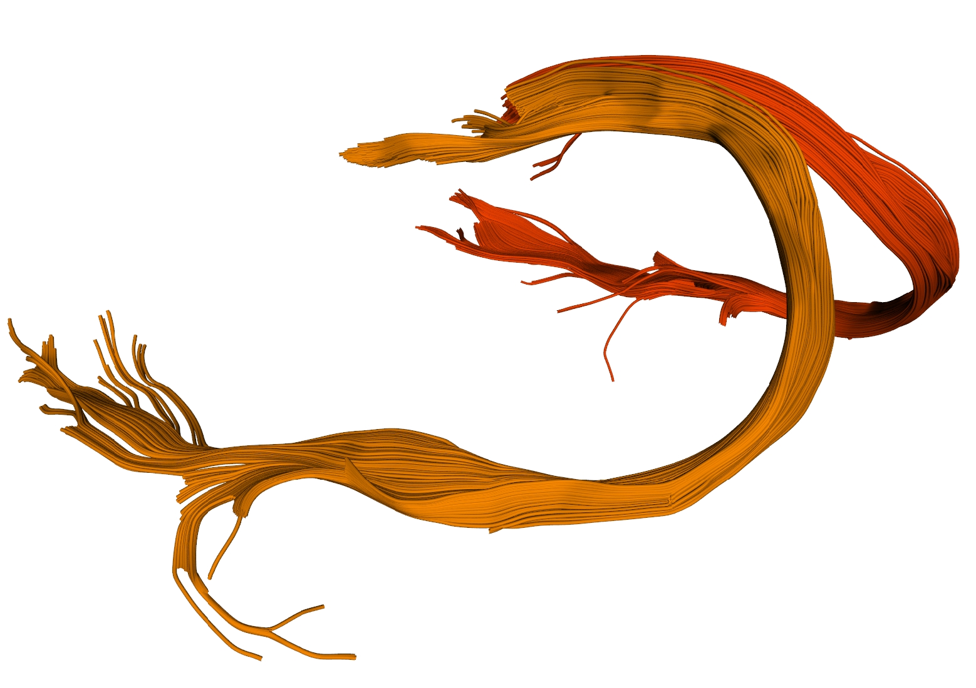
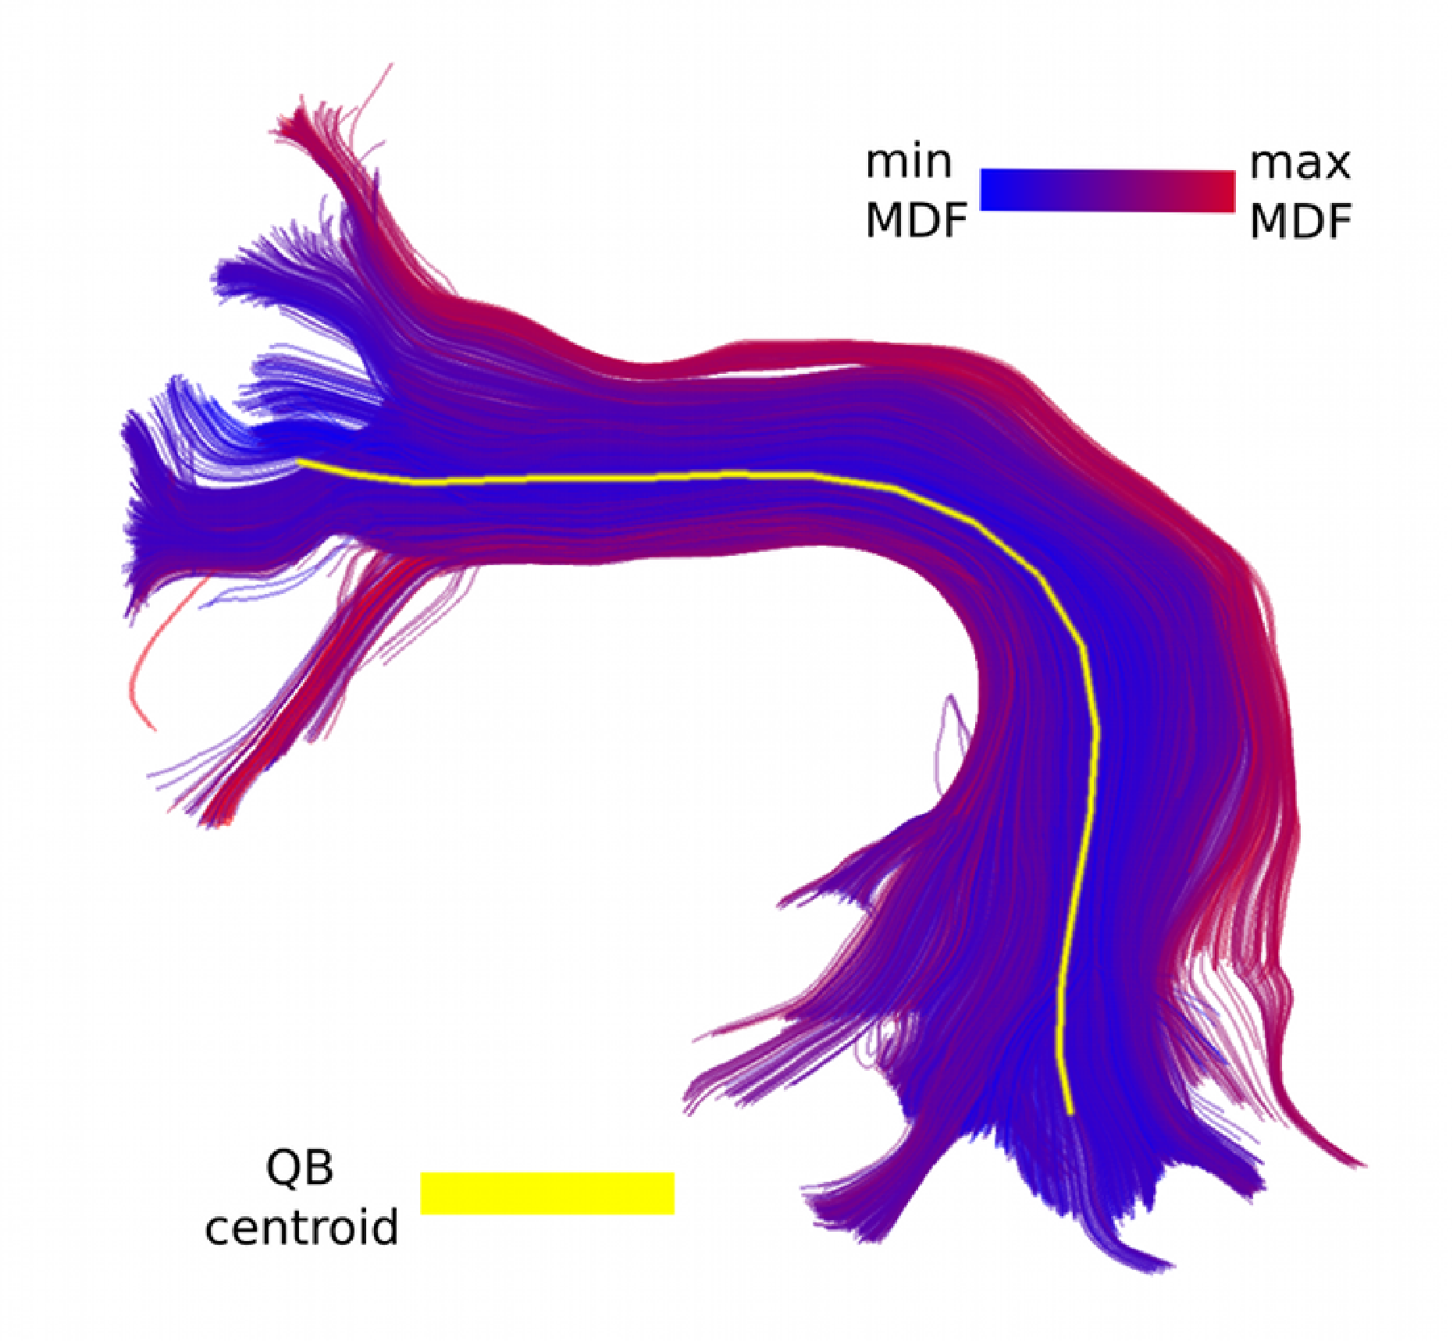
Fiber bundle analysis
Fornix
Wikipedia (Gray's anatomy)
Garyfallidis et al. (2013) Front. Neuroinformatics
Garyfallidis et al. (2013) Front. Neuroinformatics
Arcuate Fasciculus
Garyfallidis et al. (2013)
Front. Neuroscience

Slide 17
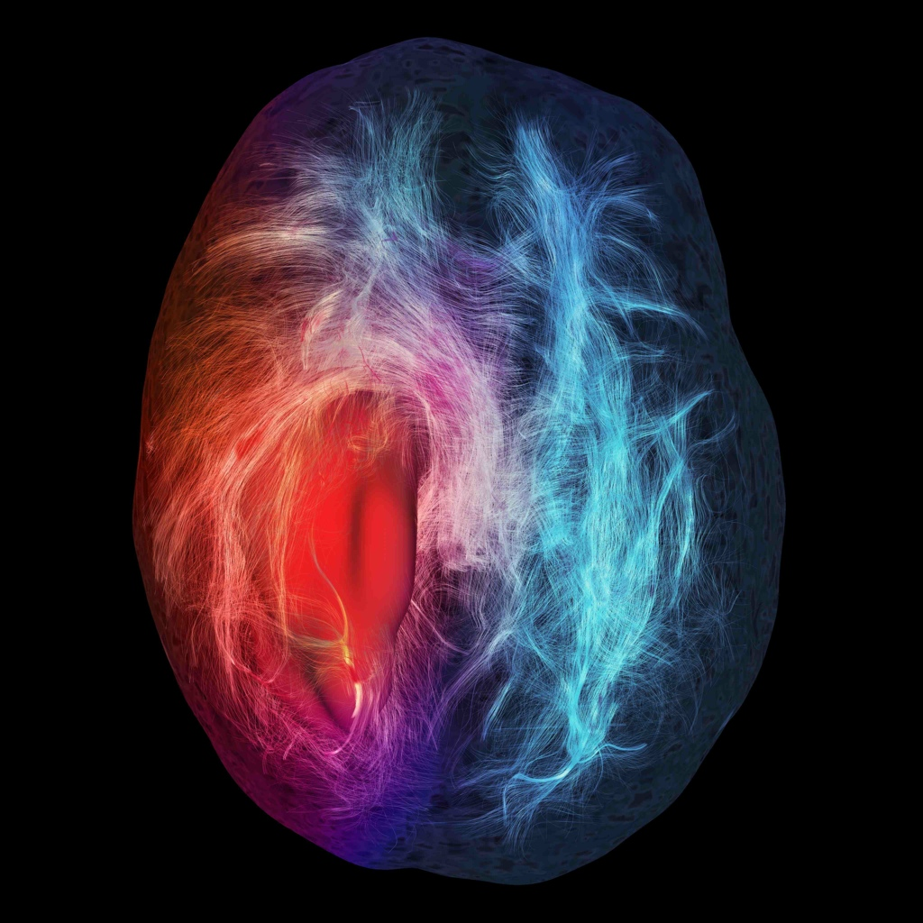
Why do diffusion MRI?
Help us understand how the brain is connected
White matter wiring
Spinal cord imaging
Muscles, ligaments, heart
Brain development
Aging
Pathologies
Neurosurgical Planning
Tumors
++
Chamberland M. et al.
(cerebral infiltration)

Slide 18
A hard problem
We want to precisely infer the structural connectivity of the brain
when it is actually so densely packed.
But, wait a minute, this looks like a difficult multi-disciplinary problem.
How can we solve such a problem?
We need a collective mind!
And here it is … I present you the collective mind :) ...

Slide 19
An international, free and open source project for the
analysis of dMRI data which brings together people with
backgrounds in:
- computer science
- mathematics
- software engineering
- medicine
- psychology
with the common goal to extend our understanding of the
structural connectivity of the brain.
http://dipy.org

Slide 20
Mission
The purpose of dipy is to make it easier to do better diffusion MR imaging
research.
- clearly written
- clearly explained
- a good fit for the underlying ideas
- a natural home for collaboration
But how do we do this?
Open to all to contribute
  No lab agendas!
Free for all to use
Highly documented
Extremely tested
  Continuous integration
  Buildbots
Open Source
- BSD License
Dependencies (ALL BSD)
- Numpy
- Scipy
- Cython
- Nibabel
- Python vtk

Slide 21


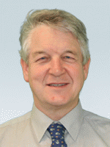

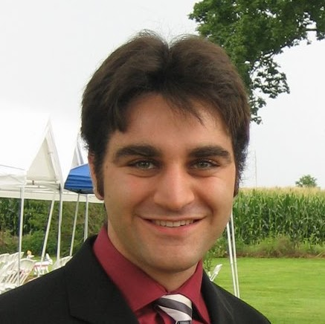

Dipy Developers
Matthew
Berkeley
Eleftherios
Cambridge, UK
Ian
MRC CBU, UK
Ariel
Stanford
Bago
UCSF
Stefan
South Africa

Slide 22
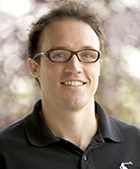



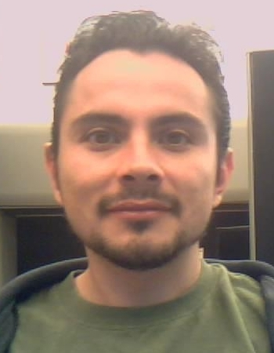
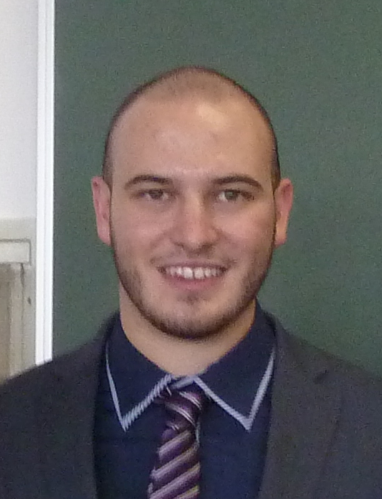
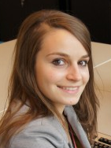
Dipy Developers (New members)
Prof. Maxime
Sherbrooke
Gab
Sherbrooke
Samuel
Sherbrooke
Marc-Alex
Sherbrooke
- And the list goes on ...
- And your name here
Jesus-Omar
Mexico
Mauro
Italy
Chantal
Netherlands

Slide 23
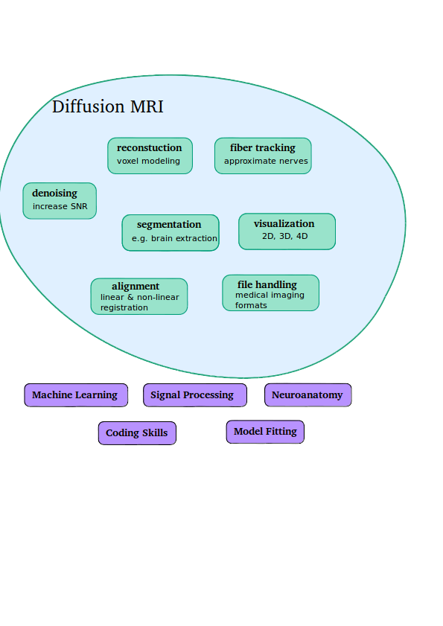


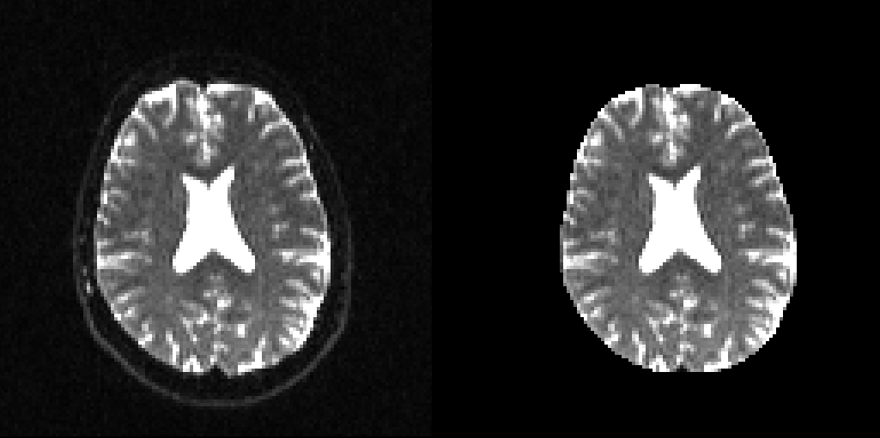
The challenges

Slide 24
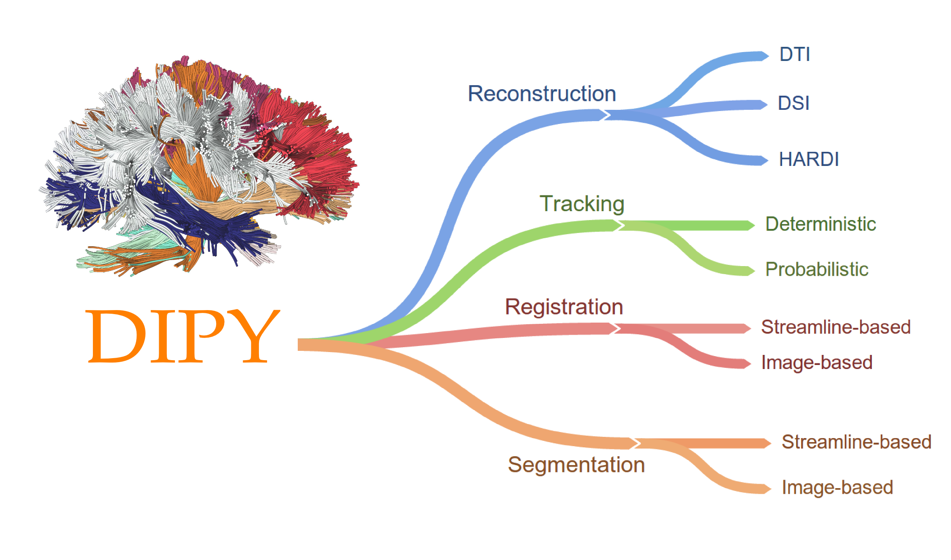
Main Components
With the combination of these components. For example using tracking and registration you can perform connectivity analysis.

Slide 25
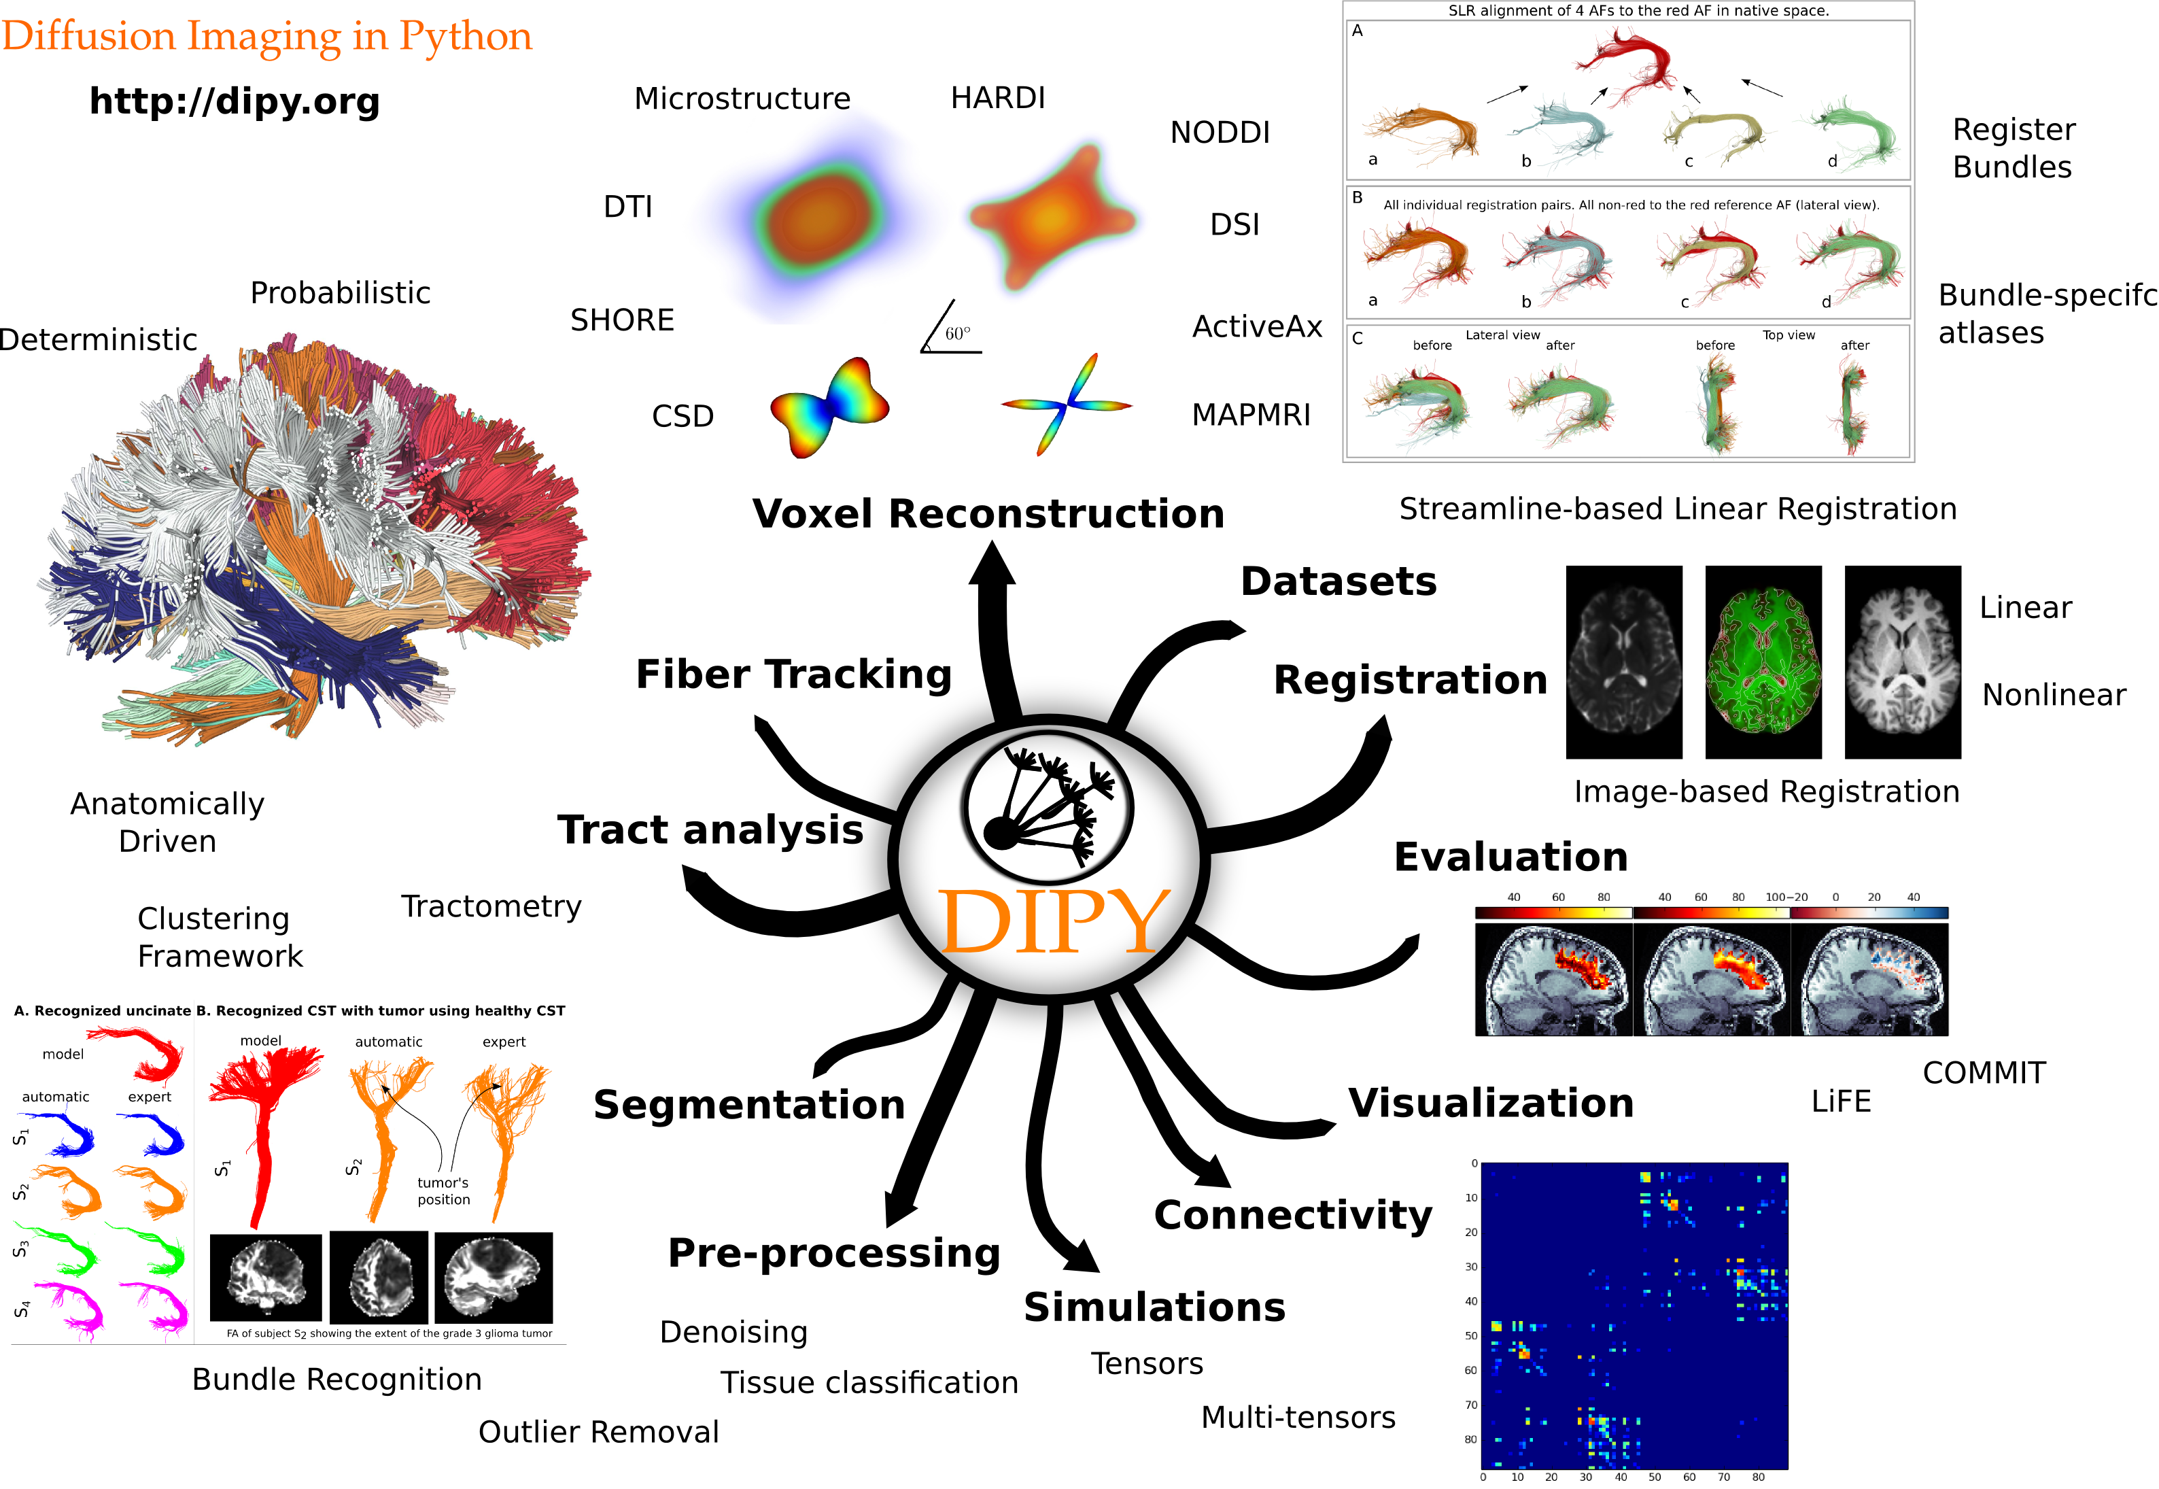
A broader view of components

Slide 26
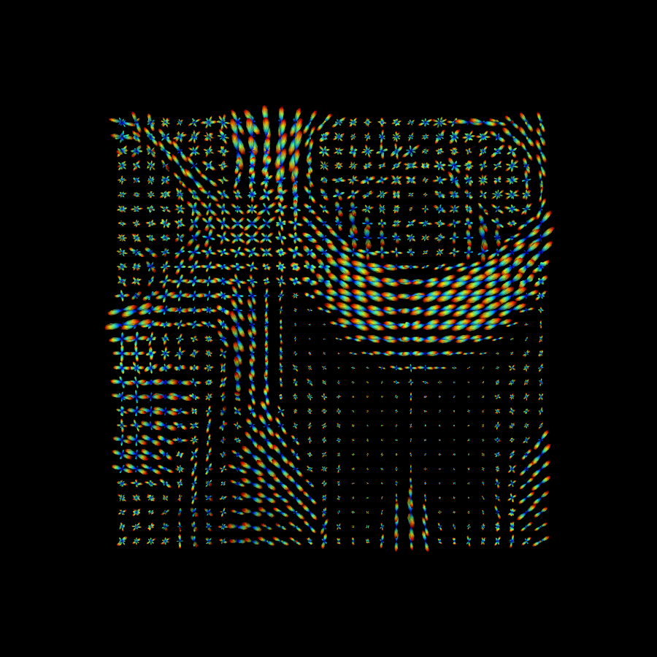
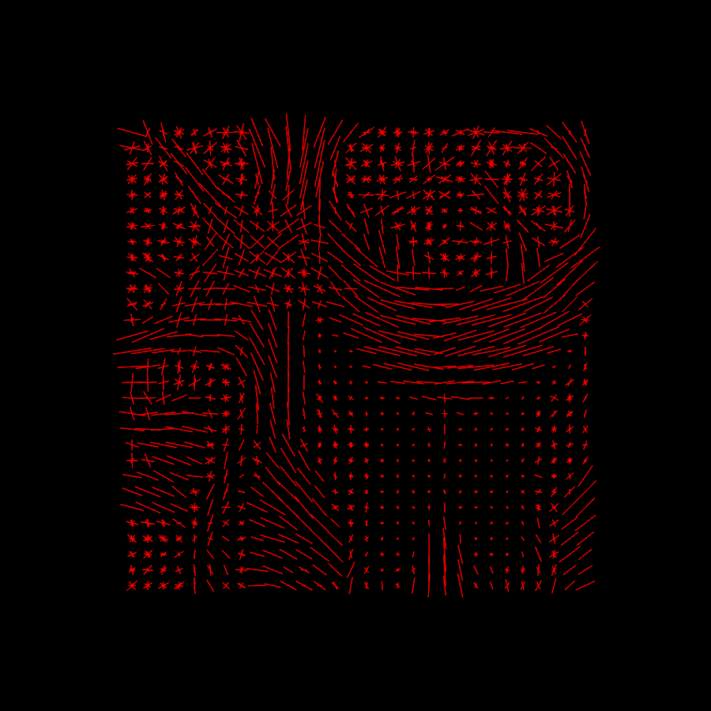
Signal reconstruction
Example of Constrained Spherical Deconvolution (Tournier et al. 2007)
Fiber ODFs Peaks
In Dipy you will find methods for DTI, HARDI (like CSD) and DSI.

Slide 27
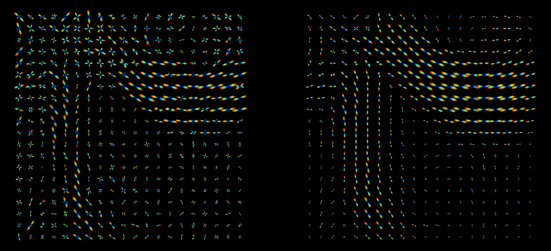
Contextual Enhancement
(5D denoising)
Before After
Remco Duits Lab

Slide 28
Image-based registration (SyN)
Moving
Evolution
Static (Reference)
Symmetric Normalization, Avants 2007
Diffeomorphic
Field
Diffeomorphic Field

Slide 29
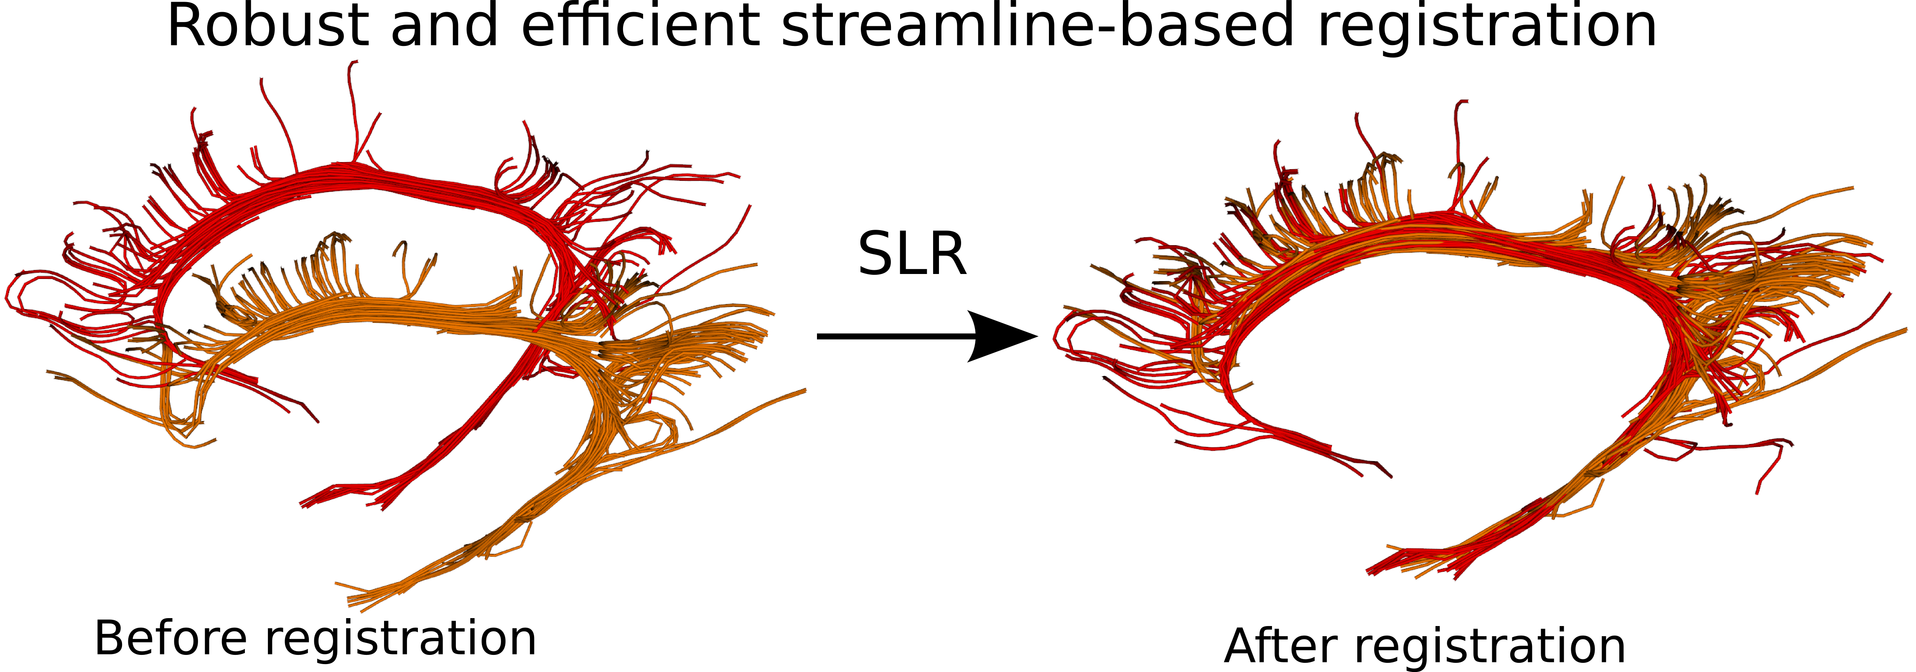
Streamline-based registration
Garyfallidis et al., “Robust and efficient registration of white-matter fascicles in the space of streamlines”, Neuroimage, (under review) 2014.
Garyfallidis et al., "Direct native-space fiber bundle alignment for group comparisons", ISMRM, 2014.

Slide 30
Streamline-based registration
Garyfallidis et al., "Direct native-space fiber bundle alignment for group comparisons", ISMRM, 2014.

Slide 31
Streamline-based registration

Slide 33
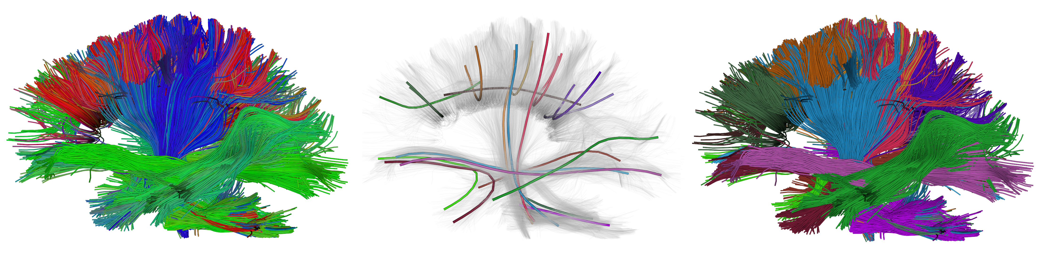
Streamline segmentation
Initial Cluster's Centroids Clusters
Garyfallidis et al. (2013), QuickBundles, Frontiers in Neuroscience

Slide 34
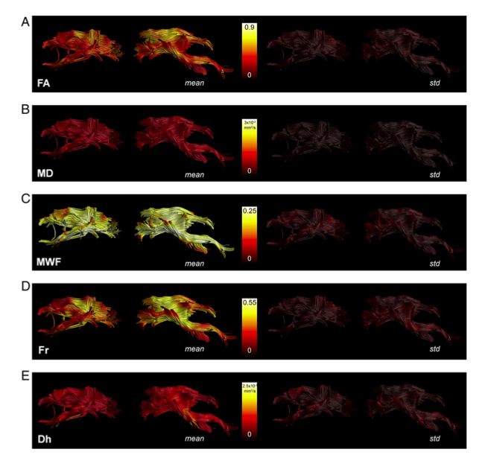
Tractometry
FA₅
FA_{n-1}
FA₄
FA₃
FA₂
FA₁
Bells et al. ISMRM 2012, Assaf et al. Neuroimage 2013,
Catani et al, PNAS 2007, Lebel & Beaulieu HBM 2009, Forkel et al. Brain 2014

Slide 35
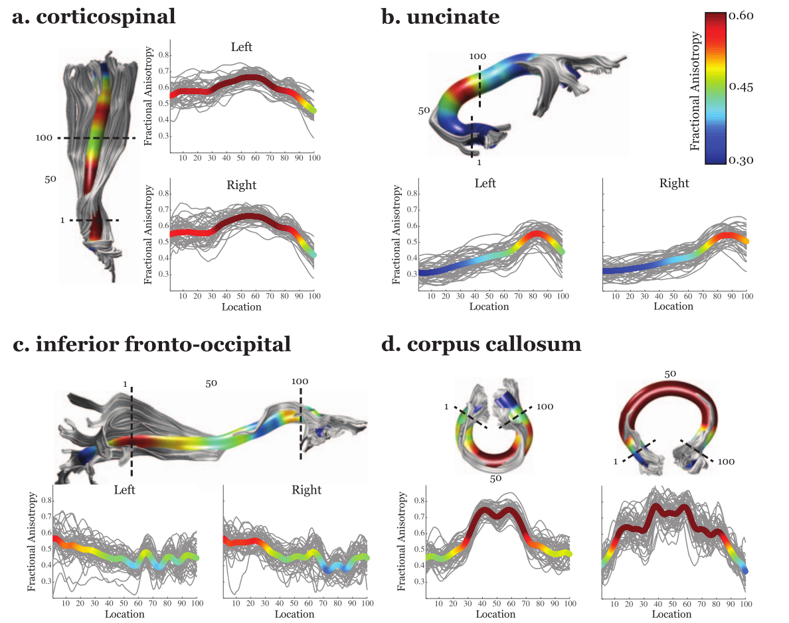
Projections along the length
Yeatman et al., PloS 2010
Yeatman et al. PLoS 2010
Yeatman et al. PLoS 2010
Yeatman et al. PLoS 2010
Yeatman et al. PLoS 2010

Slide 36
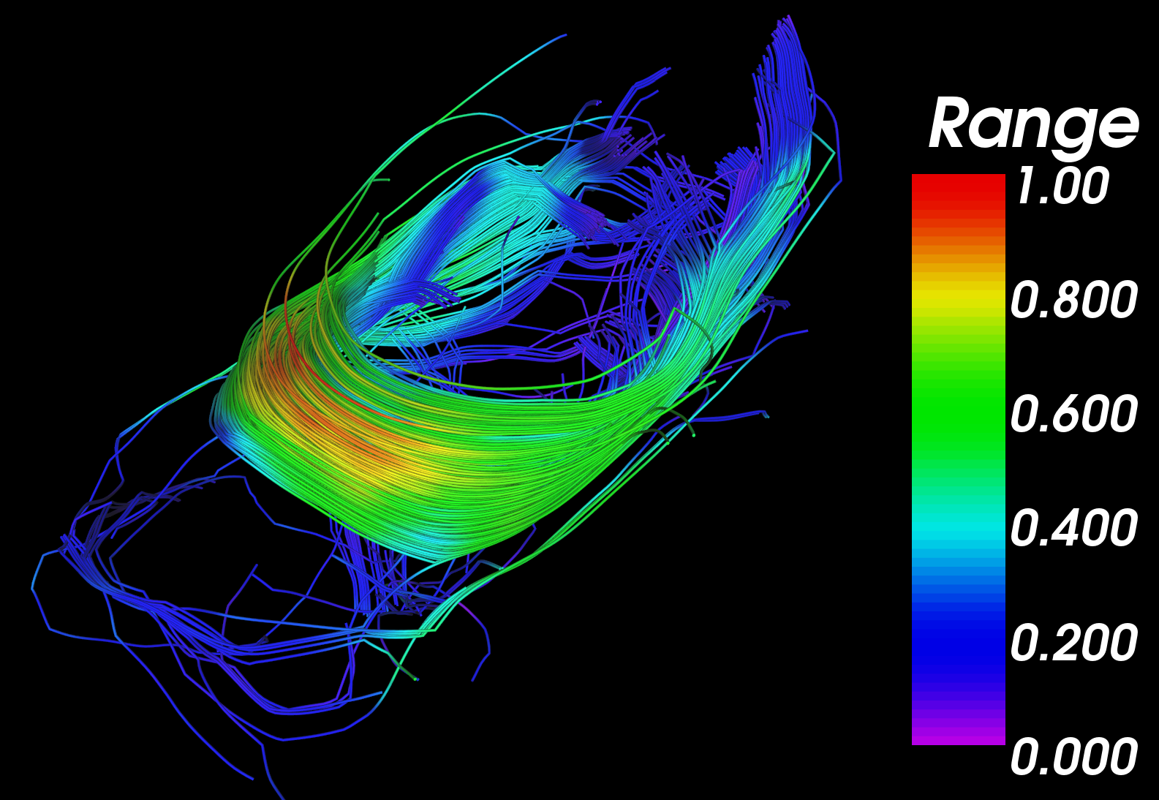
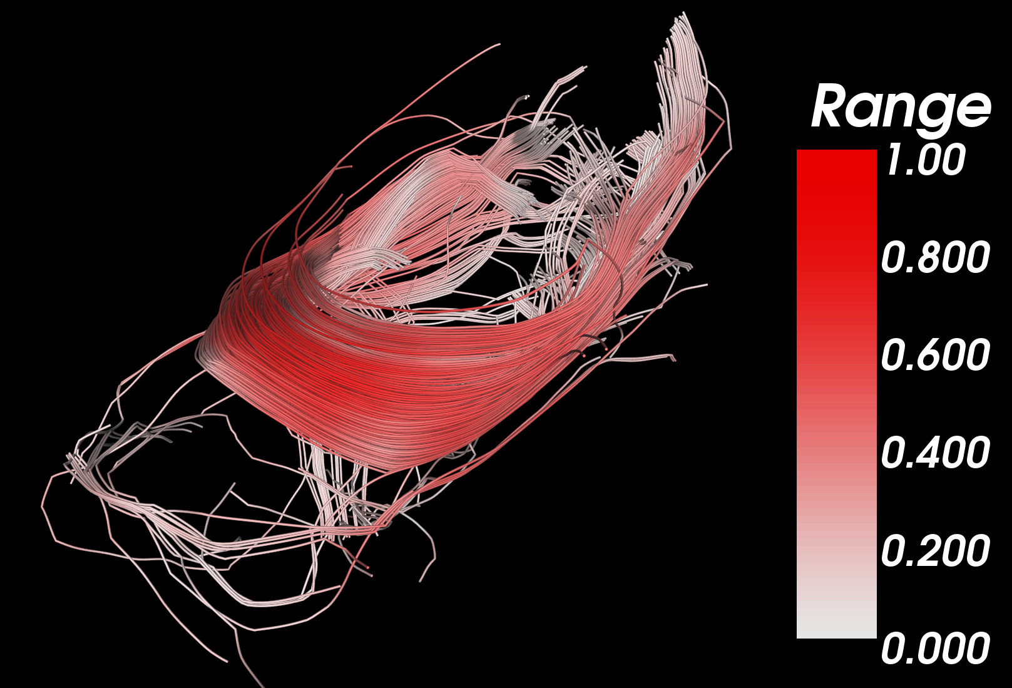

Slide 37
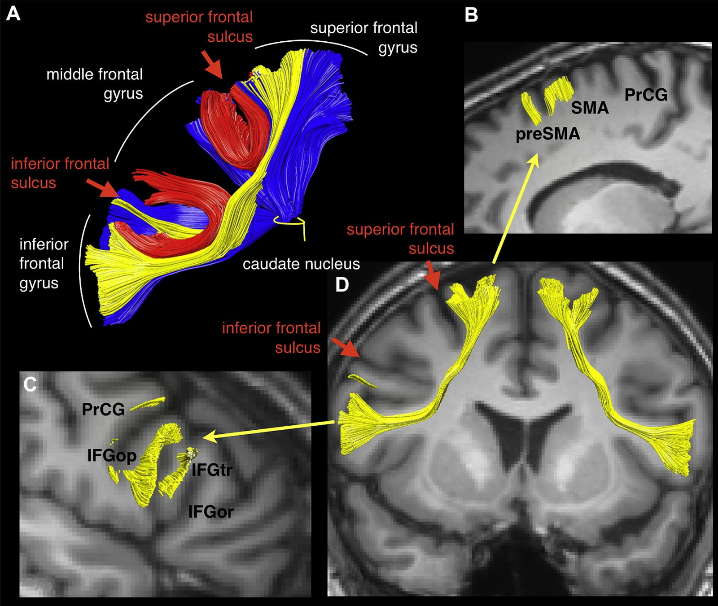
Discover new pathways
A new bundle the “Aslant”
was discovered recently by
Catani et al. (2013)

Slide 38
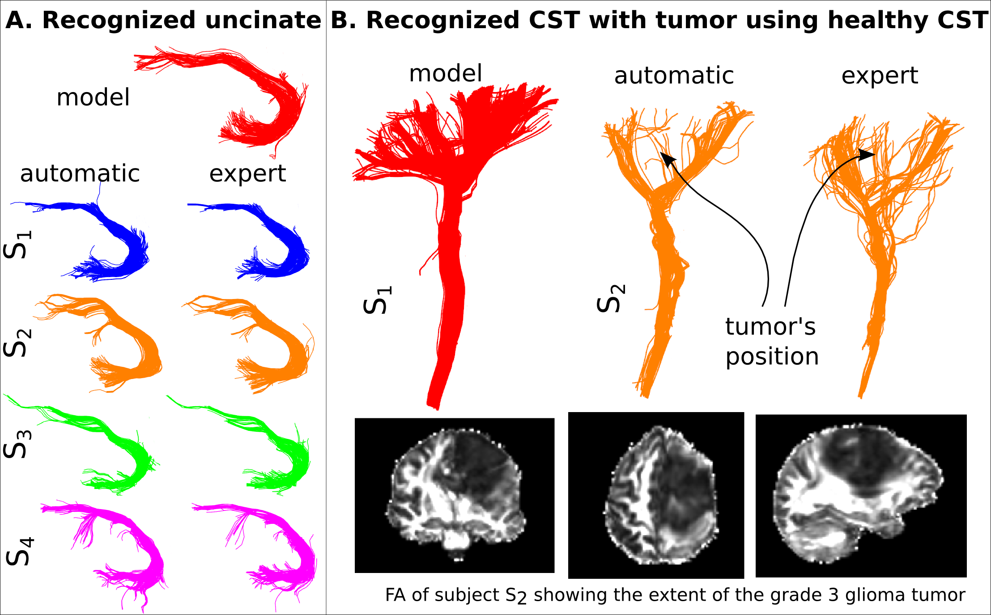
Automatic recognition of bundles
Garyfallidis et al. ISMRM 2015

Slide 39
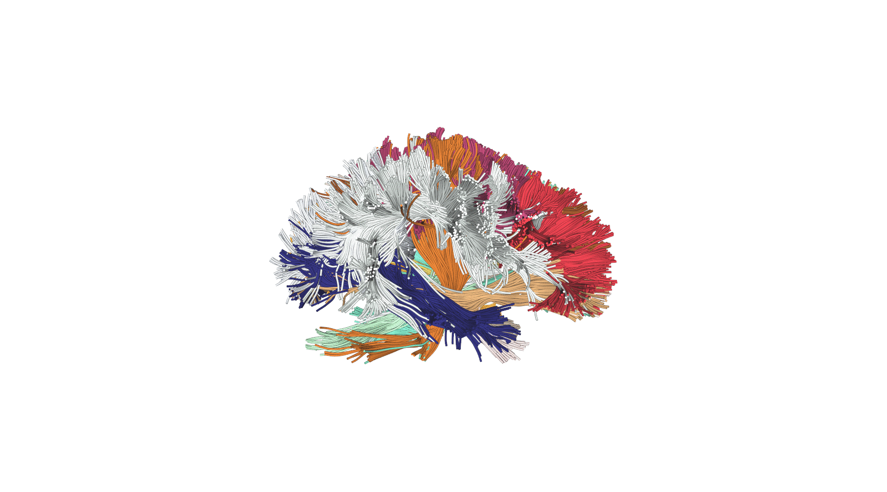
!
This talk and this animation ...
was powered by:
Thank you! :)

Slide 40
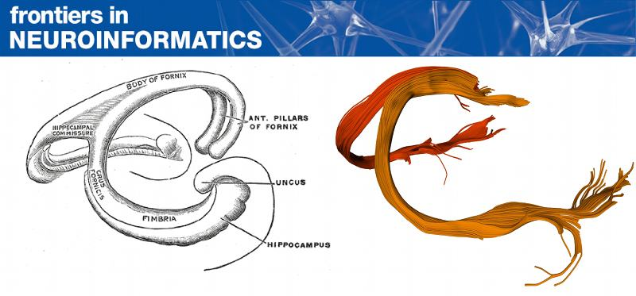
How to learn dMRI
1. Read the paper
2. Read the tutorials
3. Play with existing data or your data
4. Advanced: Fork us on github.com and contribute!
Garyfallidis E. et al. (2014). Dipy, a library for the analysis of diffusion MRI data.
Frontiers in Neuroinformatics, vol.8, no.8.
Go to http://dipy.org/examples_index.html
or dipy/doc/examples
We provide functions which download data for you :)

