Slide 1
Review of seven layers
Application A
Application B
Application
Layer
Application
Layer
Presentation
Layer
Presentation
Layer
Session
Layer
Session
Layer
Transport
Layer
Transport
Layer
Communication Network
Network
Layer
Network
Layer
Network
Layer
Network
Layer
Data Link
Layer
Data Link
Layer
Data Link
Layer
Data Link
Layer
Physical
Layer
Physical
Layer
Physical
Layer
Physical
Layer
Electrical and/or Optical Signals
Figure 2.6

Slide 2
Peer-to-peer protocols
Two communicating entities are called peer processes.
Communication between layer n+1 peers is virtual and is carried by layer n service
Two meanings of peer-to-peer:
point-to-point (hop-by-hop):
end-to-end (user-to-user):
Physical link
network

Slide 3
Peer-to-peer protocols
Protocols and service models
ARQ (Automatic Repeat Request protocol): several ARQs to provide reliable transfer over a network connection or a data link
Other adaptation functions:
  Pacing and flow control
  Synchronization and timing recovery (possible)
  How TCP uses ARQ
Data link layer:
  HDLC (High-level Data Link Control) and PPP (Point-to-Point Protocol)

Slide 4
Peer-to-peer protocols and service models
A service is to sending and receiving information with possible:
  Confirmation, keeping in order, delay limitation and jitter (variation of delay)
A service is described by a model
The features of peer-to-peer protocols:
  Whether packets arrive in order?
  How long for them to arrive?
  Whether they arrive at all?
Two typical peer-to-peer protocols:
  Data link layer → point-to-point protocol
  Transport layer → end-to-end protocol

Slide 5
Peer-to-peer protocol across a single hop
(a)
Packets
Packets
5. deliver to
1. take packets
Data link
Layer
Data link
Layer
network layer
2. form frame
Frames
A
B
3. transfer through
Physical
Layer
Physical
Layer
4. Pass up
Physical layer
(b)
1
1
2
2
1
2
3
2
1
1
2
3
2
1
Medium
2
A
B
1
1
Physical layer entity
Several pairs of data link & physical entities
2
Data link layer entity
3
Network layer entity
Only one network layer entity, a router
may connect several different networks
Figure 5.2

Slide 6
Peer-to-peer protocol operating end-to-end across network
Messages
Messages
Transport
Layer
Segments
Transport
Layer
Network
Layer
Network
Layer
Network
Layer
Network
Layer
Data link
Layer
Data link
Layer
Data link
Layer
Data link
Layer
End system
α
End system
Β
Physical
Layer
Physical
Layer
Physical
Layer
Physical
Layer
Network
Figure 5.3

Slide 7
1. Layer 4 not in middle
C
2.Data go up and down in router
3. Different paths
4. Out of order, delay,
duplicate, lost
1
2
3
2
1
2
2
1
1
End System
α
1
1
1
End System
β
2
2
2
4
3
2
1
1
2
3
2
1
1
2
3
2
1
1
2
3
4
Medium
2
A
B
1
Network
1
Physical layer entity
3
Network layer entity
3
Network layer entity
2
Data link layer entity
4
Transport layer entity
Peer-to-peer protocol operating end-to-end across network
Figure 5.4

Slide 8
Characteristics of data link layer/transport layer
Data Link layer
Transport layer
PDUs along the same path?
YES
Not really
PDUs arrive in order?
YES if no error occur
Not sure
How long it take?
Determined by the geographical distance
Do not know
Arrive at all?
Generally YES, unless link broken
Not guarantee

Slide 9
Service models
Connection-oriented and connectionless
Confirmed and unconfirmed
A service may transfer in constant bit rate ( CBR) or variant bit rate (VBR)
Quality of Service (QoS)
  Level of reliability in probability of error, lost, incorrect delivery
  Transfer delay (fixed, maximum)
  Jitter: the variation of delay

Slide 10
Adaptation functions
Network service
Application
Network
Application
Adaptation
Function
Adaptation
Function
End-to-end application requirements
Arbitrary message size
Reliability and sequencing
Timing
Pacing and flow control
Addressing
Privacy, integrity and authentication
Network service + adaptation functions → application requirements
Figure 5.5

Slide 11
Approaches implementing adaptation functions
Arbitrary message size: segmentation and blocking
Reliability and sequencing: by error-detection coding, automatic retransmission and sequence numbering (so as to provide a reliable sequenced communications over unreliable networks)
pacing & flow control: sliding-window to pace a fast sender with a slow receiver.
Timing: sequence numbering and timestamps for playback in audio/video-on demand applications
Addressing: addressing is needed in order to multiplexing
Privacy, integrity and authentication: security, data encryption and digital signature

Slide 12
End-to-end
Data are ACK or NAK by the other end
ACK/NAK
1
2
3
4
5
Data
Data
Data
Data
Hop-by-hop
Data are ACK or NAK by each hop
Data
Data
Data
Data
1
2
3
4
5
ACK/NAK
ACK/NAK
ACK/NAK
ACK/NAK
Adaptation functions may be implemented end-to-end or hop-by-hop
Figure 5.7

Slide 13
End-to-end versus hop-by-hop (cont.)
Hop-by-hop: faster recovery & more reliable
but more burden on middle nodes
End-to-end: simpler and only at end-system
QUESTIONS:
  could hop-to-hop waivers end-to-end?
  NO. it is difficult for all elements in the hop-by-hop
  chain to operate correctly, furthermore the errors
  may be introduced in middle nodes
--Adaptations are implemented at which layer(s)?
Hop-by-hop:
End-by-End:
Data link & network layer
Transport & application layer

Slide 14
End-to-end versus hop-by-hop (cont.)
In case of error-detection and recovery:
  If frequent errors, use hop-by-hop , otherwise end-to-end
Flow control and congestion control could be exercised on a hop-by-hop or end-to-end basis or both.
Security issue: may be hop-by-hop or end-by-end
  WEP (Wired Equivalent Protocol) in Data Link layer, hop-by-hop
  IPSec (IP security protocol) in Internet layer, hop-by-hop/end-to-end?
  SSL (Secure Socket Layer) in transport layer, end-to-end
  SSH (Secure Shell) in application layer, end-to-end

Slide 15
ARQ (Automatic Repeat Request) protocols
A technique used to ensure accurate delivery of a data stream despite errors during transmission
Form a basis for peer-to-peer protocols
Assume that
  There is a connection between peers
  The channel is error-prone
  A sequence of information blocks for transfer

Slide 16
1.header and CRC (Cyclic Redundancy Check) check bits
2. Information frames (I-frame) and control frames, i.e., ACK,NAK, ENQ frames
3. Assume “wirelike” channel: if frames arrive at all, then in the same order as sent
Objective: delivered to destination without error, duplicate, or out-of order
Information
frames
Error-free
packet
sequence
Packet
sequence
Transmitter
Receiver
Station A
Control frames
Station B
CRC
CRC
Header
Information
packet
Header
Control frame
Information Frame
Basic elements of ARQ
Figure 5.8

Slide 17
Typical ARQ protocols
Assume unidirectional transmission, consider bidirectional transmission later
  Stop-and-wait ARQ
  Go-back-N ARQ
  Selected repeat ARQ
Based on ARQs,
  Sliding-window flow control
  Reliable stream service (TCP preview)
Data link layer protocols
--HDLC (High-level Data Link Control)
--PPP (Point-to-Point protocol)

Slide 18
Stop-and-Wait ARQ
Transmitter sends one frame and waits for acknowledgment
Receiver acknowledges the receiving of the frame
After receiving acknowledgment, transmitter sends the next frame
In case the transmitted frame or returned acknowledgment was lost, the transmitter’s timer will time out, the transmitter resends the frame

Slide 19
Stop-and-Wait ARQ
time
A
One
frame
Another
frame
Another
frame
ACK
ACK
B
Transmitter A sends one frame and waits for acknowledgment
Receiver B acknowledges the receiving of the frame
After receiving acknowledgment, transmitter A sends the next frame
Any Problem with it?
Transmitted frame may lost, the acknowledgment may lost.
How to solve?
Set up timer, when timer times out, resends the frame
Figure 5.9

Slide 20
Using timer to retransmit the frame when a frame or acknowledgement lost
(a) Frame 1 lost or badly garbled
Time-out
time
A
One
frame
Another
frame
The
frame
Another
frame
B
ACK
ACK
(b) ACK lost
Time-out
time
A
One
frame
Another
frame
the
frame
Another
frame
ACK
ACK
ACK
B
Any problem?
Frame was received twice when ACK lost.
How to solve it?
Introduce sequence number (SN) into frame and discard
duplicate frame
Figure 5.9

Slide 21
Timer times out before the ACK comes
time-out
time
A
frame
0
frame
0
frame
1
frame
2
ACK
ACK
B
  Any Problem ?
  A misinterprets duplicate ACKs and frame 1 lost forever
How to solve it?
Including sequence number in ACK too.
Note: the number in ACK will be the SN of
the frame expecting to receive, not received
How many bits for sequence number?
1
Figure 5.10

Slide 22
System state information in Stop-and Wait ARQ
0 1
0 1
0 1
0 1
0 1
0 1
0 1
0 1
S_{last}
R_{next}
R_{next} is # of the frame expected to receive
Timer
S_{last}
Transmitter
Receiver
Station A
R_{next}
Station B
(0,0)
Error-free frame 0
arrives at receiver
(0,1)
Global State:
(S_{last}, R_{next})
ACK for
frame 0
arrives at
transmitter
ACK for
frame 1
arrives at
transmitter
Error-free frame 1
arrives at receiver
(1,0)
(1,1)
Figure 5.11

Slide 23
ENQ frame to expedite the error recovery
When timer times out, if frame is too long, then send ENQ frame
When a station receives ENQ, the station is compelled to retransmit its previous frame
E.g., when B receives ENQ, it retransmit its previous ACK.
(a) Frame 1 lost
Time-out
time
A
frame
0
frame
1
ENQ
frame
1
ACK
1
ACK
1
B
(b) ACK for frame 1 lost
Time-out
time
A
frame
0
frame
1
ENQ
frame
0
ACK
1
ACK
0
ACK
0
B
Is Stop-and Wait ARQ perfect now?
Not yet!
Figure 5.12

Slide 24
Stop-and-Wait is very inefficient
Suppose frames being transferred are 1000 bits long over a channel of speed 1.5megabits/second
Suppose from beginning of transmission to receipt of ACK , time elapses 40 ms (called delay).
40 X 10⁻³ X 1.5 X 10⁶ =60,000 bits can be transferred within 40ms, however only 1000 bits!!
Delay-bandwidth product = bit rate X delay
Examples of Stop-and-Wait: Bisync & Xmodem

Slide 25
Stop-and-Wait Efficiency
Last frame bit enters channel
ACK arrives
First frame bit enters channel
Channel idle while transmitter waits for ACK
t
A
B
t
propagation
First frame bit arrives at receiver
Receiver processes frame and
prepares ACK
Last frame bit arrives at receiver
10000 bit frame @ 1 Mbps takes 10 ms to transmit
If wait for ACK = 1 ms, then efficiency = 10/11= 91%
If wait for ACK = 20 ms, then efficiency =10/30 = 33%

Slide 26
Stop-and-Wait Model
      t₀ = total time to transmit 1 frame
A
t_{proc}
B
t_{prop}
frame
t_{f} time
t_{proc}
t_{ack}
t_{prop}
t
=
2
t
+
2
t
+
t
+
t
bits/info frame
0
prop
proc
f
ack
n
n
bits/ACK frame
=
2
t
+
2
t
+
f
+
a
prop
proc
R
R
channel transmission rate

Slide 27
Delay, Reaction time, RTT, throughput
2t_{prop} is called delay.
2(t_{prop}+t_{proc}) is called reaction time.
RTT: round trip time, i.e.,
  t₀= 2(t_{prop}+t_{proc})+t_{f}+t_{ack}=2(t_{prop}+t_{proc+}+t_{f})
Advised Window Size W: how many bits are allowed to transmitted.
Throughput r: the rate at which the information can be transmitted into the network r < W/RTT.

Slide 28
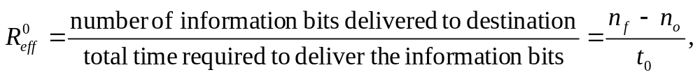
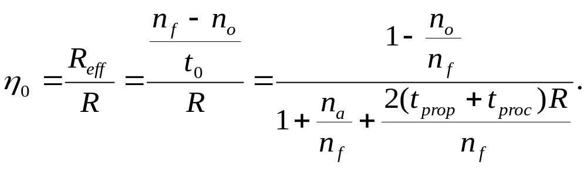
S&W Efficiency on Error-free channel
Effective transmission rate:
bits for header & CRC
Transmission efficiency:
Effect of
frame overhead
Effect of
Delay-Bandwidth Product
Effect of
ACK frame

Slide 29
Example: Impact of Delay-Bandwidth Product
n_{f}=1250 bytes = 10000 bits, n_{a}=n_{o}=25 bytes = 200 bits
2(t_{prop}+t_{proc}) (Distance) | 1 ms (200 km) | 10 ms (2000 km) | 100 ms (20000 km) | 1 sec (200000 km)
1 Mbps | 10³ 88% | 10⁴ 49% | 10⁵ 9% | 10⁶ 1%
1 Gbps | 10⁶ 1% | 10⁷ 0.1% | 10⁸ 0.01% | 10⁹ 0.001%
Stop-and-Wait does not work well for very high speeds or long propagation delays

Slide 30
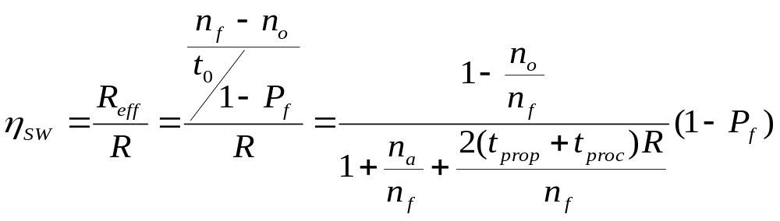
S&W Efficiency in Channel with Errors
Let P_{f} = probability frame arrives with errors
Effect of frame loss
Note: 1/(1-P_{f}) is the average number of transmissions for a frame arrive correctly

Slide 31
Example: Impact Bit Error Rate
n_{f}=1250 bytes = 10000 bits, n_{a}=n_{o}=25 bytes = 200 bits
Find efficiency for random bit errors with p=0, 10⁻⁶, 10⁻⁵, 10⁻⁴
p | 0 | 10⁻⁶ | 10⁻⁵ | 10⁻⁴
1 – P_{f} (1 Mbps) & 1 ms | 1 88% | 0.99 86.6% | 0.905 79.2% | 0.368 32.2%
Bit errors impact performance as n_{f}p approach 1

Slide 32
Go-back-N ARQ
Sends enough frames to keep channel busy and then waits for ACK
ACK to one frame validates all frames ahead of this frame (called accumulated ACK)
If ACK for a frame is not received before time out, all outstanding frames are retransmitted.

Slide 33
Basic Go-back-N ARQ
Go-Back-4:
4 frames are outstanding; so go back 4
fr
0
fr
1
fr
2
fr
3
fr
4
fr
5
fr
6
fr
3
fr
4
fr
5
fr
6
fr
7
fr
8
fr
9
time
A
B
ACK1
ACK2
ACK3
Out-of-sequence frames
ACK4
ACK5
ACK6
ACK7
ACK8
ACK9
error
A sends 0,1,2,3 frames then waits for ACK
ACK1 just comes in time and A sends one more frame: 4
ACK2 and 3 come and A sends frame 5 and 6
Frame 3 lost and no ACK for it
B discards out-of-sequence frame 4,5,6
A exhausts its window (4 frames) and does not receive ACK, so
resends all outstanding frames 3,4,5,6, called Go-back N
Figure 5.13

Slide 34
Time-out expires
Stop-and-Wait
time
fr
0
fr
0
fr
1
A
B
ACK1
error
Go-Back-N
4 frames are outstanding; so go back 4
fr
0
fr
1
fr
2
fr
3
fr
0
fr
1
fr
2
fr
3
fr
4
fr
5
fr
6
time
A
B
ACK1
ACK2
ACK3
ACK4
ACK5
ACK6
Out-of-sequence frames
error
Relationship between Stop-and-Wait and Go-back-N
Figure 5.14

Slide 35
Relationship between Stop-and-Wait and Go-back-N
A frame transmission error results in
  the loss of time equal to the time-out period
  The loss of time corresponding to W_{S} (window size) frames
The receiver is looking for
  A frame with sequence number R_{next}
  A frame with a specific sequence number, denoted as R_{next} too.
The sender retransmits when
  The timer times out
  The window is exhausted
Similarly Denote the oldest outstanding (transmitted but not ACKed) frame as S_{last}
  When window is exhausted, S_{last} and subsequent W_{S} –1 frames are retransmitted
  As long as there is a nonzero probability of error-free transmission, S_{last} will eventually get transmitted without error, the transmission get progressed
  Therefore the protocol will operate correctly

Slide 36
Go-back-N ARQ (cont.)
What wrong with that exhausted window triggers retransmission?
If there are not enough frames, never trigger retransmission
How to solve?
Timer: associate a timer with every transmitted frame
Notations:
S_{last}: the number of last transmitted frame that remains unacknowledged.
S_{recent}: the number of most recent transmitted frame
sender window: from S_{last} to S_{last}+ W_{s} –1, containing outstanding frames
R_{next}: the number of frame the receiver expects to accept
receiver window: containing R_{next} with size 1
Sender window and receiver window will slide whenever a frame transmitted
Successfully, therefore called sliding-window technique

Slide 37
Windows and timers in Go-back-N ARQ
Transmitter
Receiver
Send Window
Receive Window
...
Frames
transmitted
and ACKed
S_{last}
S_{recent}
S_{last}+W_{s}-1
Send window Buffers
frames
received
R_{next}
Timer
S_{last}
Timer
S_{last}+1
The receiver will only accept
a frame that is error-free and
that has sequence number R_{next}
...
Timer
S_{recent}
Then increase R_{next}
...
ACKing R_{next} implies correct
receipt of all previous frames
S_{last}+W_{s}-1
S_{last} is set to R_{next} when an ACK with R_{next} received
Relation: S_{last} <= R_{next} <= S_{recent}
Figure 5.15

Slide 38
Go-back-N ARQ: an ACK will acknowledge all previous frames
Go-Back-4:
S_{last}=0
S_{last}=3
fr
0
fr
1
fr
2
fr
3
fr
0
fr
1
fr
3
fr
4
fr
5
fr
6
fr
7
time
A
B
ACK1
ACK2
ACK3
ACK4
ACK4
ACK5
1. ACK 3 will acknowledge all previous frames, i.e., 0,1,2.
So even ACK 1, 2 lost and retransmitted frame 0,1 lost,
after A receives ACK 3, it retransmits frames beginning from 3.
2. The S_{last} is set to 3 from 0, i.e., R_{next}
Figure 5.13

Slide 39
Window size and number of bits for sequence number
Limited number of bits in header for sequence number
(SN), say m, therefore 2^{m} SNs
SNs must be counted using modulo 2^{m}, e.g., m=3,
then SNs are 0,1,2,3,4,5,6,7,0,1,2,…
How big is the send window size?
<= 2^{m} - 1
Why?
If window size W_{S} is 2^{m}, then it will not work, see example.
Suppose W_{S} = 2^{m} –1 and current window is 0 up to W_{S} – 1.
Assume that frame 0 is received and ACK for frame 0 is lost.
Transmitter only transmits frames up to W_{S} –1.
R_{next} will be in 1 .. W_{S} since at least frame 0 has been received
So retransmission of frame 0 will be recognized as duplicated and ignored

Slide 40
M =2² = 4, Go-Back - 4:
Transmitter goes back 4
fr
0
fr
1
fr
2
fr
3
fr
0
fr
1
fr
2
fr
3
time
A
B
ACK1
ACK2
ACK3
ACK0
Receiver has R_{next}=0, but it does not know whether its ACK for frame 0 was received, so it does not know whether this is the old frame 0 or a new frame 0
M=2²=4, Go-Back-3:
Transmitter goes back 3
fr
0
fr
1
fr
2
fr
0
fr
1
fr
2
time
A
B
ACK1
ACK2
ACK3
Receiver has R_{next}=3 , so it rejects the old frame 0
Window size should be less than 2^{m}
Figure 5.16

Slide 41
NAK message to improve the performance of Go-back-N
NAK: Negative AcKnowledgment
Transmitter goes back to frame 1
Go-Back-7:
fr
0
fr
1
fr
2
fr
3
fr
4
fr
5
fr
1
fr
2
fr
3
fr
4
fr
5
fr
6
fr
7
fr
0
time
A
B
ACK1
NAK1
Out-of-sequence
frames
ACK2
ACK3
ACK4
ACK5
ACK6
ACK7
error
When the receiver receives a out-of sequence frame, it sends back an NAK.
NAK with R_{next} will inform the sender of:
1.all frames up to R_{next} –1 have been received successfully
2. There exists error with frame R_{next}, so the frame need to be retransmitted
3. Frames after R_{next} have been received and discarded
Figure 5.17

Slide 42
More about NAK
NAK will cause the sender to go back and retransmit the lost frame immediately
Generally go back less than W_{S} frames
As a result, the performance will be improved
Only one NAK is allowed for any frame to avoid retransmiting a lost frame multiple times
In case NAK lost, no harm. The timer will do its duty

Slide 43
ACK, NAK, and ENQ
ACK with R_{next}:
acknowledge the receipt of all previous frames and ask to
transmit the frame with sequence number R_{next}
NAK with R_{next}:
acknowledge the receipt of all previous frames and ask to
retransmit the lost frame with sequence number R_{next}
ENQ:
Ask for which frame you want me to transmit, the receiver
of ENQ is compelled to retransmit its previous frame

Slide 44
Go-back-N with bidirectional information flow
Go-back-N algorithm is run in both A and B
Each direction has both I-frames and control frames
Many control frames can be deleted by piggybacking the acknowledgments in the header of I-frames
When a error-free frame is received, the receiver inserts the ACK in its next departing I-frame,
ACK timer: is set to wait for availability of I-frame, if expire, an ACK control frame is sent.
For out-of-sequence frames:
  Examine their ACK part (i.e, R_{next}) to update its S_{last}, then discard.

Slide 45
System parameters in bidirectional Go-back-N ARQ
Station A
Station B
Transmitter
S^{A}_{recent} R^{A} _{next}
Receiver
Receiver
Transmitter
S^{B}_{recent} R^{B} _{next}
S_{recent}, included in headers, is the SN of the current data frame
ACKs are piggybacked in headers
“A” Receive Window
“B” Receive Window
R^{A} _{next}
R^{B} _{next}
“A” Send Window
“B” Send Window
...
...
S^{A} _{last}
S^{A} _{last}+W^{A} _{s}-1
S^{B} _{last}
S^{B} _{last}+W^{B} _{s}-1
Buffers
Buffers
Timer
S^{A} _{last}
Timer
S^{B} _{last}
Timer
S^{A} _{last}+1
Timer
S^{B}_{last}+1
...
...
Timer
S^{A}_{recent}
Timer
S^{B}_{recent}
...
...
S^{A} _{last}+W^{A} _{s}-1
Moreover, ACK timers
Timer
Timer
S^{B} _{last}+W^{B} _{s}-1
Figure 5.18

Slide 46
Required Timeout & Window Size
T_{out}
T_{proc}
T_{prop}
T_{f}
T_{f}
T_{prop}
Timeout value should allow for:
  Two propagation times + 1 processing time: 2 T_{prop} + T_{proc}
  A frame that begins transmission right before our frame arrives : T_{f}
  Next frame carries the ACK: T_{f}
  So T_{out}=2T_{prop}+2T_{f}+T_{proc}
W_{s} should be large enough to keep channel busy for T_{out}

Slide 47
A few words about timers
When to (re)set a timer?
At the time (re)transmitting a frame
When to clear timerS ?
When the ACK for a frame is received
What is relation between timers and SNs, among timers?
Timers have ages and there are correspondences between timers and SNs, all younger
timers do not take effect unless the oldest timer (i.e., the timer of S_{last}) is cleared,
at this time the second oldest timer will take over the responsibility.
Figure 5.19

Slide 48
Examples and problem
Examples:HDLC and V.42 modem standard
Problem: inefficient in case of high error rate because of not only retransmission of frame in error but also retransmission of all subsequent frames
Solution: only retransmit the frame in error,
i.e., selective repeat ARQ

Slide 49
Required Window Size for
Delay-Bandwidth Product
Frame = 1250 bytes =10,000 bits, R = 1 Mbps
2(t_{prop} + t_{proc}) | 2 x Delay x BW | Window
1 ms | 1000 bits | 1
10 ms | 10,000 bits | 2
100 ms | 100,000 bits | 11
1 second | 1,000,000 bits | 101

Slide 50

Efficiency of Go-Back-N
GBN is completely efficient, if W_{s} large enough to keep channel busy, and if channel is error-free
Assume P_{f} is frame loss probability, then the average number of
frame retransmissions is 1/(1-P_{f})
Thus, total average time to deliver a frame is:
=
W
t
t
t
+
P
s
f
GBN
f
f
1
−
P
f
n
−
n
n
f
o
1
−
o
t
n
η
=
GBN
=
f
(
1
−
P
)
GBN
R
1
+
(
W
−
1
)
P
f
s
f
Delay-bandwidth product determines W_{s}

Slide 51
Example: Impact Bit Error Rate on GBN
n_{f}=1250 bytes = 10000 bits, n_{a}=n_{o}=25 bytes = 200 bits
Compare S&W with GBN efficiency for random bit errors with p = 0, 10⁻⁶, 10⁻⁵, 10⁻⁴ and R = 1 Mbps & 100 ms
1 Mbps x 100 ms = 100000 bits = 10 frames → Use W_{s} = 11
Efficiency | 0 | 10⁻⁶ | 10⁻⁵ | 10⁻⁴
S&W | 8.9% | 8.8% | 8.0% | 3.3%
GBN | 98% | 88.2% | 45.4% | 4.9%
Go-Back-N significant improvement over Stop-and-Wait for large delay-bandwidth product
Go-Back-N becomes inefficient as error rate increases

Slide 52
Selective repeat ARQ
The receive window is made larger than one frame so that the out-of-order but error free frames can be kept, not discarded
Retransmission mechanism is modified so that only individual frames are retransmitted, not entire frames in send window

Slide 53
Selective repeat ARQ (cont.)
Transmitter
Receiver
Receive Window
Send Window
...
Frames
transmitted
and ACKed
S_{last}
S_{recent}
S_{last}+W_{s}-1
Frames
received
R_{next}
R_{next} +W_{r}-1
Send Buffers
Receive Buffers
Timer
S_{last}
R_{next}+1
Timer
S_{last}+1
R_{next}+2
...
...
Timer
S_{recent}
R_{next}+W_{r}-1
...
S_{last}+W_{s}-1
W_{R}: size of receive window
Figure 5.20

Slide 54
Error recovery in selective repeat ARQ
fr
0
fr
1
fr
2
fr
3
fr
4
fr
5
fr
6
fr
2
fr
7
fr
8
fr
9
fr
10
fr
11
fr
12
time
A
B
ACK1
ACK2
NAK2
ACK2
ACK2
ACK2
ACK7
ACK8
ACK9
ACK10
ACK11
ACK12
error
Retransmit a frame when the frame’s timer times out or a NAK
for the frame is received
R_{next} may increase more than one due to the out-of-sequence frames
following R_{next} may have been received and buffered by receiver
Figure 5.21

Slide 55
Timers and window size in selective repeat ARQ
Is there any relation between timers and SNs, among timers?
NO, there is no clear correspondence between timers and SNs.
There is no much meaning talking about ages of timers.
How about the window size?
Suppose m bits for SN, then W_{S} <= 2^{m-1}, of course, W_{R} <= 2^{m-1}, so generally select W_{S} = W_{R} = 2^{m-1}

Slide 56
M=2²=4, Selective Repeat: Send Window = Receive Window = 3
Frame 0 resent
fr
0
fr
1
fr
2
fr
0
time
A
B
ACK1
ACK2
ACK3
Receive Window
{3,0,1}
Send Window = Receive Window = 2
Frame 0 resent
time
fr
0
fr
1
fr
0
A
B
ACK1
ACK2
frame 0 rejected
Receive Window
{2,3}
Maximum window size in Selective Repeat ARQ
Figure 5.22

Slide 57
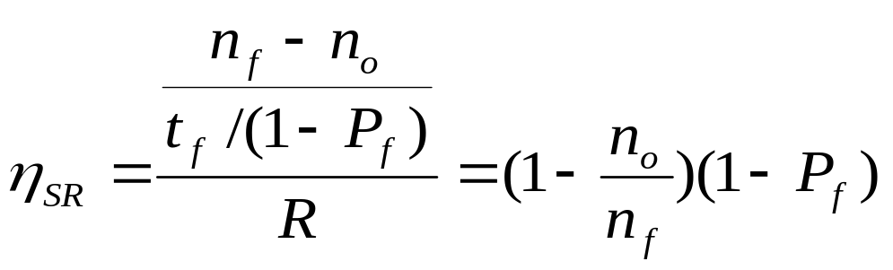
Efficiency of Selective Repeat
Assume P_{f} frame loss probability, then the average number of retransmissions is 1/(1-P_{f}),
so the average transmission time for deliver a frame successfully is:
t_{SR}=t_{f} /(1-P_{f})

Slide 58
Example: Impact Bit Error Rate on Selective Repeat
n_{f}=1250 bytes = 10000 bits, n_{a}=n_{o}=25 bytes = 200 bits
Compare S&W, GBN & SR efficiency for random bit errors with p=0, 10⁻⁶, 10⁻⁵, 10⁻⁴ and R= 1 Mbps & 100 ms
Efficiency | 0 | 10⁻⁶ | 10⁻⁵ | 10⁻⁴
S&W | 8.9% | 8.8% | 8.0% | 3.3%
GBN | 98% | 88.2% | 45.4% | 4.9%
SR | 98% | 97% | 89% | 36%
Selective Repeat outperforms GBN and S&W, but efficiency drops as error rate increases

Slide 59
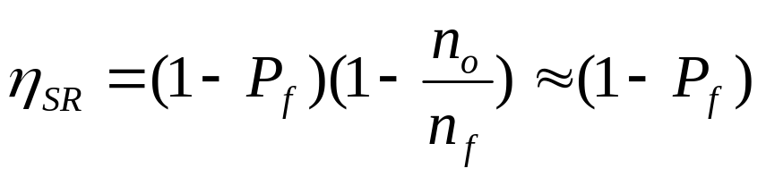
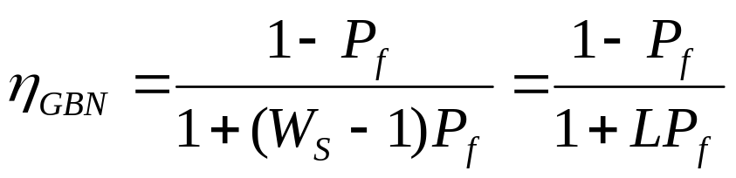
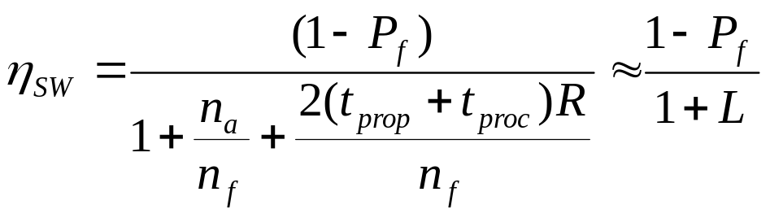
Comparison of ARQ Efficiencies
Assume n_{a} and n_{o} are negligible relative to n_{f}, and
L = 2(t_{prop}+t_{proc})R/n_{f} =(W_{s}-1), then
Selective-Repeat:
Go-Back-N:
For P_{f}≈0, SR & GBN same
For P_{f}→1, GBN & SW same
Stop-and-Wait:

Slide 60
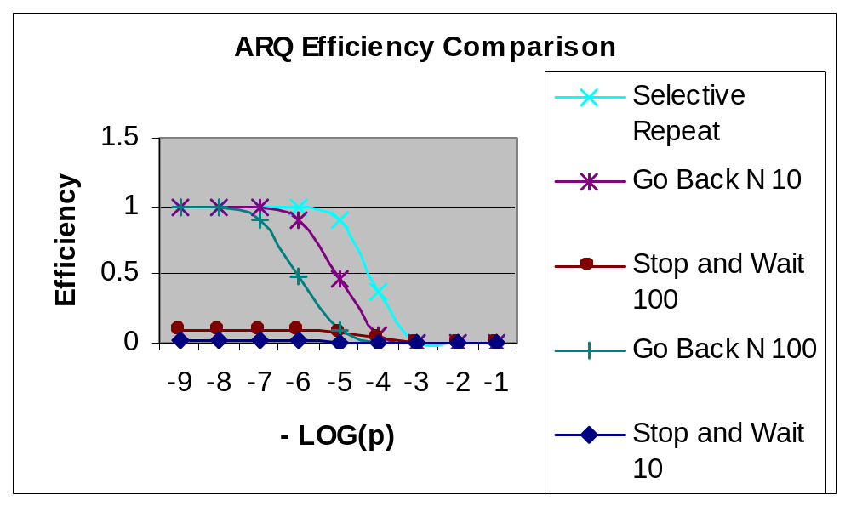
ARQ Efficiencies
10⁻⁹ 10⁻⁸ 10⁻⁷ 10⁻⁶ 10⁻⁵ 10⁻⁴ 10⁻³ 10⁻² 10⁻¹
p
Delay-Bandwidth product = 10, 100

Slide 61
Examples and a few words about ARQ
TCP (Transmission Control Protocol) in the Internet and SSCOP (Service Specific Connection Oriented Protocol) in ATM networks use Selective Repeat ARQ.
Properties of ARQ:
  Simplicity
  Very efficient for clean channels
  Adaptive to various tough channels and very robust
Approaches in ARQs
  ACK, timer (sender timer, ACK timer), retransmission, SN, ENQ, NAK, Piggbacking.
  sliding-window, windows size, timer value
  Adaptive timer value, window size,
Could you implement ARQs?
  A good reference is Tanenbaum’s book.

