Slide 1
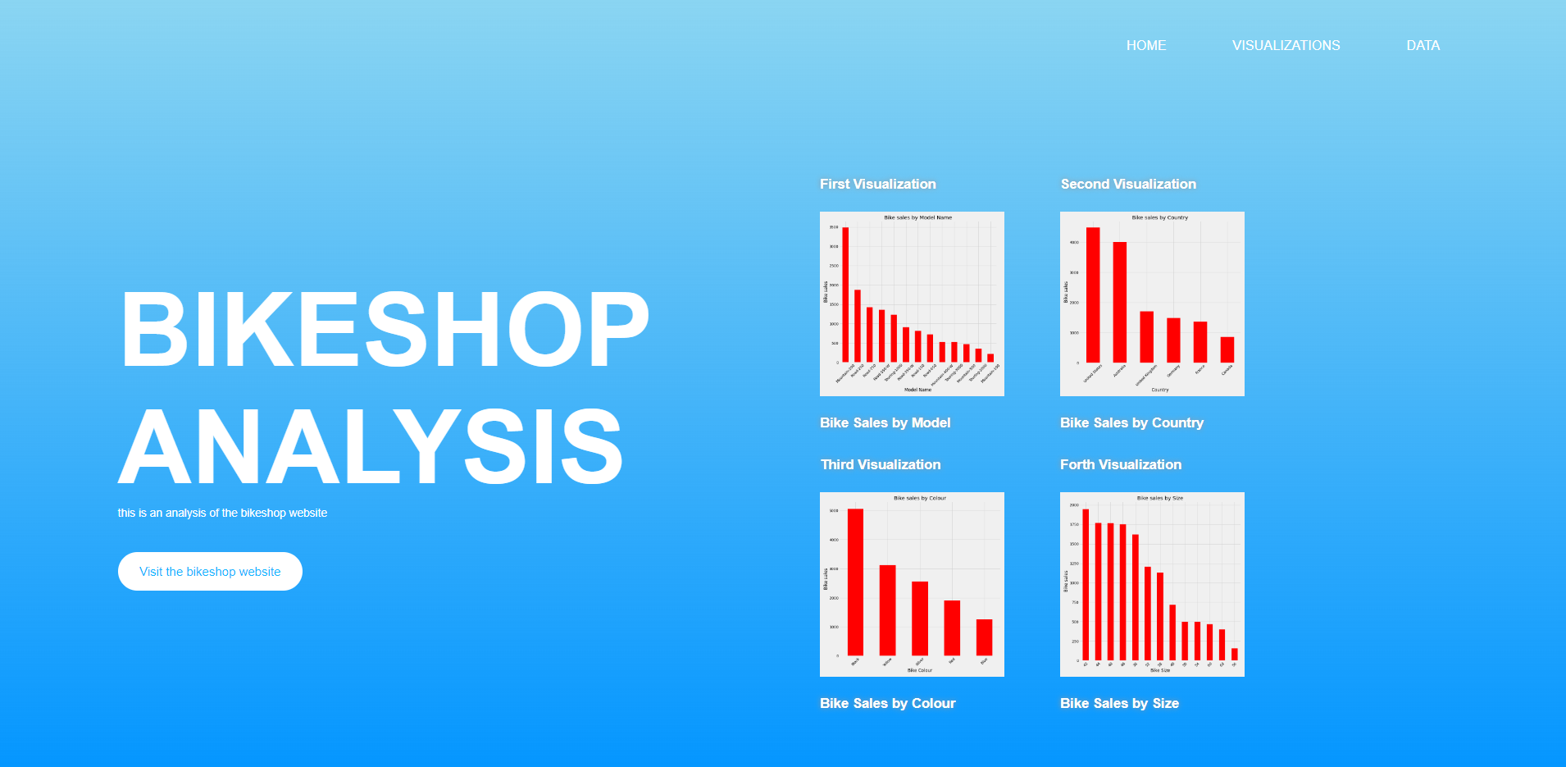

Slide 2
Project 3
Financial Root
Advise to owner on shop
Make better business decisions
Idea of which products are the best
Returned data info
Customers data for marketing

Slide 3
Which bike to invest in?
Data showing
Size of bikes
Color
Model
Countries

Slide 4
The 8 tables we have Loaded are:
AdventureWorks_Calendar
AdventureWorks_Customers
AdventureWorks_Products
AdventureWorks_Returns
AdventureWorks_Sales_2015
AdventureWorks_Sales_2016
AdventureWorks_Sales_2017
AdventureWorks_Territories

Slide 5
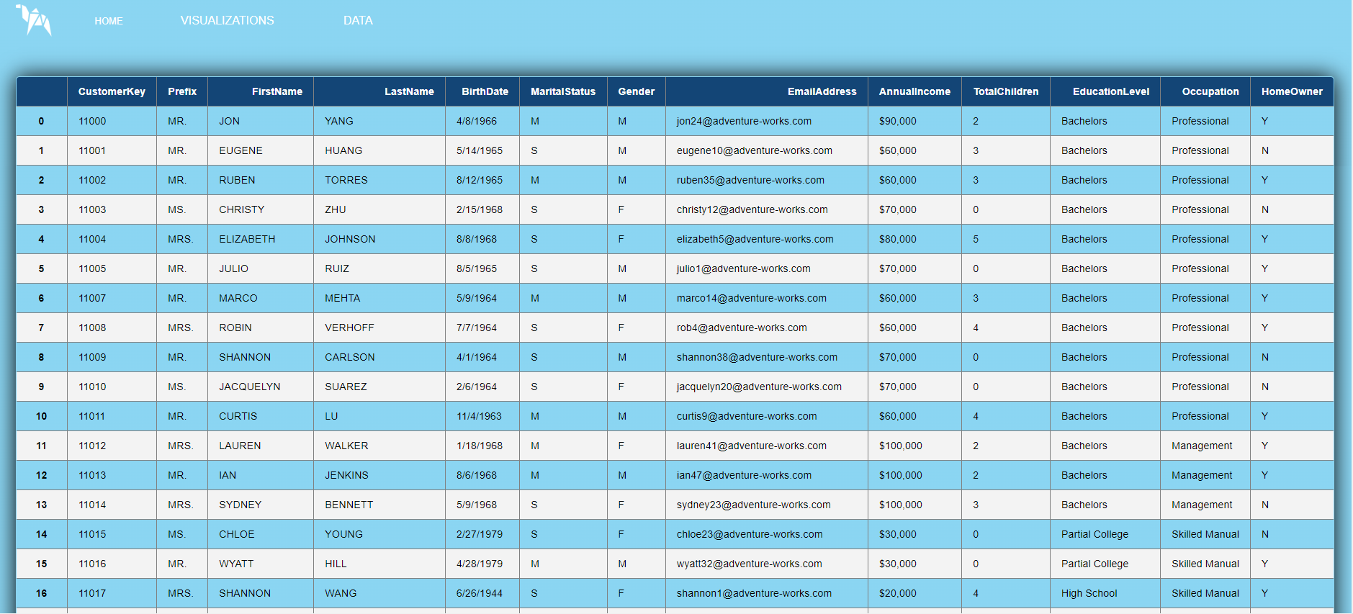

Slide 6
ETL process
Extracting the CSV files and sorting
Transform for upload
Making connection to engine
Queries from engine

Slide 7
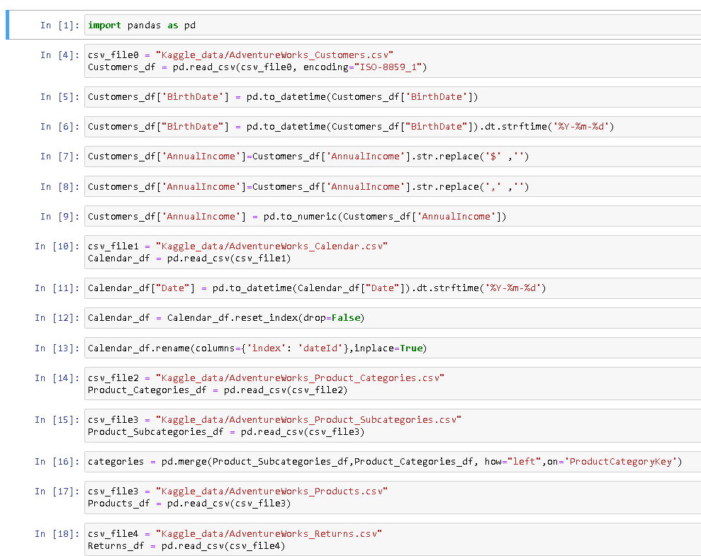
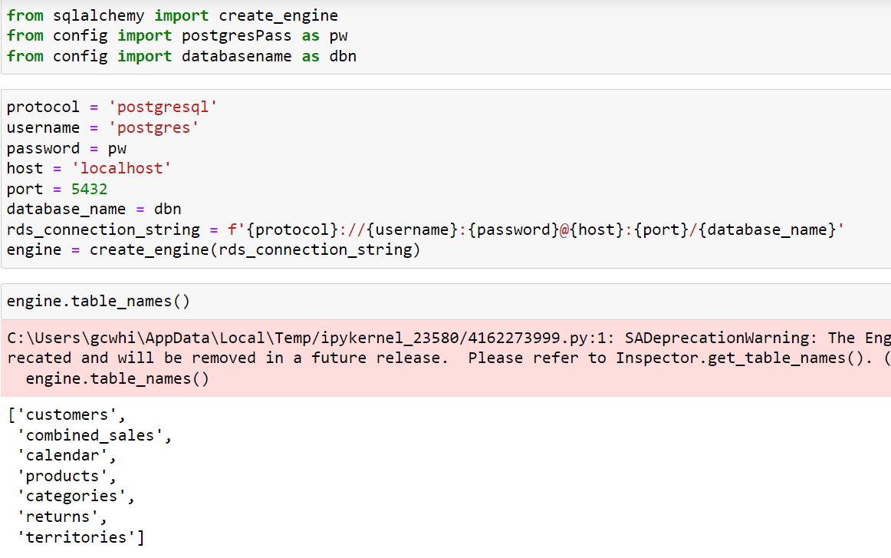
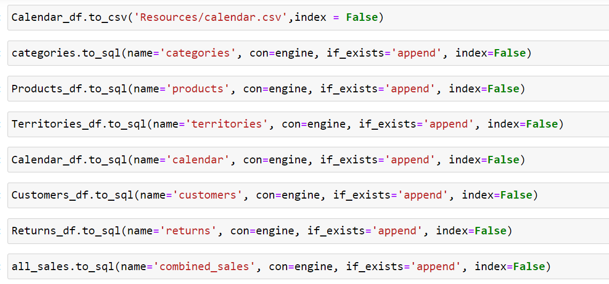

Slide 8
ETL process
Next process…
Creating plots from queries
Converting plots for web page
Formatting plots so work on web page
Design of web page

Slide 9
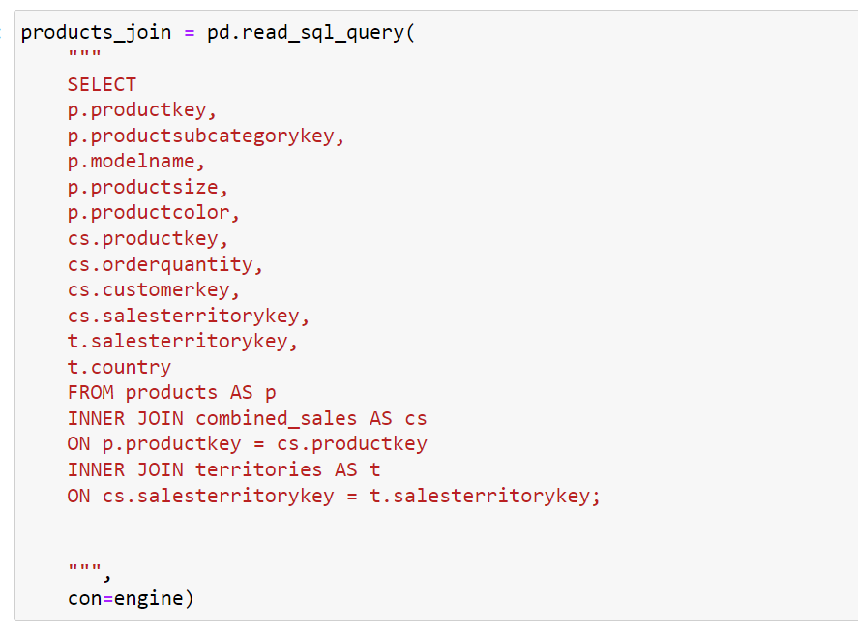
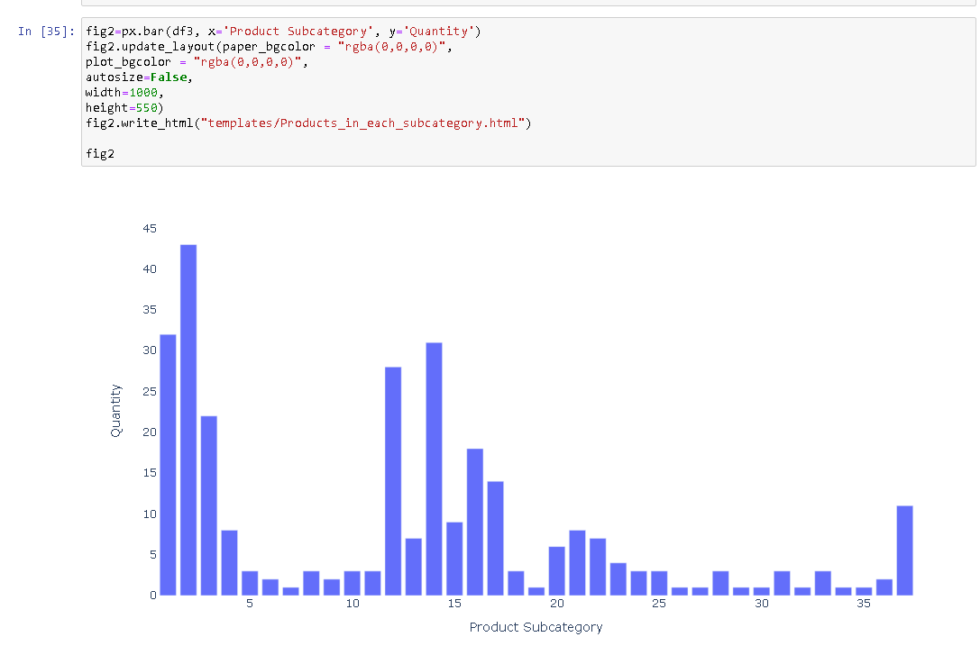

Slide 10
WEBSITE DEMO

Slide 11
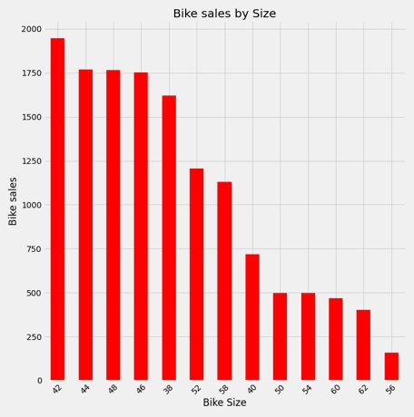
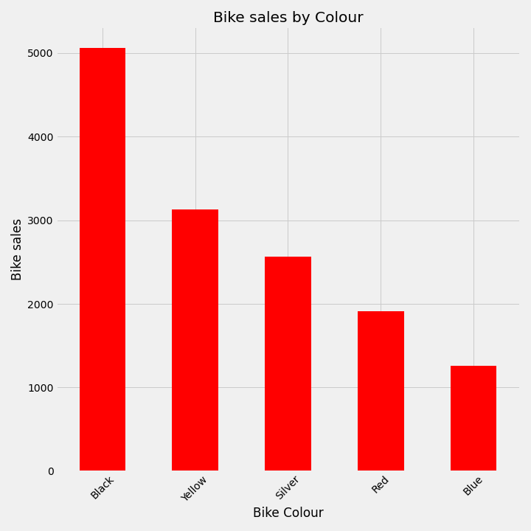
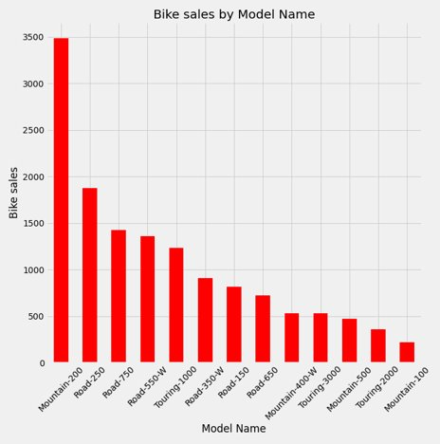

Slide 12
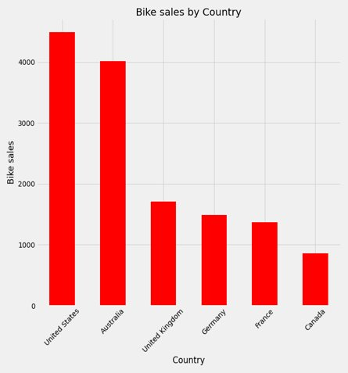

Slide 13
THANK YOU
Any Questions?

