Slide 1
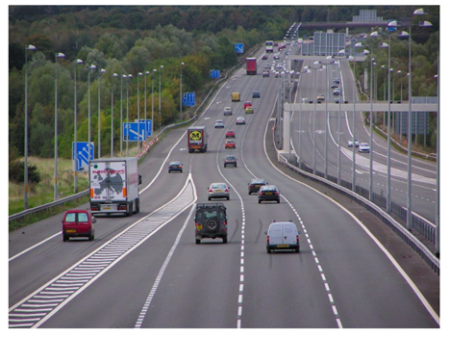
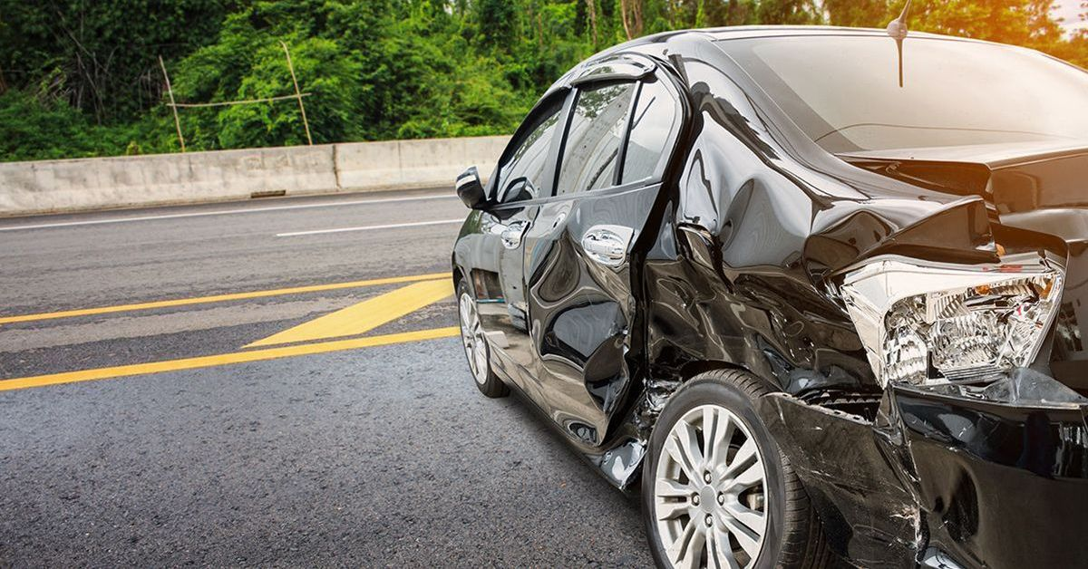
Which factors contribute to accident risk?

Slide 2
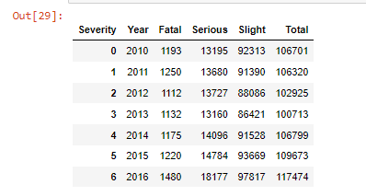
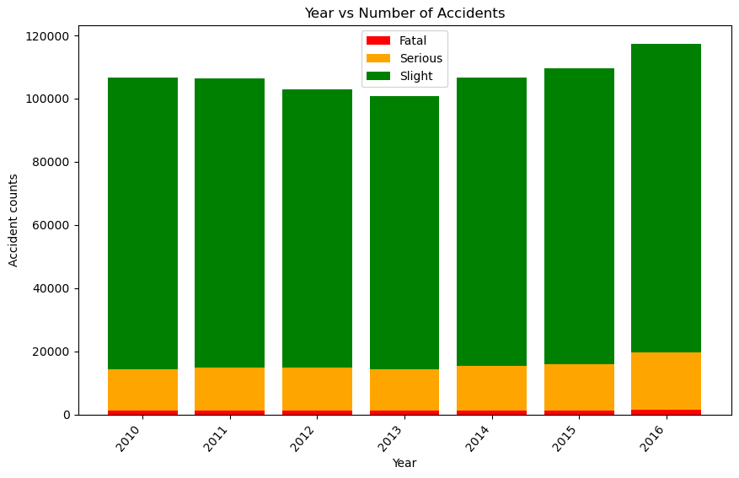
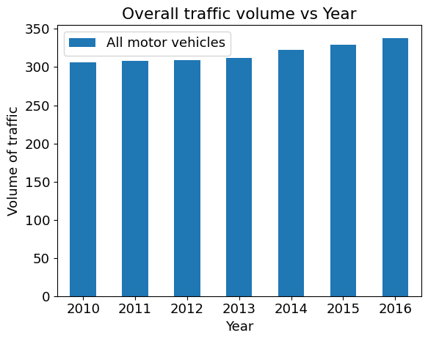
Is it volume of traffic?
Hypothesis 1: Greater volume of traffic increases the number of accidents

Slide 3
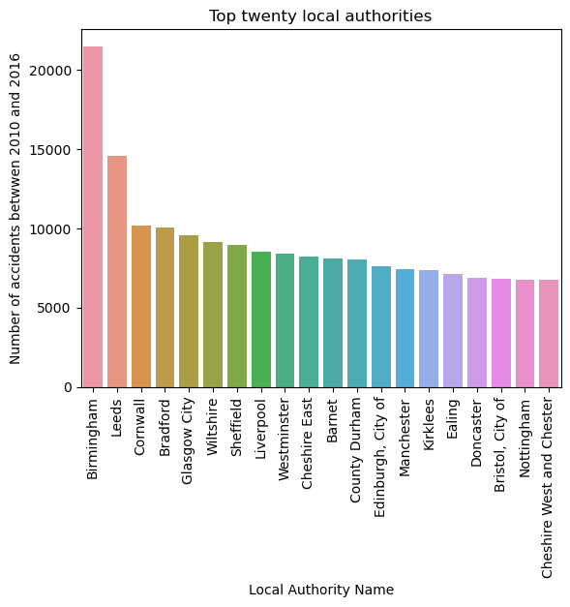
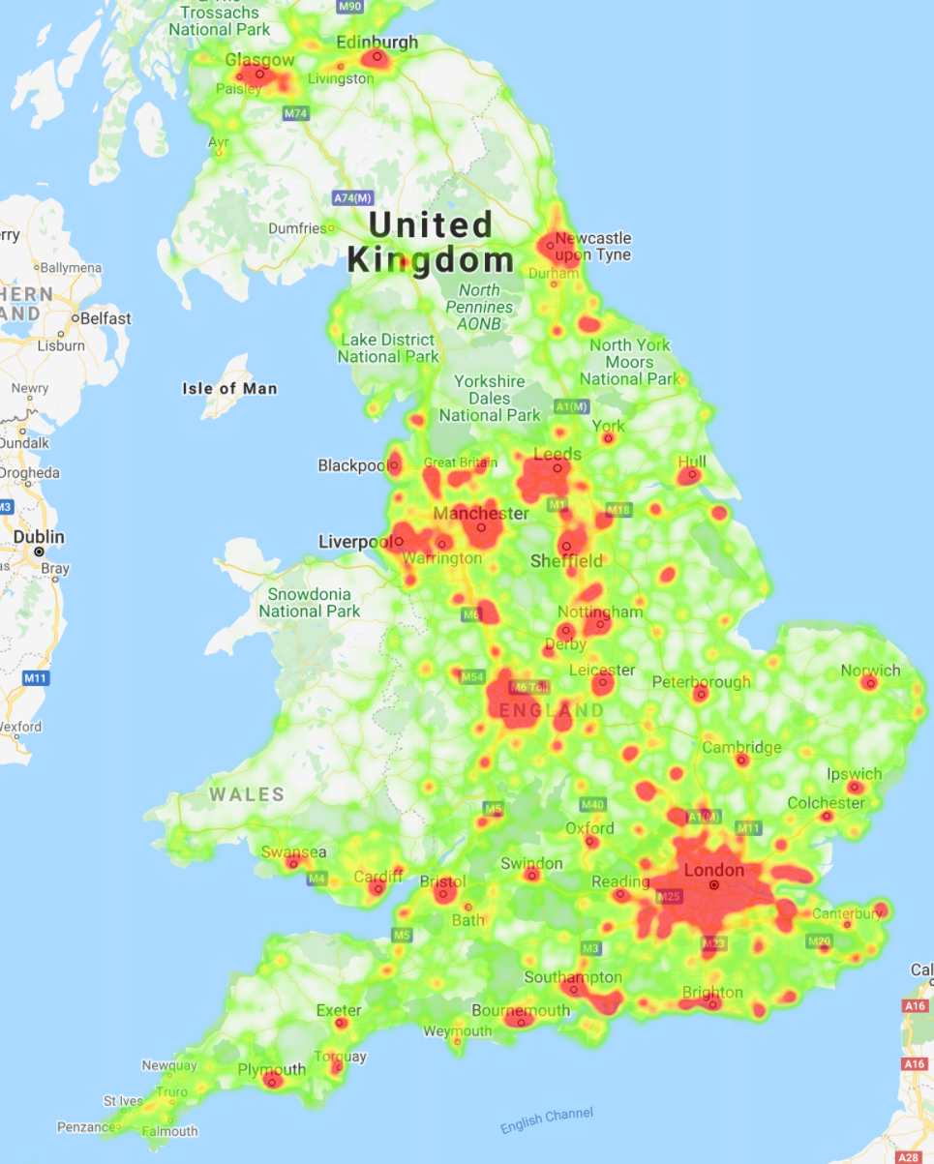
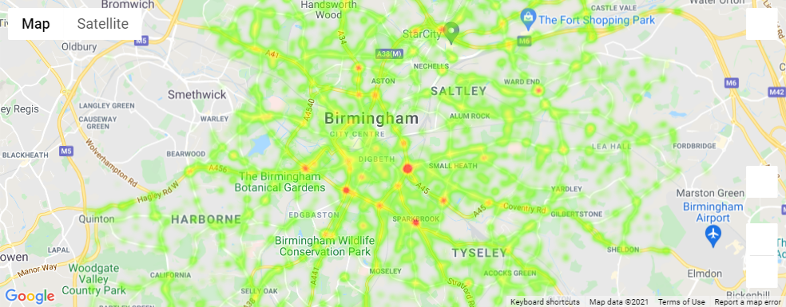
Is it where you are?
Hypothesis 2: Urban areas have a greater number of accidents than rural areas

Slide 4
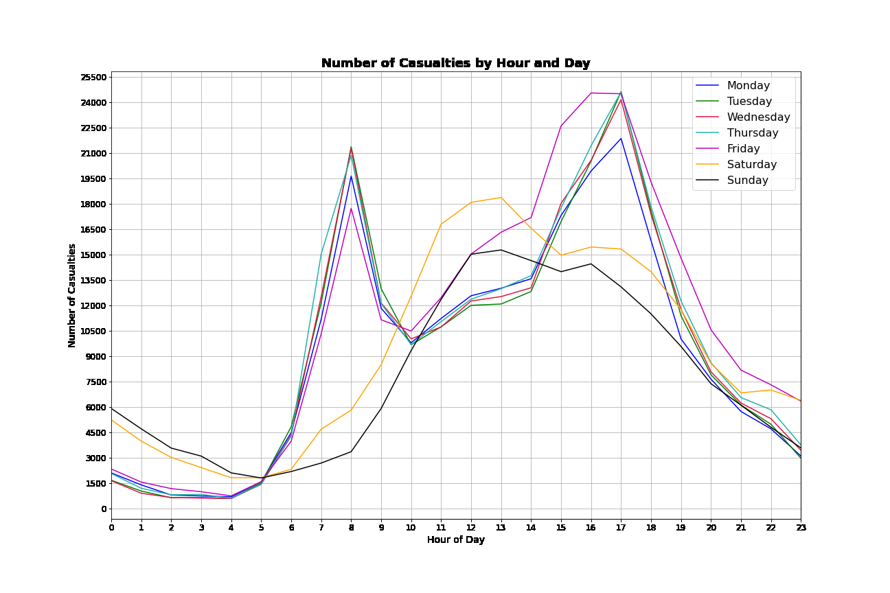
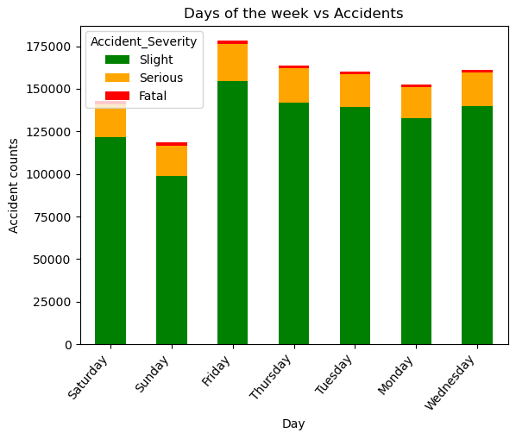
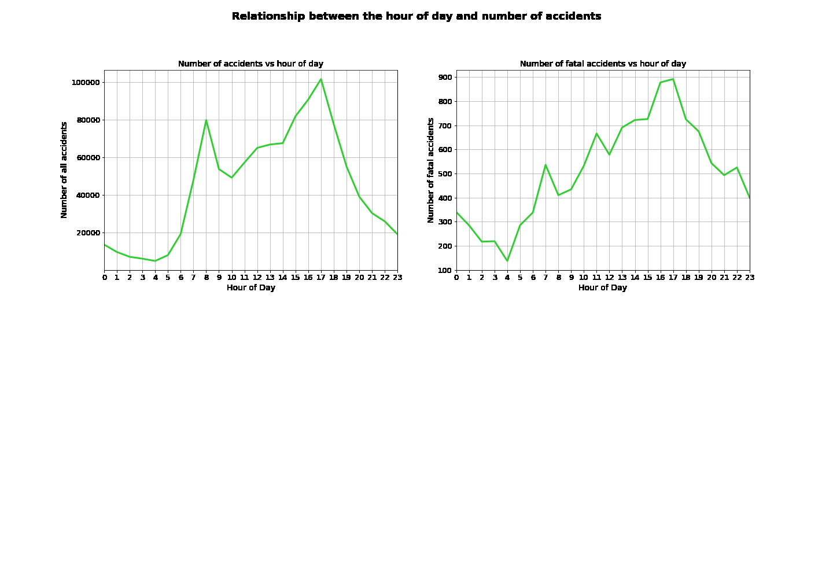
Is it the time of day, or the day of the week?
Hypothesis 3: The time or day of the week does not affect the number of accidents

Slide 5
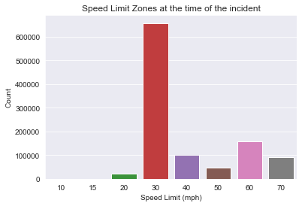
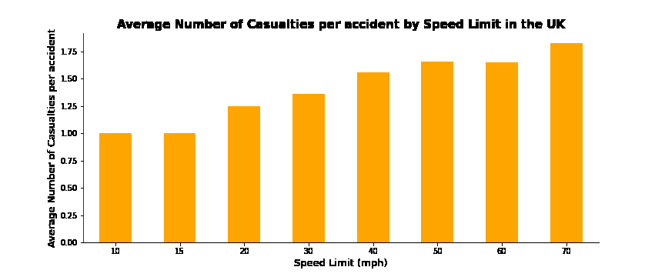
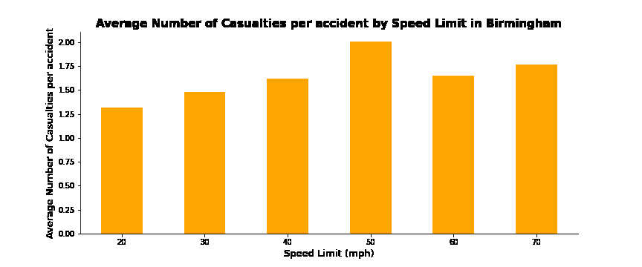
Is it the speed limit in force?
Hypothesis 4: Speed limits do not influence the number of accidents

Slide 6
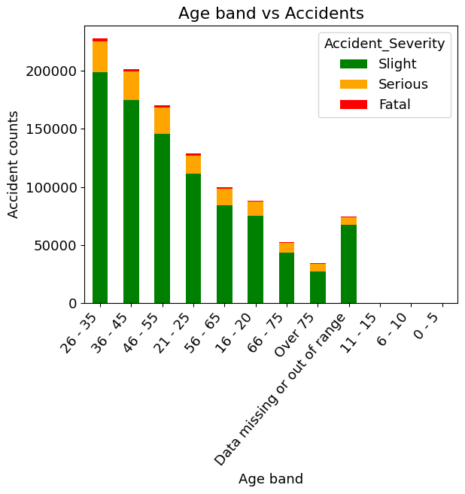
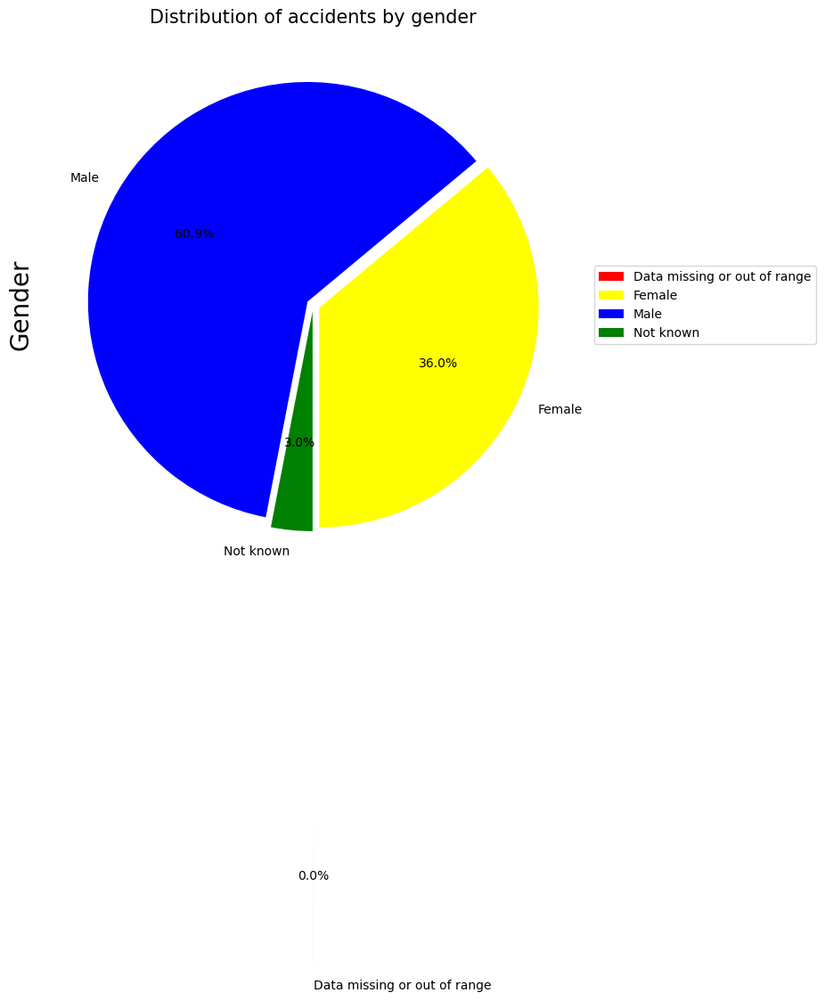
Is it the gender or age of the driver?
Hypothesis 5: Biological factors like gender and age do not influence the number of accidents

Slide 7
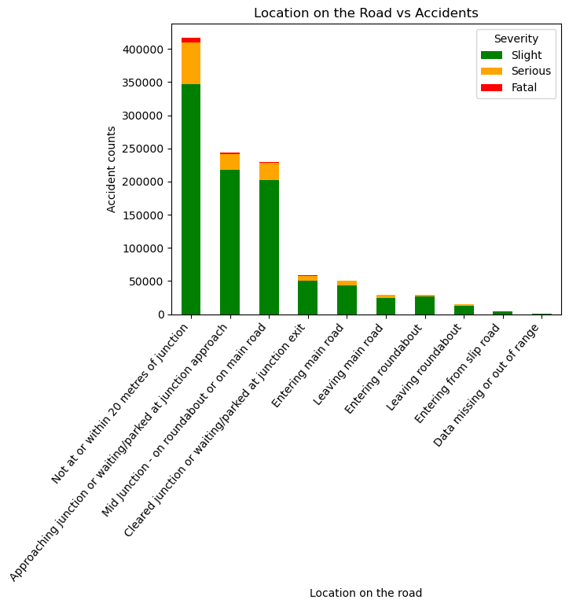
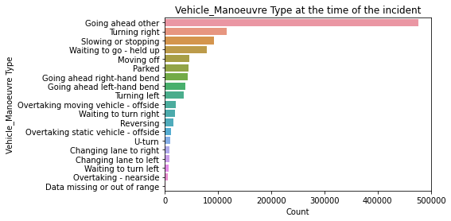
Is it the manoeuvre or the location on the road?
Hypothesis 6: Location on the road or vehicle manoeuvre does not influence the number of accidents

Slide 8
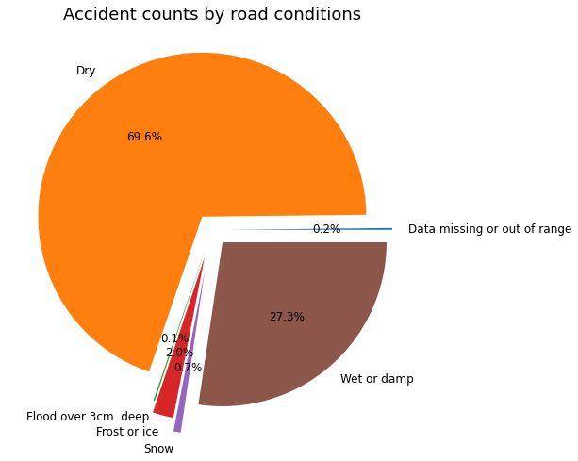
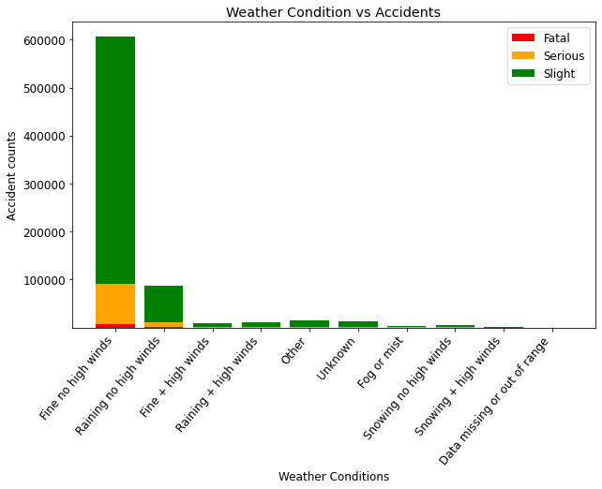
Or Is it the weather or road conditions?
Hypothesis 7: Poor weather conditions influence the number of accidents

