Slide 1
INTERNAL PRODUCT UPDATE
Sourcing Agent
A production AI sourcing platform for LinkedIn Recruiter and GitHub.
Built internally. Used today.

Slide 2
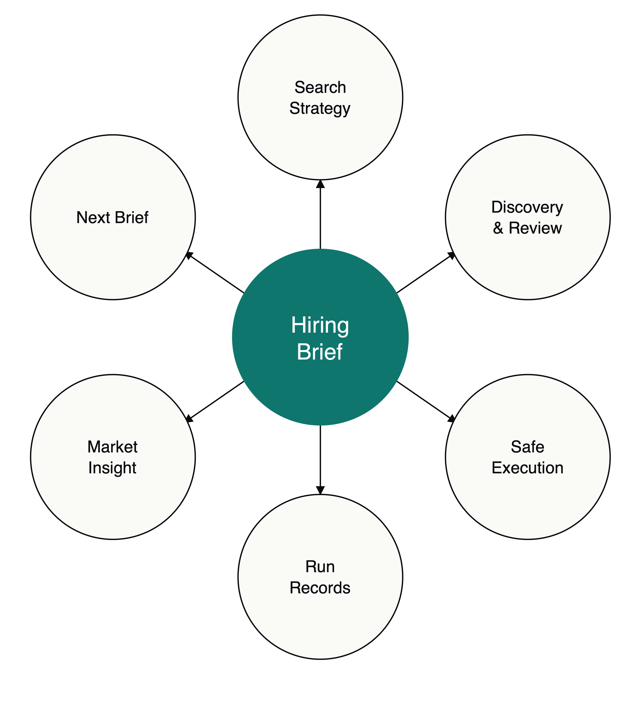
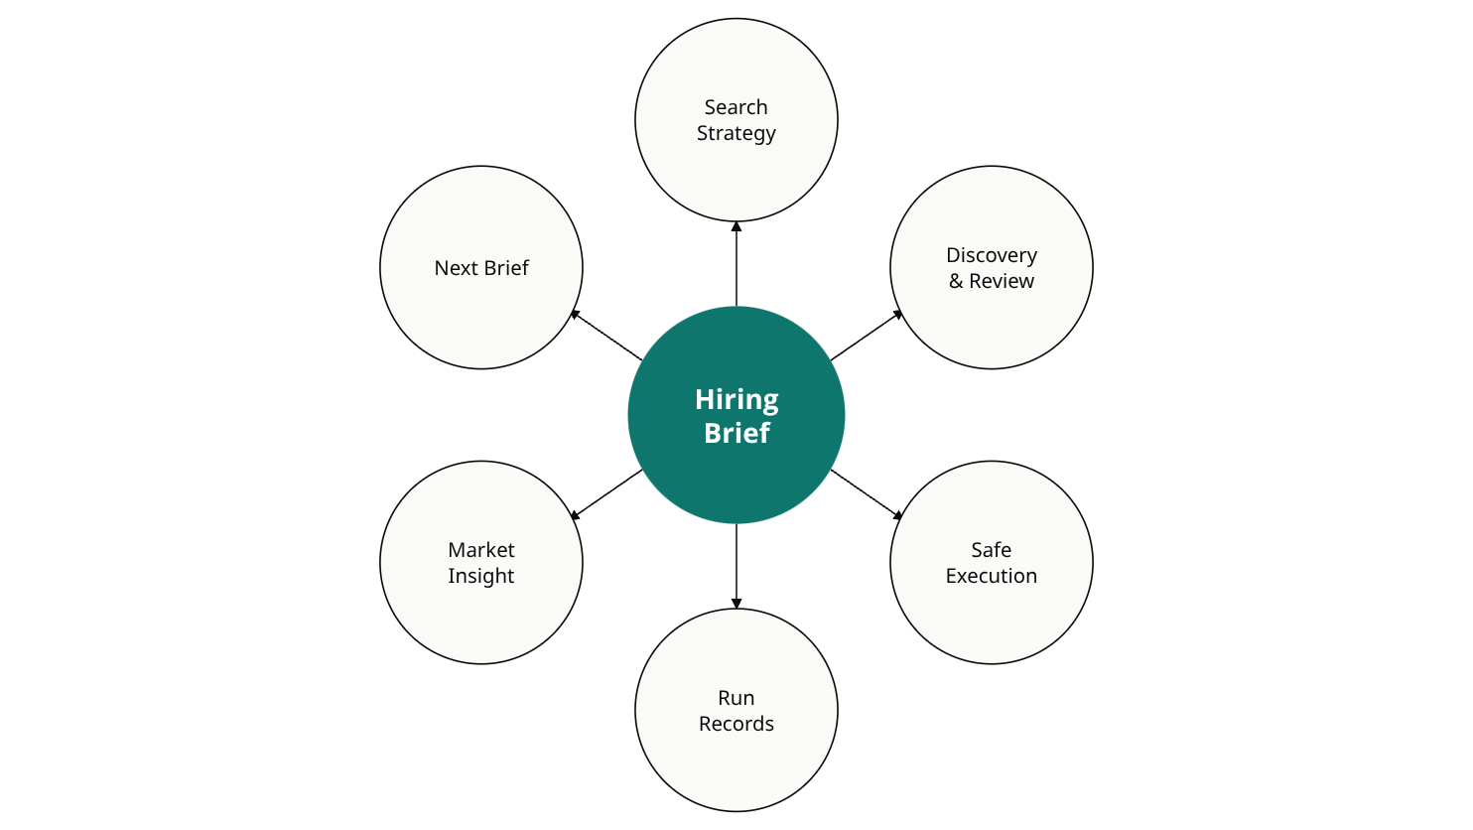
PRODUCT OVERVIEW
What it is
Sourcing Agent turns a hiring brief into full sourcing execution, across LinkedIn Recruiter and GitHub, using the same recruiter judgment a strong sourcer would apply by hand.
The hiring brief is the center of the system. It captures what the team actually needs, where the yes/no line sits, and what kinds of evidence matter. From that one brief, Sourcing Agent drives:

Slide 3
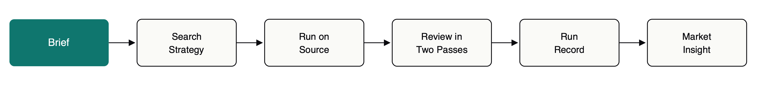
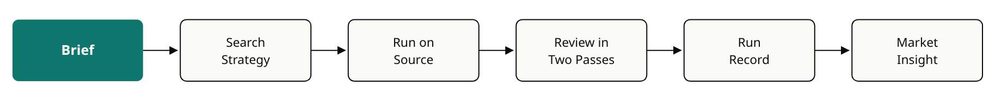
HOW IT WORKS
How a run works
Every sourcing run follows the same six steps. Each step is repeatable, reviewable, and safe to pause or resume.
01
02
Load the hiring brief
Build a search strategy
Normalize its judgment, priorities, and filters for the source.
Tailored to the source — LinkedIn or GitHub.
03
04
Run the search
Review candidates in two passes
LinkedIn inside Recruiter, GitHub through its API.
A quick scan first, a deeper read on the promising ones.
05
06
Capture every run
Feed what the run learned
As a clean, reviewable record.
Into market insight, and optionally into the next version of the brief.

Slide 4
WHAT MAKES IT DIFFERENT
Why it works
Sourcing Agent is built like a real internal product, not a script with AI bolted on. Five things make it hold up:
Judgment is captured, not improvised.
Review is staged.
Search gets smarter as it runs.
A fast first pass filters out obvious misses before any deeper work, so effort goes where the signal is.
The hiring brief encodes what good looks like, so every run evaluates candidates against the same standard.
The system learns which queries are productive and adjusts when a good query stops working.
Every run is safe to pause, resume, and review.
The system gets better across runs.
Nothing silently breaks. Nothing is lost.
What one run learns carries forward into market insight and the next brief.

Slide 5
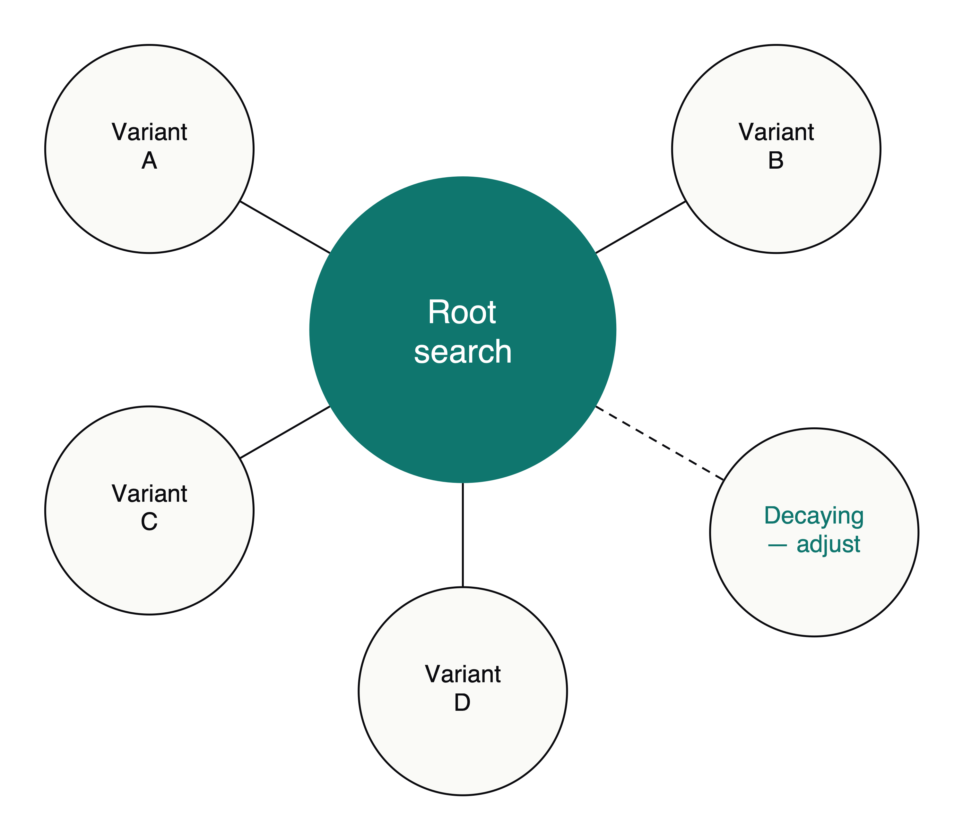
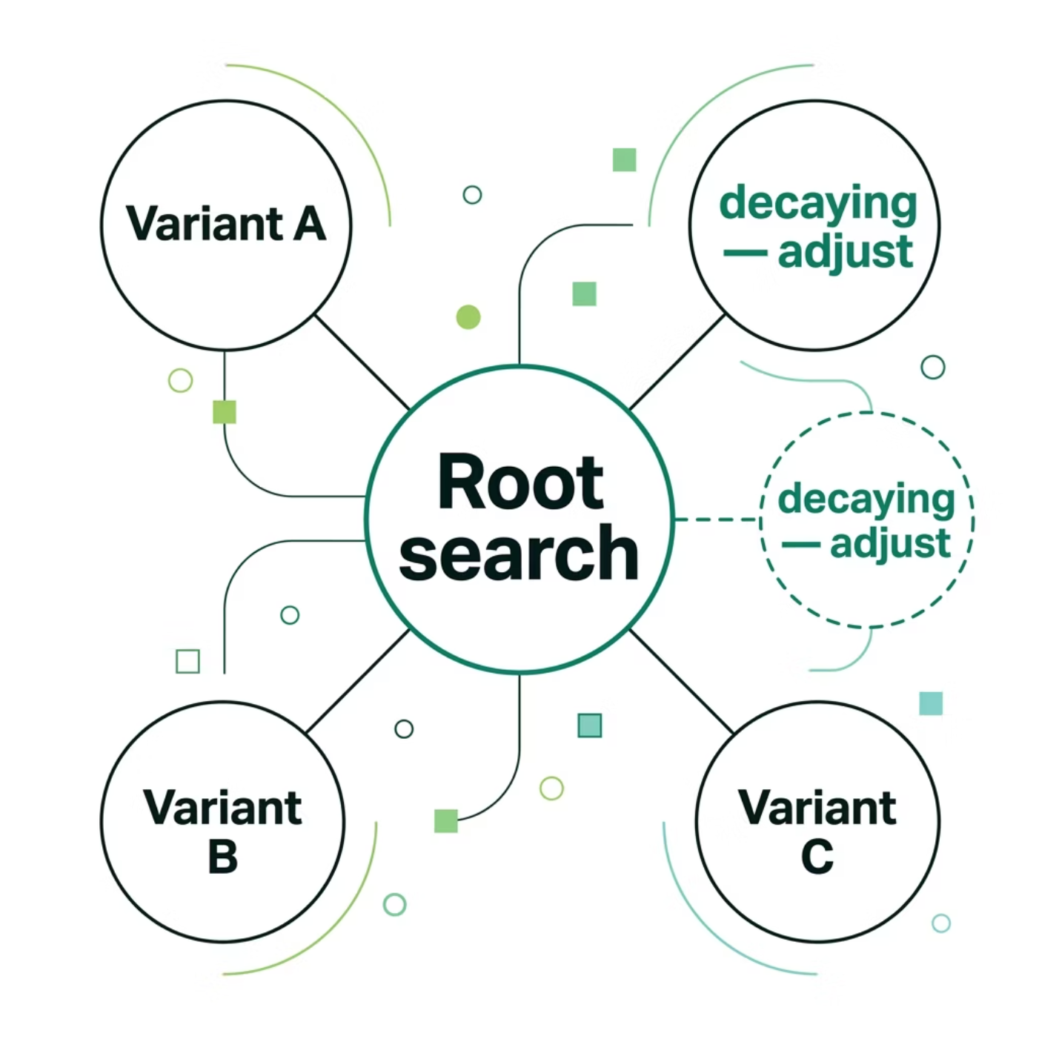

CAPABILITIES — LINKEDIN
LinkedIn: built for Recruiter
Sourcing Agent works inside LinkedIn Recruiter the way a strong sourcer would, but at a consistent, reviewable pace. Every action is traceable. Every search change is bounded and reviewable
What it does on LinkedIn:
writes role-specific searches directly from the brief
runs families of related searches, not one-off strings
tries small variations before committing to a direction
notices when a productive search is decaying and adjusts
remembers what it has already seen, across sessions
paces itself deliberately, with session budgets and safe recovery.

Slide 6
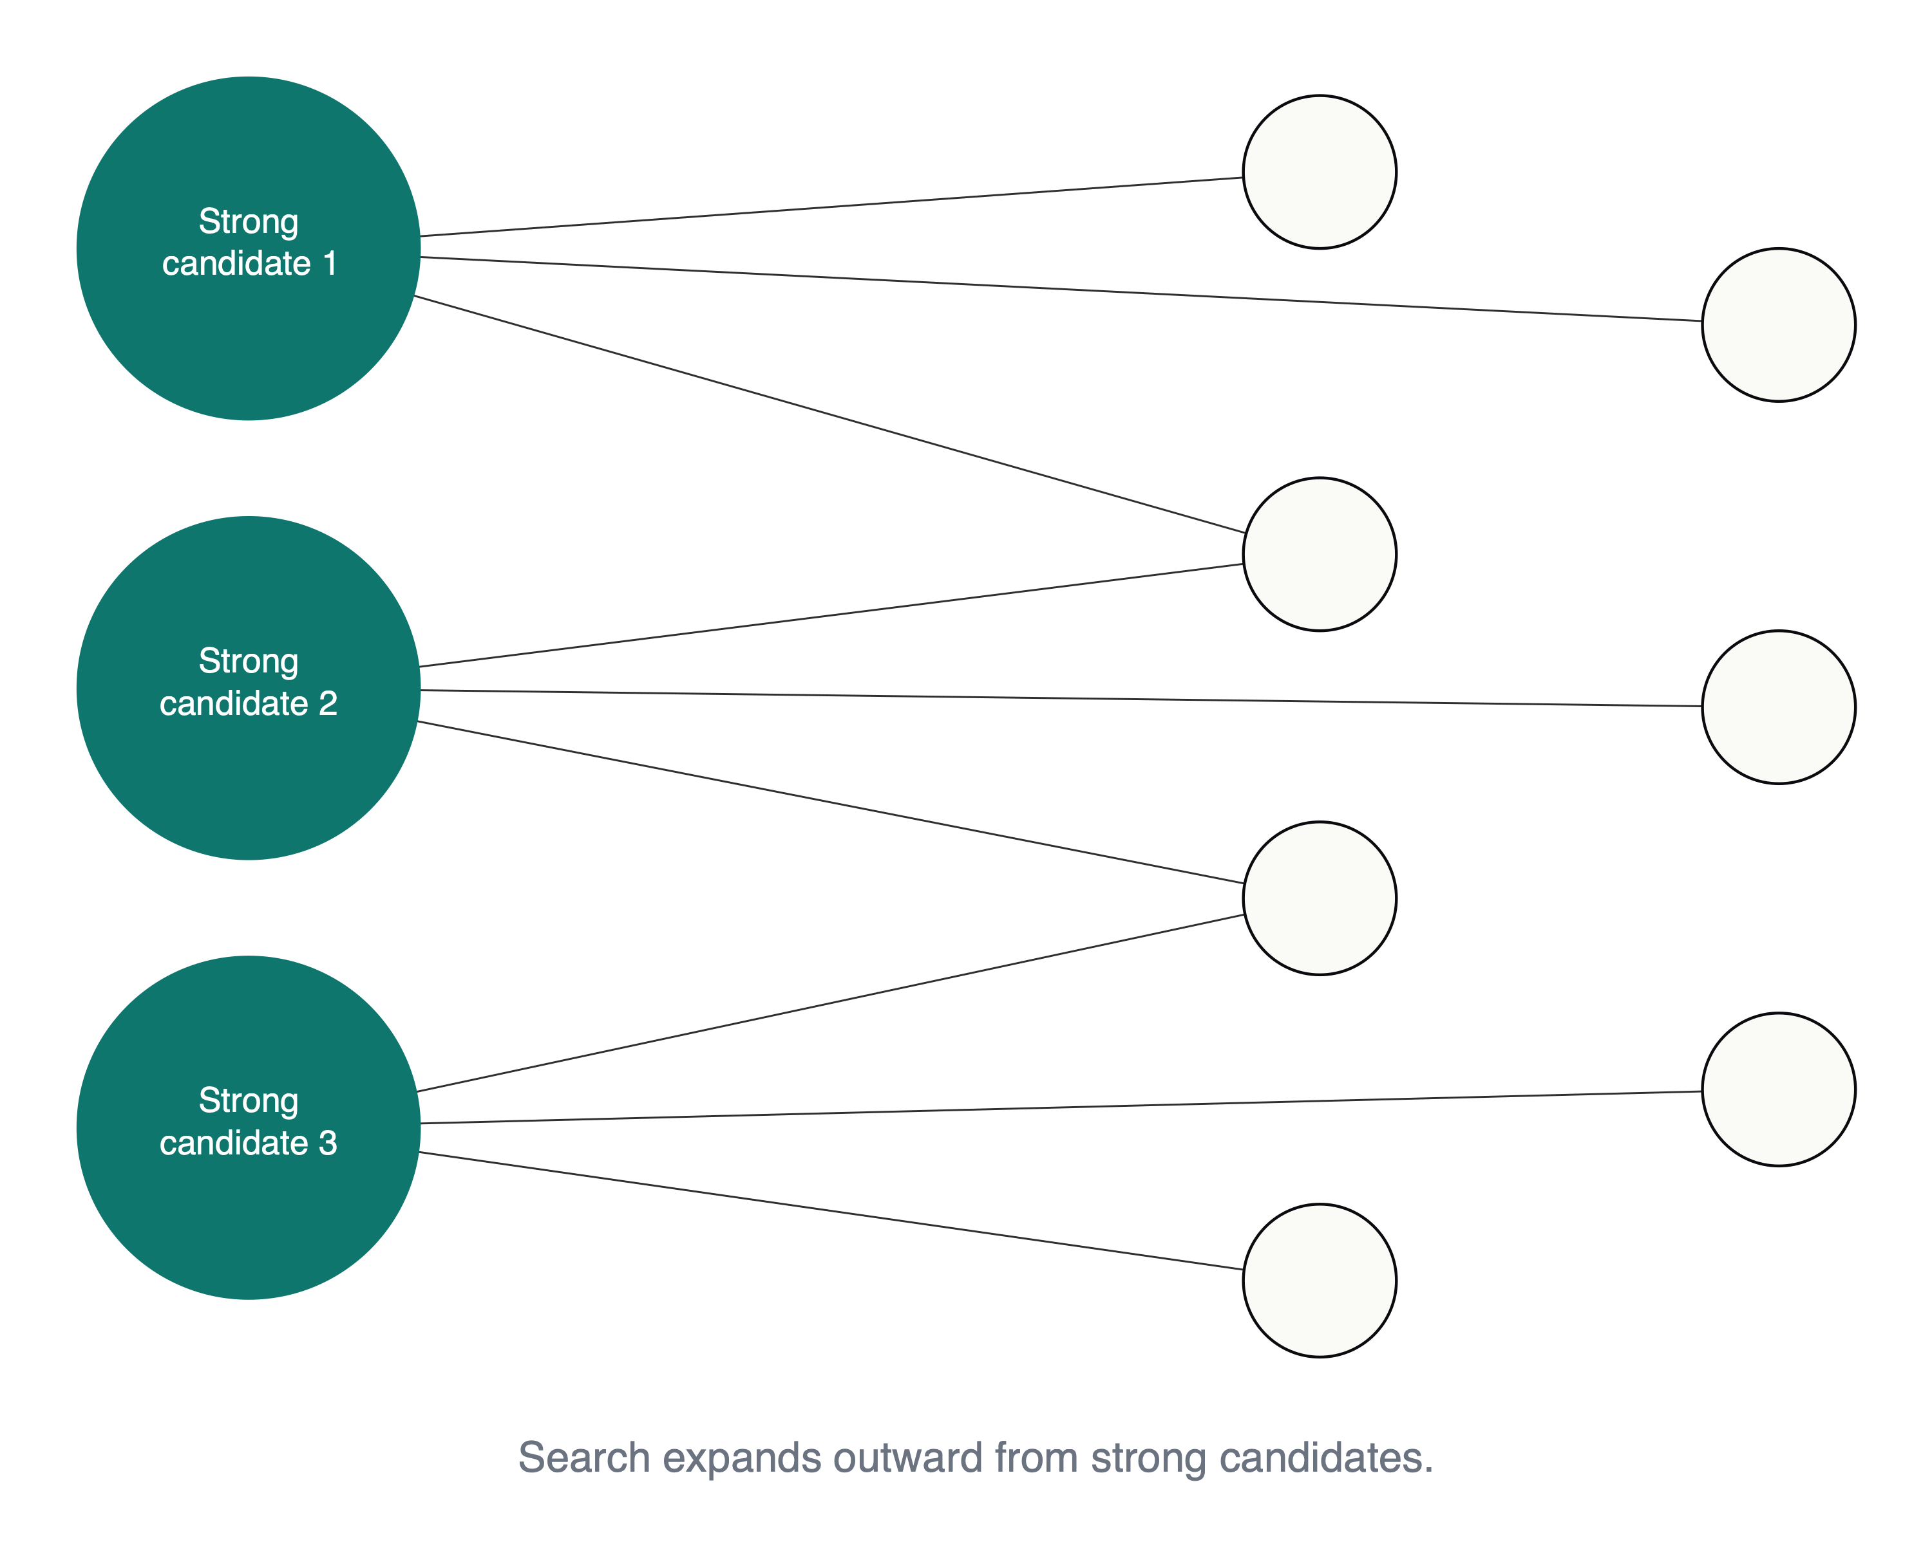
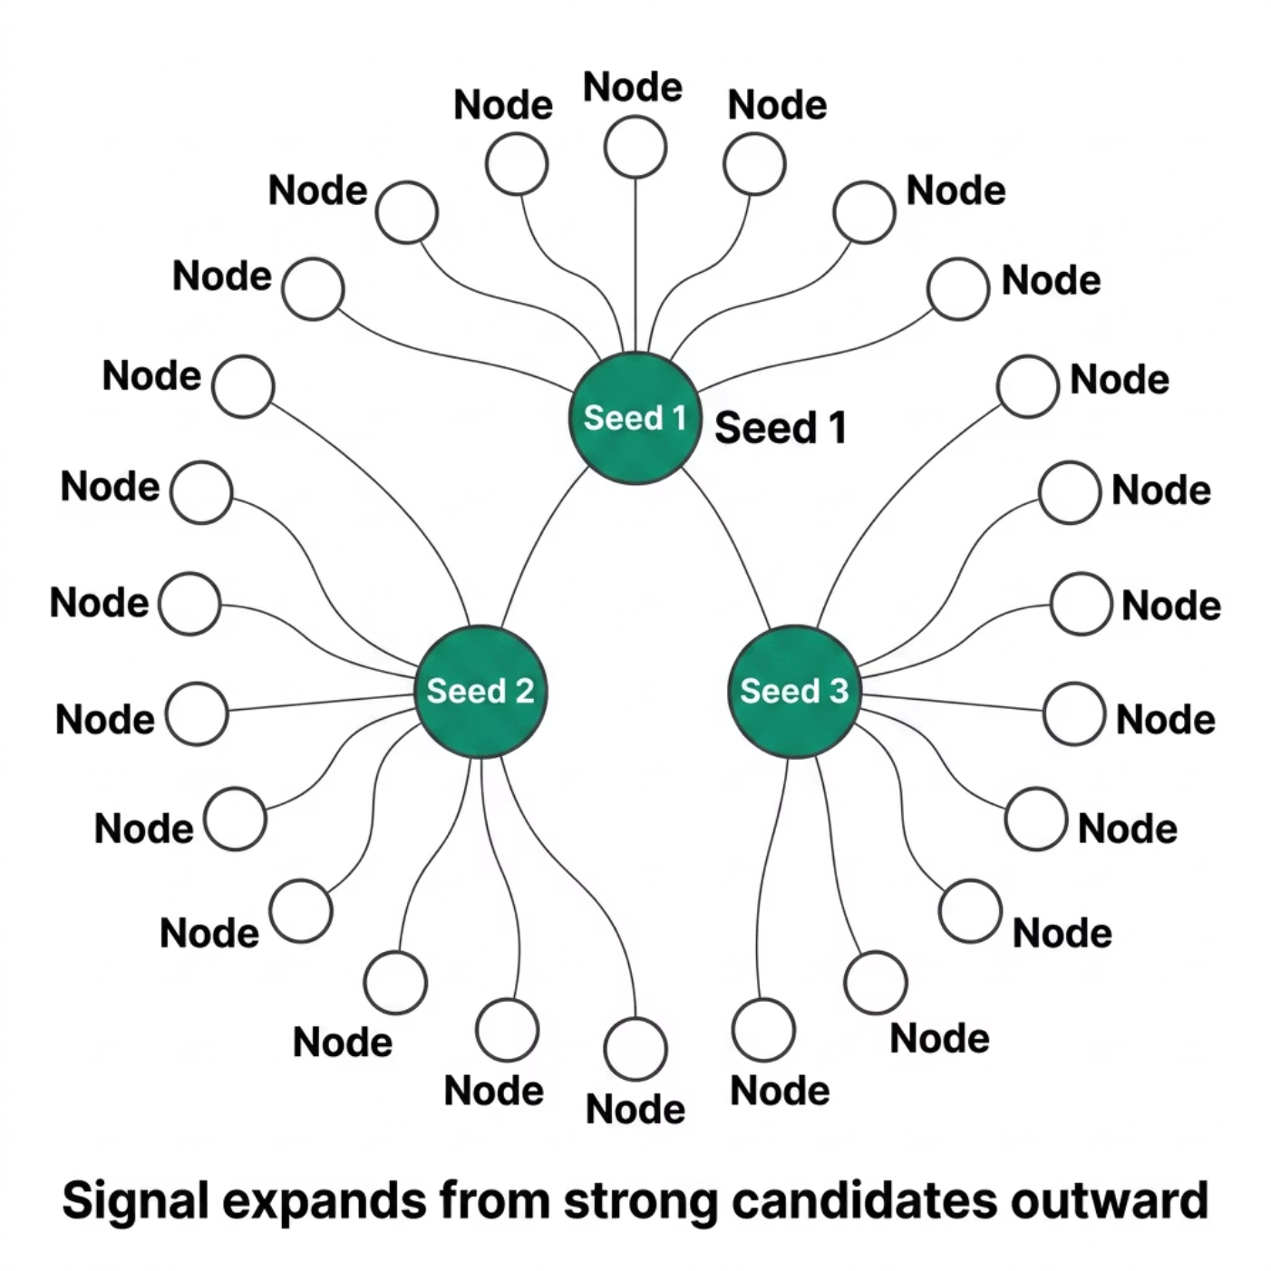
CAPABILITIES — GITHUB
GitHub: search that follows the signal
On GitHub, Sourcing Agent searches the way engineers are actually visible: through code, projects, and the people around strong work.
What it does on GitHub:
searches users, code, topics, and repositories
enriches each candidate with their real work: repos, contributions, profile, contact
expands outward from strong candidates (e.g. the people starring their projects), so the search follows real signal instead of staying stuck in the original query
produces outreach-ready exports for saved candidates

Slide 7
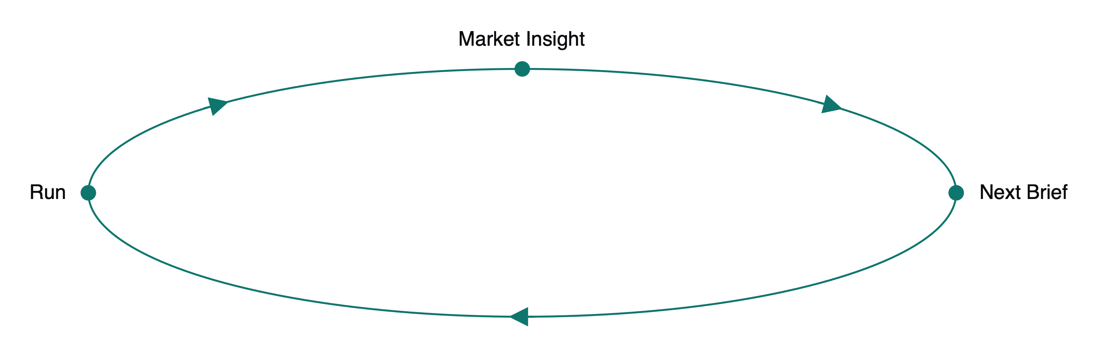


OUTPUTS
What it produces
Every run produces more than a list of candidates.
From a single run:
Across many runs:
reviewed candidates with reasoning attached
a clean, reviewable record of the run
a memory of what worked and what didn't
outreach-ready exports (GitHub)
market insight for each role and market, built from real sourcing evidence
a drafted next version of the brief, based on what the system learned
Sourcing judgment stops living only in recruiters' heads — it becomes something the team owns and builds on.

Slide 8
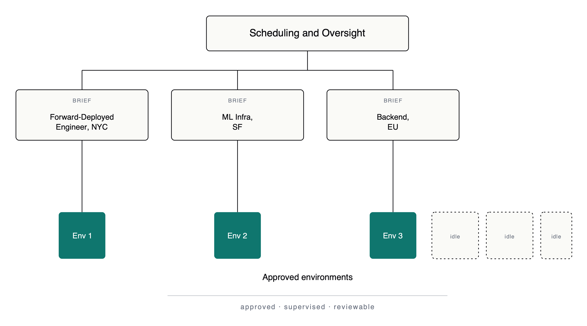
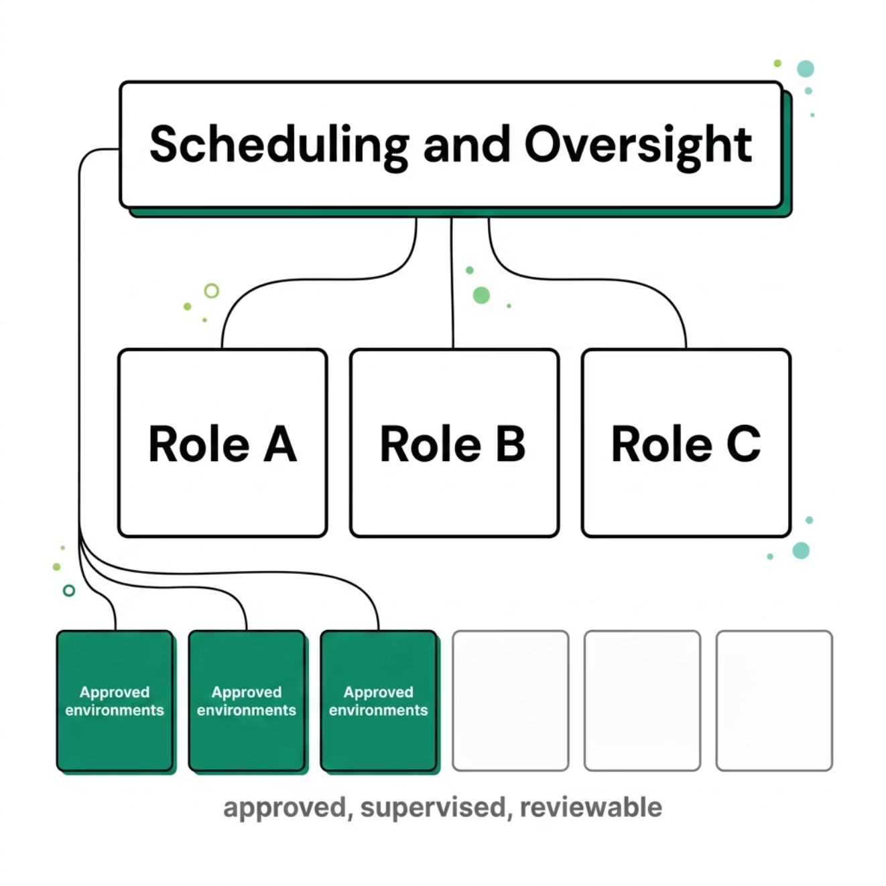

WHAT'S NEXT
Where this goes next
Today, Sourcing Agent runs one workflow at a time, in one approved environment.
The next step is orchestration — a governed way for Sourcing Agent to run across several approved environments at once. Scheduled, supervised, and fully auditable.
What that unlocks:
more sourcing throughput, without more manual work
better use of sourcing capacity the team already has
multiple roles or markets progressing in parallel
How it stays safe:
every run is explicitly approved and scoped
every action is logged and reviewable
the system runs within policy, not around it
Nothing runs that wasn't approved to run.

Slide 9
Built in-house. Running today.
Sourcing Agent is a real internal product: brief-driven, safe, reviewable, and designed to get better every run.

