Slide 1
AI-Based Crop Yield Prediction System
Predicting plot-level yield (tons/ha) across 5 Ethiopian regions and 5 crops
Gashaw Asheber · Fithalew Hailu · Bezawit Asfaw · Chernet Asrat · Sara Ayele

Slide 2
1. Problem, data and objective
TRAINING PLOTS
UNSEEN TEST
REGIONS
CROPS
15,090
3,750
5
5
plot-level observations
reserved for final prediction
Ethiopian regions
maize, wheat, sorghum, barley, teff
• Target: yield_tons_per_ha
• Supervised machine learning → regression
• 80/20 train-validation split
• Test set reserved for final prediction
• Goal: accurate and generalizable yield estimates
Can we predict plot-level crop yield from agricultural, soil, altitude and weather conditions?
AI-Based Crop Yield Prediction System • 2/7

Slide 3
2. Cleaning and integration
HIDDEN MISSING CODES
REGION LABELS
MASTER COLUMNS
ENGINEERED FEATURES
788
19 → 5
40
10
−999 codes identified
standardized
after merge + engineering
new features
Cleaning
Integration method
• Converted −999 to missing values
• Standardized case, whitespace and crop labels (e.g. Tef → teff)
• Median/mode fill for documented ~3–5% gaps in fertilizer, soil and rainfall
• Duplicates were checked; no documented duplicate-row removal was required
• Raw files preserved; cleaned outputs written to processed data
LEFT JOIN: crop-yield plots → regional monthly weather
Weather selected by standardized region and growing-season window:
planting month + following 3 months
Output: seasonal temperature, rainfall and heat-related features.
AI-Based Crop Yield Prediction System • 3/7

Slide 4
3. EDA: where are the biggest yield gaps?
SOMALI MEAN
BEST MIX
WORST MIX
MARKET DISTANCE
1.46 t/ha
4.80 t/ha
0.83 t/ha
r = 0.005
vs ~3.1 in other four regions
SNNPR maize
Somali teff
no meaningful linear relationship
Mean yield by crop (tons/ha)
Agronomic signals
Maize
3.90
• Fertilizer: +0.65 t/ha from lowest to highest band, with diminishing gains
• Altitude: maize peaks around 1,400–2,000 m; wheat and teff around 2,000–2,600 m
• Planting month: only 0.12 t/ha spread
• Tigray 2024 temperature anomaly: +2.57°C; observed yield changes differed by crop
Wheat
2.80
Sorghum
2.61
Barley
2.47
Teff
2.00
AI-Based Crop Yield Prediction System • 4/7

Slide 5
4. Feature engineering and model choice
Three essential engineered features
Why HistGradientBoosting?
SEASON RAIN TOTAL
• Yield relationships are nonlinear and contain interactions
• Tree boosting captures thresholds and interactions
• Each new tree learns from errors left by previous trees
• Histogram-based training is computationally efficient
• It achieved the best validation performance among tested models
4-month window
RAIN × TEMPERATURE
interaction
Validation RMSE — lower is better
Linear
0.898
Grad. Boosting
0.644
TEMPERATURE ANOMALY
observed − regional mean
Random Forest
0.525
Neural Net
0.490
HistGradientBoosting
0.473
AI-Based Crop Yield Prediction System • 5/7

Slide 6
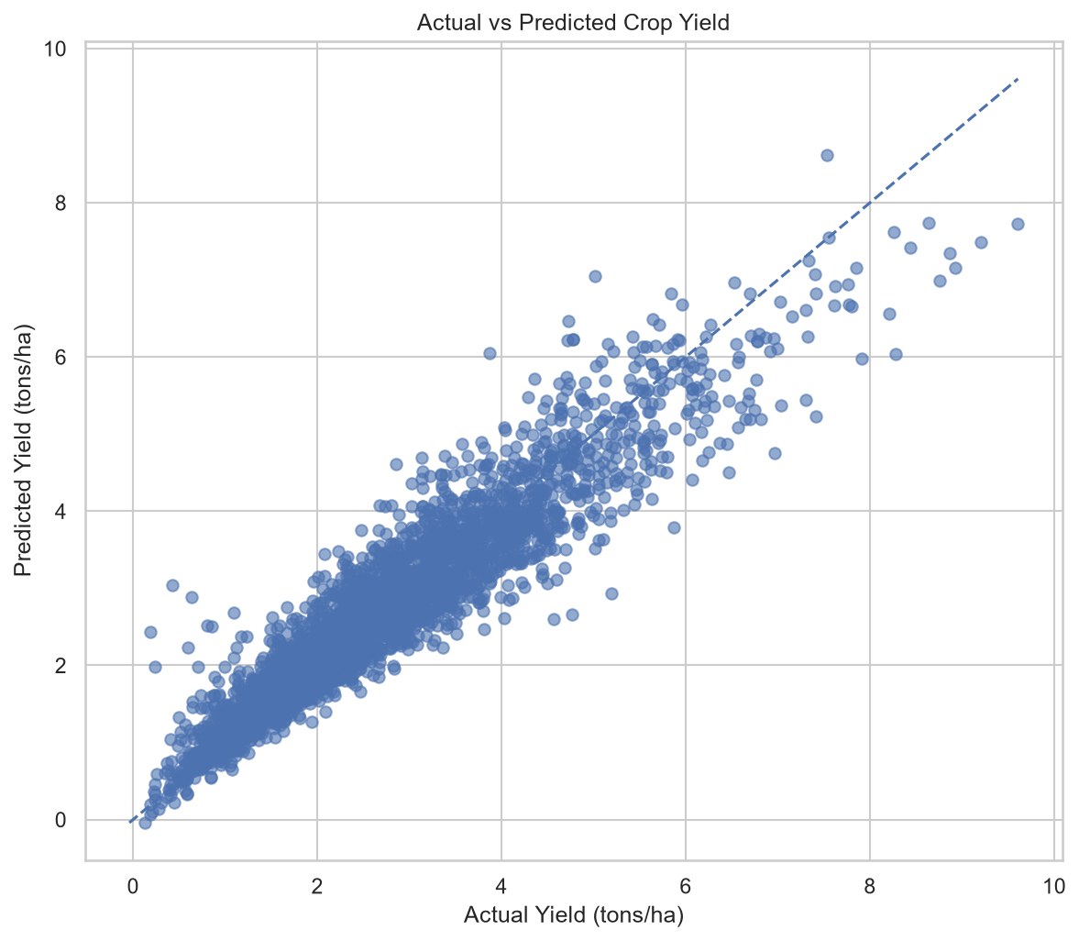
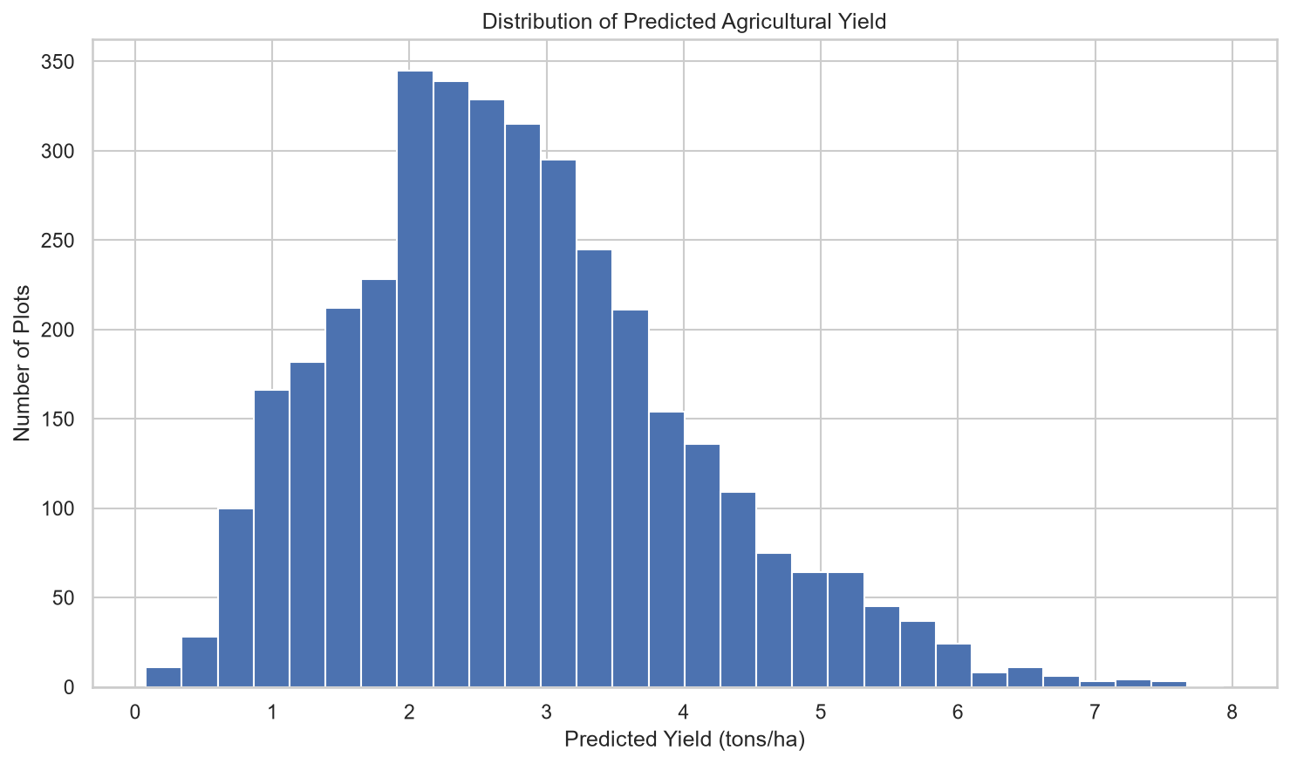

Slide 7
5. Model evaluation
HOLD-OUT RMSE
HOLD-OUT MAE
R²
5-FOLD CV
0.4734 t/ha
0.3427 t/ha
0.8877
0.474 ± 0.014
RMSE
Robustness checks
Final unseen test predictions
• Out-of-time: train 2021–2023 → test 2024; R² = 0.884
• Weather ablation: RMSE 0.491 without weather vs 0.473 with weather
• Weather reduced RMSE by ~3.7%
• 20-trial × 5-fold tuning gave 0.483, worse than 0.473, so default model retained
• 3,750 unseen test plots
• Mean predicted yield: 2.77 t/ha
• Range: 0.08–7.93 t/ha
AI-Based Crop Yield Prediction System • 6/7

Slide 8
6. What the model learned and how it becomes useful
Strongest predictive signals
Decision-support value
Crop type
0.889
• Predict expected yield before harvest
• Identify plots or regions with lower expected performance
• Combine predicted yield with a valid market price for potential revenue estimates
• Use predictive drivers to guide targeted agronomic investigation
Altitude
0.688
Season temperature
0.529
Pest/disease
0.225
Soil quality
0.168
Improved seed
0.126
Key message
Fertilizer
0.114
The value is not only prediction. It is turning heterogeneous agricultural data into evidence for where attention and resources may be needed.
Final model: HistGradientBoosting • RMSE 0.4734 • MAE 0.3427 • R² 0.8877
AI-Based Crop Yield Prediction System • 7/7

