Slide 1
NEUROBRIDGE GAME SUMMIT 2026 · BAKU
Hackathon pitch
IndieQA
An autonomous QA bot for indie studios. It plays your level ~240× faster than real time, hunts physics and collision bugs, and hands you every bug with where it happened and the exact buttons to reproduce it.
Team of 4
github.com/GasimovDev/indieQA_bot
Notes:
We're IndieQA. Small studios can't afford QA teams, so physics bugs ship. Our bot plays your level on its own, far faster than a human, finds collision bugs and tells you exactly how to reproduce each one.

Slide 2
Collision bugs ship. Players find them on launch day
PROBLEM
User value
Indie studios can't afford a QA team.
Walking through walls, falling out of the map, getting stuck: easy to miss by hand.
HUMAN QA TESTER
$25 /h
They surface as negative Steam reviews and refund requests.
Testers often can't say which inputs caused the bug, so reproducing it is slow.
and still misses physics edge cases
Notes:
A human QA tester costs about $25 an hour. Physics bugs like clipping or falling out of the map are easy to miss by hand, and they show up on launch day as negative Steam reviews and refunds. Even when found, nobody knows the exact inputs.

Slide 3
From autonomous play to a bug report you can replay
SOLUTION · HOW IT WORKS
One command, runs locally
01
02
03
04
05
Agent plays
Engine simulates
Telemetry
Bug detector
Dashboard
An autonomous agent plays the level. No human at the controls.
Fixed 60 FPS physics, headless (no window), far faster than real time.
Every frame: position, velocity, buttons, grounded, collision.
Classifies physics anomalies. One report per bug: type, severity, location, last 30 inputs.
Local website: coverage heatmap, red bug markers, filterable log, export.
buttons →
frame state →
CSV →
reports →
localhost
Python · Pygame · Streamlit
No cloud · no API keys · no GPU
Notes:
Five steps. The agent plays, the engine simulates physics at a fixed 60 FPS without a window, telemetry records every frame, the detector turns anomalies into bug reports with the last 30 inputs, and the dashboard shows it all in the browser.

Slide 4
An autonomous, rule-based agent built to break geometry
WHERE IS THE AI?
Said honestly
State machine · not machine learning · not an LLM
MODE 1
MODE 2
Boundary_Seeker
Input_Spammer
Senses the level with raycasts (wall ahead?) and ground probes (ledge ahead?). Walks to walls, edges and corners and hugs them, because that's where collision bugs live.
When touching a wall, fires rapid non-linear button combos (diagonal + jump, direction toggles) to force the physics into broken states.
Zero training data
Fully offline
Deterministic
Explainable
Cheap
works day one
runs on a laptop
same seed = same run
every decision is a rule
~$0.04/h compute
Notes:
Judges will ask where the AI is. It's an autonomous rule-based agent, a two-mode state machine, not ML and not an LLM. One mode seeks boundaries, the other spams inputs at walls. That means no training data, offline, and every bug is 100% reproducible.

Slide 5
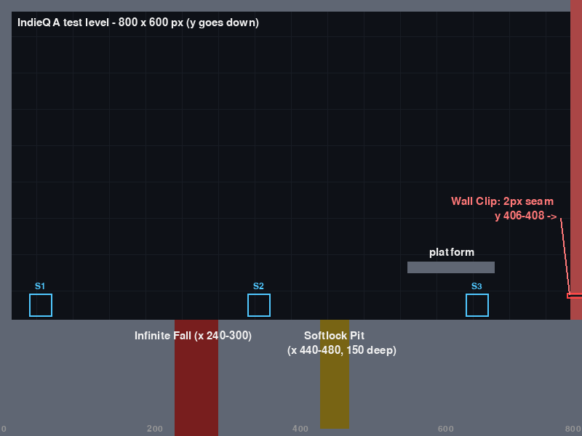
We planted 3 bugs. The bot found them on its own
PROOF · PLANTED-BUG TEST LEVEL
800 × 600 px · seed 42
PLANTED BUG | DETECTION SIGNATURE | HITS
Wall Clip 2-px seam in the right wall | > 25 px in one frame while colliding | 22
Infinite Fall hole with no bottom, no reset | > 120 frames falling, touching nothing | 48
Softlock Pit 150 px deep, jump is 100 px | buttons held > 300 frames, moved < 5 px | 16
Out of Bounds | position outside the map | —
36,000
~2.5 s
65
7,200/7,200
frames = 10 min of play
headless → ~240× real time
episodes, unaided
identical frames, same seed
Notes:
We built a test level with three bugs planted on purpose. In a 10-minute run, simulated in about 2.5 seconds, the bot produced 22 wall clips, 48 infinite falls and 16 softlocks across 65 attempts. Same seed twice gave identical data on all 7,200 frames.

Slide 6
Every bug, where it happened, and how to replay it
THE WEBSITE
Streamlit · localhost in your browser
[SCREENSHOT: dashboard overview]
header · time tested · frames · bugs · $25/h vs $0.04/h
[SCREENSHOT: map with red bug markers]
[SCREENSHOT: bug detail]
last 30 inputs
Header
game time tested, frames analysed, bugs found, cost banner
Map
heatmap of where the bot explored, red marker at every bug
Bug log
filter by severity / type, reproduction sequence per bug
Export
bug reports as Markdown
Notes:
This is the dashboard, a local website. The top shows how much gameplay we tested and the cost banner. The map shows where the bot went and red markers at every bug. Click a bug to see the exact 30 inputs that cause it, and export the report.

Slide 7
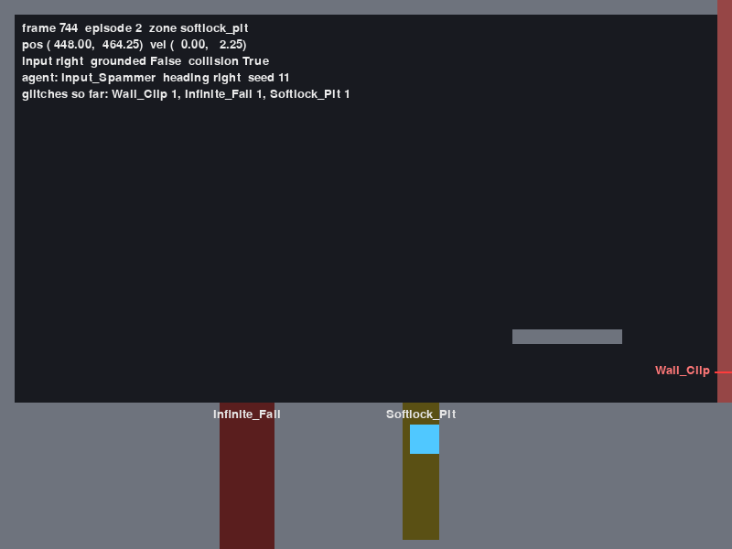
All three bugs in under 15 seconds
LIVE DEMO
Backup: screenshots in this deck
1 · Watch it play (real time, 60 FPS)
python main.py --seed 11
1.4 s
3.4 s
12.4 s
Wall Clip
Infinite Fall
Softlock
2 · 10 minutes of testing in ~3 seconds
python main.py --headless --frames 36000 --analyze
3 · Open the website: map, bug list, one bug's steps
streamlit run dashboard/app.py
Game window, seed 11, frame 744 (12.4 s): stuck in the Softlock Pit, HUD shows all 3 glitches found
Notes:
Live: seed 11 in real time. Watch it clip through the wall at 1.4 seconds, fall forever at 3.4, and get stuck in the pit at 12.4. Then headless: ten minutes of play in about three seconds. Then the dashboard. If the demo fails, this screenshot is the backup.

Slide 8
Find the bug before it hits your reviews
USER VALUE
Steam launch risk
BEFORE LAUNCH
EVERY BUILD
FIX FAST
Collision bugs are caught on your machine, not in Steam reviews and refund requests.
10 minutes of play in ~2.5 s means you can re-test the level after every change.
Each bug ships with location + last 30 inputs. Same seed, same bug, 100% reproducible.
Every bug report: type · severity · location · last 30 inputs
Seed 42 · 10 min of play · 86 glitch events
Notes:
The value is launch risk. You find collision bugs before players do, you can re-run the bot on every build because it's so fast, and every bug comes with location and inputs, so a developer reproduces it immediately instead of guessing.

Slide 9
Three failure modes we state up front
QUALITY TESTING
Where IndieQA fails
1
Cannot evaluate narrative or quest-sequencing logic.
It tests physics, not story.
HOW WE VALIDATE OURSELVES
A planted-bug level + an automatic check of detector output vs the engine's ground truth.
2
High false-positive rate on non-standard physics with custom inertia curves.
Thresholds like 25 px/frame assume standard platformer physics.
found / missed / false alarms, per bug type
BUG | DETECTED
Wall Clip | 22/22
Infinite Fall | [detector results]
Softlock | [detector results]
3
Struggles with procedurally generated maps with no static geometry reference.
Notes:
We know where we fail. One, no narrative or quest logic. Two, custom inertia physics will cause false positives because our thresholds assume a standard platformer. Three, procedural maps with no static geometry. We validate ourselves against the engine's ground truth: wall clip is 22 of 22.

Slide 10
FEASIBILITY
Unit economics · integration
HUMAN QA
INDIEQA · LOCAL COMPUTE
$25 /h
$0.04 /h
Team estimate. And one IndieQA hour covers far more than one hour of play: headless runs ~240× real time.
NEEDS NOTHING
BUILT TODAY
UNITY & GODOT
ROADMAP
No training data · no cloud · no API keys · no GPU. ~1 µs telemetry overhead per frame.
Python + Pygame engine, agent, telemetry, detector, reporter, Streamlit dashboard. One command.
Plug-ins in C# and GDScript stream the same telemetry format over WebSocket. Same detector, same dashboard. Not built yet.
Notes:
Unit economics: $25 an hour for a human, about four cents an hour of local compute for us, and that hour covers far more gameplay. No training data, no cloud. Built today in Python. Unity and Godot plug-ins are roadmap: stream the same telemetry over WebSocket.

Slide 11
Four people, one pipeline
TEAM
4 people
P1
P2
P3
P4
Engine & agent
Detection
Pitch
Website
Physics engine, planted glitches, telemetry, autonomous agent.
Bug detector and per-bug reporter.
Story, deck and demo.
Streamlit dashboard: map, bug log, export.
[Name]
[Name]
[Name]
[Name]
agent → engine → telemetry → detector → reporter → dashboard
Python · Pygame · Streamlit
Notes:
Four people, each owning one stage of the pipeline: engine and agent, detection, the website, and the pitch.

Slide 12
NEXT STEPS
IndieQA
Let the bot find the bug before your players do.
NEXT · 1
NEXT · 2
NEXT · 3
Unity (C#) and Godot (GDScript) telemetry plug-ins over WebSocket.
Per-game detector thresholds, to cut false positives on custom physics.
Run it on real indie levels.
github.com/GasimovDev/indieQA_bot
Thank you
Notes:
Next: Unity and Godot plug-ins, per-game thresholds to address our second failure mode, and testing on real indie levels. IndieQA lets the bot find the bug before your players do. Thank you.

