Slide 1
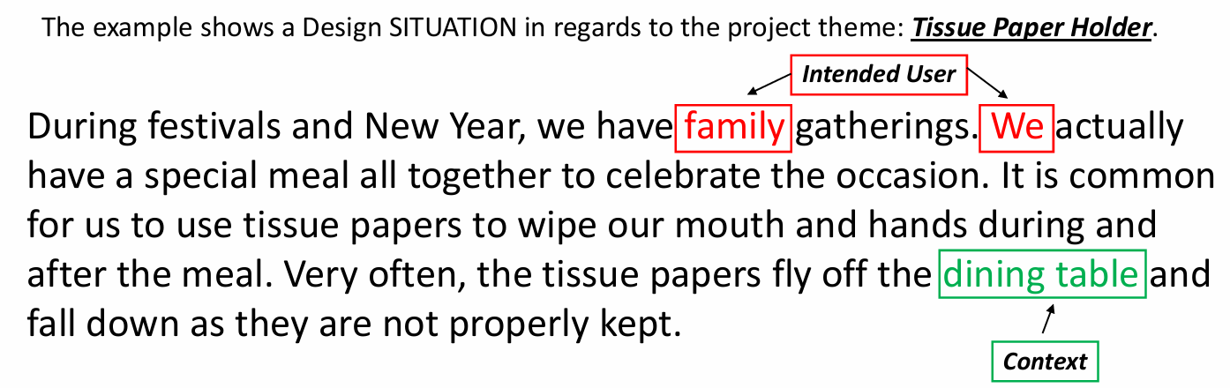
FORM 1
DT PROJECT
The Intended User and the Context:

Slide 2
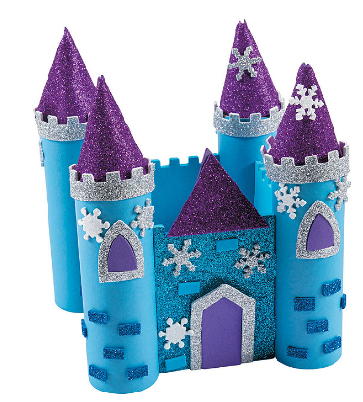
Below is your DESIGN SITUATION:
STAGE 1:
DESIGN SITUATION
The Design and Technology department has decided to organize a competition where the Form 1 students will need to individually design and construct a castle out of thin cardboard in the DT workshop. The castle will be consisted of different geometrical forms assembled together.
Name:
Class:
Project: Cardboard Castle

Slide 3
Read the following questions carefully and write your answer on the next slide
QUESTIONS for STAGE 1 (5 Marks)
Identify and name the Intended User(s) from the given situation
Identify and name the Context from the given situation
Name:
Class:
Project: Cardboard Castle

Slide 4
TASK 1.1
Write your answers down below in the spaces provided:
ANSWERS FOR STAGE 1 QUESTIONS
Answer for Q1 Intended User(s) : _____________________________________ .
Answer for Q2 Context : ______________________________________________ .
Name:
Class:
Project: Cardboard Castle

Slide 5
TASK 1.2
Write your Design Brief in the space provided below:
Design Brief
To design and make a __________________________ .
Name:
Class:
Project: Cardboard Castle

