Slide 1
COVID-19 Case Study
Covid Analysis as of 8/3/2021| Gasper Militello

Slide 2
Project Goals
Understand the patterns and trends of Covid-19
Convey important factors dictating the spread and containment of Covid-19
Empower individuals to make informed decisions on how to navigate the landscape

Slide 3
General Overview
Covid-19 cases are surging
Infection rates are high
Full vaccination rates are low
Certain states are more at risk than others
-All information gathered is from the CDC, NY Times, Government, and State Websites

Slide 4
General Statistics
Average vaccination rate for the United States – 49.09%
One dose – 56.30%
Total cases – greater than 35 million
One in ten people have contracted Covid-19 in the USA
Average infection rate – 1.21
People infected on average spread to more than one person
Average positive test rate – .12

Slide 5
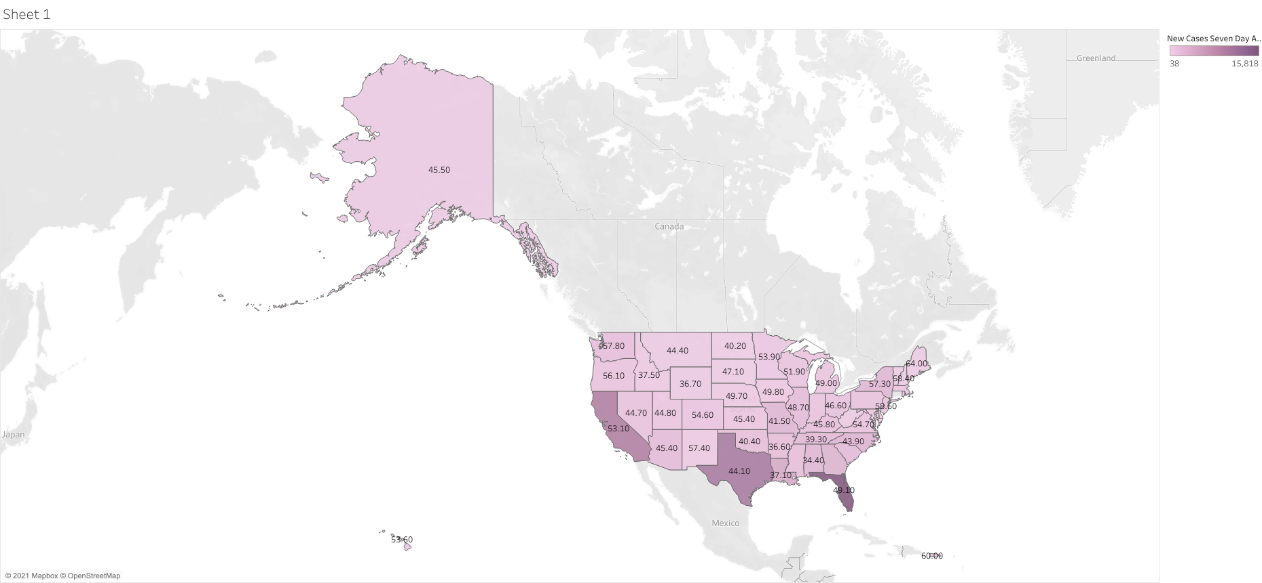

Slide 6
Full Vaccination Rates vs New Cases Per Day
States that are darker represent higher cases
Twenty-four states have more than 1,000 new cases per day
Five of those states have a vaccination rate of less than 40 percent
Tennessee – 39.3
Georgia – 38.7
Louisiana – 37.1
Arkansas – 36.6
Mississippi – 34.5

Slide 7
States With Low Vaccination Rates
The states mentioned previously have the lowest vaccination rates in the USA – together they are averaging more than 2,950 new cases per day
Average new cases in total for the USA are 1,711
The number is skewed from a few key states : Florida(15,818), Texas(10,821), and California(9,842).
Low vaccination rates paired with high infection rates will lead to rapid spread of Covid-19
The average case to death ratio is 57 to 1 for those states

Slide 8
States With High Vaccination Rates
High vaccination is a step in the right direction, but it does not make you immune to the situation
Top five states:
Vermont – 67.7
Massachusetts – 64.1
Maine – 64
Connecticut – 63.4
Rhode Island – 61.4

Slide 9
High Vaccination Rates Continued
The top five states are averaging 308 new cases per day, which is significantly lower compared to low vaccination states
This does not paint the full picture, three states in particular stand out: New Jersey, Massachusetts, and Connecticut
Each of these states have a vaccination rate greater than 58 percent but average a 40:1 case to death ratio
What do those states have in common? They are the three most densely populated states in the USA
To put things into perspective – Covid-19 was the second leading cause of death in New Jersey for 2020, behind only Heart Disease
None of these states have ICU capacity issues

Slide 10
Infection Rates
Infection rates remain high in the USA
No state has less than a 1 to 1 infection rate
Pair that with low vaccination rates, and you can see how this problem quickly exacerbates
Most states hover around 1.21, but certain counties in low vaccinated states can reach over 1.5
This is especially important when dealing with surges – if there is low ICU availability states won’t be able to handle the influx of people, ultimately leading to more deaths
For instance, Georgia has three counties with an infection rate greater than 1.5 and an ICU capacity at 89 percent. They are averaging more than 2990 cases per day, and at some point, there won’t be enough room for severe cases. This makes Georgia a severe risk for containing Covid-19

Slide 11
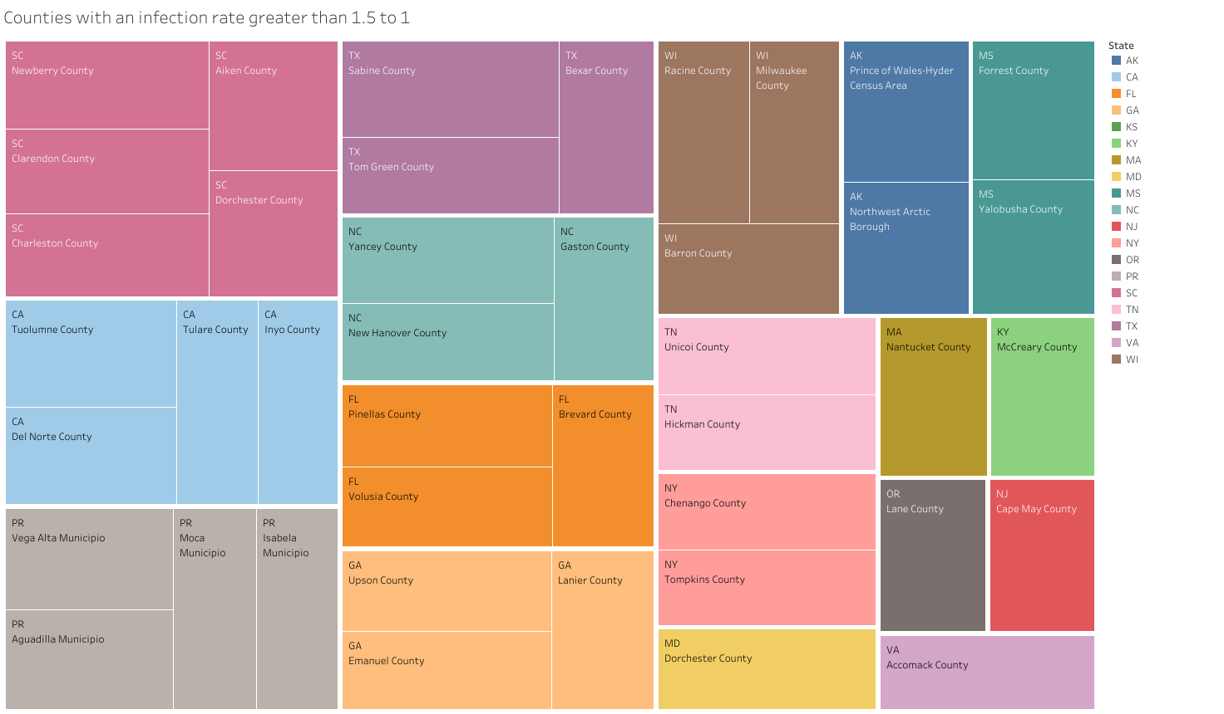

Slide 12
General Takeaways
Full vaccination is effective, but not perfect
Highly vaccinated states have some of the lowest number of new cases per day
Infection rates are also lower in those states
Hospitalizations are down
Densely populated states are disproportionately affected when it comes to cases per deaths and total cases
Cases are surging in off season
Oct to Jan 2021 had the highest rise in cases after leveling out/decreasing last summer
As of August 2021, cases continue to rise
States with low vaccination rates are experiencing severe issues
The number of new cases per day for low vaccination states continues to rise
Infection rates run rampant
The case to death ratio is not as high compared to densely populated states, but will become a problem with decreased occupancy at already full ICU beds

Slide 13
Recommendations
Get vaccinated
Social distance whenever possible
Wear a mask in public areas
Avoid traveling to high-risk areas
Research the place you intend to travel if necessary
Ultimately, the CDC had it right when it comes to protocol
We will not contain the disease until our nation has higher vaccination rates paired with low infection rates. It is a team effort

Slide 14
Sources
https://covidactnow.org/us/arizona-az/?s=21551081
https://njhealth.maps.arcgis.com/apps/opsdashboard/index.html#/81a17865cb1a44db92eb8eb421703635
https://www.mass.gov/info-details/covid-19-response-reporting
https://healthdata.gov/Hospital/COVID-19-Reported-Patient-Impact-and-Hospital-Capa/g62h-syeh/data
https://www.cdph.ca.gov/Programs/CID/DCDC/Pages/COVID-19/COVID-19-Cases-by-Age-Group.aspx
https://www.google.com/search?q=covid+cases+by+state&rlz=1C1CHBF_enUS830US830&oq=covid+&aqs=chrome.0.69i59l2j69i57j0i67i131i433j69i60l4.4744j0j4&sourceid=chrome&ie=UTF-8

