Slide 1
Cleobot

Slide 2
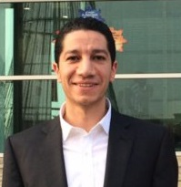



TEAM
Ayman Fathy
Gasser Akila
Mohamed Nassef
Yara Maher
IT, Charging Manager
CBU, CVM Team Leader
CBU, Data Mining Supervisor
CBU, Data Science Manager

Slide 3
PROBLEM
Social media
is booming
Human-intensive
work
High response
time
Impact due to
campaigns
No OOTB
tools
+200,000 posts per month on Vodafone channels.
Social Media team working on 24/7 basis.
Average response time of 4 hours.
Commercial campaigns result in spikes.
No suitable intelligent tools with arabic support.

Slide 4



SOLUTION (Cleobot)
AI-driven
Real-time Triggers Text Mining & NLP Response Modeling Respond Back
Arabic-enabled
FB Messenger
Real-time Events
Self-learning
Flexible integrations
FB posts/comments
Tailored reply
Confidence-based
Open-source
twitter
Cleobot AI Engine

Slide 5

BENEFITS
Grace Period Migration
Grace Period Migration
Grace Period Migration
EGP 20M
TCO Savings
1.5 Seconds
Response time instead of 4 Hours
76%
Man-day Savings

Slide 6
COSTS
“
Intelligent Automation for Social Interaction
”
License
2.1M
/year
Software
450K
Hardware
352K

Slide 7
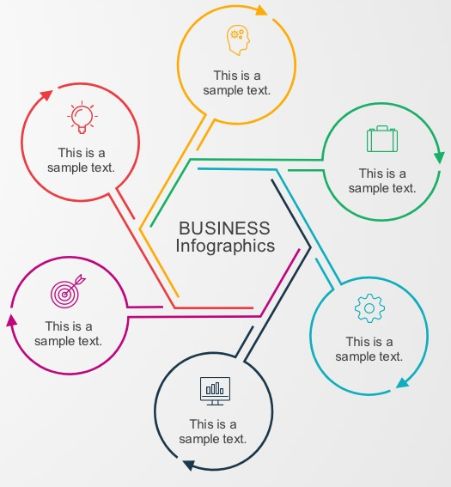
ASSUMPTIONS
5% Annual Salaries Inrcease
Agents are 100% loaded
2% Annual Inflation
6 Months Project Duration
4
Years depreciation
3 Developers

Slide 8
Cleobot: Financials
Key Highlights
Annual salaries increase by 5% and inflation increase by 2%.
Cost Savings:
After 5 years, we will have saved ~20M EGP.
Man Day Savings:
Development effort: 3 developers x 6 Months
Savings in Man days by second year = 76%
 | 1year
 | Current | GO | Current Vs Go
OPEX | 5,420,000 | 1,890,000 | 3,530,000
Depreciation | - | 728,500 | (728,500)
Total | 5,420,000 | 2,618,500 | 2,801,500
Capex | - | 2,914,000 | 2,914,000
5 years
Current | GO | Current Vs Go
29,016,307 | 5,490,000 | 23,526,307
- | 2,914,000 | (2,914,000)
29,016,307 | 8,404,000 | 20,612,307

Slide 9
WAY FORWARD
1
Big Data Stack
4
Fallback
Cloudera stack (infrastructure & storage servers).
Build fallback mechanism in case of low confidence.
2
Large Training Data
5
Pilot Launch
Inject huge amount of Arabic data to increase accuracy.
Pilot launch with pre-approved or offline responses.
3
Response Modeling
6
Monetize
Build robust model for responses.
Cleabot is industry-agnostic and can be productized.

