Slide 1
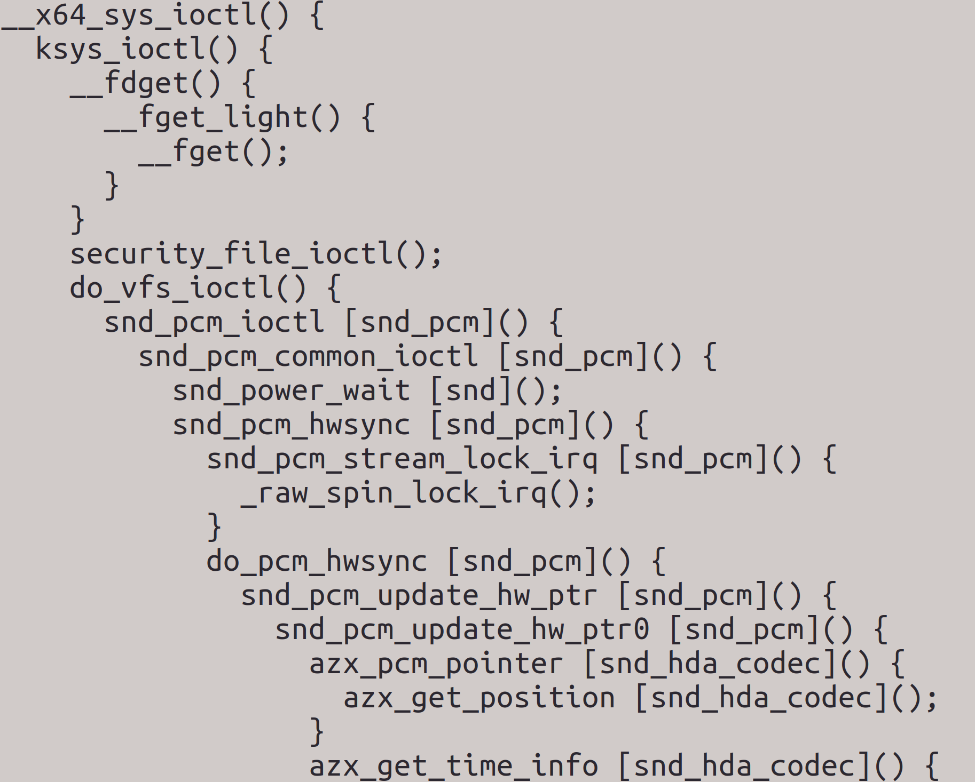

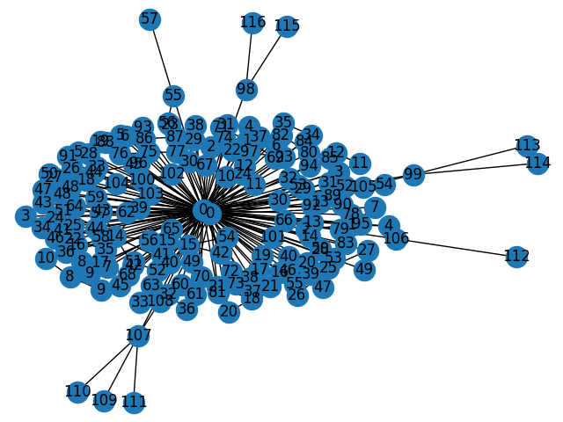
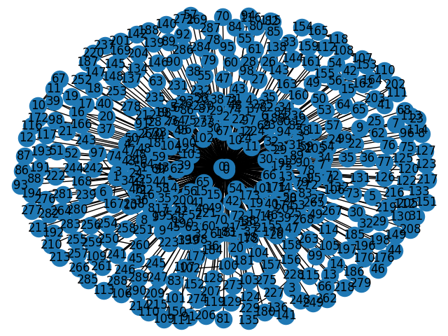
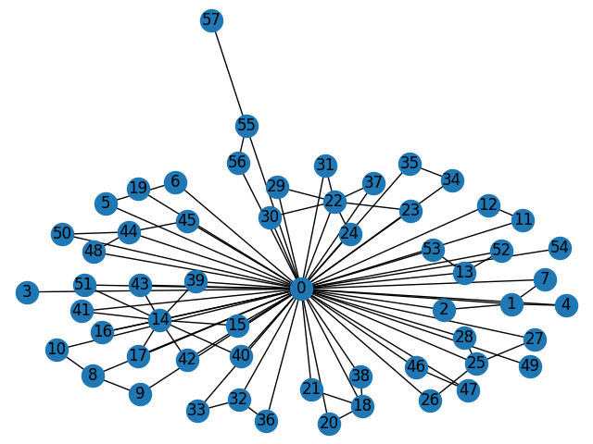
T = 100μs
T = 200μs
T = 300μs
The “function_graph” ftrace kernel tracer progressively unveils a graph that can be sampled at a configurable but constant period. Disconnected graphs are solved by keeping the latest tree. The text of the trace displayed above is purely illustrative, an accurate representation would be much larger.

Slide 2
Sample₀
...
...
Sample_{t-W-1}
Sliding window of width ‘W’
Sample_{t-W}
...
...
Sample_{t}
classify
Neural Net
Current and recent kernel data is fed into a neural net, and the expected output is the tag for the user activity at that time. Convolutional operations over current and past data are part of the network’s architecture; it actually has two inputs: one for node values and another one for the graph’s architecture. The input dimension should be a few thousands, and as collecting user data is relatively tiring it is quite clear that it is not very well posed.

