Slide 1

L_{y}
L_{x}

Slide 2

Threshold 1
Threshold 2
Threshold 3

Slide 3
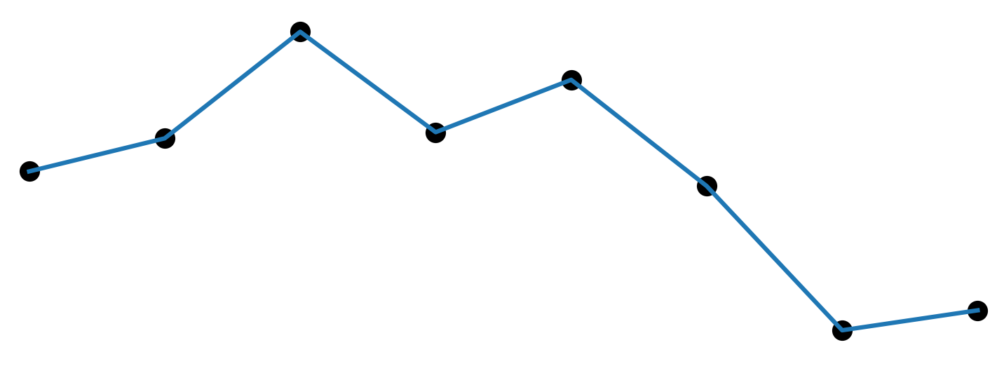
Price
Conv1D
Conv1D
Conv1D
Time

Slide 4
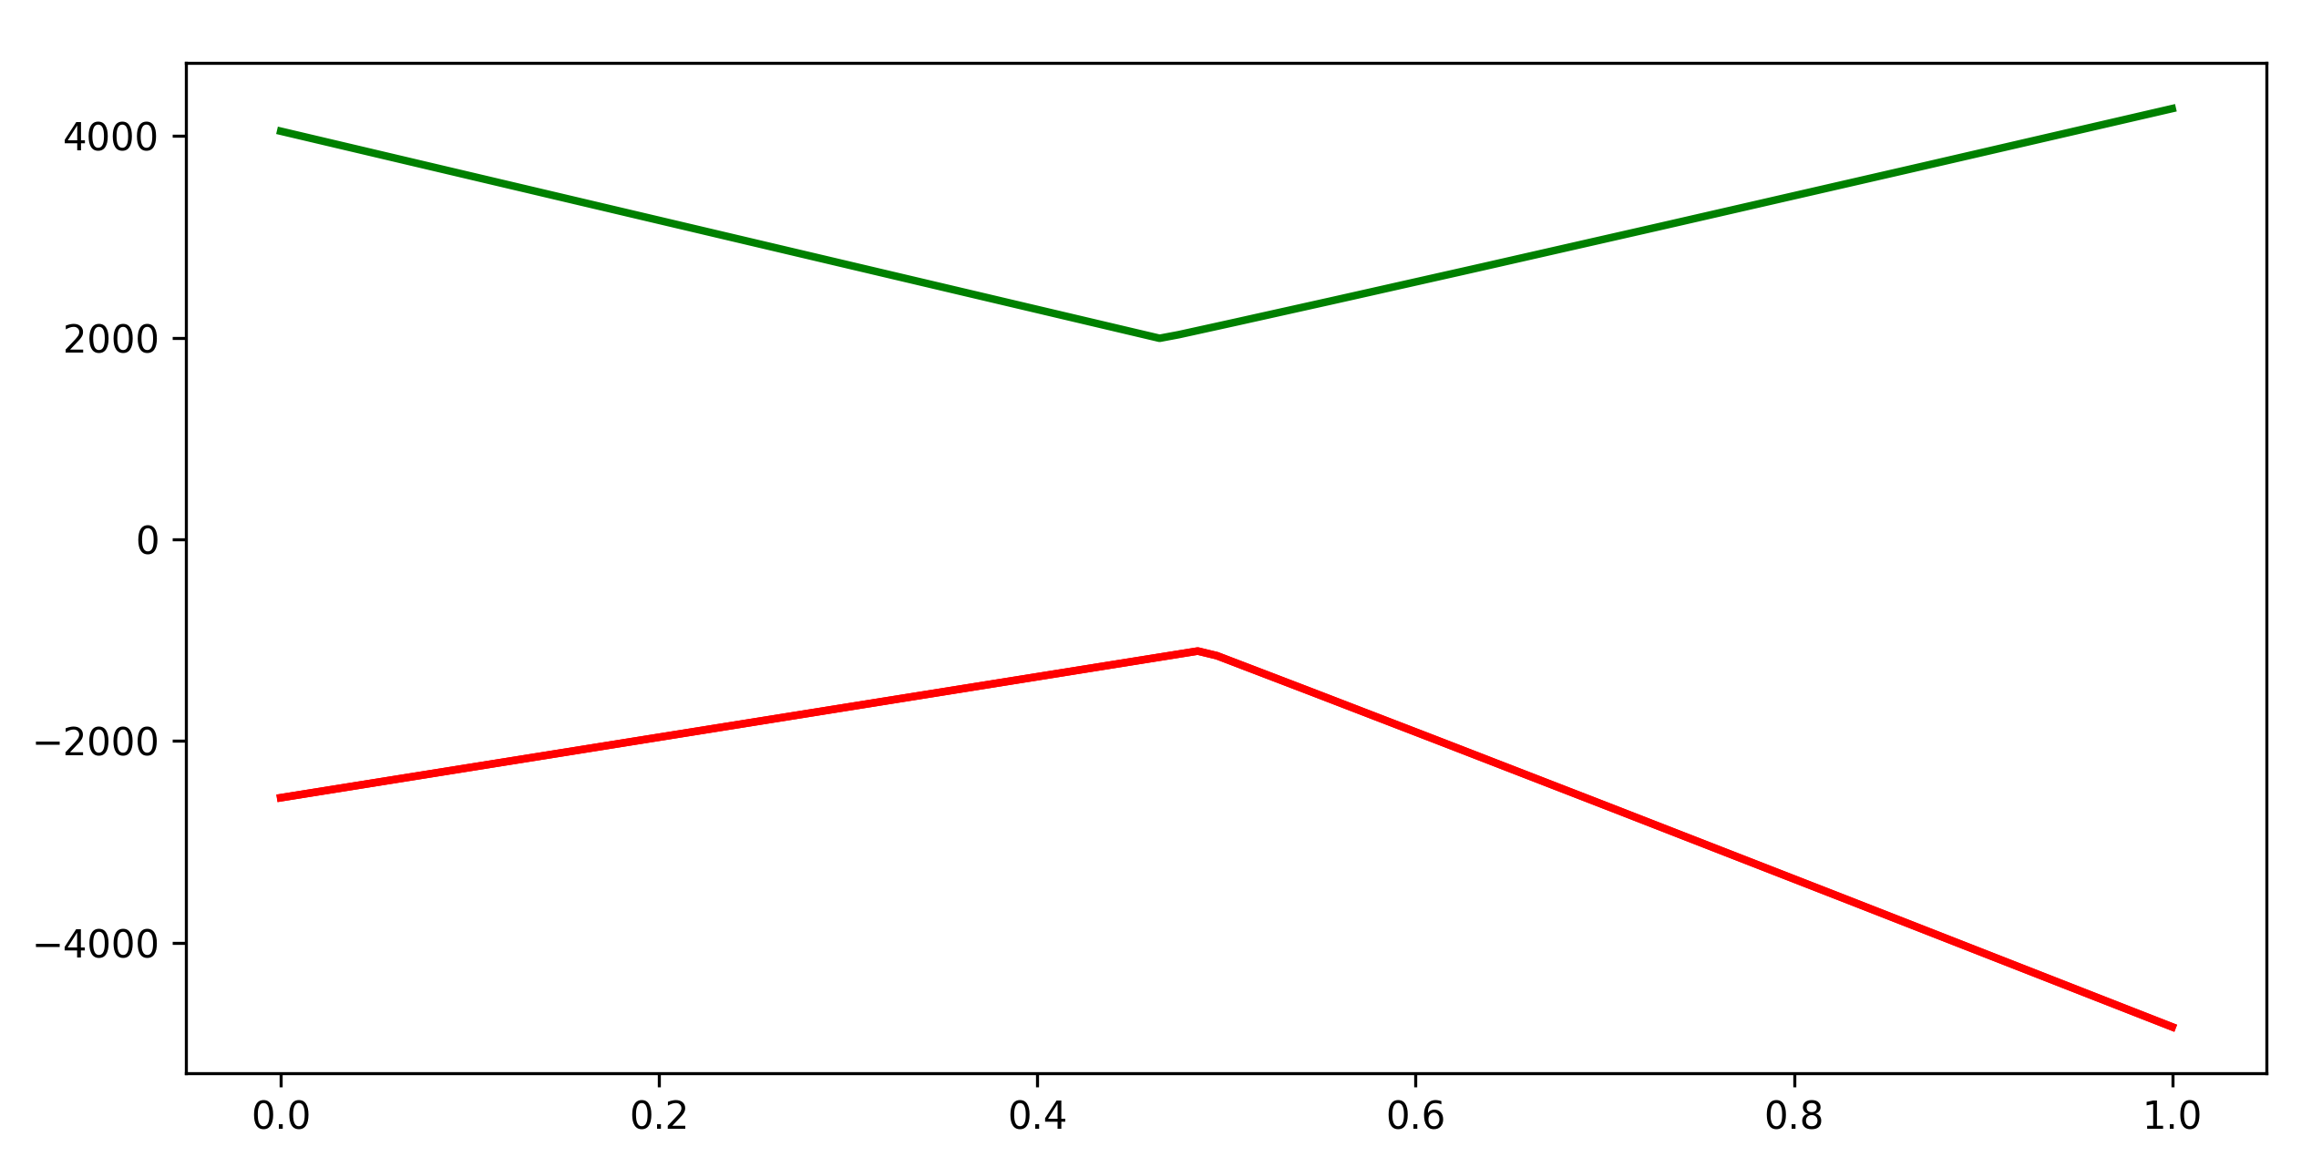
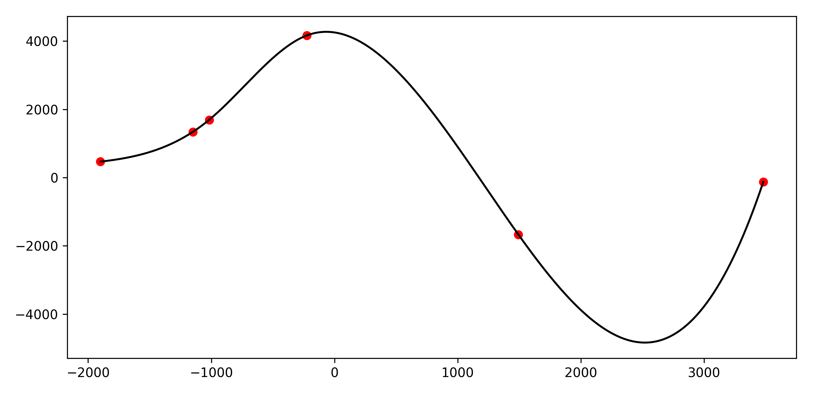
Portfolio
Underlying

Slide 5
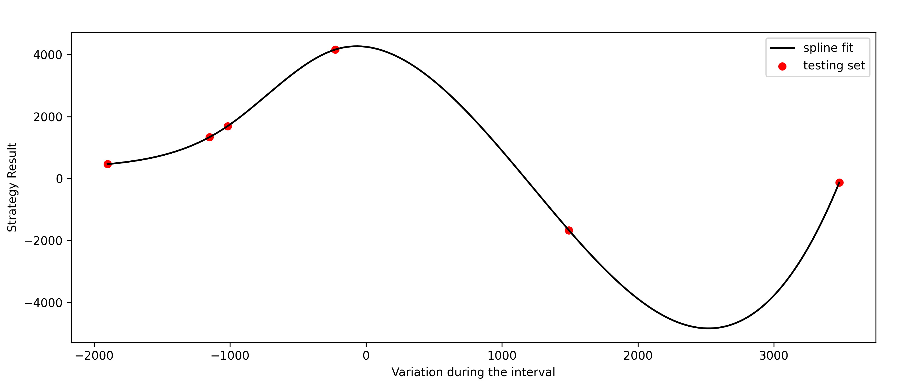

Slide 6
