Slide 1
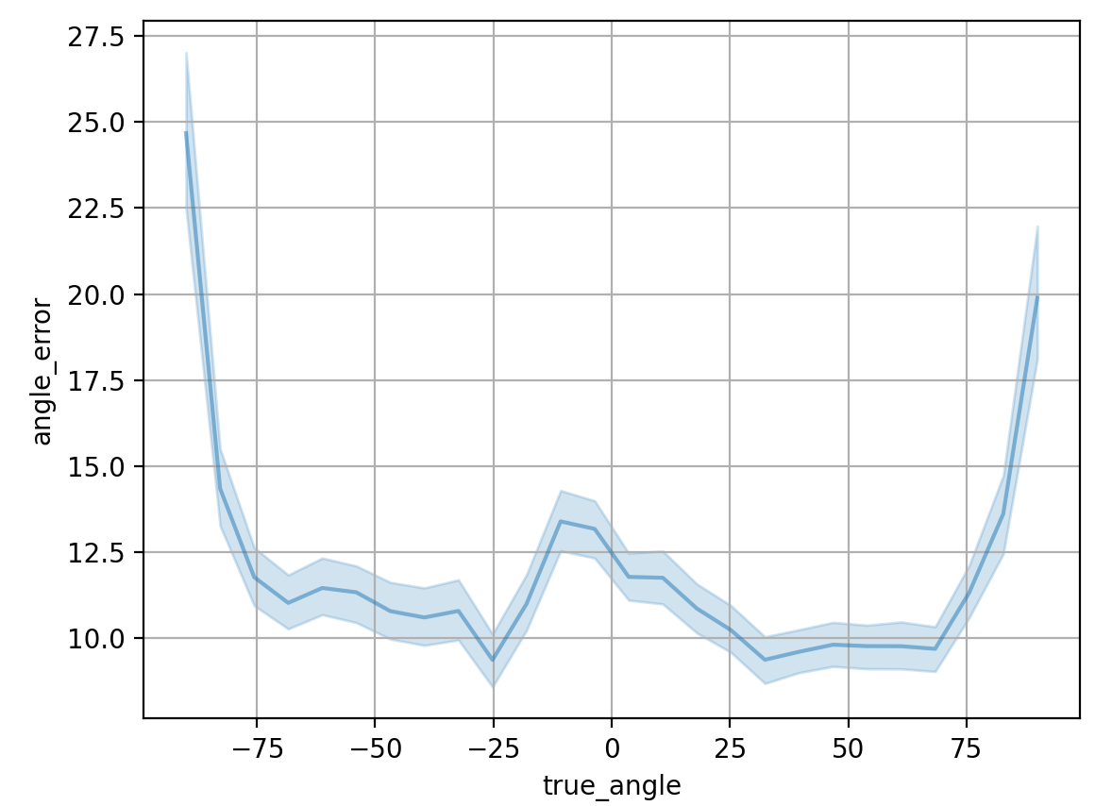
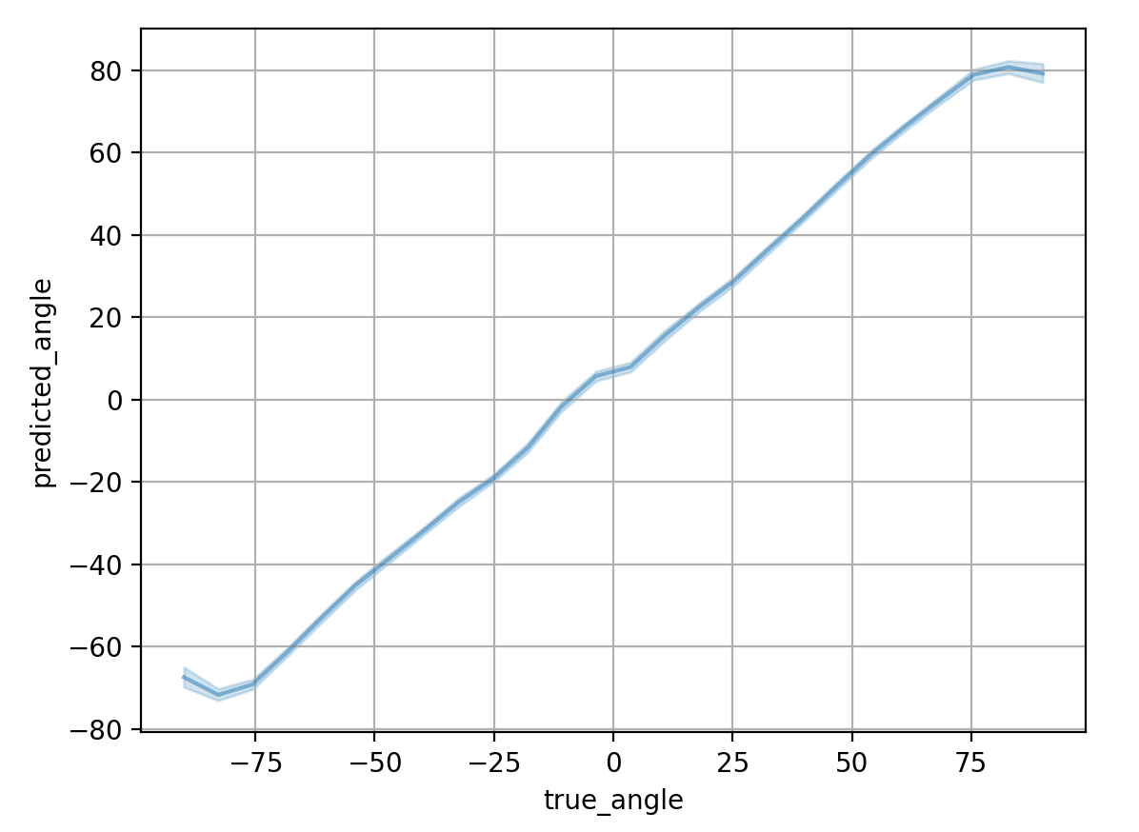
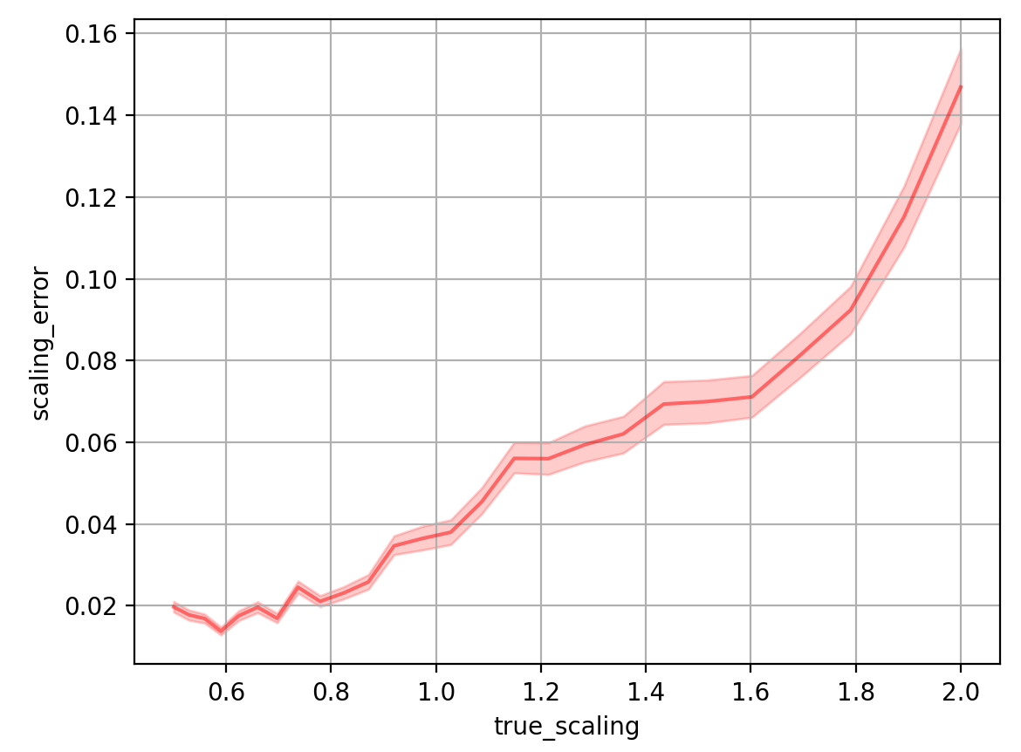
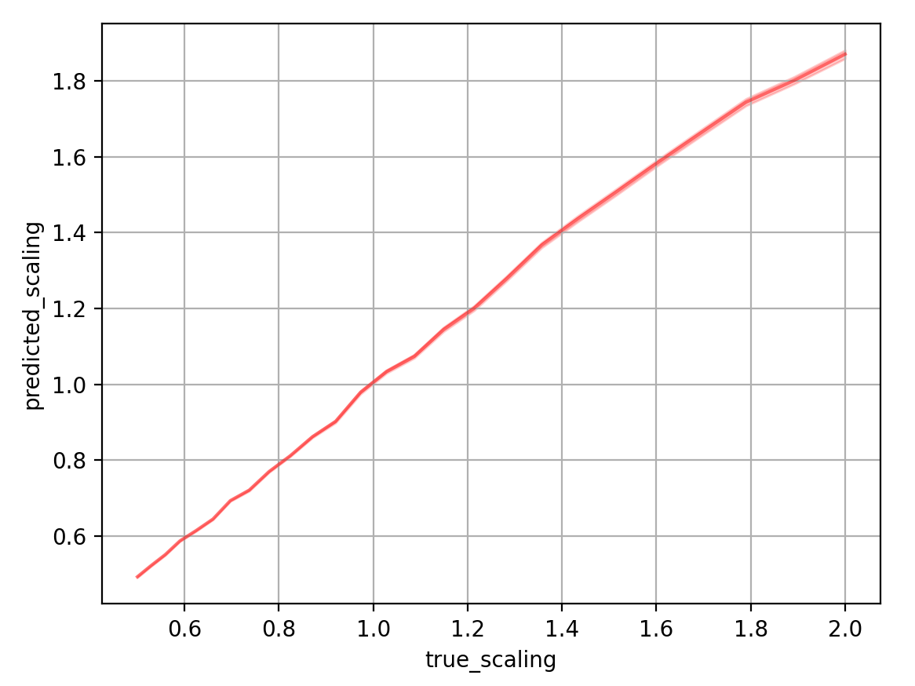
A network that wanted to do both
Angle error vs angle
Predicted vs true angle
Scaling error vs scaling
Predicted vs true scaling

Slide 2
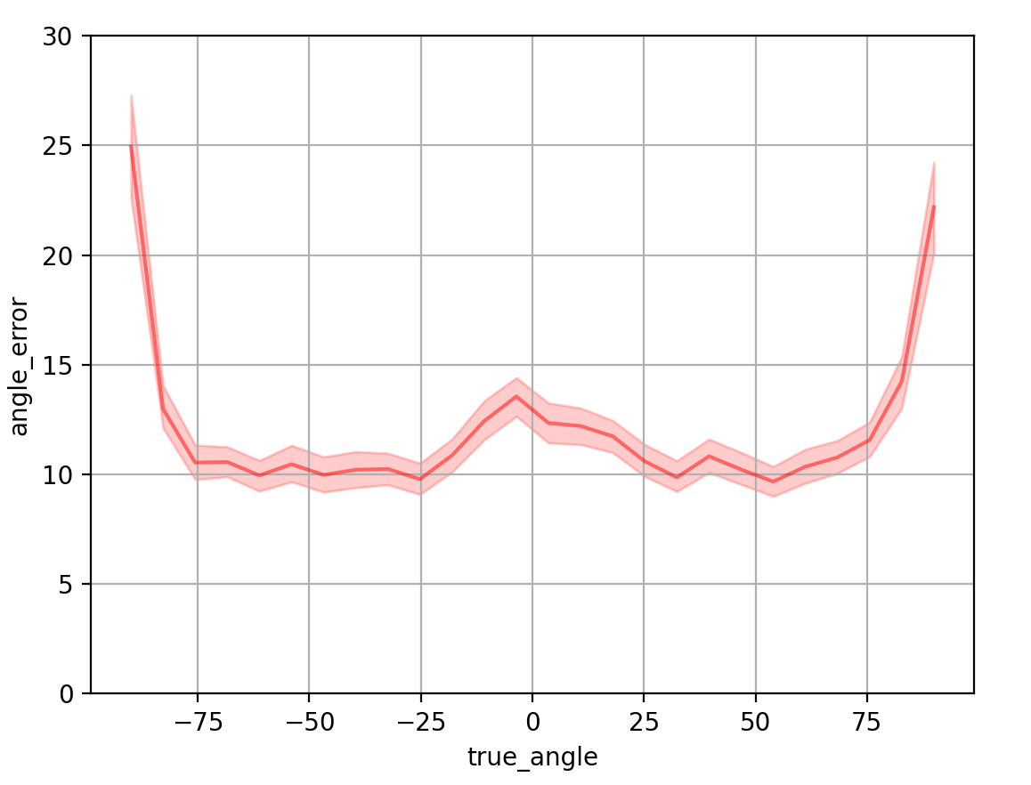
A NETWORK ENTIRELY DEVOTED TO LEARNING ANGLES… it’s failing

Slide 3
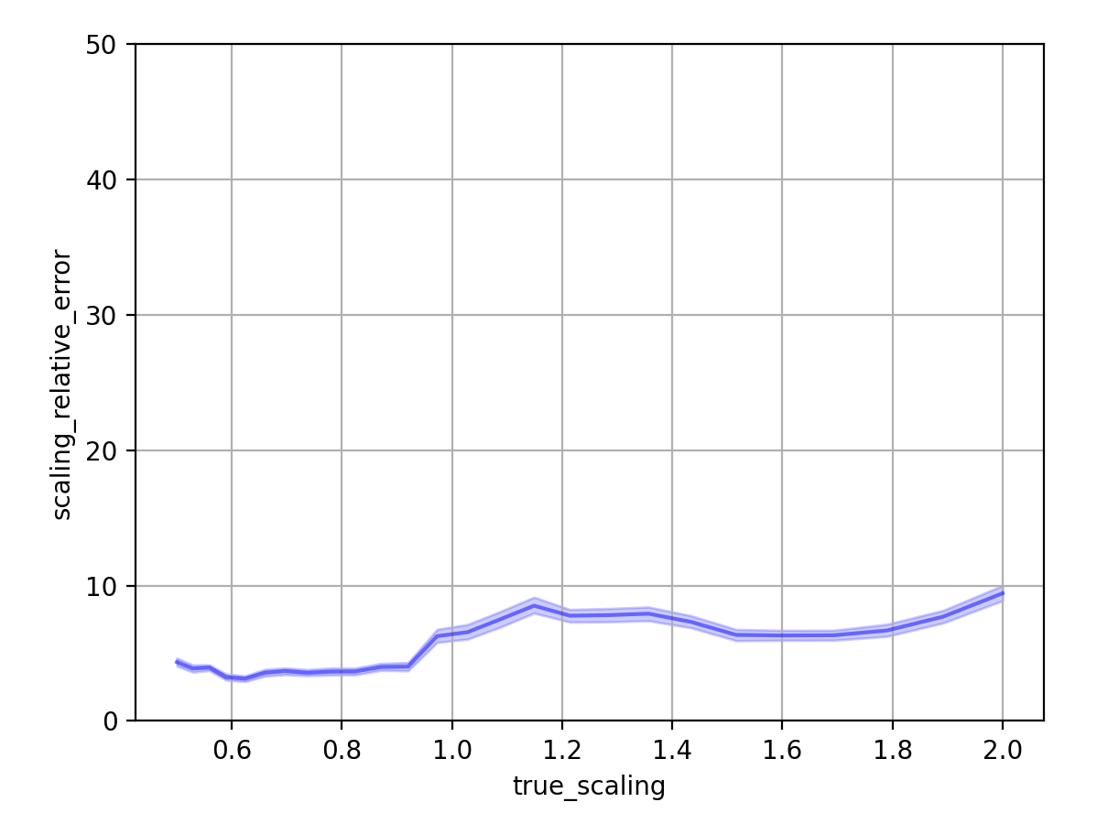
A NETWORK ENTIRELY DEVOTED TO LEARNING SCALING… it’s doing O.K.!

Slide 4
input_shape = (40,40,1)
dense_neurons = 100
f_s,f_m,f_l,f_xl = 4,8,16,32
ks_big = (3,3)
ks_small = (2,2)
4 - Conv 1 (3,3)
4 - Conv 2 (3,3)
4 - Conv 3 (3,3)
4 - Conv 1 (3,3)
4 - Conv 1 (3,3)
4 - Conv 1 (3,3)
4 - Conv 1 (3,3)
4 - Conv 1 (3,3)
4 - Conv 1 (3,3)
model = Sequential()
model.add(Conv2D(input_shape=input_shape,
filters=f_s,kernel_size=ks_big,padding="same", activation="relu"))
model.add(Conv2D(filters=f_s,kernel_size=ks_big,padding="same", activation="relu"))
model.add(MaxPool2D(pool_size=(2,2),strides=ks_small))
#model.add(Conv2D(filters=f_m, kernel_size=ks_big, padding="same", activation="relu")) #mutted 1 of 3 convs
model.add(Conv2D(filters=f_m, kernel_size=ks_big, padding="same", activation="relu"))
model.add(MaxPool2D(pool_size=(2,2),strides=ks_small))
#model.add(Conv2D(filters=f_l, kernel_size=ks_big, padding="same", activation="relu"))#mutted 1 of 3 convs
model.add(Conv2D(filters=f_l, kernel_size=ks_big, padding="same", activation="relu"))
model.add(Conv2D(filters=f_l, kernel_size=ks_big, padding="same", activation="relu"))
model.add(MaxPool2D(pool_size=(2,2),strides=ks_small))
#model.add(Conv2D(filters=f_xl, kernel_size=ks_big, padding="same", activation="relu"))#mutted 1 of 3 convs
model.add(Conv2D(filters=f_xl, kernel_size=ks_big, padding="same", activation="relu"))
model.add(Conv2D(filters=f_xl, kernel_size=ks_big, padding="same", activation="relu"))
model.add(MaxPool2D(pool_size=(2,2),strides=ks_small))
#model.add(Conv2D(filters=f_xl, kernel_size=ks_big, padding="same", activation="relu"))#mutted last step because it was already 2!
#model.add(Conv2D(filters=f_xl, kernel_size=ks_big, padding="same", activation="relu"))
#model.add(Conv2D(filters=f_xl, kernel_size=ks_big, padding="same", activation="relu"))
#model.add(MaxPool2D(pool_size=(2,2),strides=ks_small))
model.add(Flatten())
model.add(Dense(units=dense_neurons,activation="relu"))
model.add(Dense(units=dense_neurons,activation="relu"))

