Slide 1
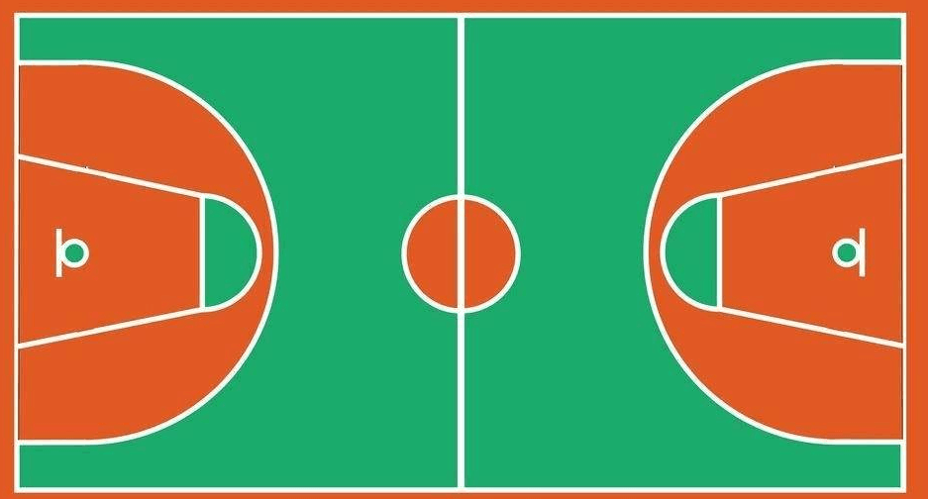
②
⑪
⑦
⑤
④
⑯
⑬
⑪
⑥
⑭
⑩
⑫
⑰
⑨
⑧
⑲
③
①

