Slide 1
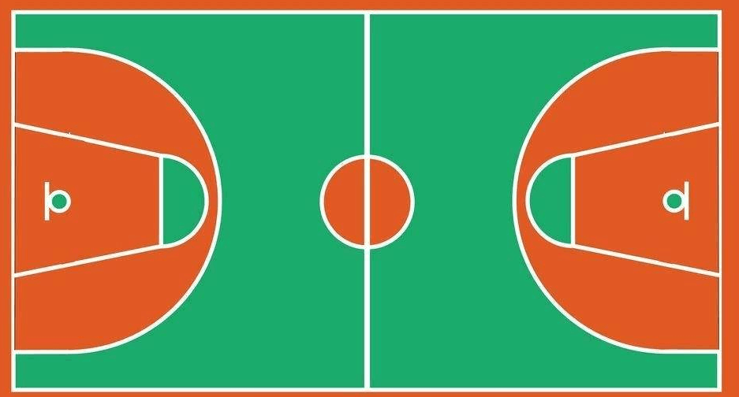
㉑
⑲
⑩
⑬
㉒
⑧
⑦
①
⑫
⑮
③
⑨
⑰
⑳
⑤
⑪
⑥
⑱
②

