Slide 1
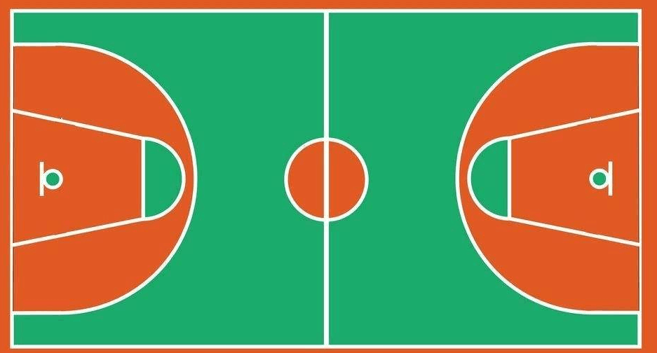
⑰
⑯
⑪
⑧
⑭
⑨
③
⑤
⑲
②
④
⑥
⑦
⑬
①

