Slide 1
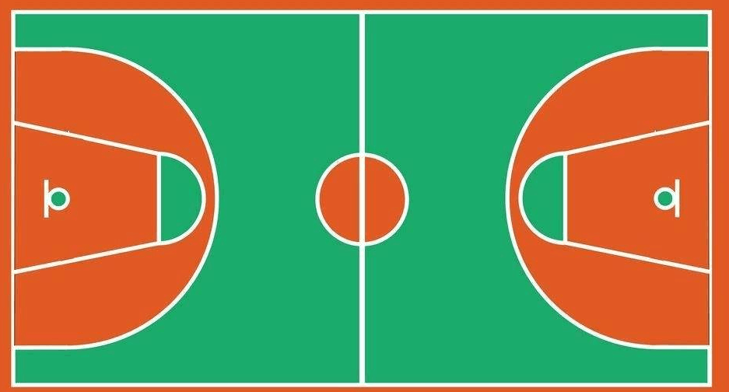
④
⑬
②
⑨
③
⑫
⑪
⑦
①
⑥
⑮
⑭
⑩
⑤
⑧

