Slide 1
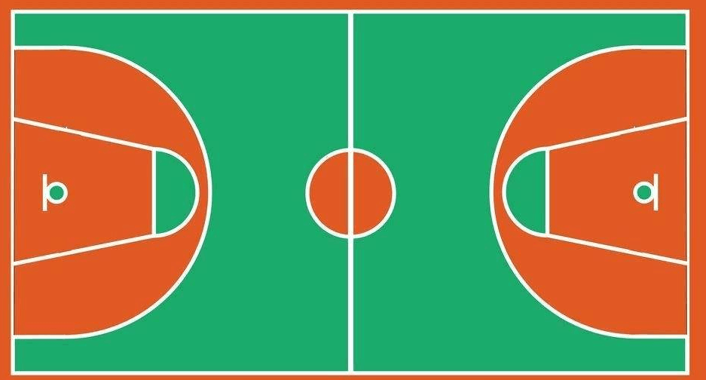
⑯
①
⑪
③
⑭
⑩
②
⑦
⑧
⑫
⑮
④
⑨
⑱
⑬
⑤
⑥

