Slide 1
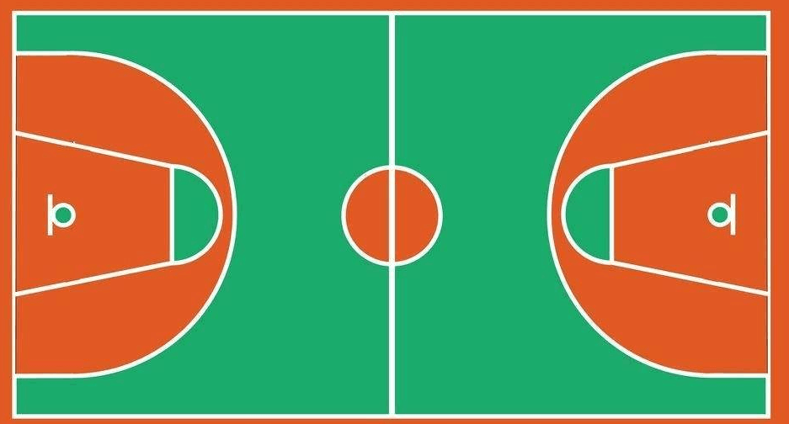
⑧
⑬
①
②
⑨
⑦
⑫
④
⑤
⑥
⑪

