Slide 1
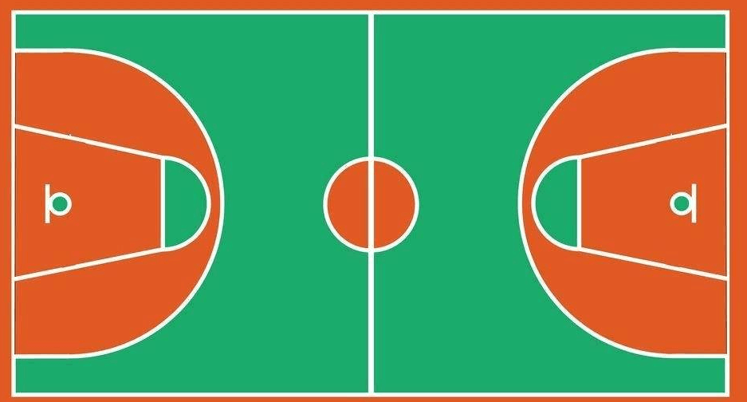
⑦
⑲
㉑
④
⑤
⑯
⑩
⑥
⑬
⑨
⑭
②
⑫
⑱
③
①
⑮

