Slide 1
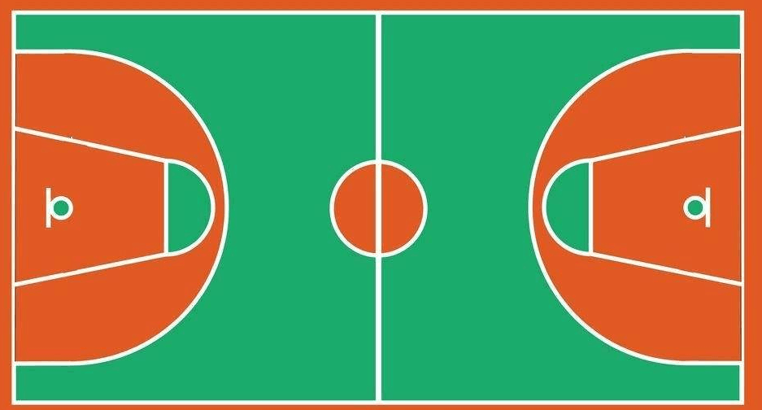
④
⑫
①
⑬
⑲
⑯
⑮
⑨
㉓
⑥
⑭
⑧
②
⑱
㉑
⑦
⑤
⑪
③
⑰
⑩
⑳

