Slide 1
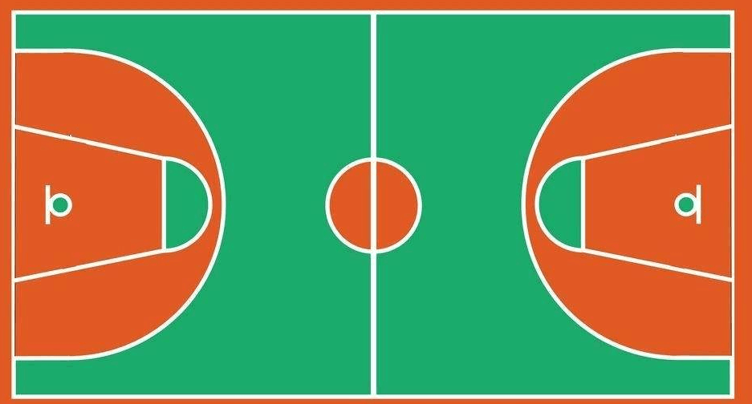
⑭
⑪
④
⑤
①
⑫
⑦
③
②
⑲
⑩
⑬
⑨
⑮
⑱
⑥
⑰
⑯

