Slide 1
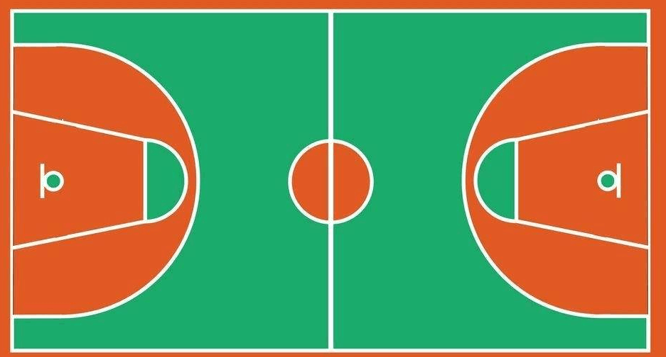
⑥
⑨
⑩
㉑
⑳
⑰
①
⑧
⑱
⑮
⑫
⑤
⑪
②
③
⑦
⑬
⑭

