Slide 1
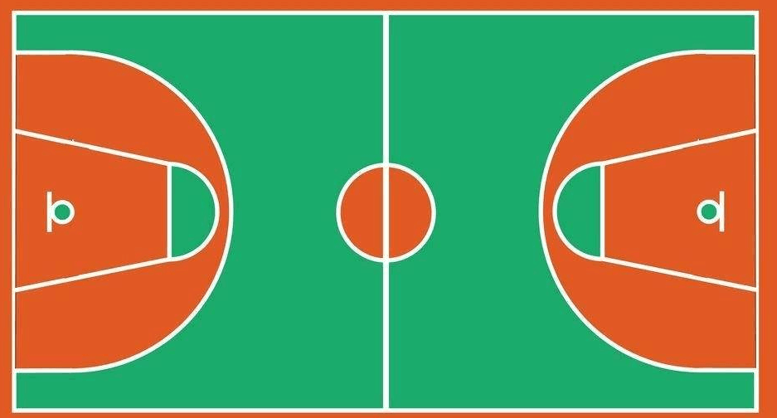
②
⑫
⑤
㉔
③
㉒
⑮
①
⑱
⑰
⑥
㉕
⑧
⑪
⑳
⑬
㉑
⑦

