Slide 1
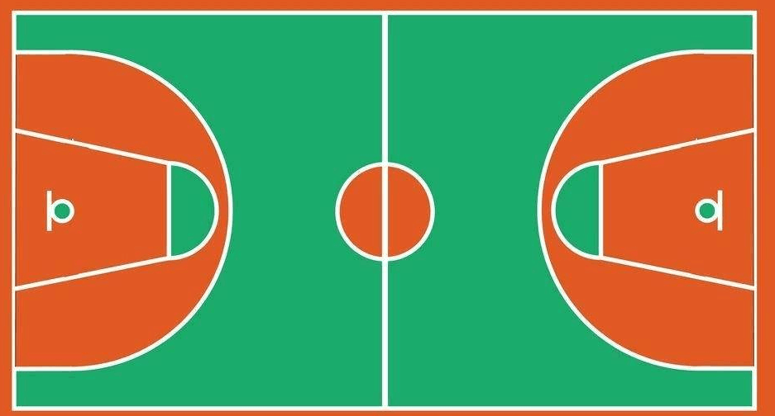
⑬
①
④
②
⑩
⑦
⑭
⑥
⑧
⑨
⑪
⑫
⑤

