Slide 1
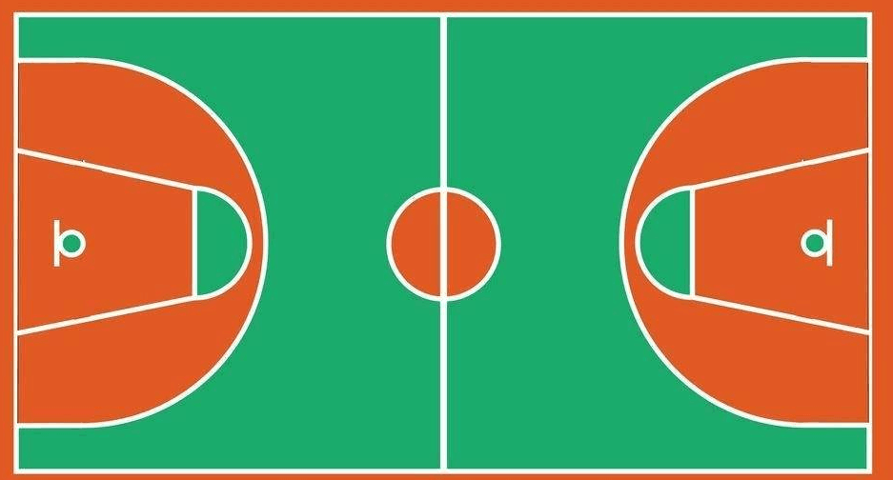
⑬
③
⑩
⑤
⑯
⑳
⑭
④
⑧
⑥
⑰
⑱
⑪
⑦
⑨
㉑
⑫

