Slide 1
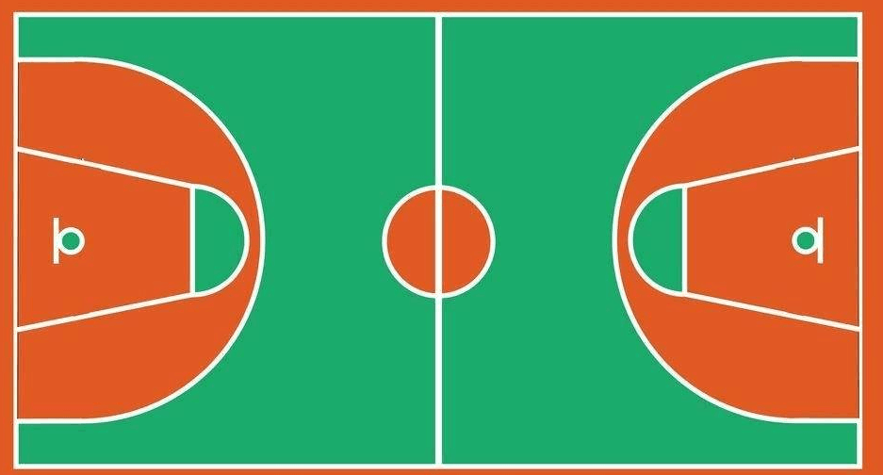
㉕
㉑
⑫
⑯
㉖
⑪
⑩
⑱
㉒
⑥
⑰
⑨
②
③
⑭
⑬

