Slide 1
RAND/US EXCHANGE RATE PREDICTION
Presented by:Maureen Gathoni

Slide 2
INTRODUCTION
Currency exchange rates, such as those between the US dollar and the South African rand, are always fluctuating. These variations may occur every day or even within a few hours. Even a slight fluctuation in the exchange rate can have a big impact on expenses and earnings for companies that import or export goods.

Slide 3
PROBLEM STATEMENT
The main challenge is that exchange rates are volatile and hard to anticipate. Small shifts can have a big impact, and traditional methods of just looking at past rates aren’t always reliable. That’s why we need a systematic, data-driven approach to forecast these rates in advance.

Slide 4
OBJECTIVES
1.To learn on the exchange rates patterns using historical data so as to give guided decisions
2.To find a model that will generalize and give accurate results and predict 7 days in advance to help in planning

Slide 5
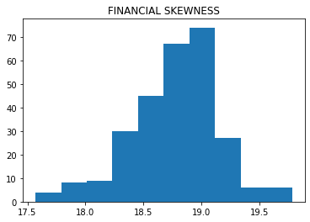
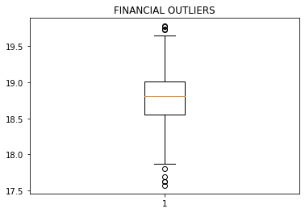
Data Overview
For our data we had 2 main columns (rand /dollar daily and the date column)&276 rows
Source of the data was provided by our mentor
Date range (2023-2024 years ,months may-dec 2023 and jan –may 2024)
No missing values present,no duplicates ,outliers were seen but where handled by interquartile method .Slight but not urgent skewness seen so no log transformation was needed

Slide 6
Objective:1WHAT IS AFFECTING EXCHANGE RATE?
Seasonality-do we have a pattern of how exchange rate is behaving overtime?
1.do we have a full repetitive cycle of years and months?
2.is our mean stationary or not?
Autocorrelation/volatility-does yesterday’s exchange rate affect todays exchange rate?

Slide 7
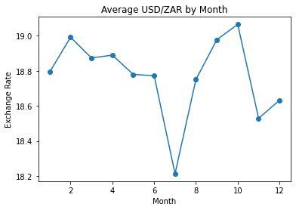
Seasonality
It was observed that our data lacked a sense of seasonality since for the two years the exchange rates was observed, they did not have full months from January to December .

Slide 8
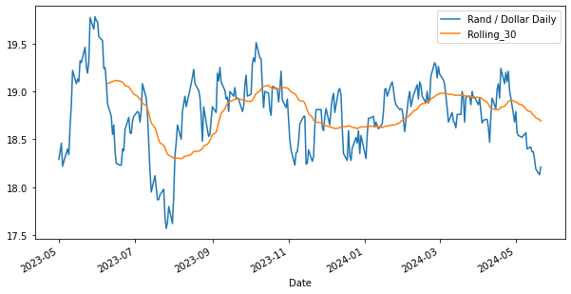
Trend
H0=to prove the exchange rate mean was non stationary
H1=to prove the exchange rate mean was stationary
If the pvalues <0.05 we accept otherwise we reject the hypothesis
Augumented dickey fuller a statistical method was used to either accept or reject the hypothesis that indeed our exchange rates as much as there is fluctuations the mean was constant.
Observations: pvalues was 0.002 which indeed rejects the hypothesis that our values have a constant mean and that supports indeed our data is not affected my seasons

Slide 9
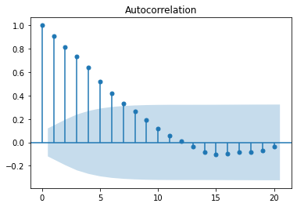
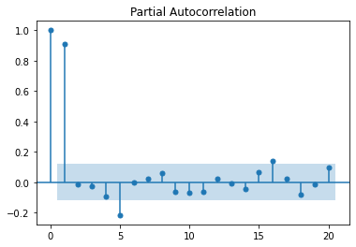
Autocorrelation

Slide 10
Objective 2:which model is suitable for the 7 day prediction?
What type of problems are we solving
Does it generalize well?
RMSE(is the actual prediction far from the predicted value)

Slide 11
Models
Model | rmse | conclusion
Linear regression | Train:0.15 Test:0.13 | Our data is generalizing well since the train and test results are slightly apart from each other
Random forest | Train:0.08 Test:0.15 | Our model is overfitting
XGBOOST | Train:0.11 Test:0.15 | Our model is overfitting

Slide 12
Conclusion And Future Recommendations
It was found out that exchange rate is affected by correlation and the best model to use is Linear regression.
For deployment I would use ussd codes where the client can just use their phone offline and dial a ussd number and check when will be a particular days prediction this helps in planning ahead to avoid loses

