Slide 1
ENHANCING WEB PERFORMANCING USING CDN [CONTENT DELIVERY NETWORK]

Slide 2
Introduction
A Content Delivery/Distribution Network (CDN) is a distributed network of servers strategically positioned in various geographic locations.
Its primary function is to deliver web content such as images, videos and scripts to users based on their geographic location.
CDNs aim to reduce latency and improve website performance by serving content from servers that are closest to the user, thereby minimizing the distance data needs to travel.

Slide 3
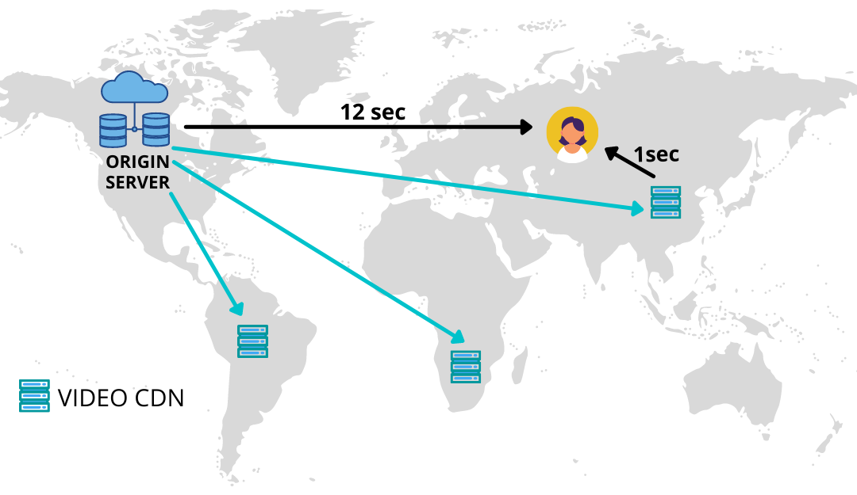

Slide 4
Benefits For Users
Faster Load Times: Content delivered from nearby CDN servers reduces latency, resulting in quicker page load times.
Improved Performance: CDNs optimize content delivery, reducing buffering times for videos and ensuring smooth browsing experiences.
Reliability: CDNs distribute content across multiple servers, minimizing the risk of downtime and ensuring consistent access to web resources.

Slide 5
Benefits For Developers
Scalability: CDNs can handle spikes in traffic by distributing load across multiple servers, reducing the burden on origin servers.
Security: Many CDNs offer built-in security features such as DDoS protection and SSL/TLS encryption, enhancing overall website security.
Analytics: CDNs provide valuable insights into website traffic patterns, user behavior, and performance metrics, empowering developers to optimize content delivery and user experiences.

Slide 6
Working of CDNs
CDNs work by establishing a point of presence (POP) or a group of CDN edge servers at multiple geographical locations. This geographically distributed network works on two principles .
Caching (for static content like images, JavaScript files, CSS files, videos)
Dynamic Acceleration (for dynamic content like weather reports and personalized recommendations)

Slide 7
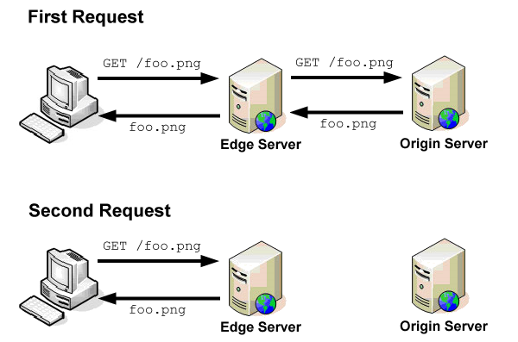
Caching
Caching is the process of storing multiple copies of the same data for faster data access.
In CDN technology, the term refers to the process of storing static website content on multiple servers in the network for a limited period of time.

Slide 8
Dynamic Acceleration
CDN servers accelerate the process between the origin server and the client.
They reduce time taken for security verification as the CDNs already have an ongoing and trusted connection with the origin server.
They optimise the connection with origin server using the following features:
Intelligent routing algorithms
The ability to process the client request which reduces its size

Slide 9
Implementation of CDNs
There are two primary methods for implementing a CDN:
Third-party CDN Providers: Third-party CDN providers like Cloudflare, Akamai, and Amazon CloudFront offer ready-to-use CDN solutions.
Building a Custom CDN: Building a custom CDN involves designing and deploying a network of servers optimized for content delivery. This approach requires expertise in networking, server infrastructure, and content caching strategies.

Slide 10
Building a Custom CDN
Identify your POPs
Choose your infrastructure set up – virtual servers, physical servers or combination of both
Identify your viewership and prepare for spikes
Prepare and plan for disaster scenarios
Choose suitable ISPs for your POPs
Install SSL certificates
Install CDN and caching software

Slide 11
Challenges asscoiated with CDN
Costs
Complexity of Implementation
Cache Invalidation Challenges
Data Privacy and Security Concerns
Limited Control

Slide 12
Strategies for Optimising CDNs
Reduce the amount of data that needs to be delivered by compressing files, optimizing images, and using efficient file formats.
If complexity is a significant concern, consider hiring professionals or consultants with CDN implementation expertise.
Implement proper cache-control headers and automate cache invalidation
Use HTTPS to encrypt data, ensuring that sensitive information is protected.
Choose a Trusted Provider
Utilize available security features such as DDoS protection, Web Application Firewalls (WAF), and two-factor authentication.

Slide 13
Conclusions
Content Delivery Networks (CDNs) play a vital role in enhancing web performance by offering benefits like faster load times and improved security.
Businesses should seriously consider integrating CDNs into their infrastructure to leverage the advantages they provide in terms of speed and security.
To ensure peak performance, it is imperative for organizations to consistently optimize their CDNs, keeping them up to date with the latest technologies.

