Slide 1
Derivatives
Introduction, Types, and Usage

Slide 2
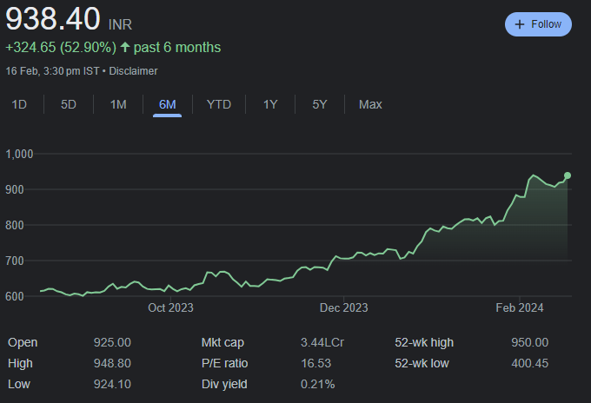

Slide 3
Introduction
Definition:
A derivative is a financial instrument whose value depends on, or is derived from, the value of another variable.
Examples: futures, forwards, swaps, options, exotics…
The term was first coined in 1976
The first documented usage goes back to ancient times attributing the use to a Greek philosopher named Thales (Bernstein, 1992)

Slide 4
The Underlying Variables
Derivatives
Bonds
Currencies
Commodities
Indices
Stocks
Interest Rates

Slide 5
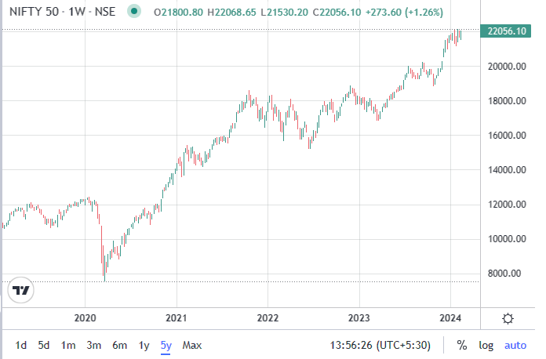

Slide 6
How Derivatives are Traded?
On exchanges like CME, CBOE, NSE, BSE, MCX, etc. as standard listed contracts
In the over-the-counter (OTC) market where traders working for banks, fund managers and corporate treasurers contact each other directly

Slide 7
OTC Markets
Before 2008
Largely unregulated Banks acted as market makers quoting bids and offers Master agreements usually defined how transactions between two parties would be handled But some transactions were cleared through central counterparties (CCPs). A CCP stands between the two sides to a transaction in the same way that an exchange does

Slide 8
OTC Markets
Since 2008
OTC market has become regulated. Objectives: Reduce systemic risk (see Business Snapshot 1.2, page 5) Increase transparency In the U.S and some other countries, standardized OTC products must be traded on swap execution facilities (SEFs) which are electronic platforms similar to exchanges CCPs must be used to clear standardized transactions between financial institutions in most countries All trades must be reported to a central repository

Slide 9
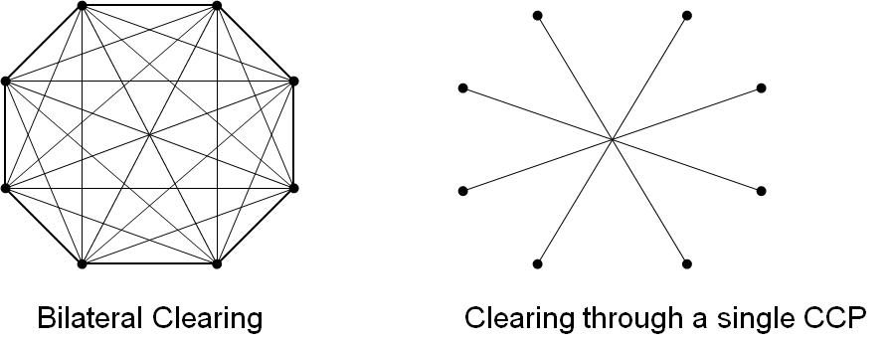
OTC Markets
Bilateral vs Central Clearing
CCCCCP
CCP

Slide 10
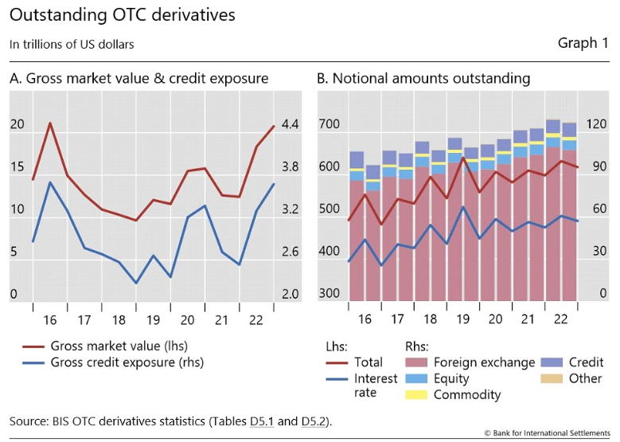

Slide 11
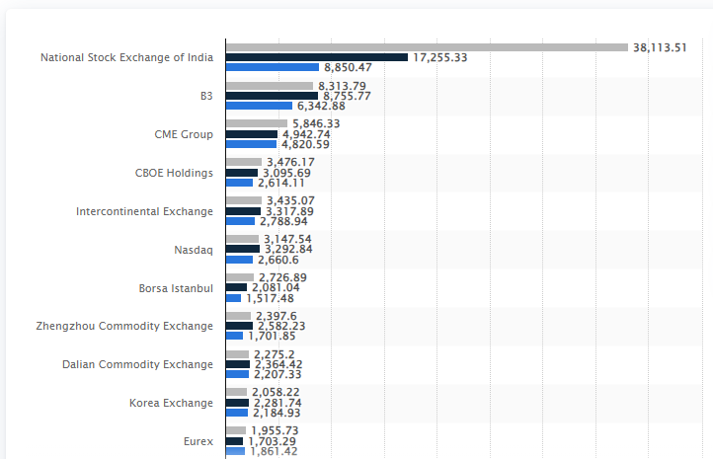

Slide 12
Uses of Derivatives
To hedge risks
To speculate (take a view on the future direction of the market)
To lock in an arbitrage profit
To change the nature of a liability
To change the nature of an investment without incurring the costs of selling one portfolio and buying another

Slide 13
Common Types of Derivatives
Forwards
Futures
Options
Swaps

Slide 14
FOREX Quotes for USD
 | BID | OFFER (ASK)
Spot Price | 83.017 | 83.037
1-month Forward Price | 7.5 | 9.5
2-month Forward Price | 21 | 23
3-month Forward Price | 31 | 33
* Sell @ BID price and Buy @ ASK price

Slide 15
What is Forward Price
The forward price for a contract is the delivery price that would be applicable to the contract if were negotiated today (i.e., it is the delivery price that would make the contract worth exactly zero)
The forward price may be different for contracts of different maturities (as shown by the table)

Slide 16
Terminology
Long Position
The party who has agreed to buy the underlying is said to have taken the long position.
Short Position
The party who has agreed to sell the underlying is said to have taken the short position.

Slide 17
Example
On Feb 17, 2024, the treasurer of a corporation enters into a long forward contract to buy £1 million in six months at an exchange rate of 104.561
This obligates the corporation to pay Rs. 104,561,000 for £1 million on November 17, 2024
What are the possible outcomes?

Slide 18
Long Forward Position
(K= delivery price=forward price at time contract is entered into)
Profit
Price of Underlying at Maturity, S_{T}
K

Slide 19
Short Forward Position
(K= delivery price=forward price at time contract is entered into)
Profit
Price of Underlying
at Maturity, S_{T}
K

Slide 20
Futures Contracts
Agreement to buy or sell an asset for a certain price at a certain time
Similar to forward contract
Whereas a forward contract is traded OTC, a futures contract is traded on an exchange
Trade on margins and are marked-to-market (daily settled)

Slide 21
Examples of Futures Contracts
Agreement to:
Buy 100 oz. of gold @ US$1300/oz. in December
Sell £62,500 @ 1.4500 US$/£ in March
Sell 1,000 bbl. of oil @ US$50/bbl. in April
Notes:
9

Slide 22
Gold: An Arbitrage Opportunity?
Suppose that:
The spot price of gold is US$1,200
The 1-year forward price of gold is US$1,300
The 1-year US$ interest rate is 5% per annum
Is there an arbitrage opportunity?
Notes:
18

Slide 23
Gold: Another Arbitrage Opportunity?
Suppose that:
The spot price of gold is US$1,200
The 1-year forward price of gold is US$1,200
The 1-year US$ interest rate is 5% per annum
Is there an arbitrage opportunity?
Notes:
19

Slide 24
The Forward Price of Gold (ignores the gold lease rate)
If the spot price of gold is S and the forward price for a contract deliverable in T years is F, then
F = S (1+r )^{T}
where r is the 1-year (domestic currency) risk-free rate of interest.
In our examples, S = 1200, T = 1, and r =0.05 so that
F = 1200(1+0.05) = 1,260
Notes:
20

Slide 25
Oil: An Arbitrage Opportunity?
Suppose that:
The spot price of oil is US$50
The quoted 1-year futures price of oil is US$60
The 1-year US$ interest rate is 5% per annum
The storage costs of oil are 2% per annum
Is there an arbitrage opportunity?
Notes:
21

Slide 26
Oil: Another Arbitrage Opportunity?
Suppose that:
The spot price of oil is US$50
The quoted 1-year futures price of oil is US$40
The 1-year US$ interest rate is 5% per annum
The storage costs of oil are 2% per annum
Is there an arbitrage opportunity?
Notes:
22

Slide 27
Practice …
During the summer you get an opportunity to spend some time as an intern with a Gramin bank, whose majority clientele is wheat farmers. Your mentor, knowing you have studied DRM at BITS Pilani, asked for your expertise in designing financial contracts that can protect farmers against the adverse price movement of wheat. Thus, you have to design and price the contracts maturing in 1yr.
You find out that the current price of wheat is Rs. 2,125 per quintal and interest rates are at 6%. However, you also find out that it is relatively expensive to store wheat for one year. Assume that this cost, which must be paid upfront, runs at about Rs. 57 per quintal.

Slide 28
Types of Traders
Hedgers
Speculators
Arbitrageurs
Notes:
15

Slide 29
Hedging Examples
A US company will pay £10 million for imports from Britain in 3 months and decides to hedge using a long position in a forward contract
An investor owns 1,000 Microsoft shares currently worth $28 per share. A two-month future is available with a strike price of $29.50. The investor decides to hedge by shorting 10 contracts
Notes:
16

Slide 30
Speculation Example
An investor with Rs. 200,000 to invest feels that a stock price will increase over the next 2 months. The current stock price is Rs. 200 and the expected price after 2 months is Rs. 260. Futures are trading at 10% margin
What could be the strategy?
Notes:
17

Slide 31
Arbitrage Example
A stock price is quoted as £100 in London and $150 in New York
The current exchange rate is 1.5300
What is the arbitrage opportunity?

Slide 32
Dangers
Traders can switch from being hedgers to speculators or from being arbitrageurs to speculators
It is important to set up controls to ensure that trades are using derivatives in for their intended purpose
Soc Gen (see Business Snapshot 1.5 on page 25) is an example of what can go wrong

Slide 33
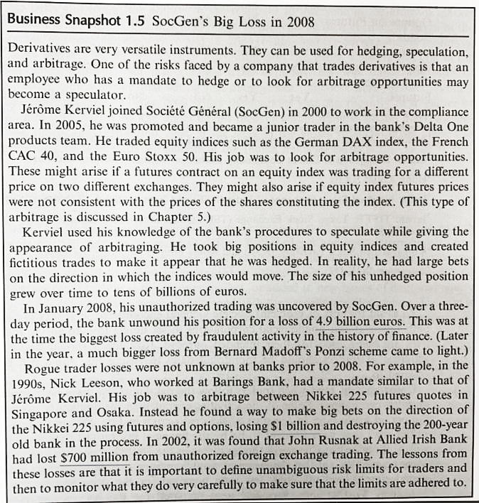

Slide 34
Hedge Funds (see Business Snapshot 1.3, page 12)
Hedge funds are not subject to the same rules as mutual funds and cannot offer their securities publicly.
Mutual funds must
disclose investment policies,
make shares redeemable at any time,
limit use of leverage
Hedge funds are not subject to these constraints.
Hedge funds use complex trading strategies are big users of derivatives for hedging, speculation and arbitrage

