Slide 1
Studying complex relationships between employees’ compensation and other organizational factor using Machine Learning techniques
AIT 614 003
Dr. Zhang
George Mason University
11/27/2023
By:
Davon Carvalho
Sarik Dhungel
Nikhil Reddy Gatla
Saiphani Chandra Vuppala
Sai Unnathi Nandula

Slide 2
Introduction and Background
For effective Human Resource Management, understanding complex relationships between employees’ compensation, workforce dynamics and many other organizational factors is important.
Moreover, for better career choices also it is important to understand which departments, jobs, etc. are more likely to get paid higher in any organization.
AI/ML have been employed in different organizations for employee performance evaluation, recruitment, training, discipline management and many more with an end goal of growing business values and building reliable decision-making systems.
However, there is still a need for in-depth AI/ML based statistical analyses to better understand complex relationships between employees’ compensation and other organizational factors like departments, organizational groups, health and dental facilities, etc.

Slide 3
Research Objective
How have there been a change in employees’ compensation patterns over the last decade and what is the expected patterns in future?
Which jobs are more likely to get paid in days to come?
How are the patterns of salaries distribution across different organizational groups?
Can the employees’ salaries be predicted by using regression Machine Learning techniques?

Slide 4
Project Timeline
Phase | Approx. Time
Planning and data collection | 10/10/23 - 10/20/23
Data Cleaning, and preprocessing | 1st iteration: 10/20/23 - 10/22/23 Multiple other iterations involved throughout the project.
Data tools & technology | 10/22/23 - 10/26/23
Analytics approaches & Descriptive Analysis | 10/26/23 - 11/12/23
Model & Framework | 11/12/23 - 11/22/23
Result, Discussion, and documentation | 11/23/23 - 11/27/23
Multiple iterations for each major phases
Planning and research brainstorming phase
Data cleaning and preprocessing phase
Statistical, descriptive analysis and visualization phase
Models building phase
Result and Analysis phase

Slide 5
Dataset
Employee Compensation Dataset
Data Source: Data Gov https://catalog.data.gov/dataset/employee-compensation
Attribute | Data type | Attribute | Data type
Year | Interval | Organization group | Nominal
Department | Nominal | Union | Nominal
Job Family | Nominal | Salaries | Ratio
Overtime | Ratio | Retirement | Ratio
Total Salaries | Ratio | Other Benefit | Ratio
Total Compensation | Ratio | Compensation Cat | Ordinal

Slide 6
System : Development Platforms
Databricks platform
Cloud based unified data analytics platform
Suitable for data intensive applications.
Intelligent because it optimizes performance and manages infrastructures as needed for the project.
Simple because it simplifies user experience and makes development work convenient.
Secure platform that facilitates data privacy.
Makes distributed ML models development tasks easier.

Slide 7
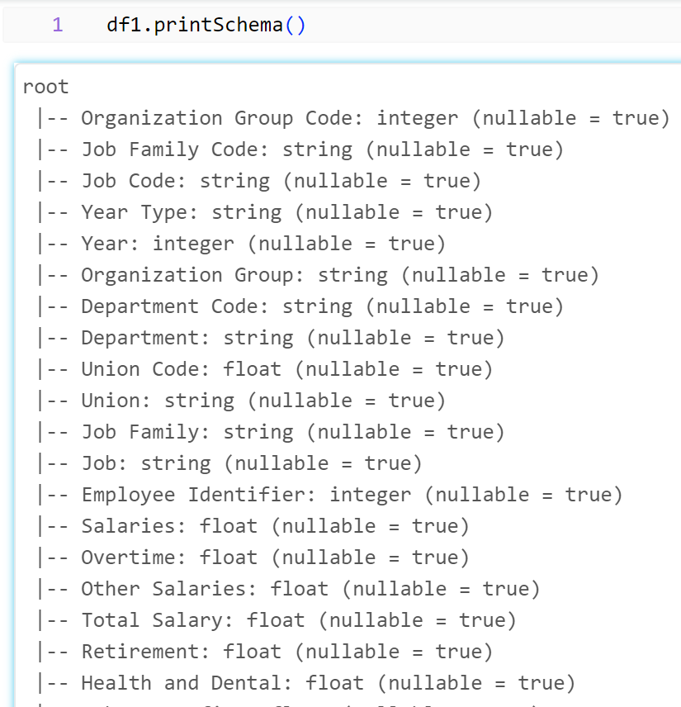
Database
Databricks File System (DBFS) is used to load the employees’ compensation dataset.
The data types of all the attributed were string type after the data was uploaded in the dbfs.
To get the correct intended format of the dataset, new schema was created. [A part of the schema is shown in the image on the right]

Slide 8
Architecture and Framework
Machine Learning models implementation for building predictive models
Linear regression, Decision tree regression, Random forest
Cross validator to evaluate the performance of the model on unseen data
Data processing and Analytics approaches
Analysis for estimates of salaries over the past decade with kernel density estimates.
Filtering and grouping for jobs with highest number of employees with salaries below 35k analysis
Matplotlib for scatter plots, histograms, and barcharts.
Seaborn for heatmap, kernel density estimation plots.
Correlation analysis between various attributes of the dataset.
Joining, sorting, and filtering approaches for generating insights.

Slide 9
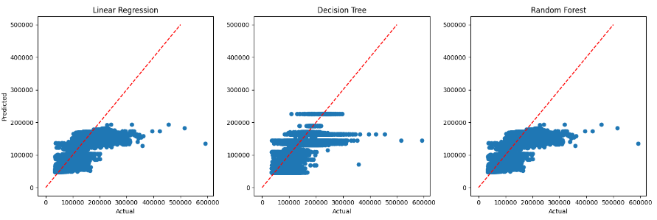
Experimental Results and Analysis
Linear Regression (R2: 0.82, RMSE: 15808.6)
Decision Tree Regressor(R2: 0.81, RMSE: 16234.6)
Random Forest Regressor (R2: 0.82, RMSE: 15808.6 )
Fig: Regression plots for three models used in our study

Slide 10
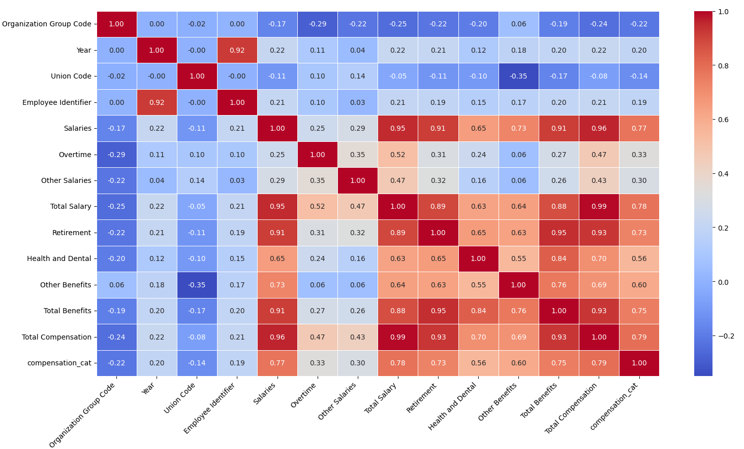
Correlation Analysis
Correlation coefficient measure between different attributes in the dataset.
Visualization as heatmap as shown in the right.
Fig: Correlation coefficients between various variables in the dataset

Slide 11
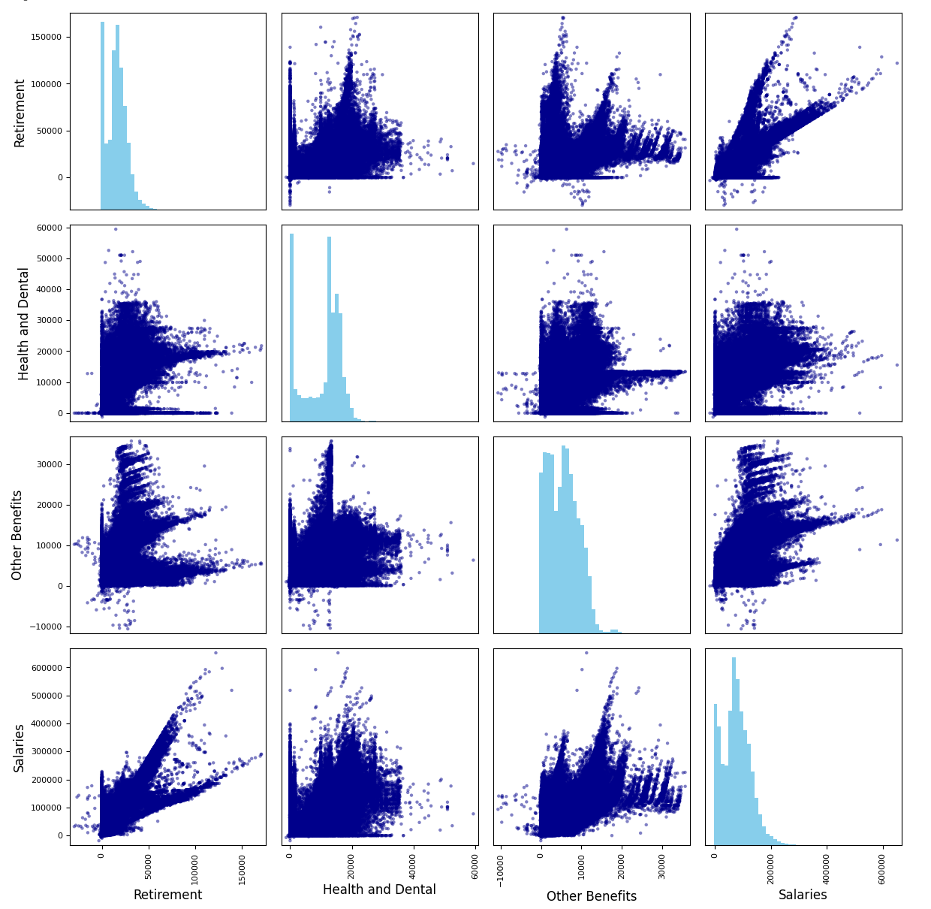
Statistical and Descriptive Analyses
Histograms and scatter plots between retirement, salaries, health and dental, and other benefits.
We see that retirement and salaries are positively correlated with these visualization.
However, there is no clear correlation of salaries with health and dental and other benefits
Furthermore, histograms gives us the idea about which values of salaries are more common among people.
Fig: Scatter plots and histograms for benefits and salary analysis

Slide 12
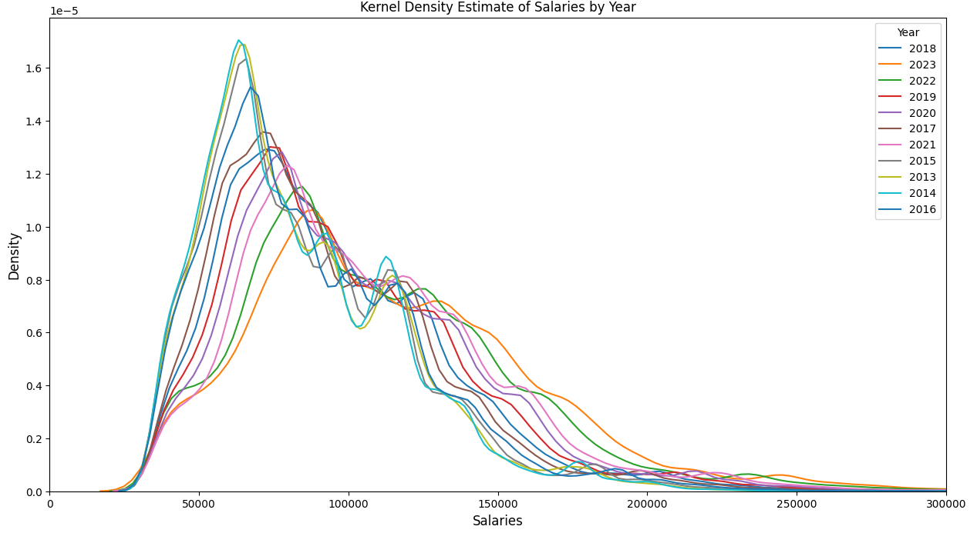
Experimental Results and Analysis : Temporal Patterns
The plot visualizes the distribution of salaries across different years.
This visualization is particularly useful for spotting changes in salary distribution, such as shifts in the concentration of salaries or changes in the range of salaries paid across different years
Some insights we can infer includes, with passage of time, people are getting more salary in general.
However, still there is an unequal distribution of money within an organization resulting in very few people making a high amount of money.

Slide 13
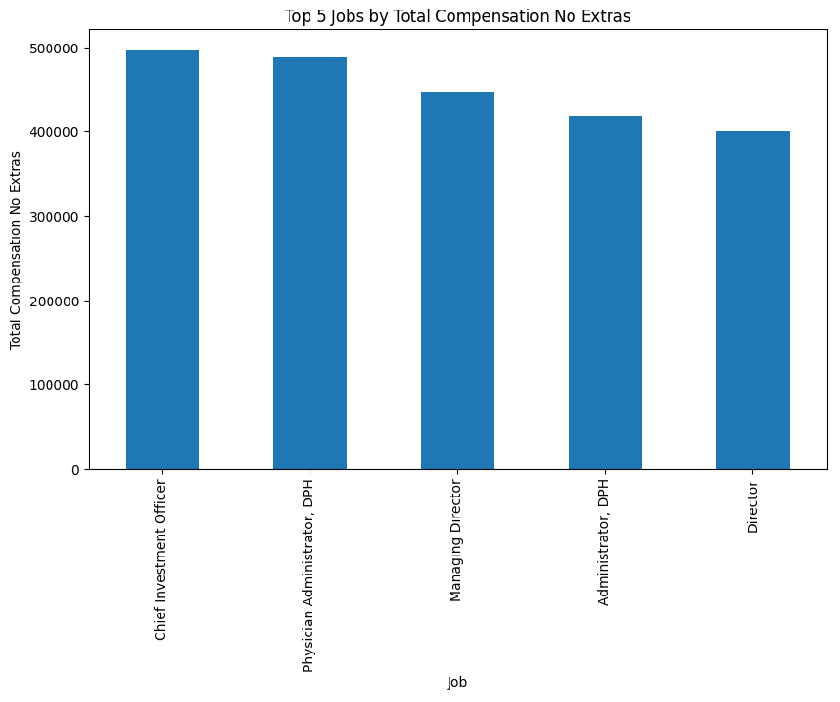
Experimental Results and Analysis : Highest paying jobs
This analysis is valuable for understanding which job titles offer the highest base compensation, independent of additional earnings like overtime and other salaries.
It provides insights into the compensation structure across different job roles, which can be crucial for salary benchmarking and organizational budget planning as well as for career choice.
So basically, chief investment officer, physician administrator, managing director, administrator and director are paid more in general.

Slide 14
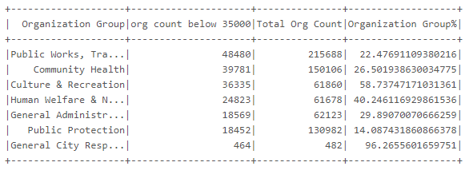
Experimental Results and Analysis : Salaries across organizational groups
This analysis is crucial for identifying organization groups that may require further investigation or intervention regarding salary distribution and workforce planning.
Top 7 organization groups where the majority of lower salary cases are concentrated within the organization.
Fig: Organizational groups where the majority of lower salaries are concentrated

Slide 15
Conclusions, limitations and future works
To conclude, in this study, we implemented several ML regression models to predict employees’ compensation with good accuracy
Temporal patterns were analysed which hinted that with the passage of time, people are getting a higher salary in general. However, still there is an unequal distribution of money within an organization.
Chief investment officer, physician administrator, managing director, administrator and director are paid more in general.
Employees associated with general city responsibilities, culture and recreation organizational groups are more likely to get a lower amount of salary in comparison to other organizational groups.
Talking about the limitations of the study, due to slow computation power of the community edition of the databricks platform, we couldn’t perform hyperparameter tuning with lots of parameters and higher folds validations.

Slide 16
Acknowledgement
We would like to express our sincere gratitude to Dr. Zhang who conducted the classes for AIT 614 003 and guided us with helpful contents along with tools like pySpark, databricks, and so on. Without these, this research wouldn’t have been possible. Thank you for all insights and knowledge.
REFERENCES
Data Gov. (2023). Employee Compensation [Dataset]. data.sfgov.org. https://catalog.data.gov/dataset/employee-compensation
Votto, A. M., Valecha, R., Najafirad, P., & Rao, H. R. (2021). Artificial intelligence in tactical human resource management: A systematic literature review. International Journal of Information Management Data Insights, 1(2), 100047.
Cullen, Z., Perez-Truglia, R. (2022). How much does your boss make? the effects of salary comparisons. Journal of Political Economy, 130, 766-822
Pyspark Overview (2023, September 09). Spark. Retrieved from https://spark.apache.org/docs/latest/api/python/index.html

