Slide 1
Mamba: Linear-Time Sequence Modeling with Selective State Spaces
Authors: Albert Gu & Tri Dao
Presenters: Anna Hampton & Isaly Tappan

Slide 2
Motivation: Sequence Modeling
Efficiency versus effectiveness trade-off when leveraging context
Transformers achieve high performance on long sequences
No context compression
Computations scale quadratically with sequence length

Slide 3
Motivation: Sequence Modeling
Efficiency versus effectiveness trade-off when leveraging context
Transformers achieve high performance on long sequences
No context compression
Computations scale quadratically with sequence length
State space models achieve high performance in continuous domains (e.g. audio)
Finite state
Computations scale linearly (or near linearly) with sequence length

Slide 4
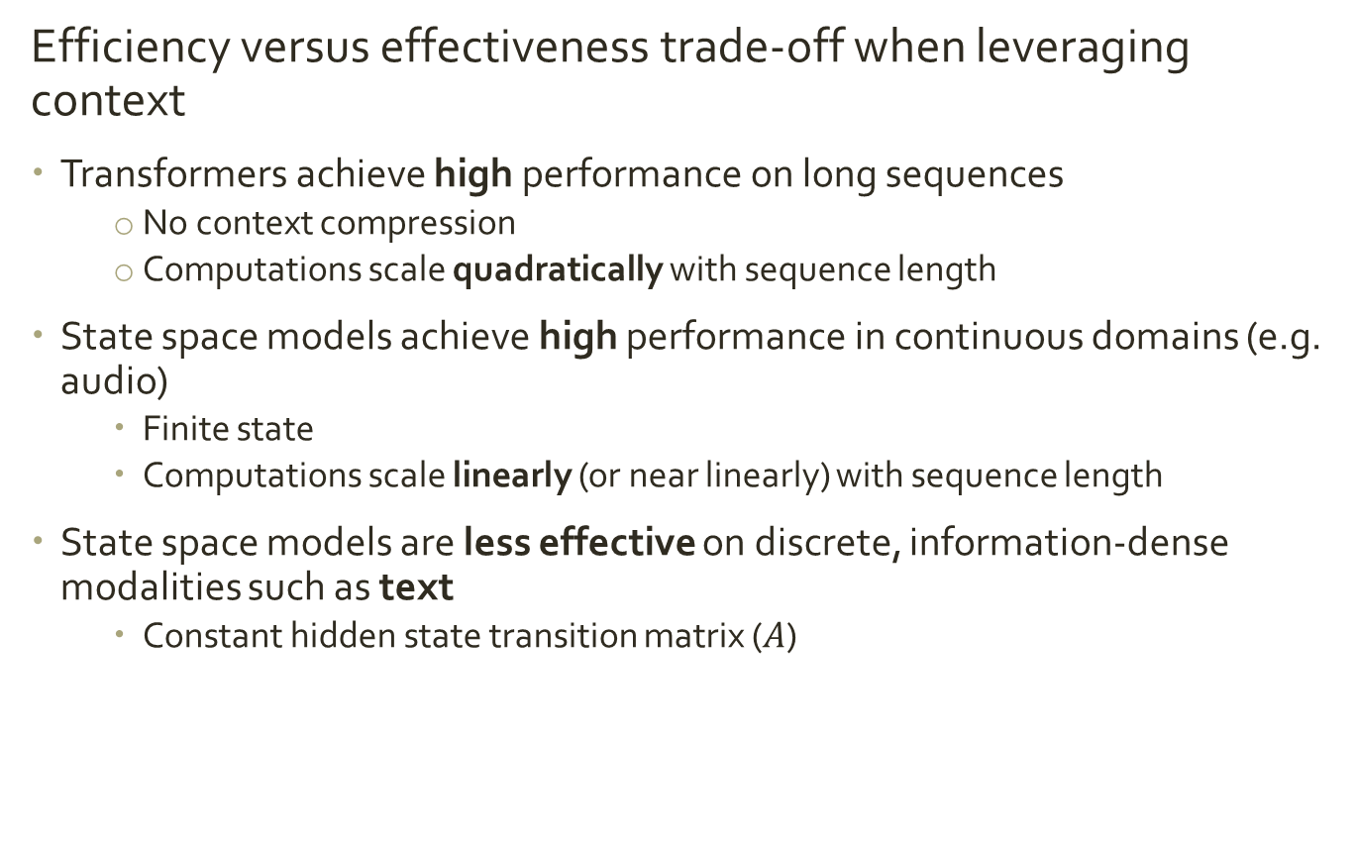
Motivation: Sequence Modeling
Efficiency versus effectiveness trade-off when leveraging context
Transformers achieve high performance on long sequences
No context compression
Computations scale quadratically with sequence length
State space models achieve high performance in continuous domains (e.g. audio)
Finite state
Computations scale linearly (or near linearly) with sequence length
State space models are less effective on discrete, information-dense modalities such as text
Constant hidden state transition matrix ($A$)

Slide 5
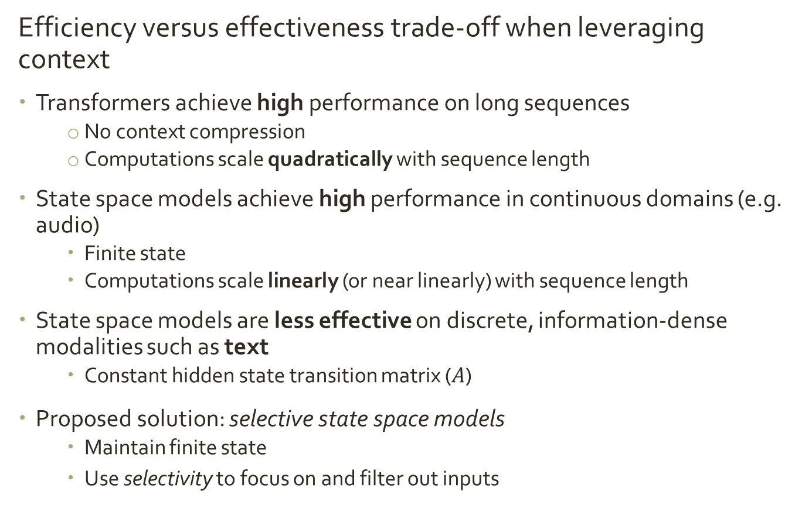
Motivation: Sequence Modeling
Efficiency versus effectiveness trade-off when leveraging context
Transformers achieve high performance on long sequences
No context compression
Computations scale quadratically with sequence length
State space models achieve high performance in continuous domains (e.g. audio)
Finite state
Computations scale linearly (or near linearly) with sequence length
State space models are less effective on discrete, information-dense modalities such as text
Constant hidden state transition matrix ($A$)
Proposed solution: selective state space models
Maintain finite state
Use selectivity to focus on and filter out inputs

Slide 6


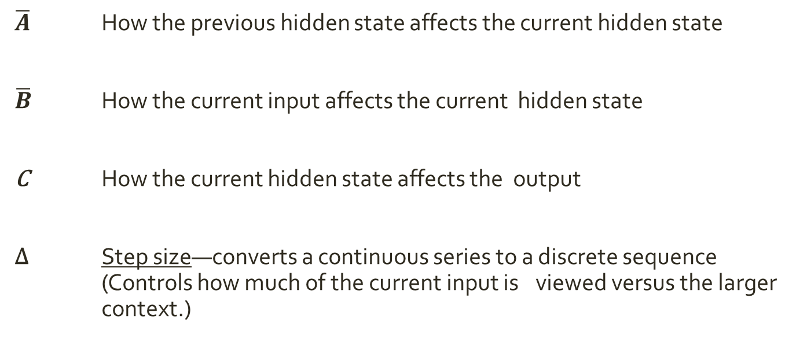










Overview of Selective State Space
In classic S4 models, the transition matrices are learnable but fixed (LTI system).
In the Selective State-space Models (SSMs) used in Mamba , the transition matrices are functions of the input.
$$h_{t}=\overline{A}h_{t−1}+\overline{B}x_{t}$$
$$h_{t}={\overline{A}}_{t}h_{t−1}+{\overline{B}}_{t}x_{t}$$
kinda
$$y_{t}=Ch_{t}$$
$$y_{t}= C_{t}h_{t}$$
$\overline{A}$ How the previous hidden state affects the current hidden state
$\overline{B}$ How the current input affects the current hidden state
C How the current hidden state affects the output
Δ Step size—converts a continuous series to a discrete sequence
(Controls how much of the current input is viewed versus the larger context.)
$\overline{A}$ = $exp(ΔA)⁡$
$\overline{B}$= $({\left(ΔA\right)}^{−1}\left(\exp\left(ΔA\right)−I\right))∙exp(ΔB)⁡$
$$\left(A, B, C, Δ\right) ⟼\text{(}\overline{A}\text{, }\overline{B}, C)$$
D: input channels
N: hidden state size
$$x_{t}∈ℝ^{D×1}$$
$$h_{t}∈ℝ^{D×N}$$
$$C_{t}^{}∈ℝ^{N×1}$$
$$A_{t}∈ℝ^{D×N}$$
$$B_{t}∈ℝ^{D×N}$$
Notes:
Hadamard for 1xD, DxN
Introduce selectivity
Give intuition for each matrix

Slide 7
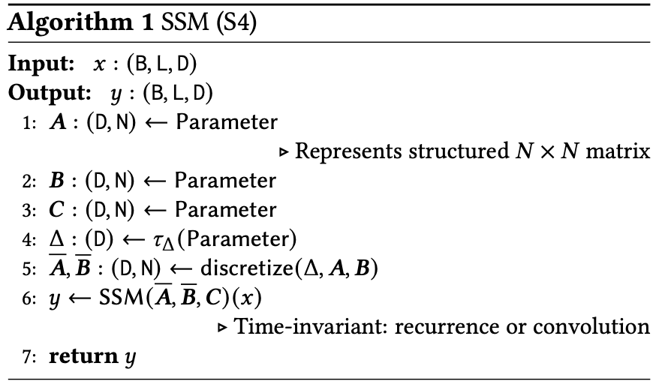
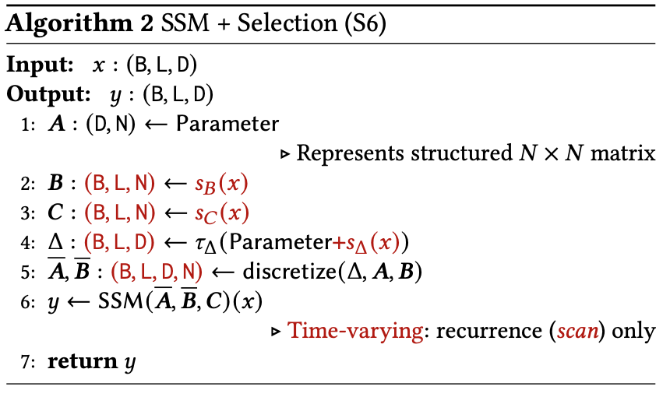



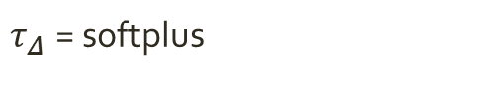


Algorithm Differences
Updated Selective State Space (S6) Algorithm
$$h_{t}=\overline{A}h_{t−1}+\overline{B}x_{t}$$
$$y_{t}=Ch_{t}$$
B: Batch size
L: sequence length
D: input dimension
N: projected dimension
(N = ED, where E is typically 2 )
${\text{Linear}}_{d}$ = parameterized projection to dimension d
$$s_{B}\text{(}\text{x}\text{) = }{\text{Linear}}_{N}\text{ (}\text{x}\text{) }$$
$$s_{C}\text{(}\text{x}\text{) = }{\text{Linear}}_{N}\text{ (}\text{x}\text{) }$$
$$s_{Δ}\text{(}\text{x}\text{) = }{{\text{Linear}}_{N}\text{(}\text{Linear}}_{1}\text{ (}\text{x}\text{)) }$$
$τ_{Δ} \text{=}$ softplus
Notes:
Structure -> structured A matrix (diagonals) for ease of computation
Parameter -> function

Slide 8
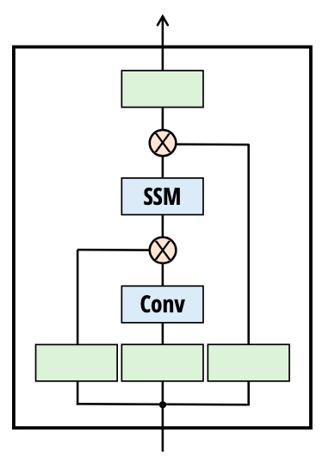
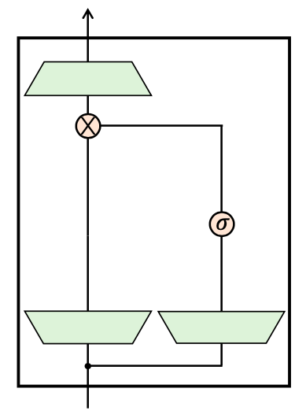
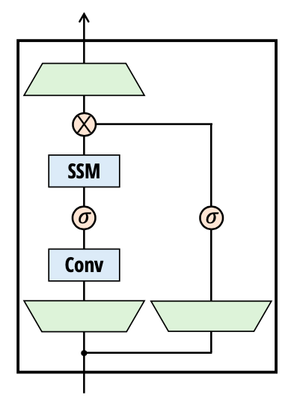

Mamba Block: Architecture Overview
+
=
H₃
Gated MLP
Mamba
Sequence transformation
Nonlinearity (swish or element-wise multiplication)
Linear projection
Notes:
The multiplicative interactions between the output of the shift SSM and the V projection mimics local multiplicative interactions in linear attention (depending on the size of the hidden state). Similarly, multiplicative interactions with the Q projection and the output of the diagonal SSM allows comparisons between tokens over the entire sequence.
multiplicative interactions between input projections and their outputs to model comparisons between points in a sequence
Introduce 1D convolution

Slide 9






Selective SSM: Selective $B_{l}$, $C_{l}$ and computation of $Δ_{l}$
Linear layer with N nodes
LINEAR
$$C_{l}∈ℝ^{N}$$
$$X_{l}∈ℝ^{D}$$
Linear layer with N nodes
LINEAR
$$B_{l}∈ℝ^{N}$$
$$f\left(x\right)=\log{(1+\exp\left(x\right))}$$
D = channels in input to SSM
N = size of hidden state
LINEAR
LINEAR
SOFTPLUS
$$Δ_{l}∈ℝ^{D}$$
Linear layer with R nodes where R|D
Linear layer with D nodes
* Authors use R = 1
Notes:
R = 1 rationale – if an input should be ignored, it should be ignored across all D channels
Soft plus is like smooth ReLU

Slide 10








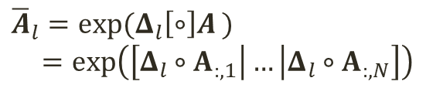



Selective SSM: Discretization of A
Recall, the SSM is essentially being applied to each dimension of the input
$$A∈ℝ^{D×N}$$
$$Δ_{l}∈ℝ^{D}$$
$${\overline{A}}_{l,d}=exp{(Δ_{l,d}A_{d})}∈ℝ^{1×N}$$
The discretization method they recommend for A is the zero-order hold
$$×$$
$$A_{d}∈ℝ^{1×N}$$
$$Δ_{l,d}∈ℝ^{1}$$
Matrix form
Repeat for all D channels
$$×$$
$${\overline{A}}_{l}=exp(Δ_{l}\left[∘\right]A )$$
$=exp\left(\left[Δ_{l}∘A_{:,1}\right|…\left|Δ_{l}∘A_{:,N}\right]\right)$
$${\overline{A}}_{l}=exp$$
$$×$$
D = channels in input to SSM
N = size of hidden state
…
$$×$$
$${\overline{A}}_{l}∈ℝ^{D×N}$$
Notes:
Since the SSM is being applied to each dimension independently, each feature channel has its own discretization value contained in the vector delta. This value is multiplied across the A vector for the corresponding dimension. This is repeated for all channels and then the output row vectors are stacked and exponentiated to form the A matrix. This can also be seen in matrix form on the left where the circle with brackets around it denotes a column-wise Hadamard product. Essentially the delta vector multiplies each column of A. For initialization of A, they recommend the HiPPO formulation.

Slide 11













Selective SSM: Discretization of B
$$Δ_{l}∈ℝ^{D}$$
$$B_{l}∈ℝ^{N}$$
$${\overline{B}}_{d}={Δ_{l,d}B_{l}^{T}}∈ℝ^{1×N}$$
$$×$$
$$B_{l}^{T}∈ℝ^{1×N}$$
$$Δ_{l,d}∈ℝ^{1}$$
Euler’s method for discretization is recommended for B
Repeat for all D channels
Matrix form
$$×$$
$$×$$
$$×$$
$${\overline{B}}_{l}=$$
…
$$×$$
D = channels in input to SSM
N = size of hidden state
$${\overline{B}}_{l}={Δ_{l}B_{l}^{T}}∈ℝ^{D×N}$$
$${\overline{B}}_{l}∈ℝ^{D×N}$$
Notes:
B relates the inputs to the state space. Each dimension originally shares the same B vector, but post discretization, each dimension will have its own. This stems from the fact that each input dimension will have its own discretization value.

Slide 12














Selective SSM: Hidden state update and output computation
Recall, the SSM is essentially being applied to each dimension of the input
Hidden State Update
$${\overline{A}}_{l}∈ℝ^{D×N}$$
$$X_{l}∈ℝ^{D}$$
$$=$$
$$∘$$
$$+$$
$$[∘]$$
$$h_{l}∈ℝ^{D×N}$$
$$h_{l−1}∈ℝ^{D×N}$$
$${\overline{B}}_{l}∈ℝ^{D×N}$$
Output Computation
$$C_{l}^{T}∈ℝ^{1×N}$$
D = channels in input to SSM
N = size of hidden state
$$=$$
$$×$$
$$y_{l}∈ℝ^{1×D}$$
$$h_{l}^{T}∈ℝ^{N×D}$$

Slide 13
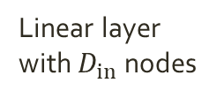







Mamba Block
$$X∈ℝ^{L×D}$$
$$Y_{mam}∈ℝ^{L×D_{in}}$$
Linear layer with D nodes
LINEAR
Causal CONV
SiLU
Selective SSM
$$×$$
LINEAR
Linear layer with $D_{in}$ nodes
$$X_{in}∈ℝ^{{L×D}_{in}}$$
$$SiLU\left(x\right)=x \left(\frac{1}{1+\exp\left(−x\right)}\right)$$
$$G∈ℝ^{L×D}$$
Linear layer with D nodes
LINEAR
SiLU
$D_{in}$ = channels in input to Mamba block
D = channels in input to SSM
N = size of hidden state
L = sequence length
Inspired by gated attention unit and hungry, hungry hippos (H3)
Context over time – D convolutional filters looking across the previous 4 time points
Use sigmoid linear unit instead of sigmoid for activation function
Scales input using sigmoid
Notes:
Convolution – current time step is convolved with the previous 4 timesteps (pad with zeros)

Slide 14
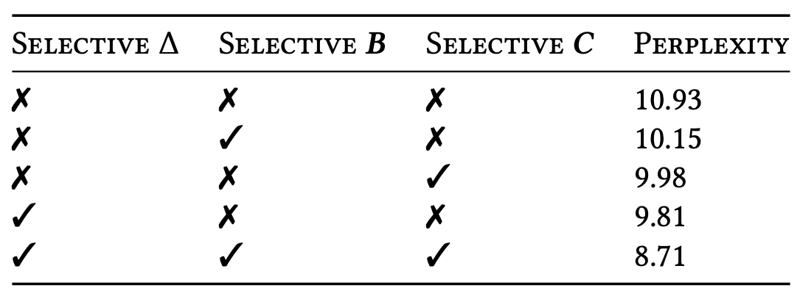
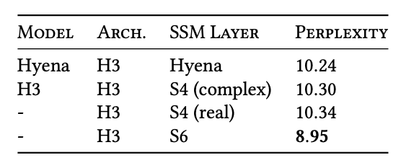
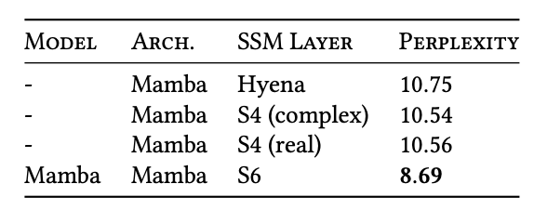
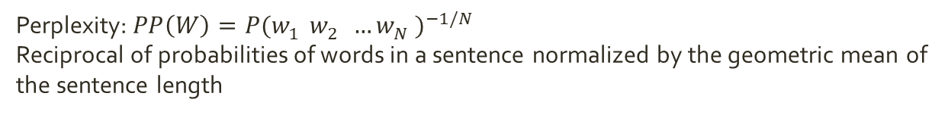
Experimental Results: Ablation
Task: “Language modeling”
Table 7: Selectivity Comparison
Table 6: Architecture Comparison
Perplexity: $PP\left(W\right)=P{(w_{1}^{}w_{2}^{}…w_{N}^{})}^{−1/N}$
Reciprocal of probabilities of words in a sentence normalized by the geometric mean of the sentence length
Notes:
Table 6 investigates the effects of the architecture (block) and its inner SSM layer (Figure 3). We find that
• Among previous non-selective (LTI) SSMs, which are equivalent to global convolutions, performance is very similar.
• Replacing the complex-valued S4 variant from previous work with a real-valued one does not affect performance much, suggesting that (at least for LM) real-valued SSMs may be a better choice when accounting for hardware efficiency.
• Replacing any of these with a selective SSM (S6) significantly improves performance, validating the motivation of Section 3.

Slide 15
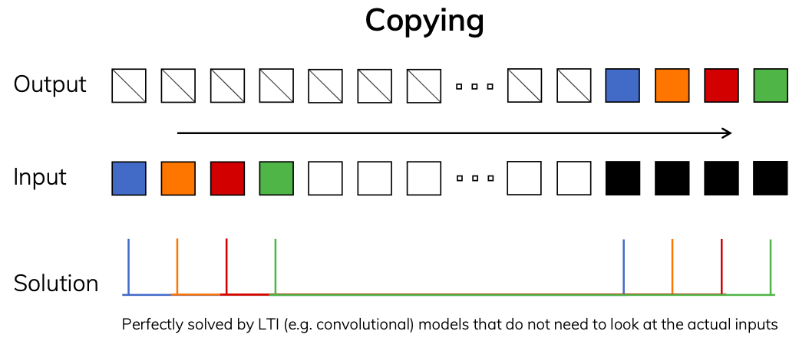
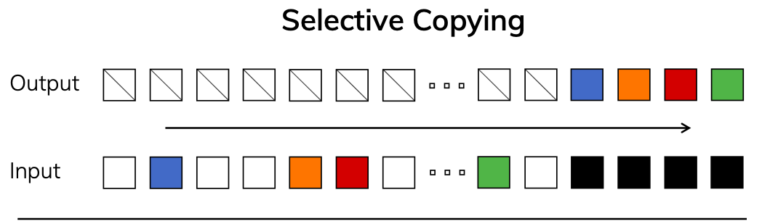
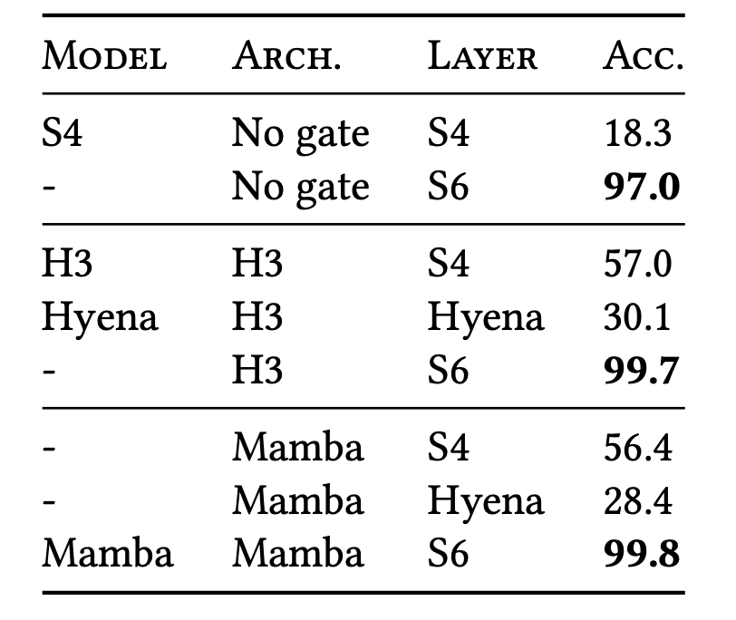
Experimental Results: Selective Copying
Results
Architecture gating using multiplicative interactions (H3, Mamba) block are not important.
Selection mechanism (S6) is important.

Slide 16
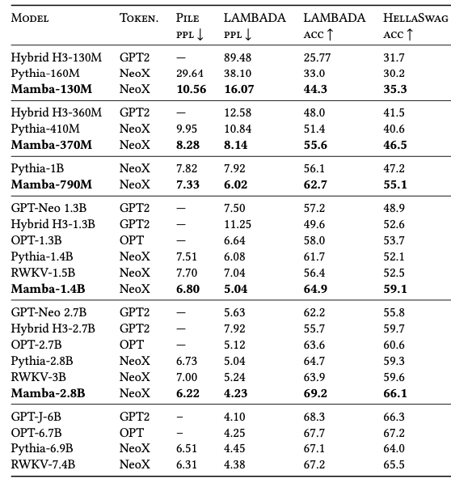
Experimental Results: Zero-Shot Evaluation
Task:
Select the appropriate next sequence from four sequences.

Slide 17
Conclusions
State space models are now competitors to language modeling with transformers

Slide 18
Conclusions
State space models are now competitors to sequence modeling with transformers
LTI state space models perform worse on discrete, information-dense data
Bias toward continuous domains

Slide 19
Conclusions
State space models are now competitors to sequence modeling with transformers
LTI state space models perform worse on discrete, information-dense data
Bias toward continuous domains
Including selectivity alleviates these issues
Maintains hardware speed up compared to transformers

Slide 20
Conclusions
State space models are now competitors to sequence modeling with transformers
LTI state space models perform worse on discrete, information-dense data
Bias toward continuous domains
Including selectivity alleviates these issues
Maintains hardware speed up compared to transformers
Achieves transformer-quality performance
In pretraining complexity and downstream evaluation

