Slide 1
Deep State Space Models for Time Series Forecasting
by Syama Sundar Rangapuram, Matthias Seeger, Jan Gasthaus, Lorenzo Stella, Yuyang Wang, and Tim Januschowski
Yuang Geng and Jordan Peper

Slide 2
Agenda
Background
Time series forecasting, applications, and models
Overview of state space models
Motivation
Problem with state space models for time series forecasting
Solution: recurrent neural network
Setup
State space transition and observation models
Parameter learning
Deep state space model
Setup
Training
Prediction
Experiments
Background
Examples
Motivation
Intro to the SSM
Intro to other time-series predictive model (RNN)
Comprehensive model structure
Training and prediction phase
Results demonstration

Slide 3
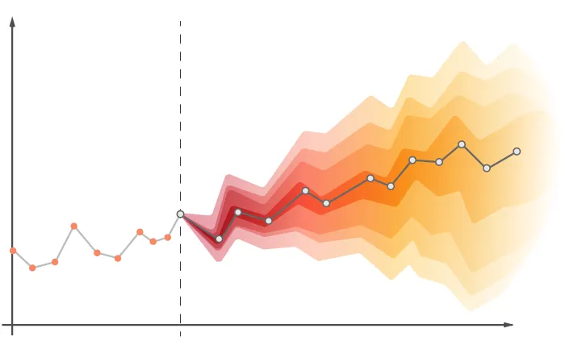
Time Series Forecasting
Time series forecasting is a technique used to model patterns on historical, time-stamped data
https://medium.com/analytics-vidhya/time-series-forecasting-c73dec0b7533

Slide 4
Time Series Forecasting
Time series forecasting is a technique used to model patterns on historical, time-stamped data
In finance: analyze stock prices or cash flow trends
In meteorology: predict rainfall or temperature
In ME/AE: study fuel consumption trends or machine health
https://medium.com/analytics-vidhya/time-series-forecasting-c73dec0b7533

Slide 5
Time Series Forecasting Models
Time series forecasting requires a model for historical data to predict future values

Slide 6
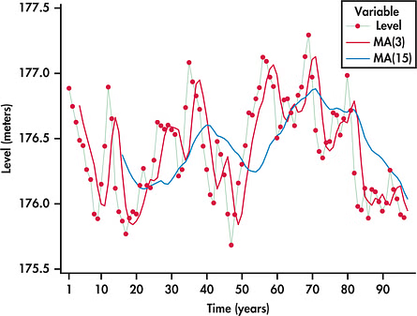
Time Series Forecasting Models
Time series forecasting requires a model for historical data to predict future values
Moving average: uses average of points in a moving window to create a smooth curve
https://www.projectpro.io/article/moving-average-time-series-model/716

Slide 7

Time Series Forecasting Models
Time series forecasting requires a model for historical data to predict future values
Moving average: uses average of points in a moving window to create a smooth curve
Autoregressive (AR) models:
Infer predictions from lagged variables
future states are a linear combination of previous states

Slide 8
Agenda
Background
Time series forecasting
State space models
Continuous representation
Discrete representation
Convolutional representation
Motivation
Setup
Deep state space model
Experiments
Background
Examples
Motivation
Intro to the SSM
Intro to other time-series predictive model (RNN)
Comprehensive model structure
Training and prediction phase
Results demonstration

Slide 9
Quick Overview of State Space Models (SSM)
State space models are a fundamental representation of dynamical systems which relate latent states, inputs, and observations
Applicable to control systems, time series analysis, signal processing, etc.

Slide 10
Quick Overview of State Space Models (SSM)
State space models are a fundamental representation of dynamical systems which relate latent states, inputs, and observations
Applicable to control systems, time series analysis, signal processing, etc.
Three fundamental representations of an SSM:

Slide 11
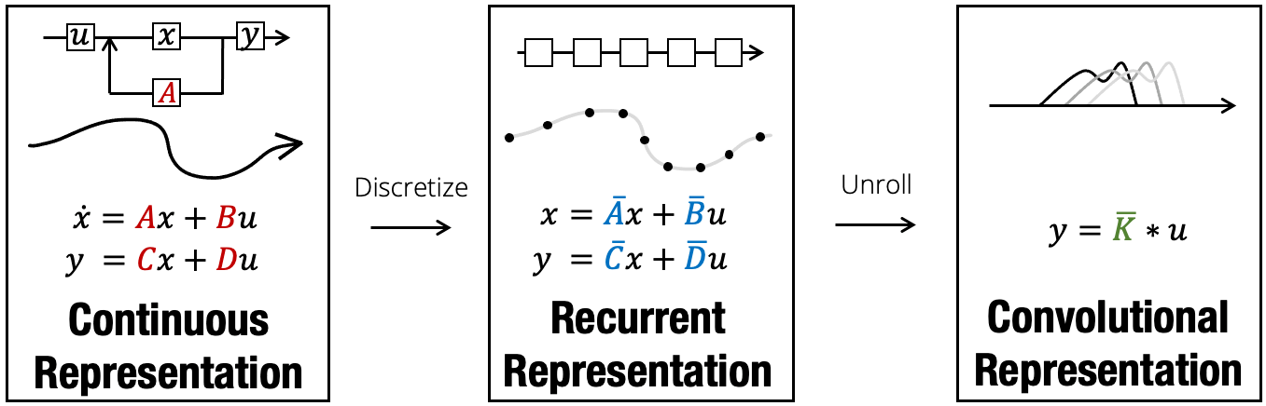
Quick Overview of State Space Models (SSM)
State space models are a fundamental representation of dynamical systems which relate latent states, inputs, and observations
Applicable to control systems, time series analysis, signal processing, etc.
Three fundamental representations of an SSM:

Slide 12
Quick Overview of State Space Models (SSM)
State space models are a fundamental representation of dynamical systems which relate latent states, inputs, and observations
Applicable to control systems, time series analysis, signal processing, etc.
Three fundamental representations of an SSM:

Slide 13
Quick Overview of State Space Models (SSM)
State space models are a fundamental representation of dynamical systems which relate latent states, inputs, and observations
Applicable to control systems, time series analysis, signal processing, etc.
Three fundamental representations of an SSM:

Slide 14
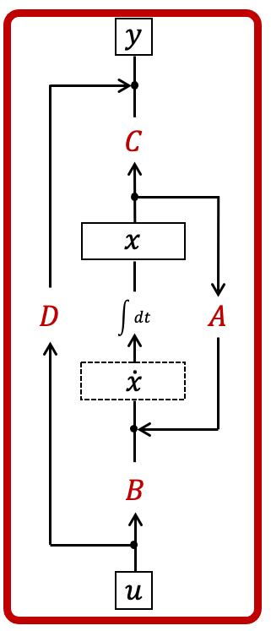

Quick Overview of State Space Models (SSM)
The continuous SSM representation feeds signals through a continuous feedback loop:

Slide 15
Quick Overview of State Space Models (SSM)
The continuous SSM representation feeds signals through a continuous feedback loop:
In the above model:
A, B, C, and D are learnable matrices containing time-invariant model parameters

Slide 16
Quick Overview of State Space Models (SSM)
The continuous SSM representation feeds signals through a continuous feedback loop:
In the above model:
A, B, C, and D are learnable matrices containing time-invariant model parameters
Intutively, they entangle state and input variables to compute the output

Slide 17
Quick Overview of State Space Models (SSM)
The continuous SSM representation feeds signals through a continuous feedback loop:
In the above model:
A, B, C, and D are learnable matrices containing time-invariant model parameters
Intutively, they entangle state and input variables to compute the output
This is the common form when deriving dynamical differential equations in controllable systems

Slide 18
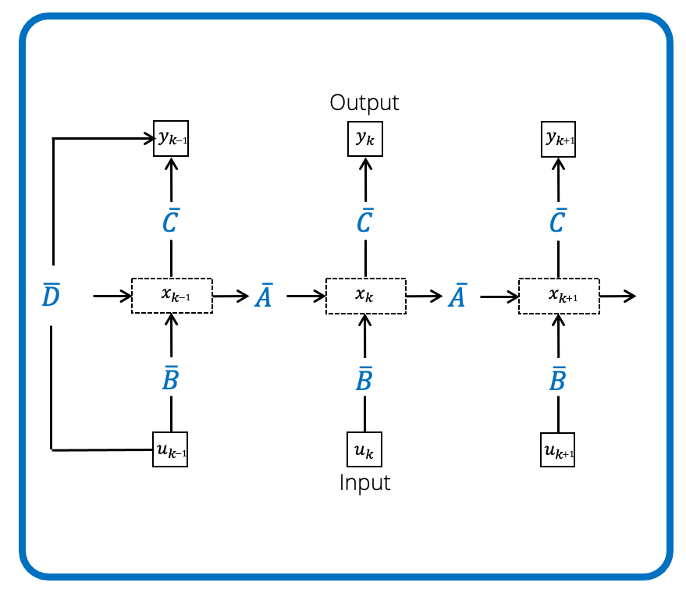

Quick Overview of State Space Models (SSM)
The recurrent SSM representation is the practical, discrete, linear recurrence form:

Slide 19
Quick Overview of State Space Models (SSM)
The recurrent SSM representation is the practical, discrete, linear recurrence form:
Structured state space sequence model (S4)

Slide 20
Quick Overview of State Space Models (SSM)
The recurrent SSM representation is the practical, discrete, linear recurrence form:
Structured state space sequence model (S4)
Transitions similar to a simple RNN

Slide 21
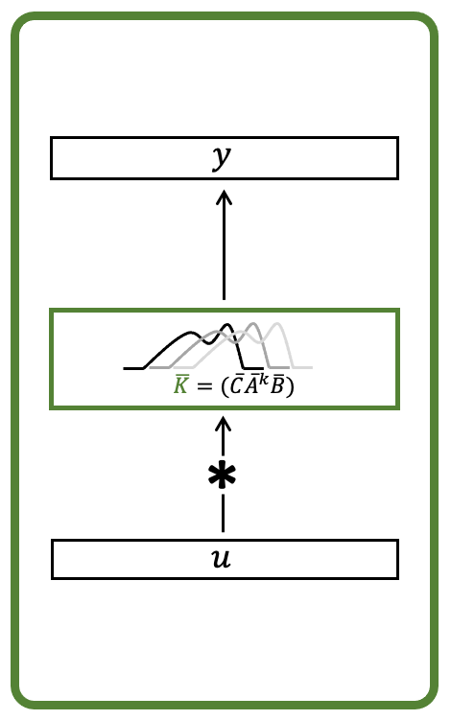
Quick Overview of State Space Models (SSM)
The convolutional SSM representation is the form unrolled across all recurrences:
Source: https://hazyresearch.stanford.edu/blog/2022-01-14-s4-3

Slide 22

Quick Overview of State Space Models (SSM)
The convolutional SSM representation is the form unrolled across all recurrences:
Collected terms can be compacted into a single “kernel”:
Source: https://hazyresearch.stanford.edu/blog/2022-01-14-s4-3

Slide 23
Quick Overview of State Space Models (SSM)
The convolutional SSM representation is the form unrolled across all recurrences:
Collected terms can be compacted into a single “kernel”:
…so the convolutional form becomes:
Source: https://hazyresearch.stanford.edu/blog/2022-01-14-s4-3

Slide 24
Agenda
Background
Motivation
Examples of SSMs in time series forecasting
Problems with SSMs
Solution: recurrent neural network
Setup
Deep state space model
Experiments
Background
Examples
Motivation
Intro to the SSM
Intro to other time-series predictive model (RNN)
Comprehensive model structure
Training and prediction phase
Results demonstration

Slide 25
State Space Models for Time Series Forecasting
Autoregressive (AR) models are a family of state space models:
AR moving average (ARMA)
AR integrated moving average (ARIMA)
Vector AR (VAR)

Slide 26

State Space Models for Time Series Forecasting
Autoregressive (AR) models are a family of state space models:
AR moving average (ARMA)
AR integrated moving average (ARIMA)
Vector AR (VAR)
Exponential smoothing

Slide 27
Problems w/SSMs for Time Series Forecasting
Require labor and compute-intensive tasks:
Model selection
Covariate selection

Slide 28
Problems w/SSMs for Time Series Forecasting
Require labor and compute-intensive tasks:
Model selection
Covariate selection
Cannot infer shared patterns trained on similar time series data
They are fit to separate time series

Slide 29
Problems w/SSMs for Time Series Forecasting
Require labor and compute-intensive tasks:
Model selection
Covariate selection
Cannot infer shared patterns trained on similar time series data
They are fit to separate time series
A solution: deep neural networks
Identify more complex patterns
Minimal human effort
Difficult to interpret (hard to enforce temporal smoothness)
Requires more data

Slide 30
Solution: Recurrent Neural Networks (RNN)
An RNN is designed to process sequential data through an internal memory stream which carries context of historical data
Notes:
LSTM is the more widely used type of RNN because it doesn’t suffer from the vanishing/exploding gradient problem in training
Why does it enforce temporal smoothness and not DNNs?
Why does it alleviate overfitting?

Slide 31
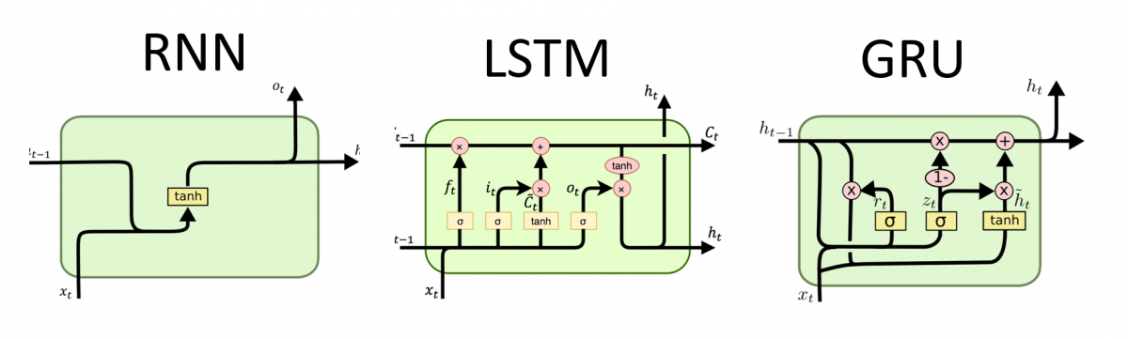
Solution: Recurrent Neural Networks (RNN)
Simple RNN
An RNN is designed to process sequential data through an internal memory stream which carries context of historical data
Simple RNN, LSTM
LSTM
Notes:
LSTM is the more widely used type of RNN because it doesn’t suffer from the vanishing/exploding gradient problem in training
Why does it enforce temporal smoothness and not DNNs?
Why does it alleviate overfitting?

Slide 32
Solution: Recurrent Neural Networks (RNN)
Simple RNN
An RNN is designed to process sequential data through an internal memory stream which carries context of historical data
Simple RNN, LSTM
For time series data:
Enforces temporal smoothness
LSTM
Notes:
LSTM is the more widely used type of RNN because it doesn’t suffer from the vanishing/exploding gradient problem in training
Why does it enforce temporal smoothness and not DNNs?
Why does it alleviate overfitting?

Slide 33
Solution: Recurrent Neural Networks (RNN)
Simple RNN
An RNN is designed to process sequential data through an internal memory stream which carries context of historical data
Simple RNN, LSTM
For time series data:
Enforces temporal smoothness
Scales from small to large data seamlessly
LSTM
Notes:
LSTM is the more widely used type of RNN because it doesn’t suffer from the vanishing/exploding gradient problem in training
Why does it enforce temporal smoothness and not DNNs?
Why does it alleviate overfitting?

Slide 34
Solution: Recurrent Neural Networks (RNN)
Simple RNN
An RNN is designed to process sequential data through an internal memory stream which carries context of historical data
Simple RNN, LSTM
For time series data:
Enforces temporal smoothness
Scales from small to large data seamlessly
Alleviate overfitting when there is little data to learn from
LSTM
Notes:
LSTM is the more widely used type of RNN because it doesn’t suffer from the vanishing/exploding gradient problem in training
Why does it enforce temporal smoothness and not DNNs: are a recurrent function ofn consecutive time series data with an inherent natural trend
Why alleviate overfitting? use shared parameters on each recurrence and hence inherently avoid overfitting to individual steps or subsets of steps
Why does it alleviate overfitting?

Slide 35
Solution: Recurrent Neural Networks (RNN)
Simple RNN
An RNN is designed to process sequential data through an internal memory stream which carries context of historical data
Simple RNN, LSTM
For time series data:
Enforces temporal smoothness
Scales from small to large data seamlessly
Alleviate overfitting when there is little data to learn from
Infers shared patterns trained on similar time series data
LSTM
Notes:
LSTM is the more widely used type of RNN because it doesn’t suffer from the vanishing/exploding gradient problem in training
Why does it enforce temporal smoothness and not DNNs?
Why does it alleviate overfitting?

Slide 36
Agenda
Background
Motivation
Setup
Problem statement
SSM parameters
Parameter learning
Deep state space model
Experiments
Background
Examples
Motivation
Intro to the SSM
Intro to other time-series predictive model (RNN)
Comprehensive model structure
Training and prediction phase
Results demonstration

Slide 37







Problem Statement
Given historical observations:
and time-varying covariate vectors:
find the distribution for future trajectories
Definitions:
: learnable model parameters
: training range
: prediction range

Slide 38



State Space Model Setup
Latent state transition model:
: latent state vector (encoded seasonality effects based on input)
: transition matrix (relates and entangles consecutive latent states)
: controls strength of Gaussian noise

Slide 39



State Space Model Setup
Latent state transition model:
: latent state vector (encoded seasonality effects based on input)
: transition matrix (relates and entangles consecutive latent states)
: controls strength of Gaussian noise
Observation model:
: observation (output of the model; time series data)
: tunable parameters relating latent state to observations
: tunable bias term

Slide 40
Learning State Space Model Parameters
State space model parameters (assumed time invariant):
Transition model
Observation model

Slide 41
Learning State Space Model Parameters
State space model parameters (assumed time invariant):
Transition model
Estimate through maximum marginal likelihood:
Observation model

Slide 42

Learning State Space Model Parameters
State space model parameters (assumed time invariant):
Transition model
Estimate through maximum marginal likelihood:
Observation model
denotes the marginal likelihood of training observations given the corresponding model

Slide 43
Learning State Space Model Parameters
State space model parameters (assumed time invariant):
Transition model
Estimate through maximum marginal likelihood:
Observation model
…which expands to the product of marginal probabilities when the chain rule is applied

Slide 44
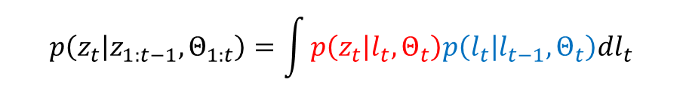
Learning State Space Model Parameters
State space model parameters (assumed time invariant):
Transition model
Estimate through maximum marginal likelihood:
Observation model
The likelihoods can be further decomposed into the transition and observation models (marginalized over the latent states)

Slide 45
Learning State Space Model Parameters
State space model parameters (assumed time invariant):
Transition model
Estimate through maximum marginal likelihood:
Observation model

Slide 46
Agenda
Background
Motivation
Setup
Deep state space model
Model summary
Training
Prediction
Experiments
Background
Examples
Motivation
Intro to the SSM
Intro to other time-series predictive model (RNN)
Comprehensive model structure
Training and prediction phase
Results demonstration

Slide 47
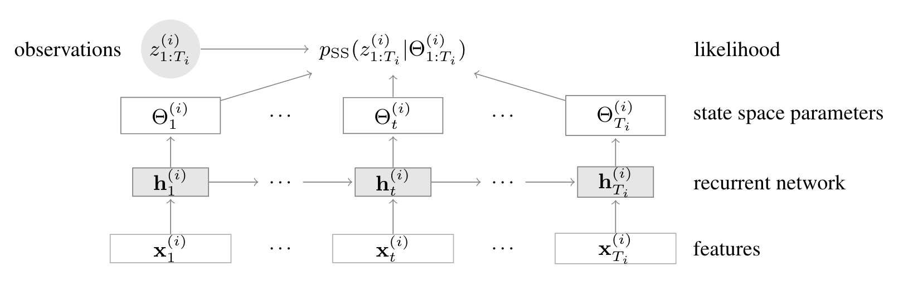


Model summary
Features x: time-independent (a set of dummy variables indicating the day of the week) and time-independent (the produce brand) covariate vectors
: SSM parameter
Observations z: the time-series values we need to predict;
Observations: y values we need to predict; P_{SS} is the posterior probability we try to maximize; the features x time independent and time independent;
They use RNN to predict the state-space mode parameters:
Parameters Θ(i) t are then used to compute the likelihood of the given observations z(i) t, which is used for learning of the network parameters Φ
Notes:
e.g. product price or a set of dummy variables indicating the day of the week; or the produce brand and category;
Latent variables inside SSM: another type of information???

Slide 48

Model summary
Observations: y values we need to predict; P_{SS} is the posterior probability we try to maximize; the features x time independent and time independent;
They use RNN to predict the state-space mode parameters:
Parameters Θ(i) t are then used to compute the likelihood of the given observations z(i) t, which is used for learning of the network parameters Φ
RNN predicts the SSM parameters
SSM predicts the future observations
https://www.ibm.com/topics/recurrent-neural-networks
Notes:
Φ: fai; Ψ:sai; i is the index representing the sequence of time-series training dataset.

Slide 49
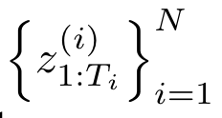

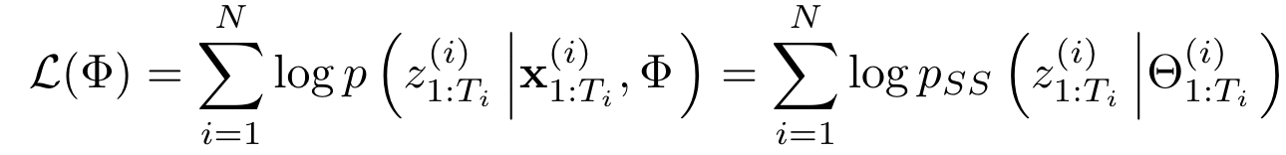

Training RNN for SSM
Given the structure of state space model, observation dataset ,
Goal: maximize the (log-) likelihood of observations for state-space model:
RNN Ψ is to predict the SSM parameters
Therefore, we switch the posterior probability to,
Notes:
We have the state space parameter Θ, RNN neural network parameter Φ
The state space model is based on the latent variables from RNN.
latent states l are from the RNN; yt is the intermediate variable, which is deterministic; z is the obervation
We can view each summand of L(Φ) in Eq. 7 as a (negative) loss function, that measures compatibility between the state space model parameters Θ(i) 1:Ti produced by the RNN when given input x(i) 1:Ti , and the true observations z(i) 1:Ti

Slide 50
Loss function
Loss function is to measure compatibility between the state space model parameters Θ produced by the RNN when given input x, and the true observations z from time i to T.
Advantage: Extend this ideas to other instances of state space models by simply redefining parameters as the outputs of the RNN.
Notes:
We have the state space parameter Θ, RNN neural network parameter Φ
The state space model is based on the latent variables from RNN.
latent states l are from the RNN; yt is the intermediate variable, which is deterministic; z is the obervation
We can view each summand of L(Φ) in Eq. 7 as a (negative) loss function, that measures compatibility between the state space model parameters Θ(i) 1:Ti produced by the RNN when given input x(i) 1:Ti , and the true observations z(i) 1:Ti

Slide 51
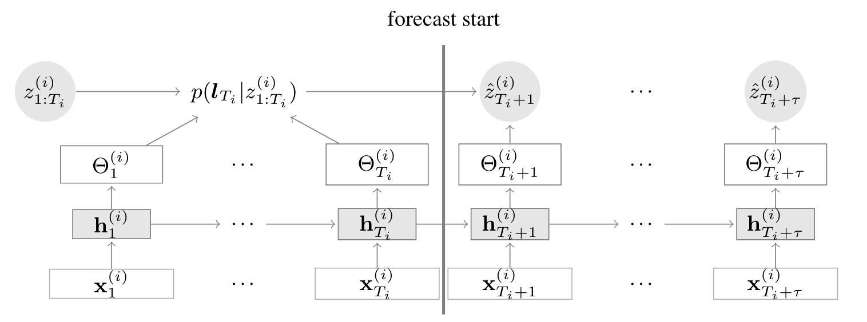
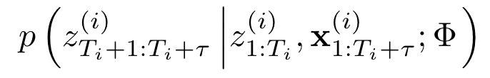
Prediction
Training phase
Prediction phase
hidden variables
hidden variables
Once the RNN is learned, we can obtain the SSM parameters:
to make probabilistic forecasts for each given time series
In practice we use the Monte Carlo method to represent the forecast distribution,
Notes:
Add the intro of the ARIMA?

Slide 52

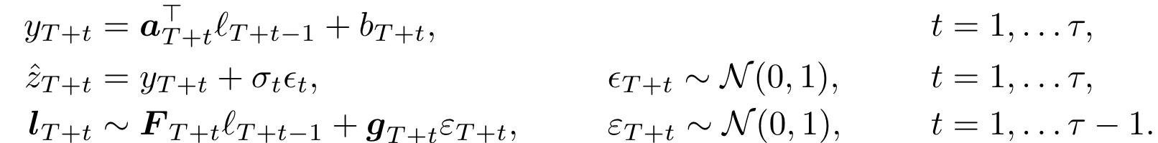
Prediction
Calculate the posterior of latent variable at time T:
Precisely, we sample
Recursively applies the transition equation and the observation model to generate prediction samples
Notes:
How to do that??? latent state is given???

Slide 53
Agenda
Background
Motivation
Setup
Deep state space model
Experiments
Qualitative experiments
Quantitive experiments
Background
Examples
Motivation
Intro to the SSM
Intro to other time-series predictive model (RNN)
Comprehensive model structure
Training and prediction phase
Results demonstration

Slide 54
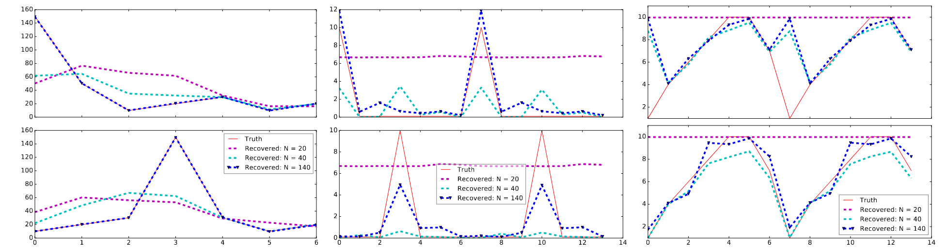
Qualitative experiments
Test whether effectively recovers the SSM parameters trained on synthetic data
Latent state definition: The day-of-week seasonality (seven components: each component corresponds to a different day of the week)
The recovery of SSM becomes more accurate gradually with increasing data
Prior means
Smoothing parameter
Observation noise
They can just given in the prediction! Why???
Notes:
We encode the day-of-week seasonality using seven components of the latent state as in [22], i.e., L = 7 and μ0 ∈ R7
we test whether our model effectively recovers the state space parameters if trained on synthetic data

Slide 55
Quantitive experiments
Application area:
Electricity: Hourly time series of electricity consumption of 370 customers.
Traffic: The traffic dataset contains hourly occupancy rates (between 0 and 1) of 963 car lanes of San Francisco bay area freeways.
Time setting
Compare different training horizon: {7, 14, 28} days
Prediction horizon: 7 days
Features
Time independent features representing the category (i.e., the index) of the time series
Time-based features like hour-of-the-day, day-of-the-week, day-of-the-month.
Latent variables: Size of SSM (i.e., latent dimension) directly depends on the granularity of the time series which determines the number of seasons. For hourly data, we use hour-of-day (24 seasons) as well as day-of-week (7 seasons) models.

Slide 56
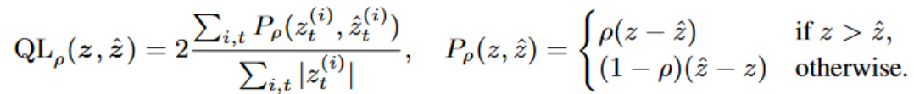
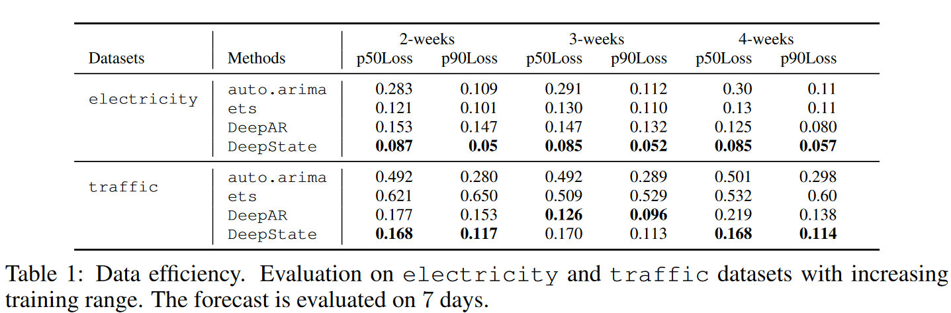
Quantitive experiments
Pure RNN structure: DeepAR model
Pure ARIMA model
ets: R’s forecast package
SSM + RNN model: DeepState model
The metric is the ρ-quantile loss:
Robust to Outliers
Flexibility
Notes:
Add the intro of the ARIMA?
ets: R’s forecast package
The quantile loss is asymmetric, meaning it penalizes under-predictions and over-predictions differently based on the value of ρ\rhoρ;
quantile regression task can help model tail risks, such as extreme price movements or outliers. the mean absolute error (MAE)

