Slide 1






AI-Powered MRI Report Data Extraction: Accuracy Evaluation
Challenge
Manual extraction from MRI reports is slow and error-prone.
Supervisor: Tim Chen
Objective
Presenters & Team : Haiyi Li Yutong Li and Yihen Chi
Develop AI tool using LLM to extract structured data.
Date: April 28, 2025.
Methodology
Automated pipeline: PDF to image to AI API to validation and evaluation.

Slide 2
Automating Medical Data Extraction
Challenge
Manual extraction from MRI reports is slow and error-prone.
Objective
Develop AI tool using LLM to extract structured data.
Methodology
Automated pipeline: PDF to image to AI API to validation and evaluation.
AI Model
Dataset
Ground Truth
Comparison
OpenAI GPT-4 Turbo via API.
193 RRI reports processed.
Expert-validated Stage 1A MRI Data Entry_cleaned.xlsx.
Cell-by-cell AI vs. ground truth Excel comparison with tolerant logic.

Slide 3



How We Measured Accuracy
AI Model
Dataset
Ground Truth
Comparison
81.34%
82.12%
7.63%
OpenAI GPT-4 Turbo via API.
193 RRI reports processed.
Expert-validated Stage 1A MRI Data Entry_cleaned.xlsx.
Cell-by-cell AI vs. ground truth Excel comparison with tolerant logic.
Average Accuracy
Median Accuracy
Standard Deviation
There is some better model that we could try

Slide 4
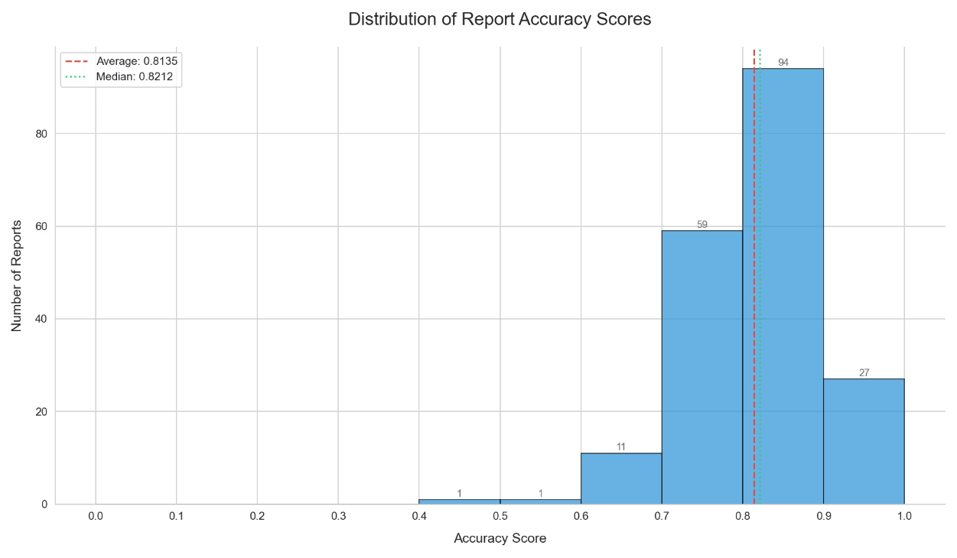
AI Extraction Accuracy: Summary Statistics
81.34%
82.12%
7.63%
Average Accuracy
Median Accuracy
Standard Deviation

Slide 5
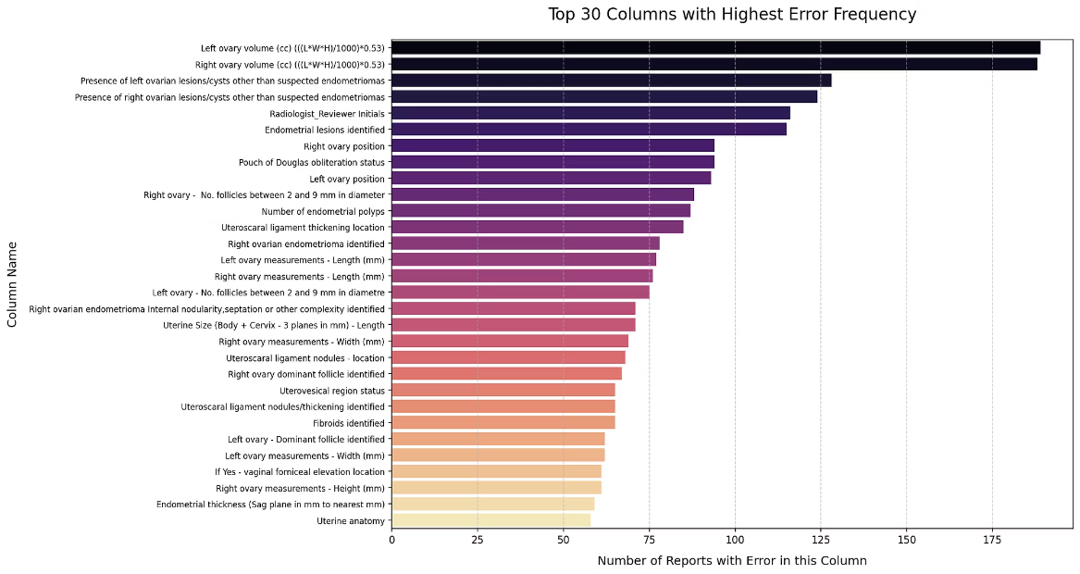
How Accuracy Varies Across Reports
Top Error Columns
Ovary Volume Calculations (Left & Right)
Presence of ovarian lesions/cysts (Left & Right)
Radiologist Initials
Endometrial Lesions (Boolean)
Ovary Position & POD Status

Slide 6
Where Does the AI Make Mistakes?
Top Error Columns
Ovary Volume Calculations (Left & Right)
1
2
Presence of ovarian lesions/cysts (Left & Right)
Achievements
Key Questions
Radiologist Initials
Automated pipeline developed
Paper focus: feasibility or full retrospective study?
Endometrial Lesions (Boolean)
Baseline AI accuracy ~81%
Data source: existing ground truth or new data?
Ovary Position & POD Status
Identified error areas and variability
Foundation for next steps

Slide 7
1
Deeper Error Analysis
Define important fields and analyze error patterns.
Guide targeted expert double-checking.
2
Multi-Model Comparison
Evaluate Gemini, Med-PALM models.
Requires additional development time.
3
Suggestion
specialist sonographer report vs general sonographer report
Achievements & Paper Strategy
1
2
Achievements
Key Questions
Automated pipeline developed
Paper focus: feasibility or full retrospective study?
Baseline AI accuracy ~81%
Data source: existing ground truth or new data?
Identified error areas and variability
Foundation for next steps

Slide 8
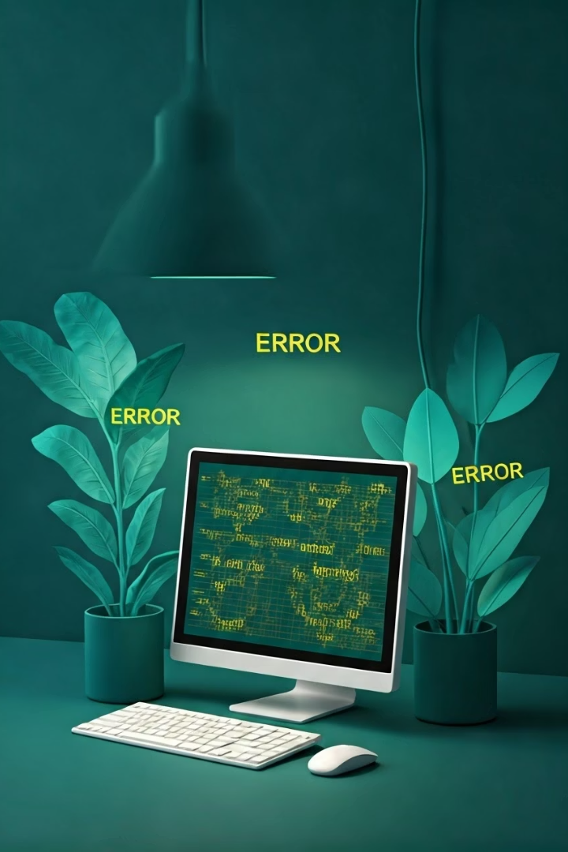
Analysis Priorities & Error Insights
1
Deeper Error Analysis
Define important fields and analyze error patterns.
Guide targeted expert double-checking.
2
Multi-Model Comparison
Evaluate Gemini, Med-PALM models.
Requires additional development time.
3
Suggestion
specialist sonographer report vs general sonographer report
looking into specialist sonographer report vs general sonographer report

Slide 9



Analysis & Manual Extraction Role
Purpose
2
Enables AI vs. human assistant comparison to strengthen findings.
Human Comparator Question
1
Is non-expert manual extraction needed ?
Implication
3
Requires coordination of manual effort and evaluation script development.

Slide 10

Thank You
Open Discussion & Questions

