Slide 1
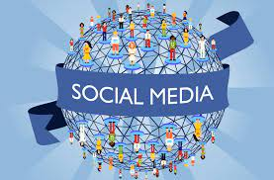
Topic : “Do Social media networks strengthen or degrade human relationships?”
Gattoussi Emna

Slide 2
Results revealed that the more time an individual spent on social media the more likely they were to experience a negative impact on their overall emotional well- being and decreased quality in their relationships.
Social media allows users to foster positive relationships online, especially for otherwise isolated groups. However, social media can also negatively affect relationships when you compare yourself with others, according to experts.

Slide 3
Social Media is relatively a newer technology, hence, it is a little difficult to establish its long-term good and bad consequences. However, multiple researchers have concluded a strong relationship between heavy use of social media platforms with an increase in risk of depression, self-harm, anxiety, and loneliness.

