Slide 1

SECURE PASSWORD ANALYZER
With Attack Simulation
Team: [Insert Team Name]
Members: [Member 1], [Member 2], [Member 3], [Member 4]

Slide 2

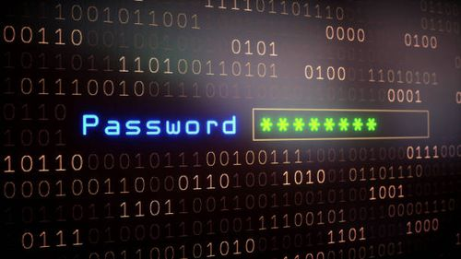
THE CRITICAL NEED FOR ROBUST PASSWORD SECURITY
The Problem: Weak passwords remain a primary vector for cyberattacks and unauthorized system access.
User Behavior: Most users prioritize memorability over security, leading to predictable patterns.
Consequences: Compromised personal data, financial loss, and systemic security breaches.

Slide 3
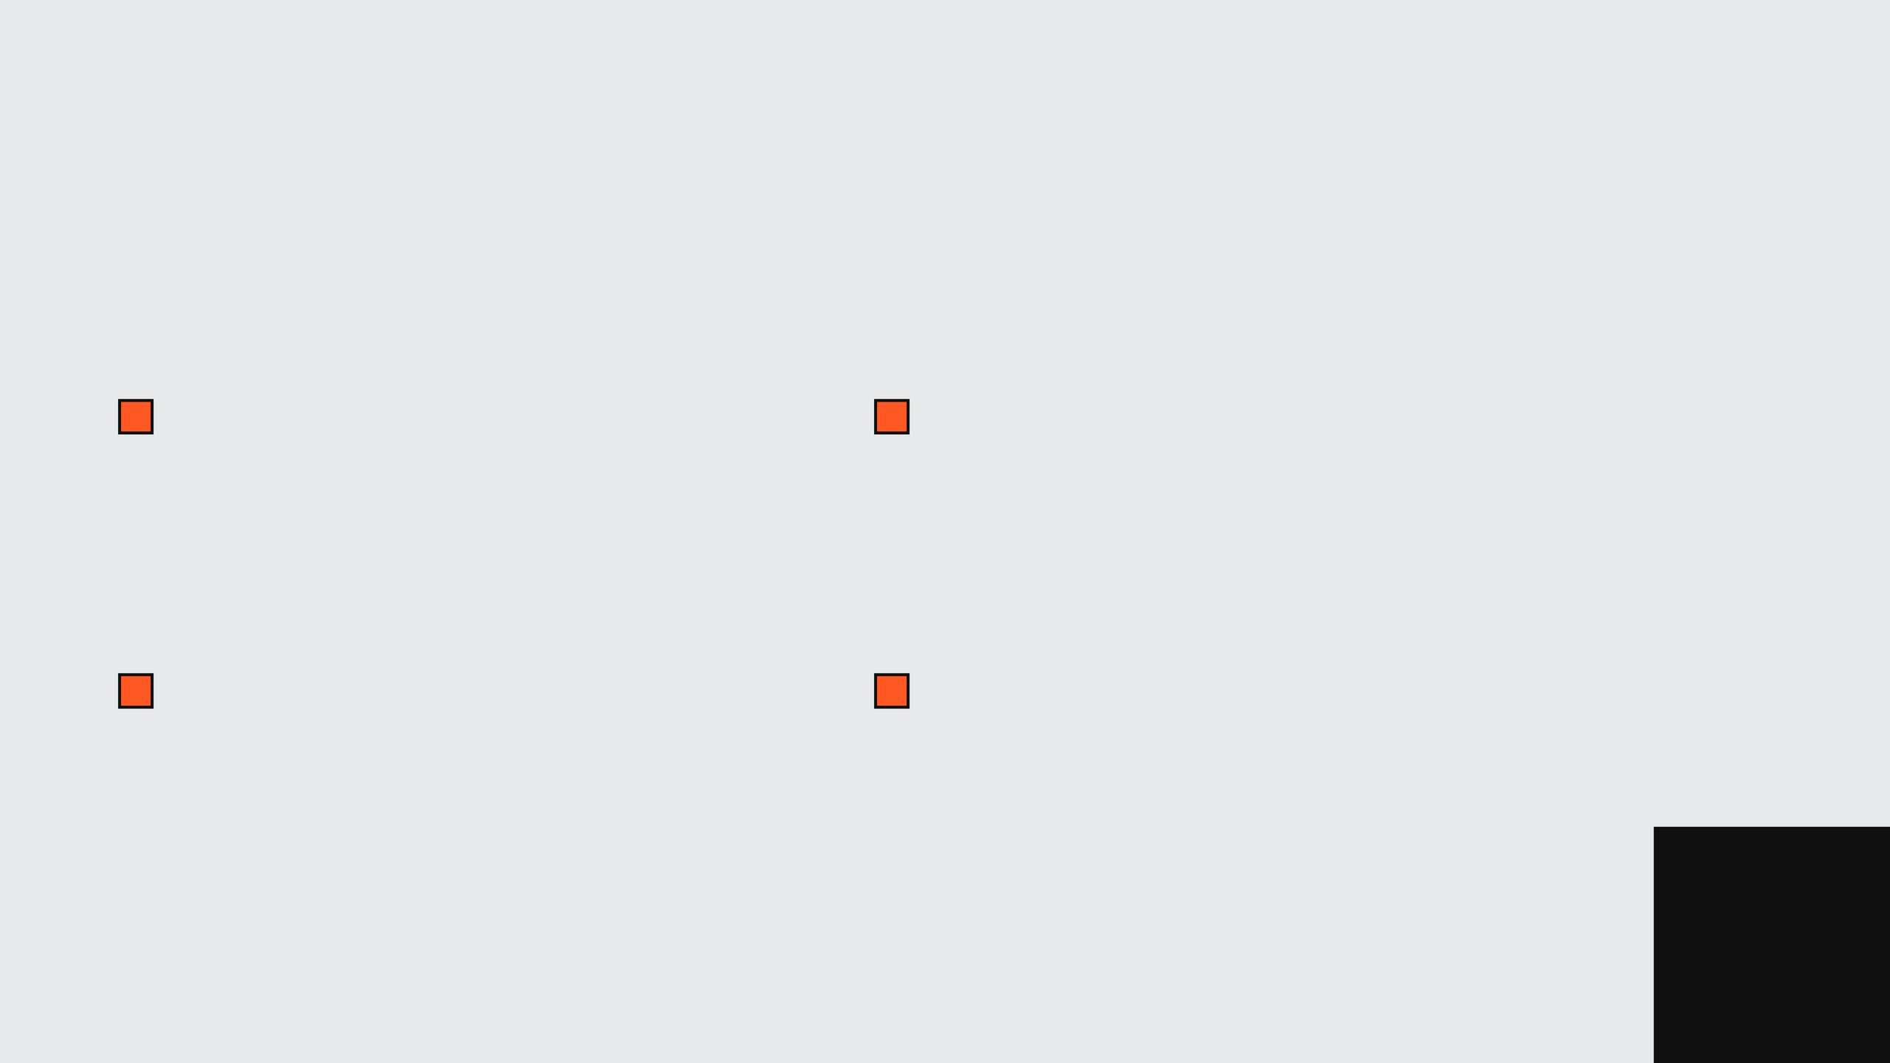
CORE PROJECT OBJECTIVES
Comprehensive Analysis: Evaluate password strength using multi-factor scoring systems.
Vulnerability Detection: Identify weak patterns and common dictionary-based passwords.
Cryptographic Security: Generate SHA-256 hash values for secure storage principles.
Empirical Estimation: Provide real-world crack time estimates based on modern computing.

Slide 4
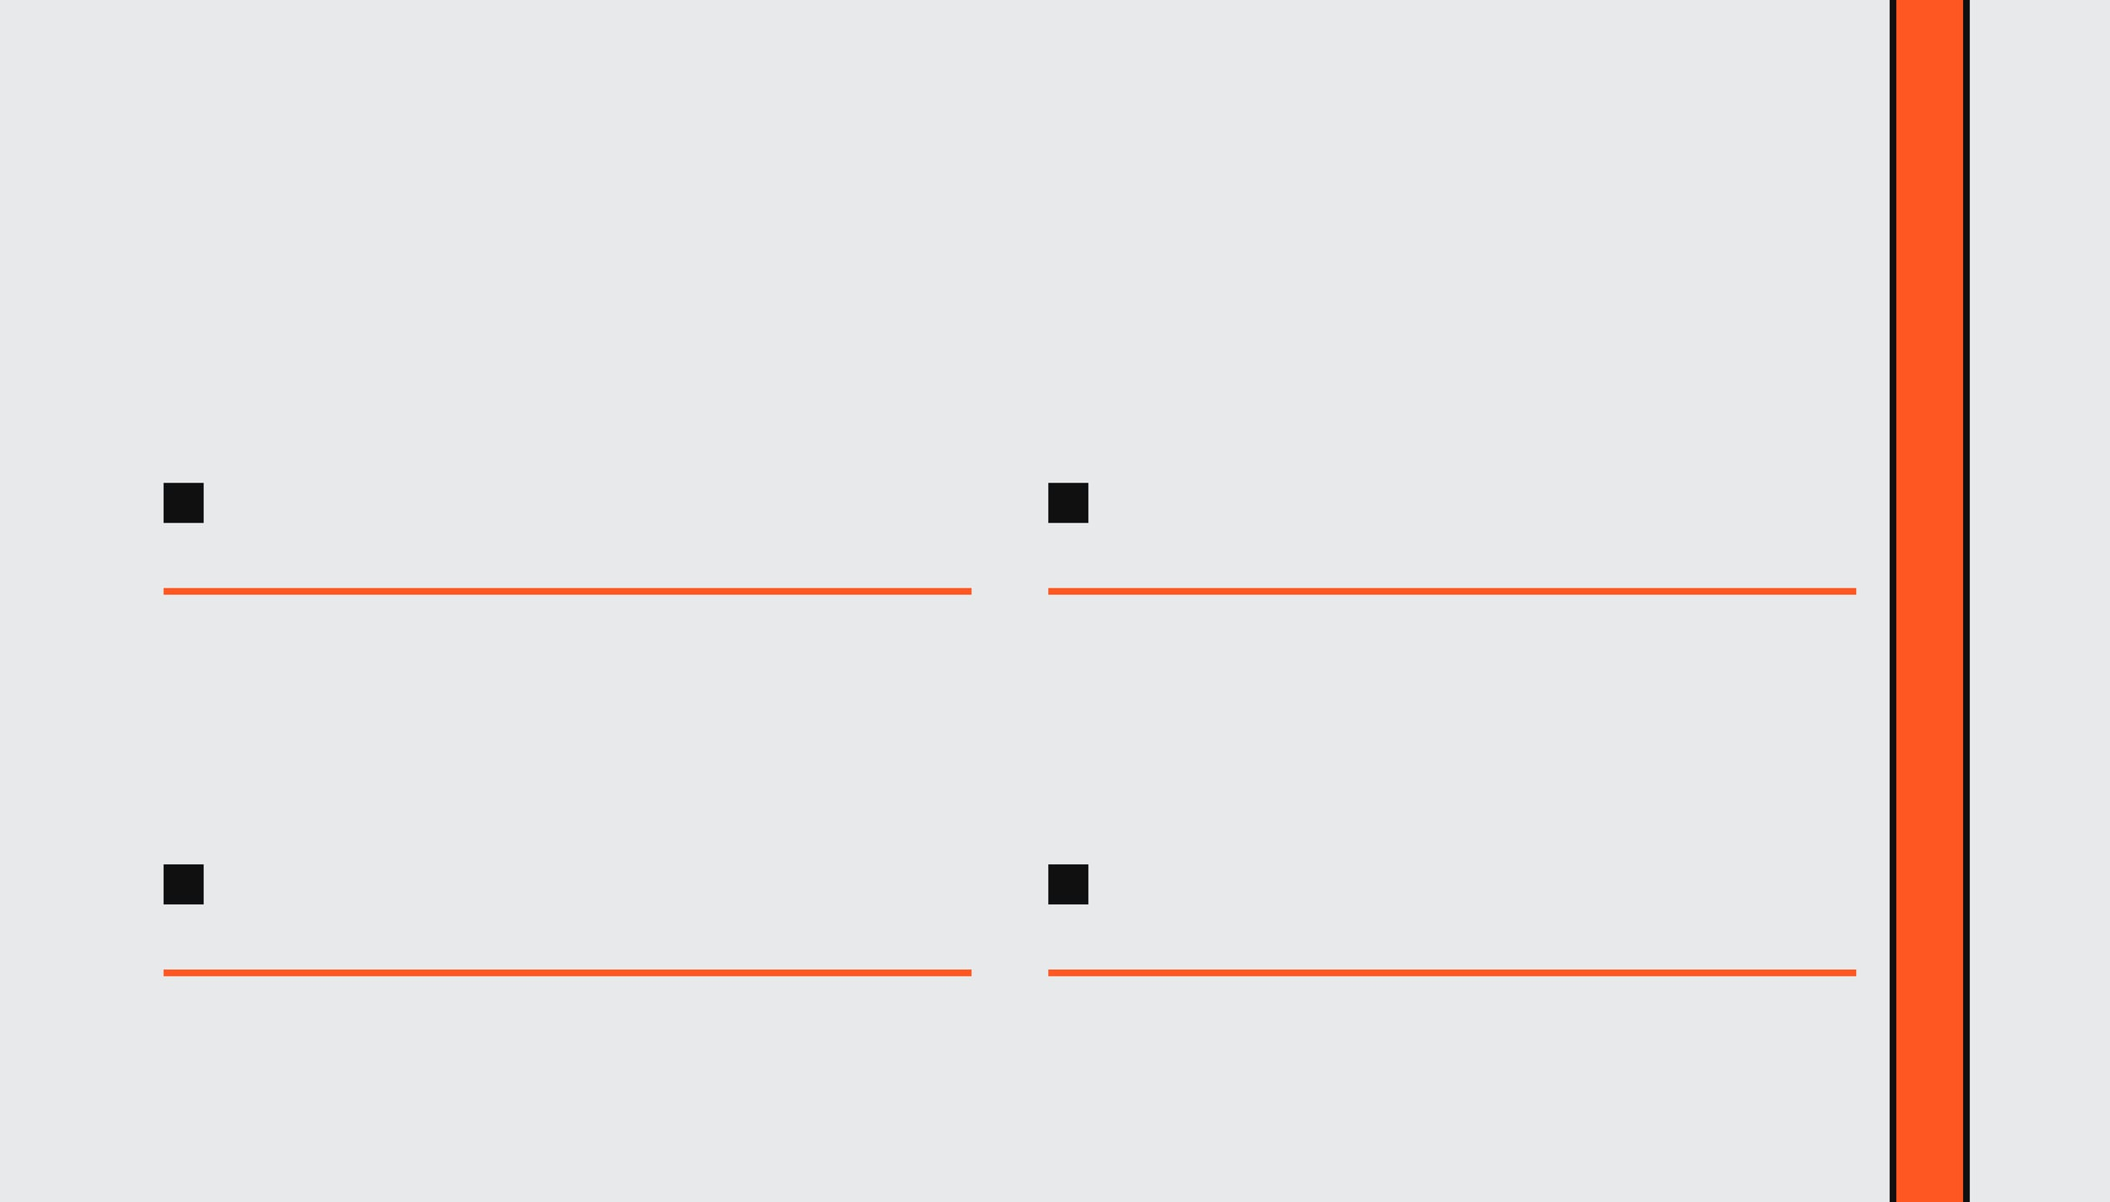
LEVERAGING DSA CONCEPTS FOR SECURITY
STRINGS
HASHING
Advanced character analysis and pattern detection algorithms for real-time password evaluation.
Implementation of SHA-256 for one-way cryptographic transformation and secure data integrity.
HASH SETS
PATTERN MATCHING
Utilizing O(1) average time lookup structures for instant cross-referencing against weak password databases.
Specialized logic to identify sequential sequences, keyboard walks, and character repetitions.

Slide 5
SYSTEMATIC SECURITY WORKFLOW
INPUT PASSWORD
01
02
STRENGTH & PATTERN ANALYSIS
03
SHA-256 HASH GENERATION
04
CRACK TIME ESTIMATION
05
RESULTS & SUGGESTIONS

Slide 6

MODULE 1: PASSWORD STRENGTH ANALYZER
EVALUATION CRITERIA
SCORING & PERFORMANCE
Minimum Length Check
Uppercase & Lowercase
Score Range:
0 — 6 Points
Complexity:
O(n) Linear Time
Numeric Digits
Special Characters
Output Tiers:
Weak / Medium / Strong

Slide 7

MODULE 2: ADVANCED PATTERN DETECTION
DETECTION LOGIC
COMMON WEAK PATTERNS
Dictionary Cross-Referencing
password / qwerty
Sequential Number Sequences
123456 / 987654
Alphabetical Keyboard Walks
Character Repetition Analysis
aaaaa / 111111
COMPLEXITY: O(N)

Slide 8

MODULE 3: SHA-256 HASHING IMPLEMENTATION
ONE-WAY TRANSFORMATION
SECURITY BENEFITS
INPUT PASSWORD:
Irreversible Cryptographic Storage
Password123
Data Integrity Verification
Secure Authentication Protocols
Fixed-Length 256-bit Output
SHA-256 HASH:
008c70392e3abf...
COMPLEXITY: O(N)

Slide 9

BENCHMARK: 1 Billion Guesses / Sec
MODULE 4: EMPIRICAL CRACK TIME ESTIMATION
THE MATHEMATICS OF BRUTE FORCE
Combinations = (Set Size) ^ Length
WEAK PASSWORD
STRONG PASSWORD
Input: "abc123"
Input: "StrongP@ss123"
Entropy: Low
Entropy: High
Time: Seconds
Time: Centuries

Slide 10

FRAMEWORK: PYTHON TKINTER
USER INTERFACE & EXPERIENCE
INTERACTIVE FEATURES
SECURITY DASHBOARD
Real-time Strength Meter
SHA-256 Hash Visualization
Show/Hide Password Toggle
Vulnerability Pattern Alerts
Built-in Password Generator
Crack Time Estimation Display
Dynamic Suggestions Engine
Clean, Minimalist Layout

Slide 11

CHALLENGES & FUTURE HORIZONS
TECHNICAL HURDLES
FUTURE INTEGRATION
GUI Development: Mastering Tkinter for a responsive and intuitive desktop experience.
Breach Detection: Checking passwords against known leaked databases (e.g., HaveIBeenPwned).
Logic Refinement: Balancing pattern detection weights for accurate strength scoring.
AI Recommendations: Implementing machine learning for personalized security advice.
Performance: Ensuring O(n) complexity across all analysis modules.
Global Reach: Expanding support for international character sets and patterns.

Slide 12

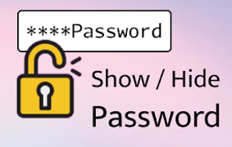
CONCLUSION & KEY TAKEAWAYS
Synthesis: Successfully applied DSA concepts to solve real-world cybersecurity challenges through practical tool development.
Impact: Empowers users to take control of their digital security through education and improved password habits.
Security Philosophy: Demonstrated that security is a continuous process of evaluation and improvement, not a one-time product.
THANK YOU FOR YOUR ATTENTION

