Slide 1
Microsoft Movie Studio Recommendation
Francis Gatura Njenga
24/07/2023

Slide 2
Overview
Project Objective: Provide sound and profitable recommendations to Microsoft for entering the movie industry.
Importance: Date-driven decisions for success in the competitive movie market.

Slide 3
Project Objectives
Identify the genre of movies to produce, considering viewership trends.
Analyze the impact of runtime on production budget, revenue, and viewership.
Determine the average budget for well-performing movies in the chosen genre.
Calculate the expected revenue from the investment.
Explore correlations between factors influencing movie success.

Slide 4
Methodology and Techniques
Data Collection: IMDb (title basics, title ratings) and The Numbers (movie budgets) datasets.
Data Cleaning: Handle missing values, convert data types, and remove special characters.
Exploratory Data Analysis (EDA): Visualize and interpret movie genre, runtime, and budget trends.
Data Merging: Combine datasets to perform comprehensive analysis.
Data Visualization: Use charts and graphs to present insights effectively.

Slide 5
Data Sources
IMDb Datasets:
title.basics.csv (movie genres and runtime minutes)
title.ratings.csv (movie ratings and number of votes)
The Numbers Dataset:
tn.movie_budgets.csv (movie production budgets and revenues)

Slide 6
Data Cleaning
Eliminate missing values in 'original_title' and 'genres' columns.
Impute missing values in 'runtime_minutes' column using the median.
Convert data types of 'production_budget', 'domestic_gross', and 'worldwide_gross' to float64.
Remove special characters and commas from monetary columns.

Slide 7
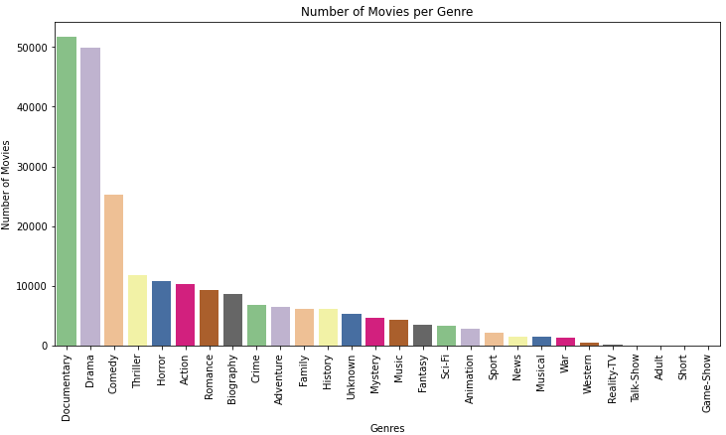
Exploratory Data Analysis
Visualize and interpret movie genre popularity using bar and pie charts.

Slide 8
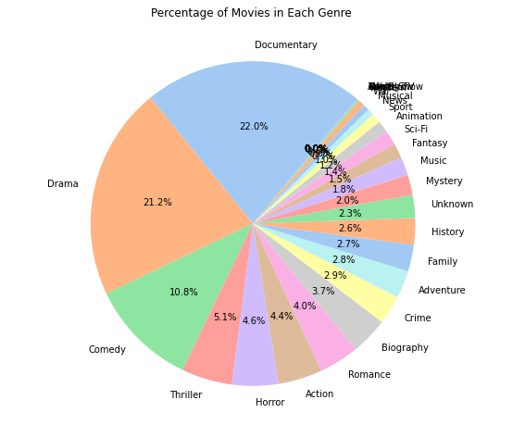

Slide 9
From the bar graph it is clear that the most popular genres are Documentary followed by Drama with about 50000 movies each.
22% of the movies are documentaries which shows how popular documentaries are with the public. Drama films are also just as popular with 21.2% of the movies.

Slide 10
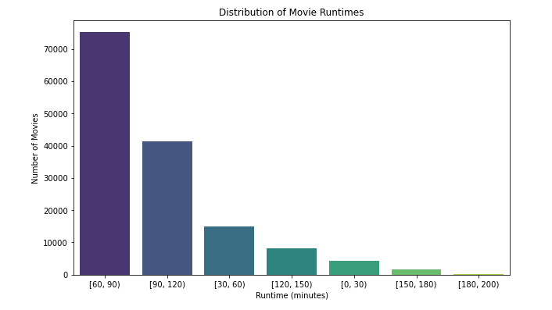
Analyze the distribution of movie runtimes with a bar chart.

Slide 11
The bar graph calculates the number of movies in different runtime intervals.
From the bar graph it is visible that a majority of the movies that were most produced were from 60 - 90 minutes long.

Slide 12
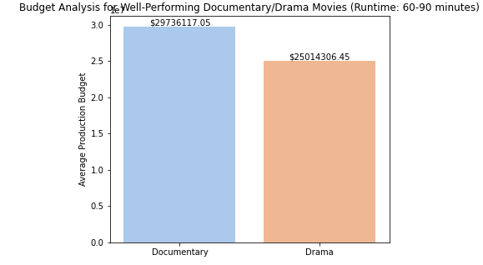
Budget Analysis
Calculate the average budget for well-performing documentary and drama films.

Slide 13
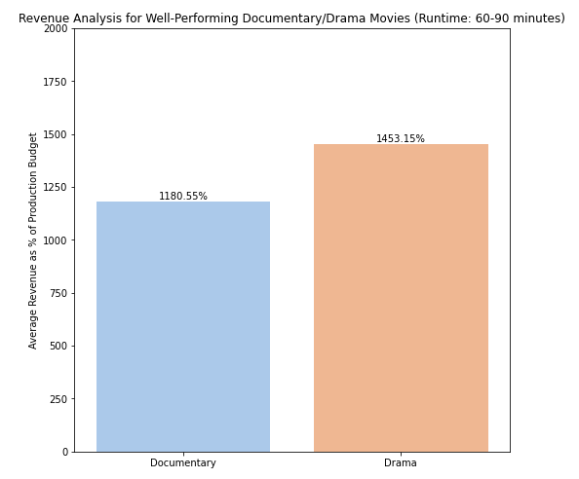
Revenue Analysis
Determine the expected revenue from the investment in well-performing documentary and drama films.
Highlight the revenue percentage in relation to the production budget.

Slide 14
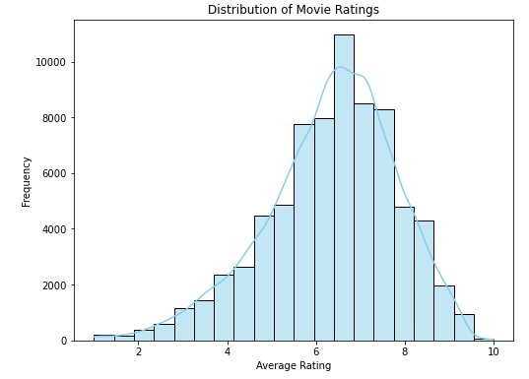
Rating Analysis
Visualize the distribution of movie ratings.

Slide 15
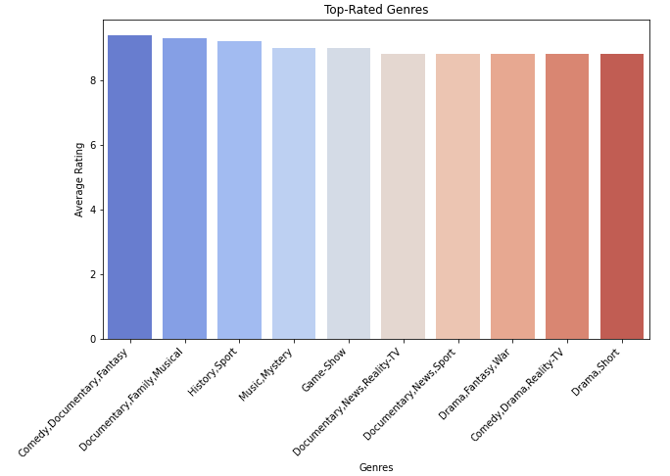

Slide 16
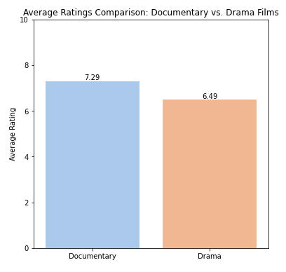
It can be observed that Documentary films are highly rated compared to drama films with a rating of 7.29 compared to 6.49, respectively.

Slide 17
Recommendations
The analysis suggests that Microsoft Movie Studio should prioritize the production of Documentary films with a runtime of 60 to 90 minutes. This genre has shown high popularity, profitability, and positive ratings, making it a promising venture for the studio. As the studio gains momentum, it can also explore producing Drama films, which offer a cost-effective approach with potential for high profitability.

Slide 18
Thank you for your time.

