Slide 1
PREDICTING MEDICAL CONDITIONS FROM REDDIT POSTS
Group-4
Gaurav Srivastava, Arnab Roy, Om Chouhan, Priyamjeet Kumar

Slide 2
Introduction
Reddit being a forum based social platform brings ample of user generated information content associated with different health problems.
This project aims to leverage machine learning models to predict medical condition from Reddit post data.
Early detection through social media analysis could support public health monitoring and early warning systems.

Slide 3
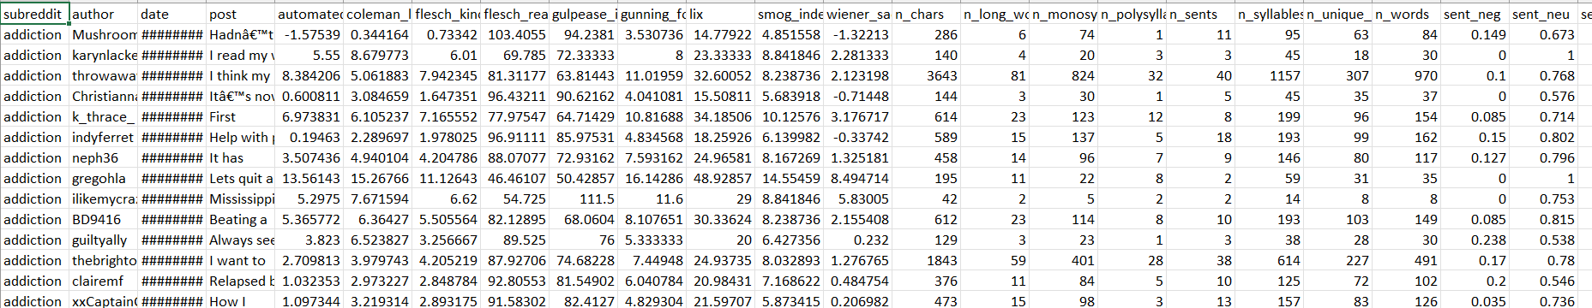
Dataset Description
Contains posts from mental health and non-mental health subreddits with text features across multiple timeframes.
15 Specific Mental Health Support Groups: EDAnonymous, addiction, anxiety, depression, ptsd, suicidewatch, ADHD, autism, bipolarreddit, BPD, healthanxiety, lonely, schizophrenia, socialanxiety, alcoholism.
2 Broad Mental Health Subreddits: mentalhealth, COVID19_support.
11 Non-Mental Health Subreddits: conspiracy, fitness, legaladvice, relationships, teaching, divorce, guns, jokes, meditation, parenting, personalfinance.
We had a total of 110 csv files approximating 3 Gb.

Slide 4
Data Preprocessing
We select files from pre-covid post-covid files and merge into a single csv file which results in around 600000 x 350
Text Cleaning:
Removed irrelevant characters (e.g., special characters, punctuation, numbers not relevant to medical content).
Standardized text format by converting all text to lowercase, ensuring consistency across posts.
Stop Word Removal:
Removed common, non-informative words (e.g., “and,” “is,” “the”) that don’t contribute meaningful information about medical conditions.
This step reduces noise in the data, improving the accuracy and relevance of the model's predictions.

Slide 5
Data Preprocessing
Tokenization:
Split text into individual words (tokens) to facilitate word-level analysis, essential for feature extraction methods like TF-IDF and Word2Vec.
Vectorization:
Transformed the cleaned text data into numerical formats (using TF-IDF or Word2Vec) to make it suitable for machine learning models.
TF-IDF captures the importance of each term relative to the dataset, while Word2Vec embeddings capture contextual and semantic relationships between words.

Slide 6
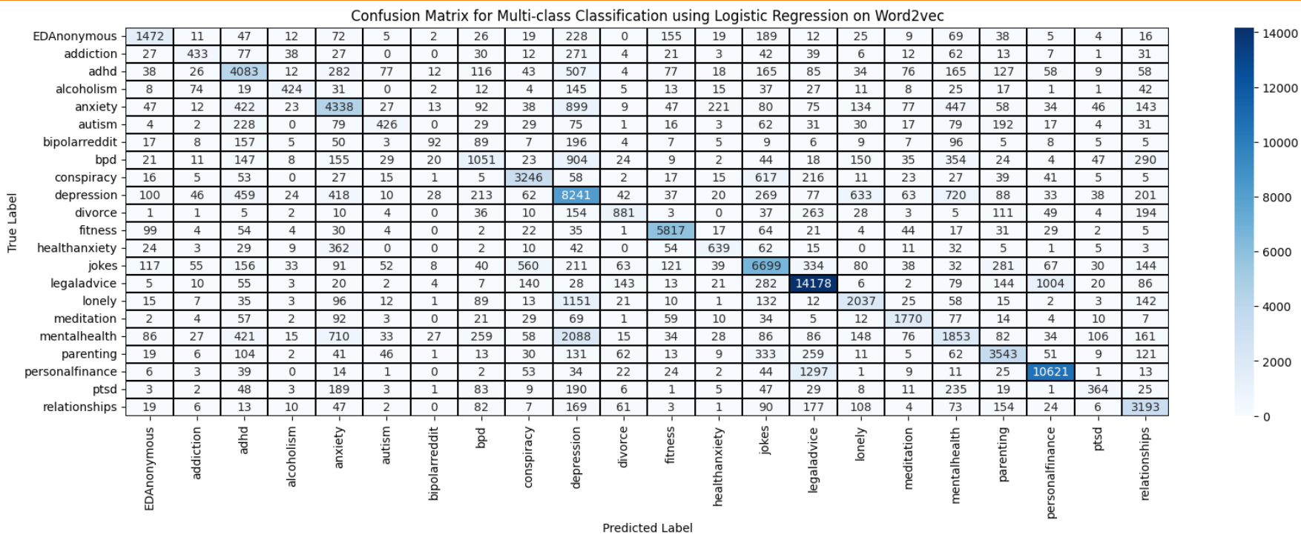
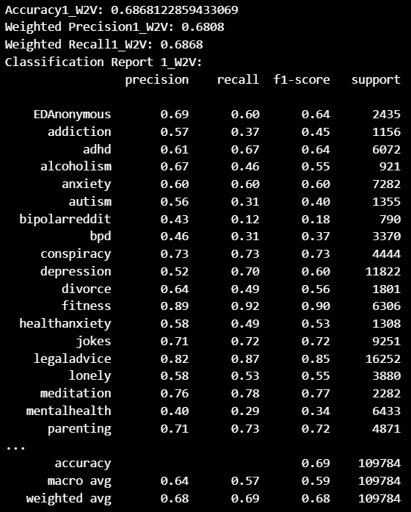
Logistic Regression

Slide 7
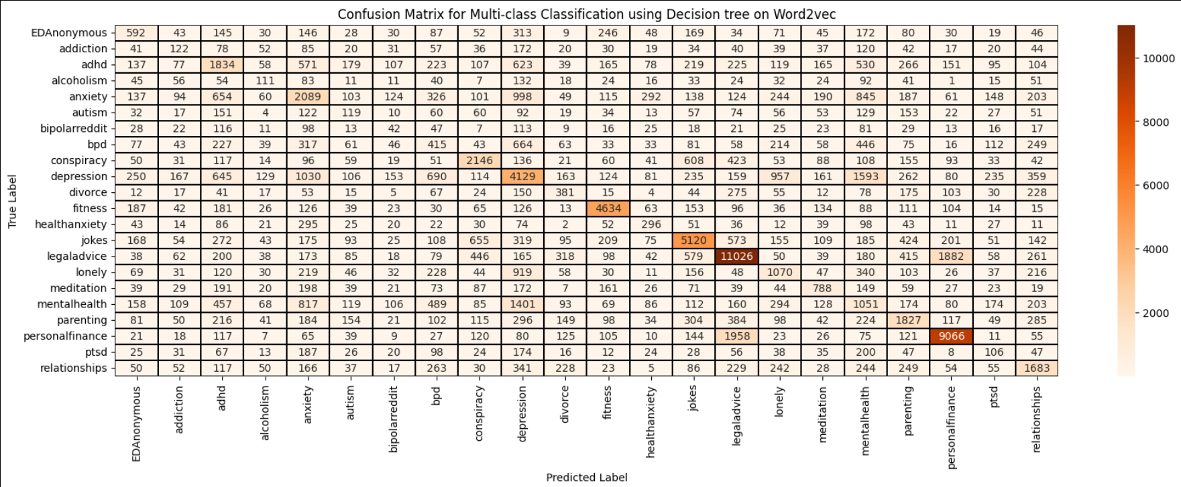
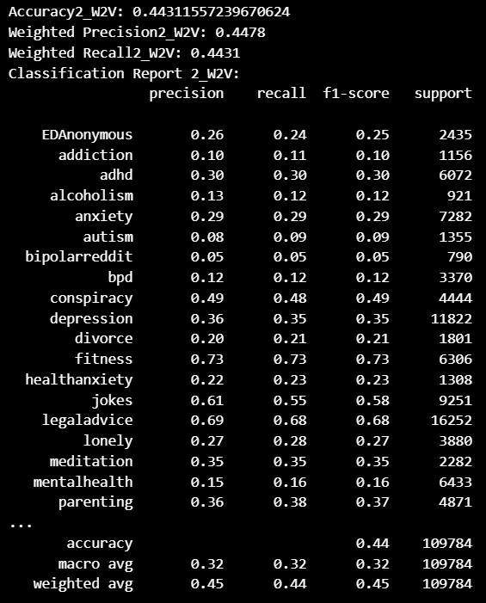
Decision Tree

Slide 8
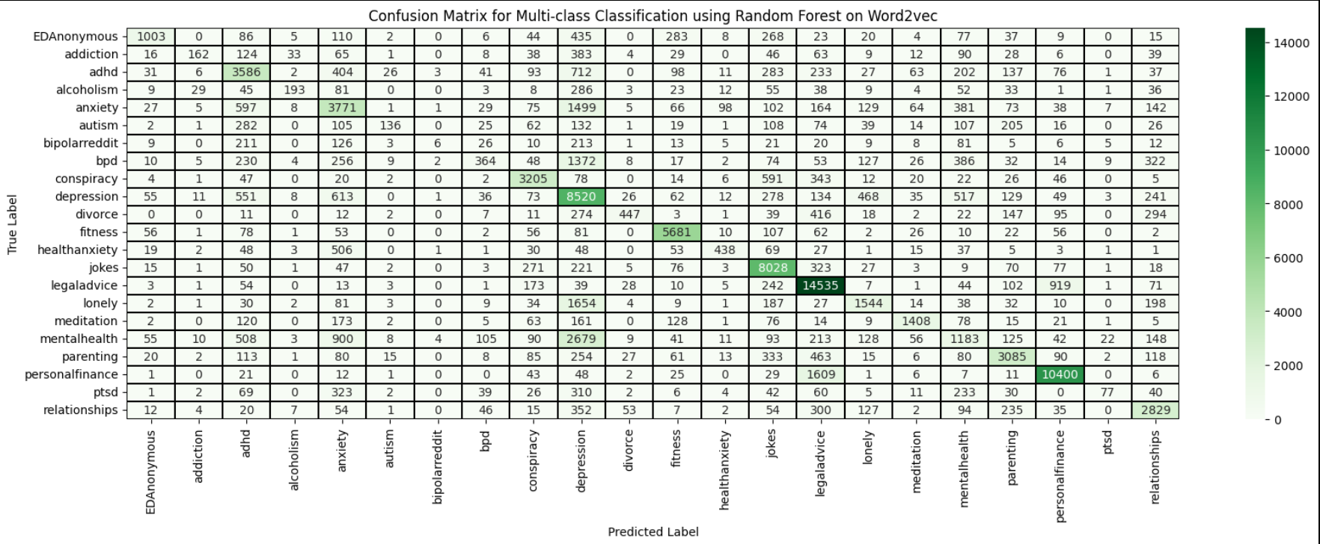

Random Forest

Slide 9
LSTM (Long Short-Term Memory)

Slide 10
Results: Model Performance
Logistic Regression: Accuracy 68.7%, baseline model
Decision Tree: Accuracy 44.3%, struggled with complex text data.
Random Forest: Accuracy 64.3%, improved but limited on nuanced categories.
LSTM: Accuracy 71.8%, best for capturing sequence in text, excelled with nuanced data.

Slide 11
Comparison of Model Performance

Slide 12
Conclusion
Logistic Regression and LSTM are most effective.
LSTM is superior in handling sequence data, making it promising for health text classification.

Slide 13
Thank You!

