Slide 1
Project - Music Player
Newton School HTML,CSS, pure JS project

Slide 2
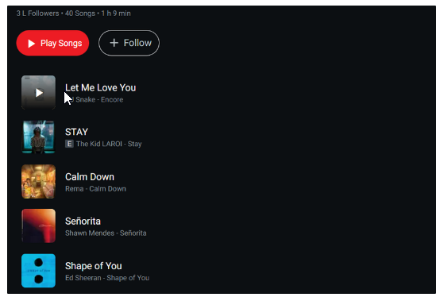
List of Features to be made:
Music player controls
List of music available
Music filters
Option to make playlists

Slide 3
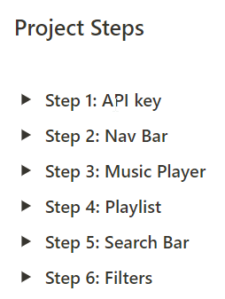
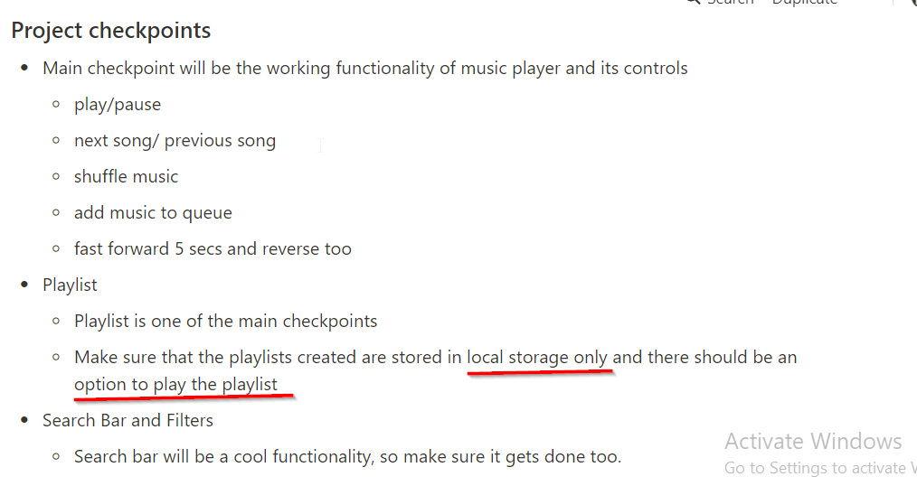
II. Nav Bar:
1. Logo
2.1. Home Page - contains list of music available
2.2. Music player
3. Playlist page - User created playlist in local storage
III. Music player:
1. option to add music to the queue and also display the queue if user asked for it
2. Shuffle
3. add forward and backward 5sec control
IV. playlist:
1. search option
2. stored in the local Storage
Guidelines
IV. Search Bar:
1. Home page -> Search bar
2. using regex expressions
3. should disappear when focus is removed
V. Filters:
1. filter music by artists, recently played etc.
2. Integerate this filter with search

Slide 4
Plan
Concepts to Learn
Functions to Learn
Create UI ppt with functions in callouts
Do HTML and CSS as fast as possible
Create all necessary functions
Finish
Spend time on CSS style optimization
API
Local Storage
play/pause
next song/ previous song
shuffle music
add music to queue
fast forward 5 secs and reverse too
search
filter
play playlist

Slide 5
Notes
Using modern libraries like particle JS, material UI
Minor animations over each component
https://stackoverflow.com/questions/33347806/regex-through-array-of-objects

Slide 6
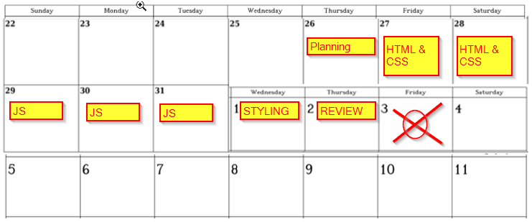
Planner

Slide 7
LOGO
Home
playlist
Seacrch
Songs
Songs
Songs
Songs
Songs
Songs
Songs
Songs
Songs
Songs
Songs
Songs

Slide 8
Playlist
X
Songs
Songs
Blur
Songs
Songs
Songs
Songs
Songs
Songs
Songs
Songs

Slide 9
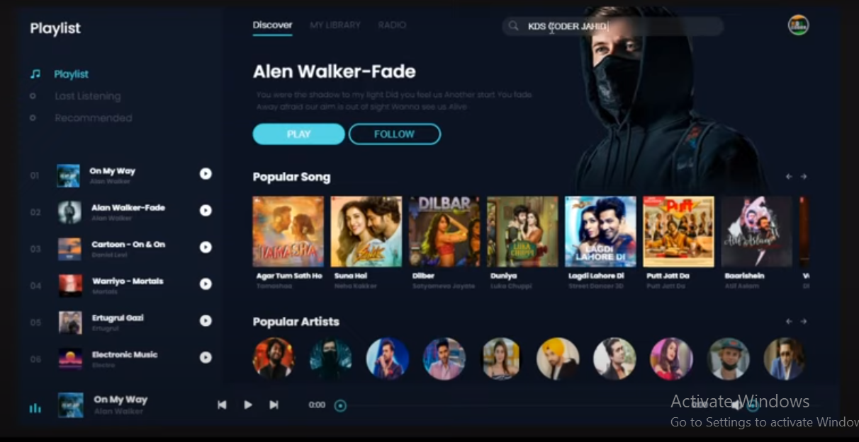

Slide 10

Logo

Slide 11
Logo

Slide 12


Slide 13




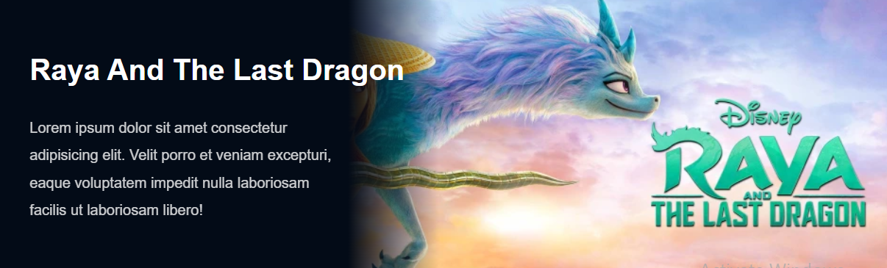
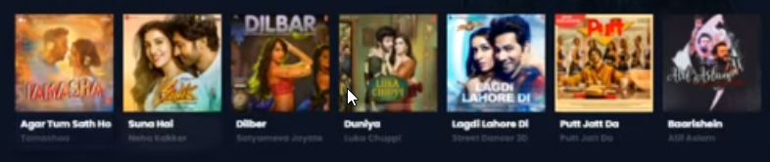
HOME

Slide 14
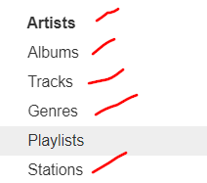

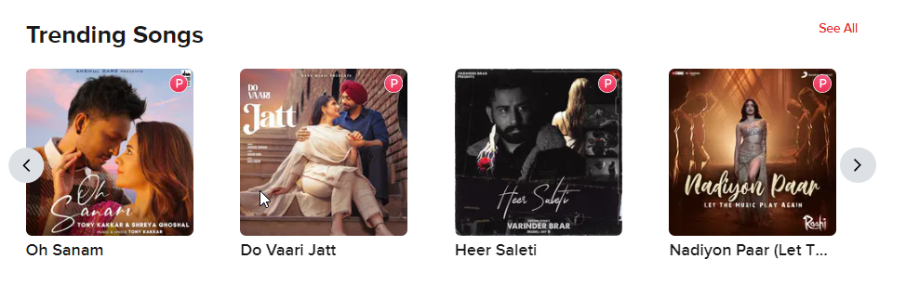
Plan

Slide 15
SCROLL

Slide 16
Song
Artist
Genre
SEARCH

Slide 17
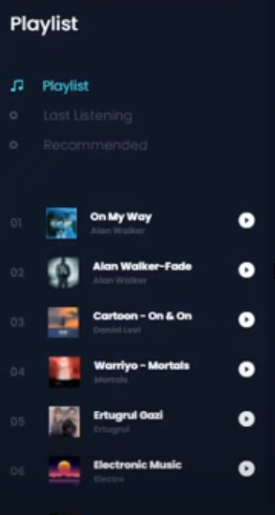
🔍 Search
PLAYLIST

Slide 18

3 div
fex space between
left and right margin
gap
div 1 and div 3:
move to end and adjust
div 1
1. image
<div
2. Title
3. author
div 3
div volume
div shuffle and add to playlist
div 2
div 5 buttons
div cur time, seek, total time

Slide 19
Js plan
Playlist open close == 1
bring songs to cards == 2
<- -> arrow functions == 10
control buttons, seek button, volume button == 3
add to playlist button == 4 (local storage)
remove from playlist button == 5
Search (with filters) == 6

Slide 20
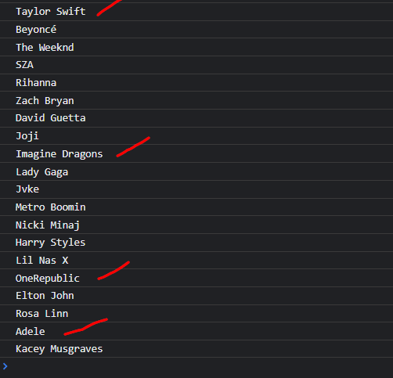
Taylor Swift , art.10482910
Beyoncé , art.42919
The Weeknd , art.51742775
SZA , art.69410617
Rihanna , art.7375005
Zach Bryan , art.329001177
Joji , art.283169213
Imagine Dragons , art.41226138
David Guetta , art.5015428
Lady Gaga , art.20067373
Jvke , art.302017422
Metro Boomin , art.116219918
Nicki Minaj , art.32558379
Harry Styles , art.146985808
OneRepublic , art.9557788
Lil Nas X , art.317800381
Adele , art.20554979
Elton John , art.3231
Kacey Musgraves , art.55080214
Rosa Linn , art.604170821

Slide 21
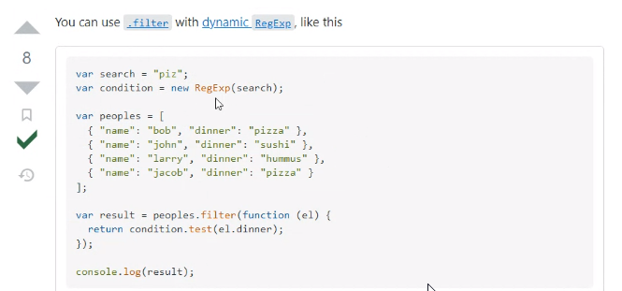
Search

Slide 22
NAPSTER - API
https://developer.prod.napster.com/developer/apps/547715e6-0e0d-4a23-ac22-b60147d5e377
https://developer.prod.napster.com/examples
https://api.napster.com/v2.2/artists/top
API Key
YWNkZDJkZjktN2Y0ZS00MTExLWI2MzAtNmE4ZDZlODI3MWRk
API Secret
NGRjODNlMjAtOWE0ZS00NzE5LThjMDctOGI0OWI5MGMzODMz
Callback URL
music_app

Slide 23
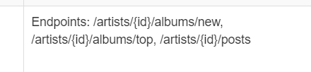
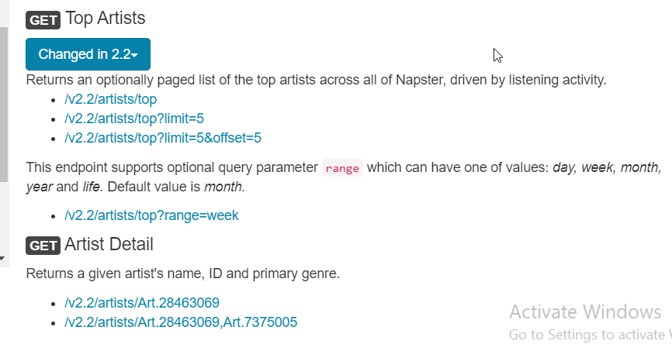
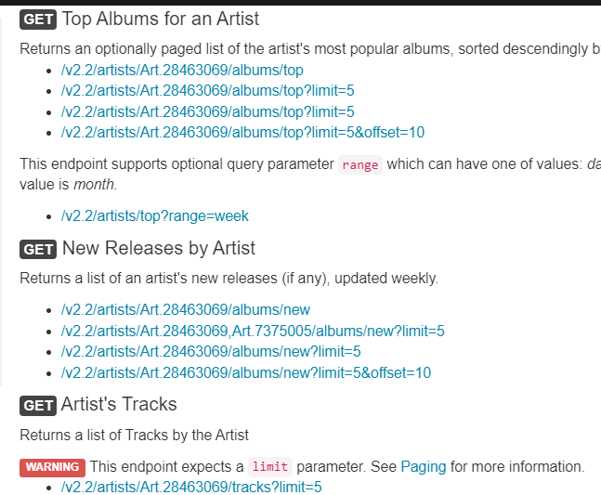


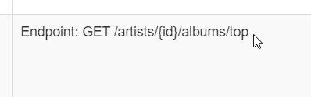
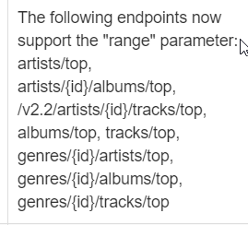
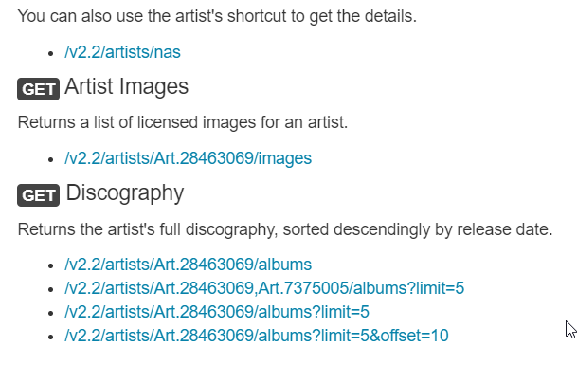
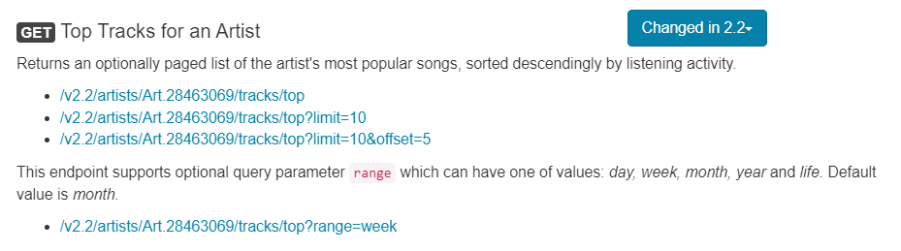
Home - display all songs
Search - searh for all songs, or artist
Filter by artist:
2.1 check-box

Slide 24
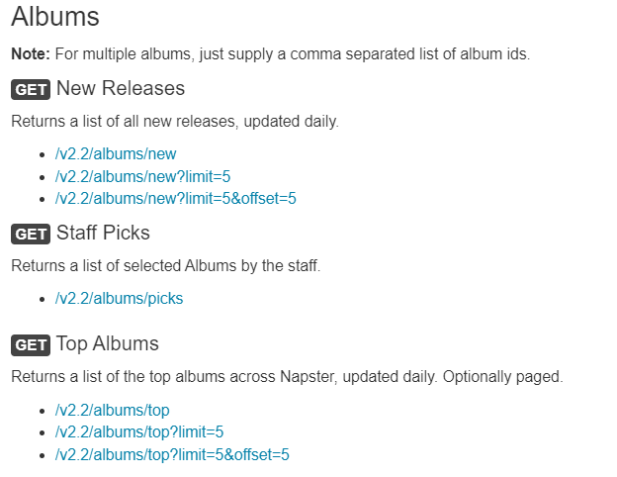
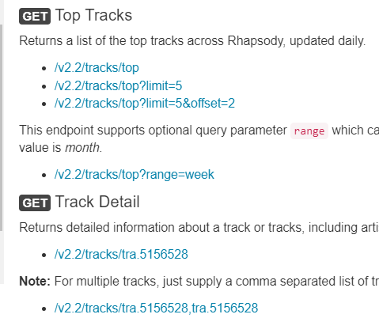
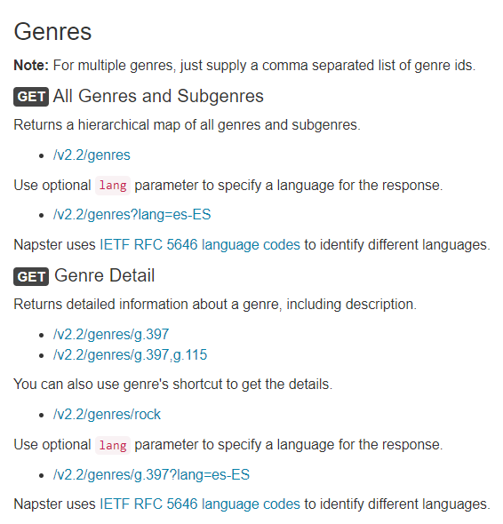
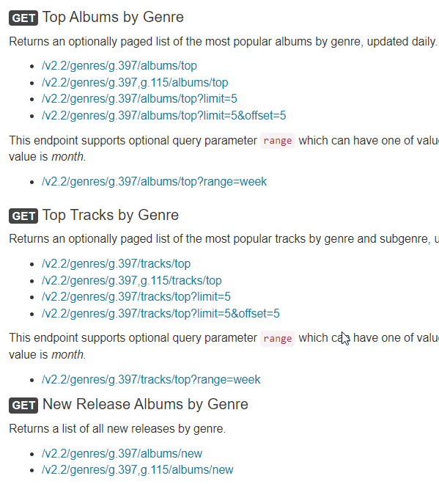
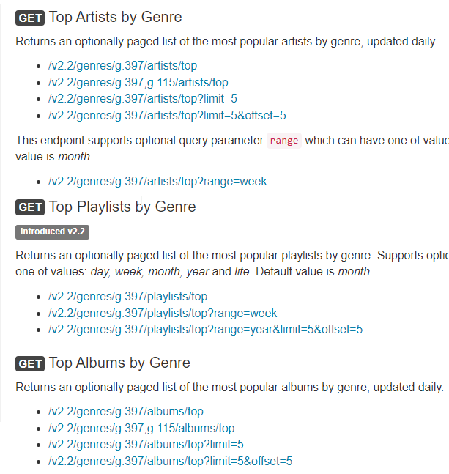
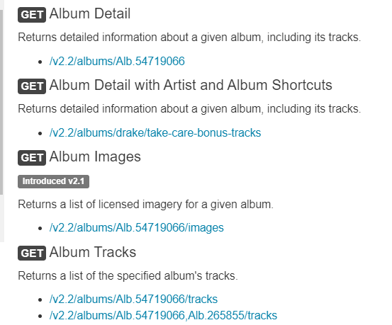

Slide 25
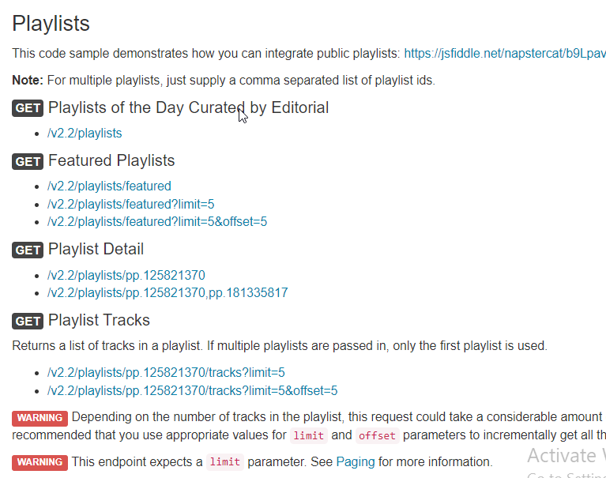
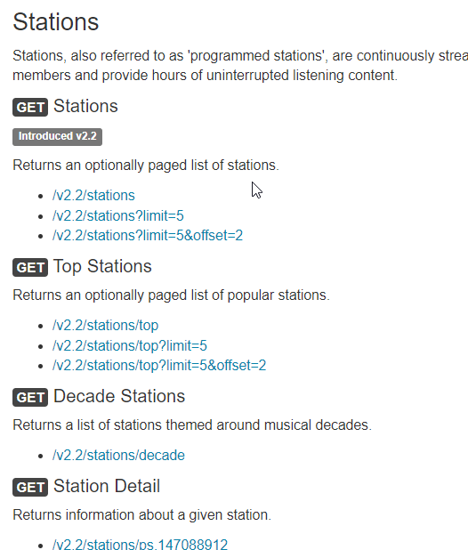
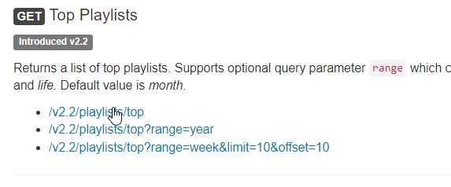

Slide 26
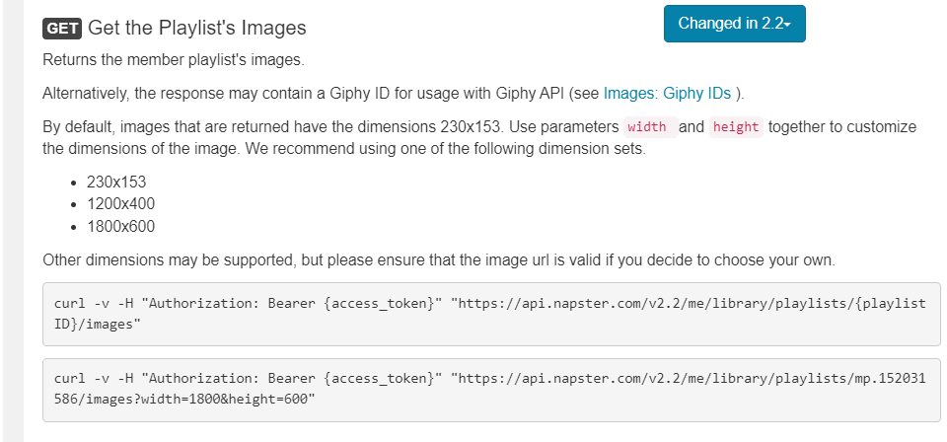
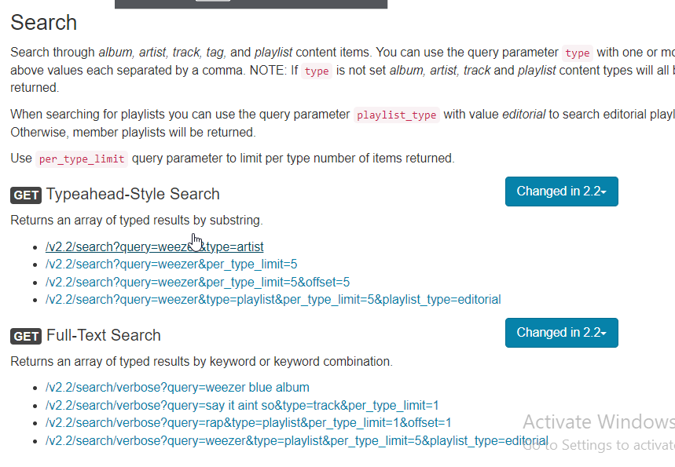
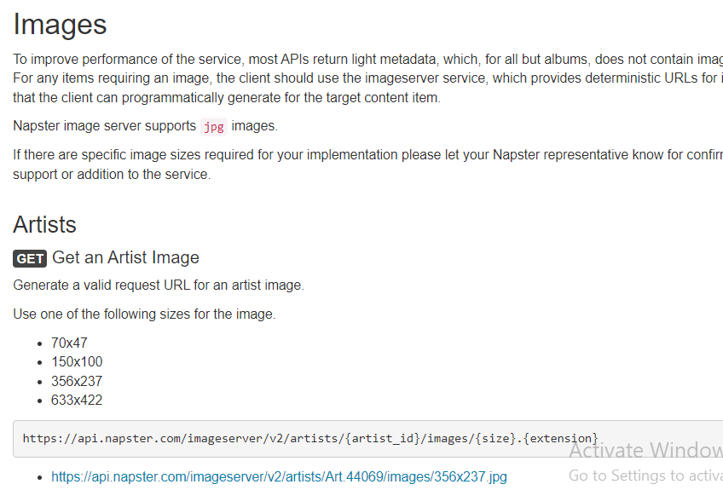
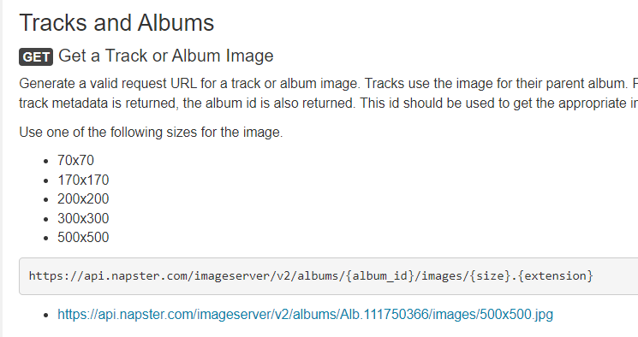
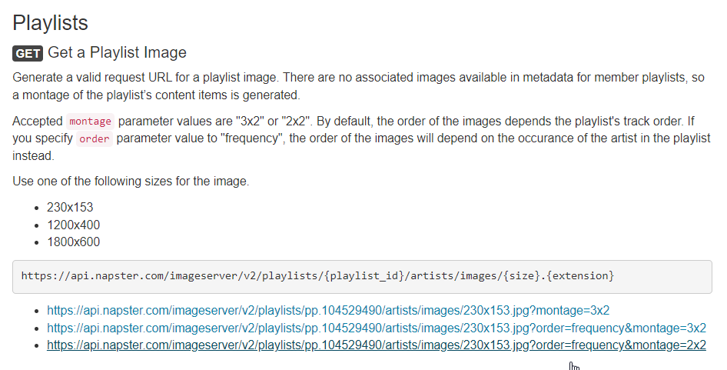
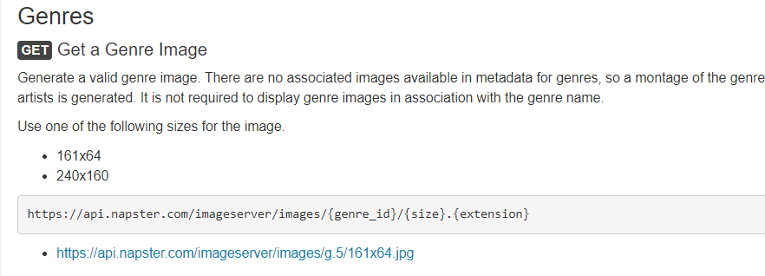
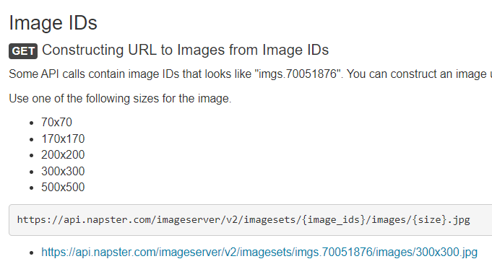

Slide 27
General:
album - new, top - tracks
tracks - top
Artists:
album - new, top - tracks
tracks - top
Genre:
artist - top
album - top
tracks - top
playlist - top
new releases
Tracks:
range and limit
Playlists: Top
Stations: top
Album -> tracks, artists, genre
Artist -> albums, genres -> top tracks
Genre -> parent, child genre
Playlist -> tracks
Tracks -> all song details

Slide 28
Album
New
Get
albums list
Tracks for each albums
Top
Tracks
Top

