Slide 1
Presentation ON Graphical password authentication system
OF
Bachelor Engineering
IN
Information Technology
BY
Prashil Raorane Gautham Mudaliar Abhishek Tukrul
Under The Guidance Of
Prof Ganesh (Taklya)
Department Of Information Technology
Shivajirao S Jhondhale College Of Engineering
Dombivli (East)

Slide 2
What Is Graphical Authentication system ?
A Graphical Password Is an Authentication System that works by having the user select from images in specific order , presented in a Graphical User Interface ( GUI).
A graphical password is easier than a text-based password for most people to remember.
Graphical passwords may offer better security than text-based passwords because many people , in an attempt to memorize text-based passwords , use plain words
A Dictionary search can often hit on a password and allow a hacker to gain entry into a system in seconds.

Slide 3
Methods Of Authentication
1.Token Based
Based On Something You possess.
2. Biometric Based
System which recognizes humans based on physical traits.
3. Knowledge Based
Based on Something You Know.

Slide 4
How Security Systems Works ?
Identification
Identify The User.
Authentication
User Supplies The Proof of his/her Identity.
Authorization
User Can Access The Resource.

Slide 5
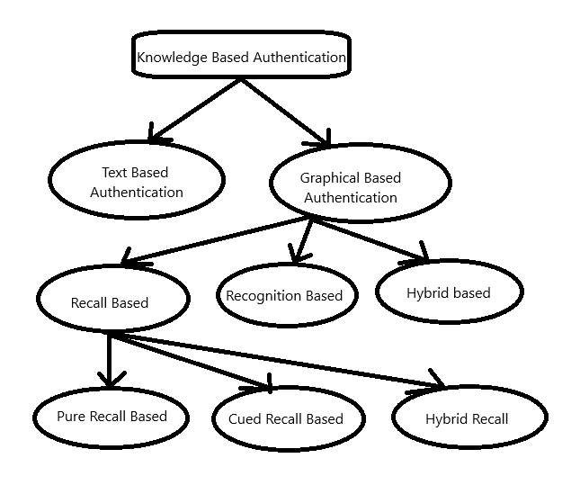

Slide 6
Framework Used
Visual Studio Code
Technology Used
Hypertext Preprocessor (PHP)
My SQL
JavaScript
Hypertext Markup Language(HTML)
XAMP

