Slide 1
Django
Made by: Slamova Gaukhar
Mukhanova Meruyert

Slide 2
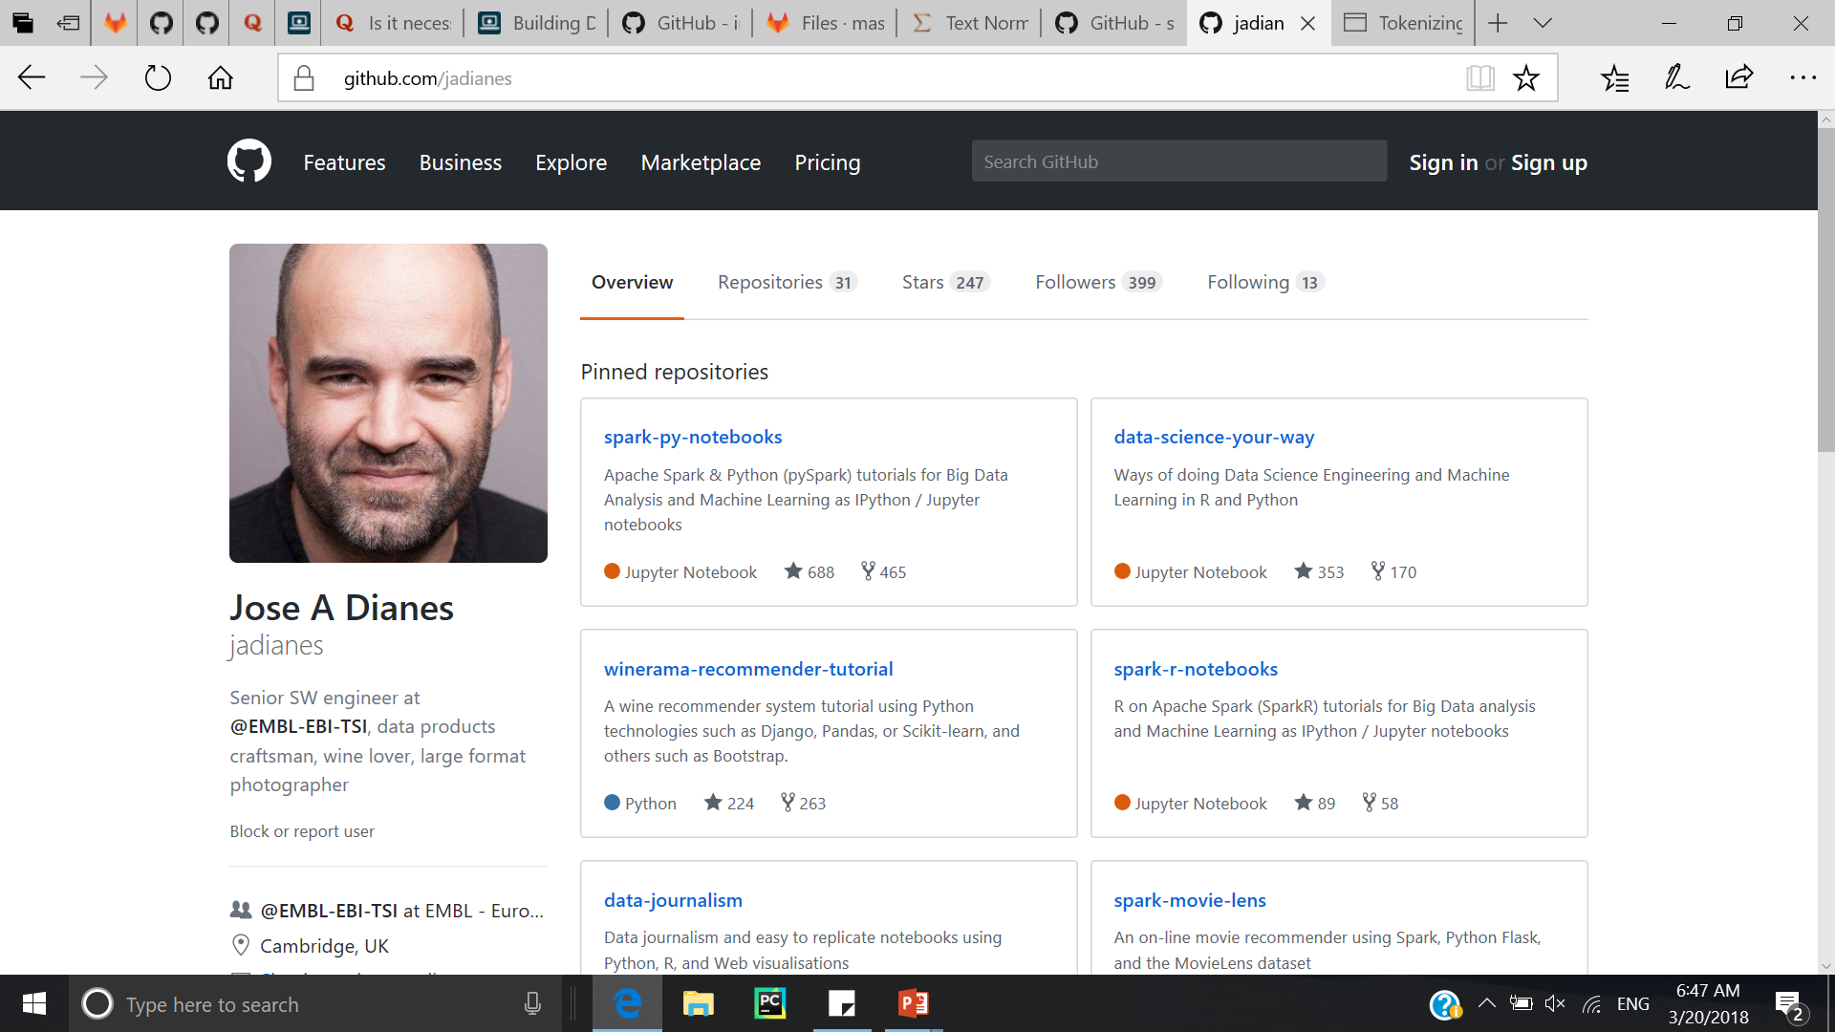
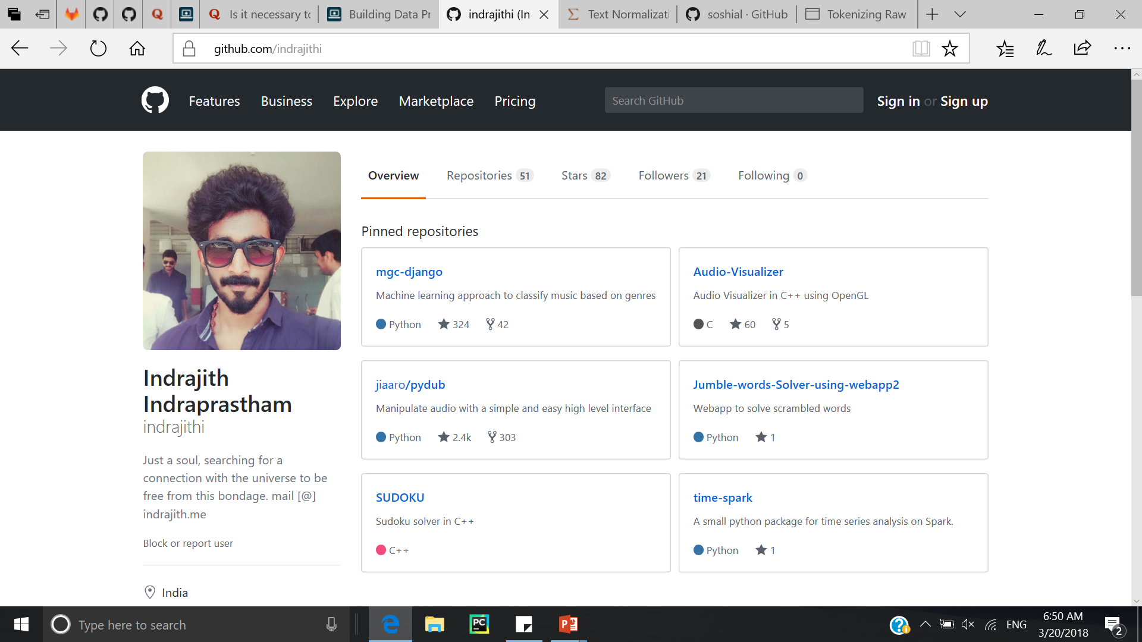

Slide 3
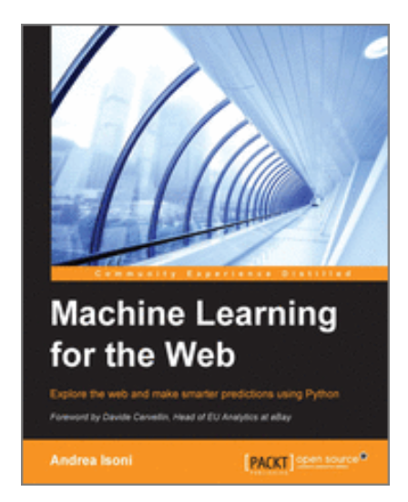

Slide 4
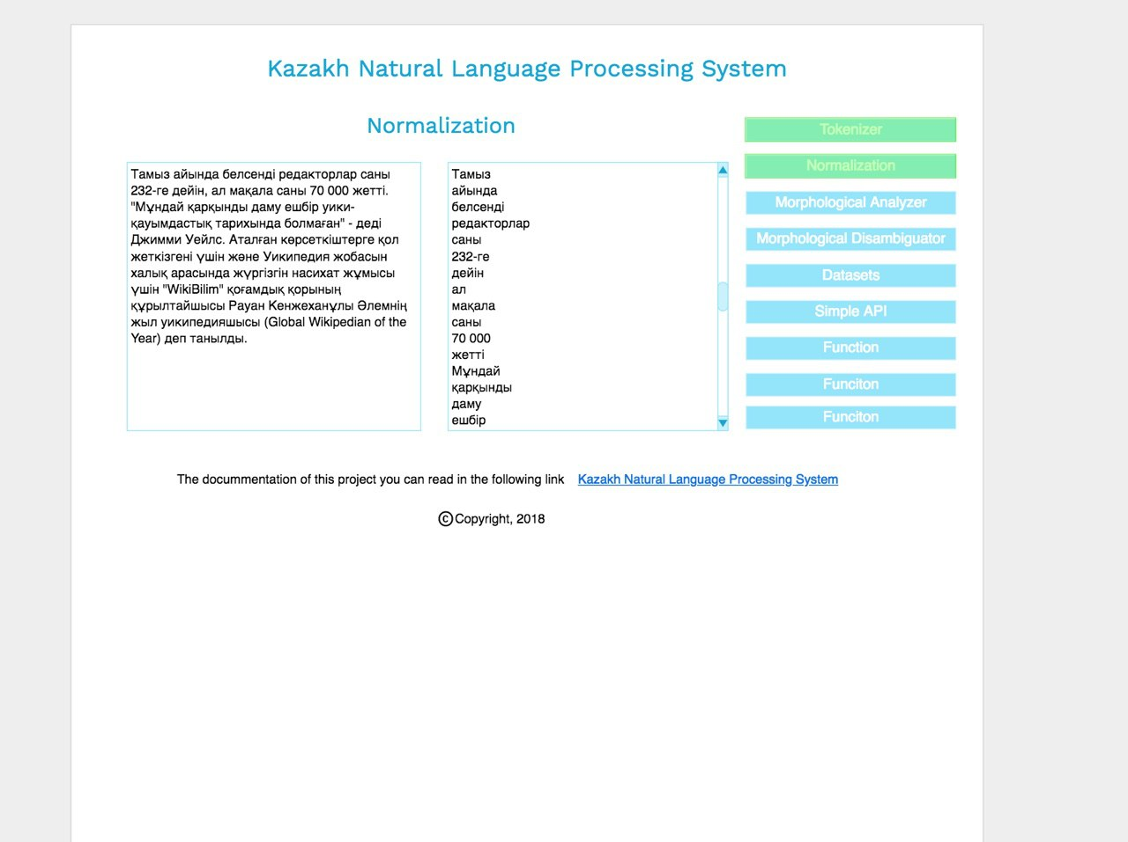

Slide 5
Tokenization
Made by: Slamova Gaukhar
Mukhanova Meruyert

Slide 6
Tokenization is the process of breaking a stream of text up into words, phrases, symbols, or other meaningful elements called tokens.
In Python, there are number of methods for quickly tokenizing text. The most naïve method for doing this is to simply the split() function associated with Python strings. By default, split() simply splits the string into a list by whitespace characters.
>>> mystring = "My favorite color is blue“
>>> mystring.split()
['My', 'favorite', 'color', 'is', 'blue']

Slide 7
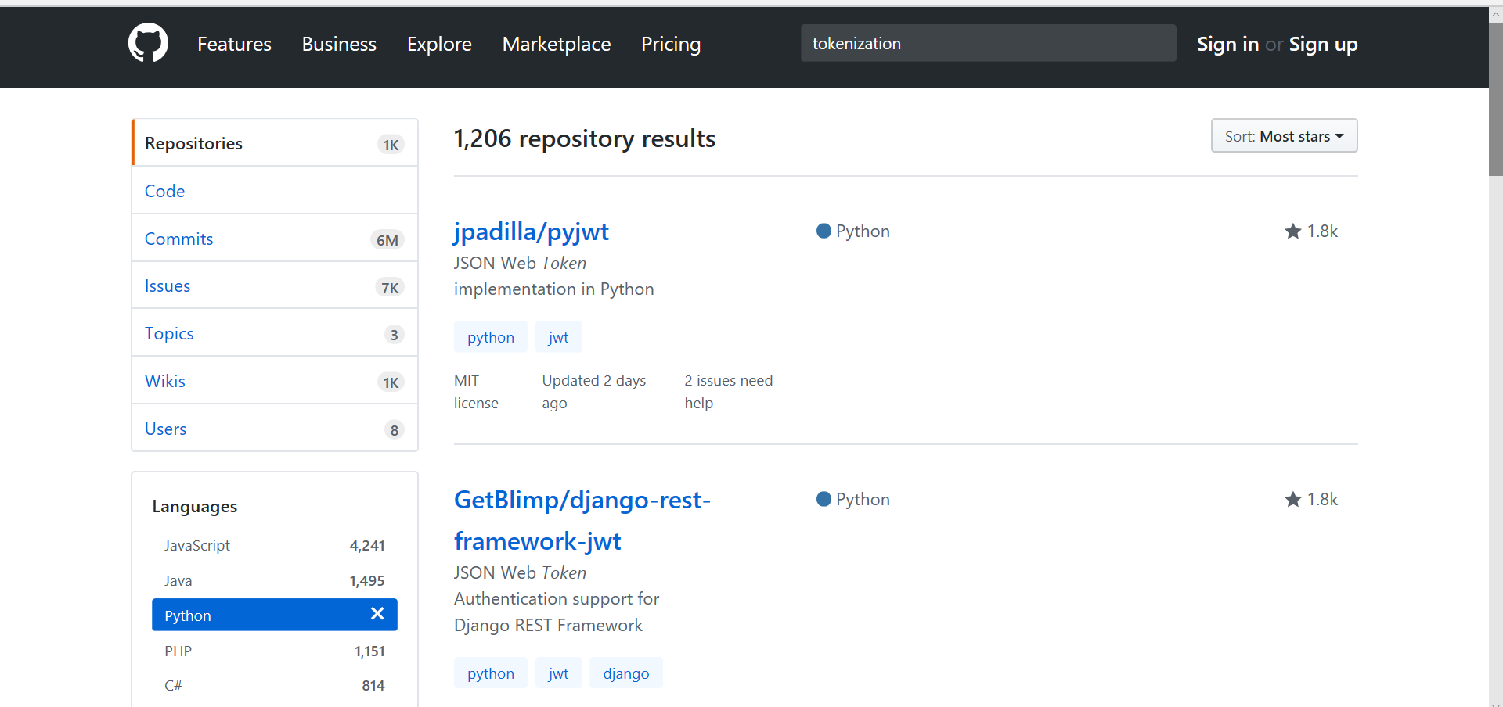

Slide 8
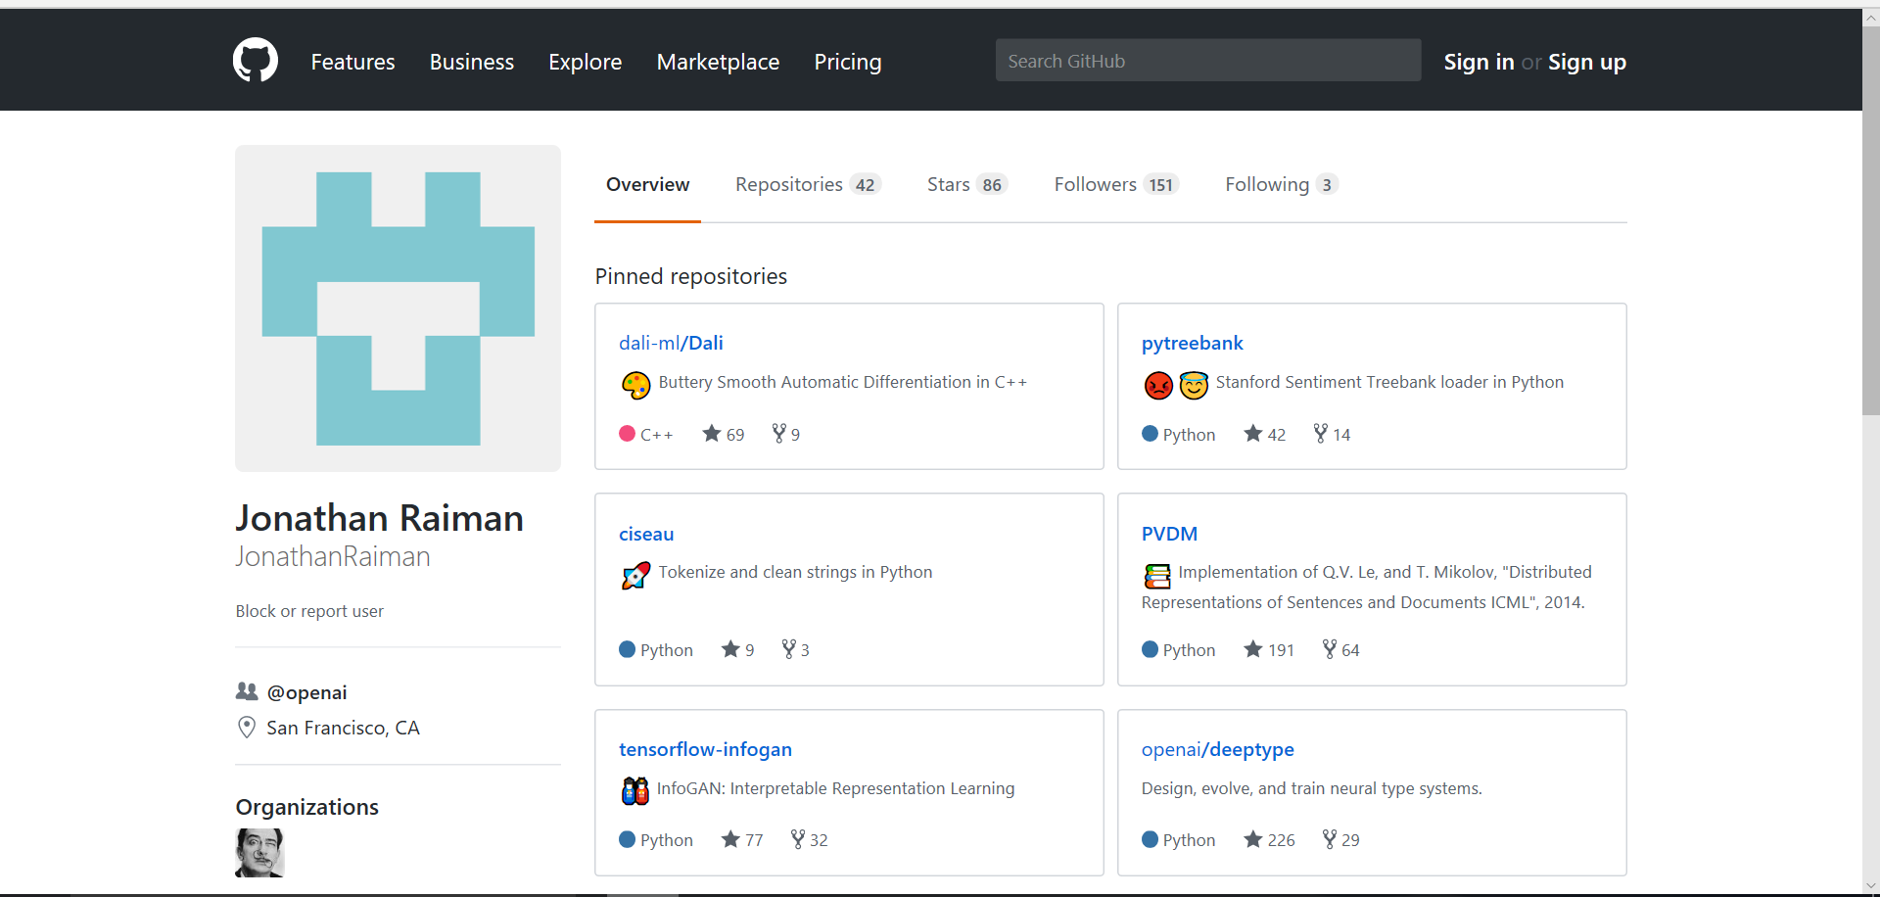

Slide 9
Normalization
Made by: Slamova Gaukhar
Mukhanova Meruyert

Slide 10
Text Normalization
It’s a part of NLP Pipeline for preprocessing text data
Normalization = applying some linguistic models to tokens of text
Text tokens often have some minor difference in spelling, but refer to same thing
Need to recognize such tokens and reduce them to the same common form

Slide 11
converting all letters to lower or upper case
removing punctuation
converting numbers into words
removing accent marks and other diacritics
expanding abbreviations
removing stop words or "too common" words
text canonicalization (tumor = tumour, it's = it is)

Slide 12
Stemming: keeping only the root of the word (usually just deleting suffixes). Ex: economy, economic, economically, economize => econom
Lemmatization: keeping only the lemma. Ex: produce, produces => produce
Values
Sometimes we want to enforce some specific format on some values of some types
PHONES: (+7(777)7077185198 => 87777077185198)
Dates, times: (25 June 2015, 25.06.15 => 2015.06.25)
Currency($400 => 400 dollars)
Addresses
$400 => Money, email@gmail.com => Email, 25 June 2015 => Date, etc.

Slide 13
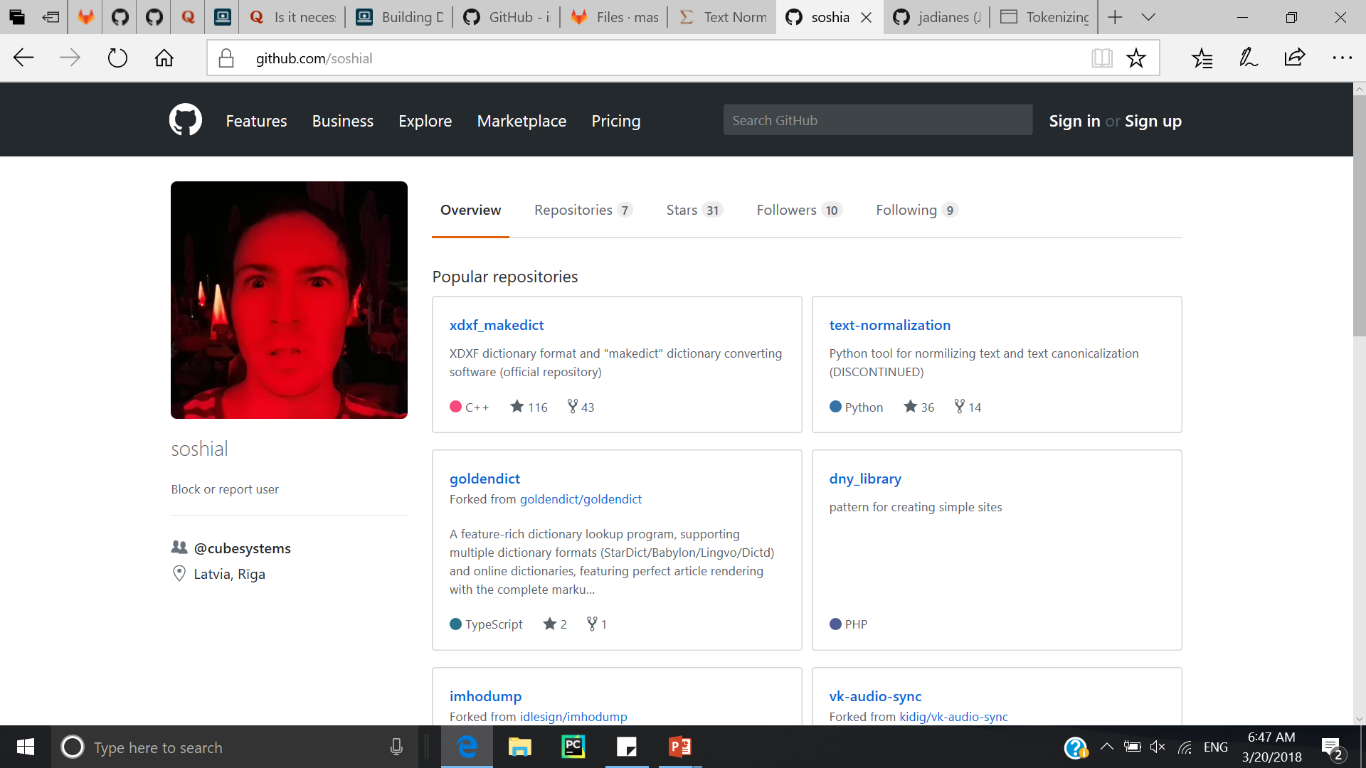
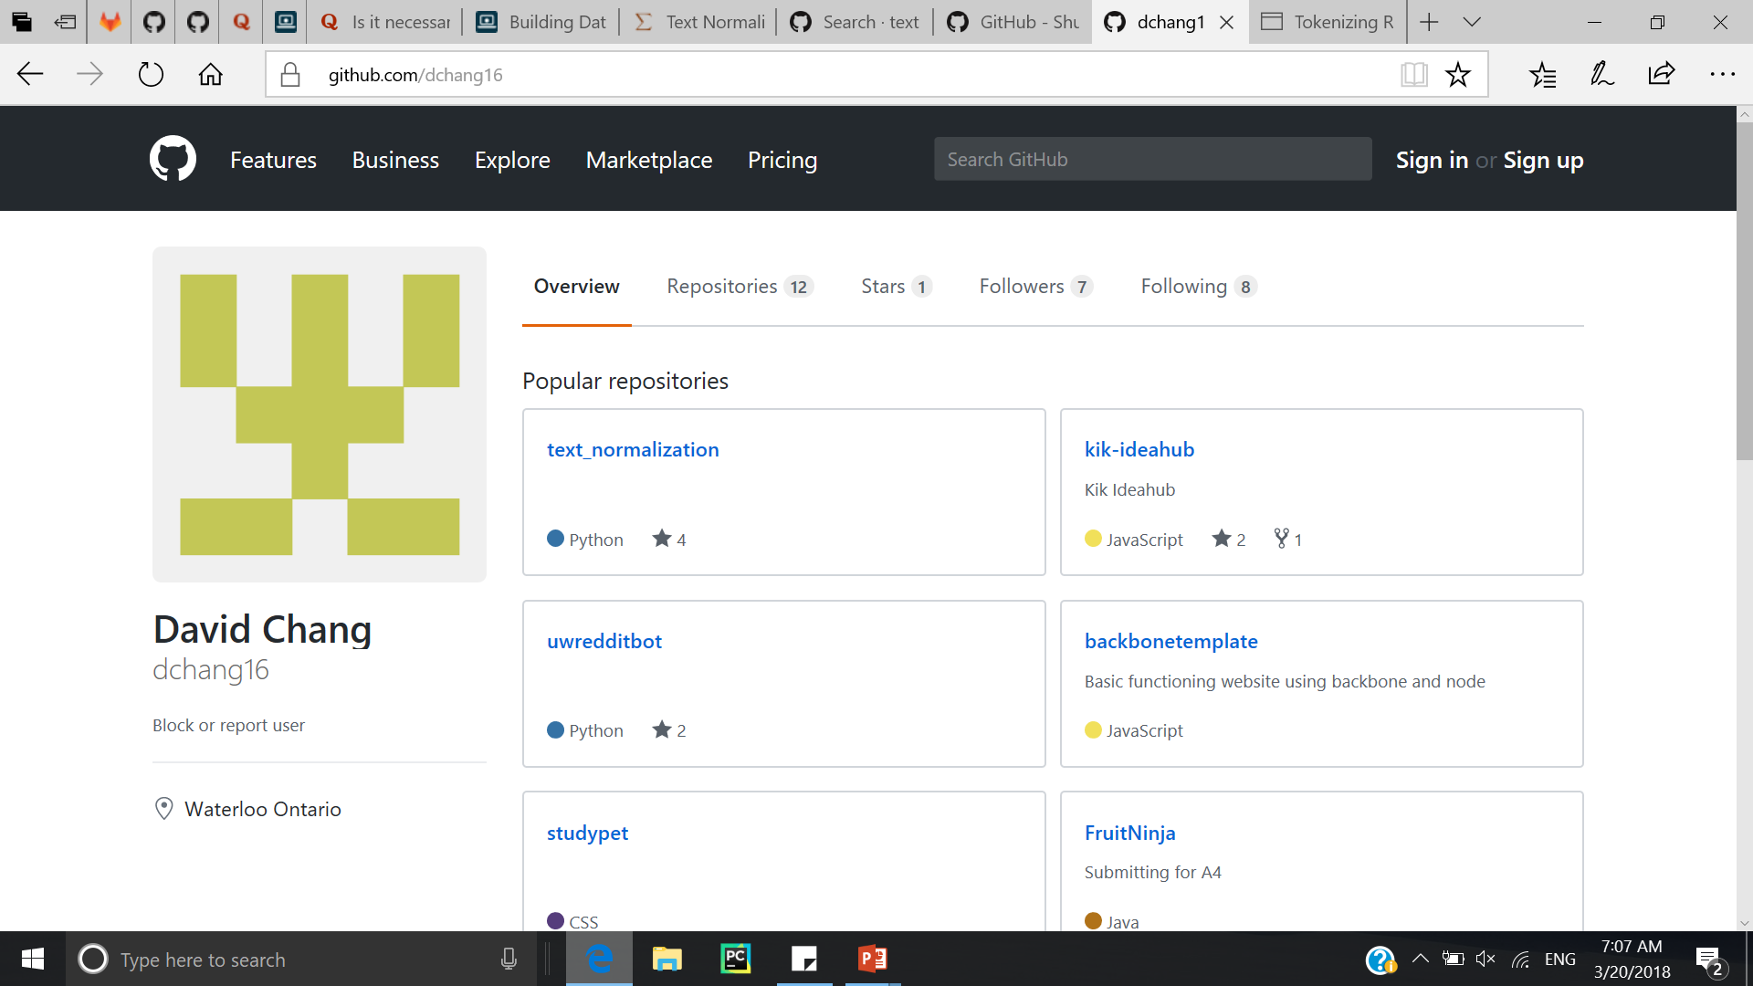

Slide 14
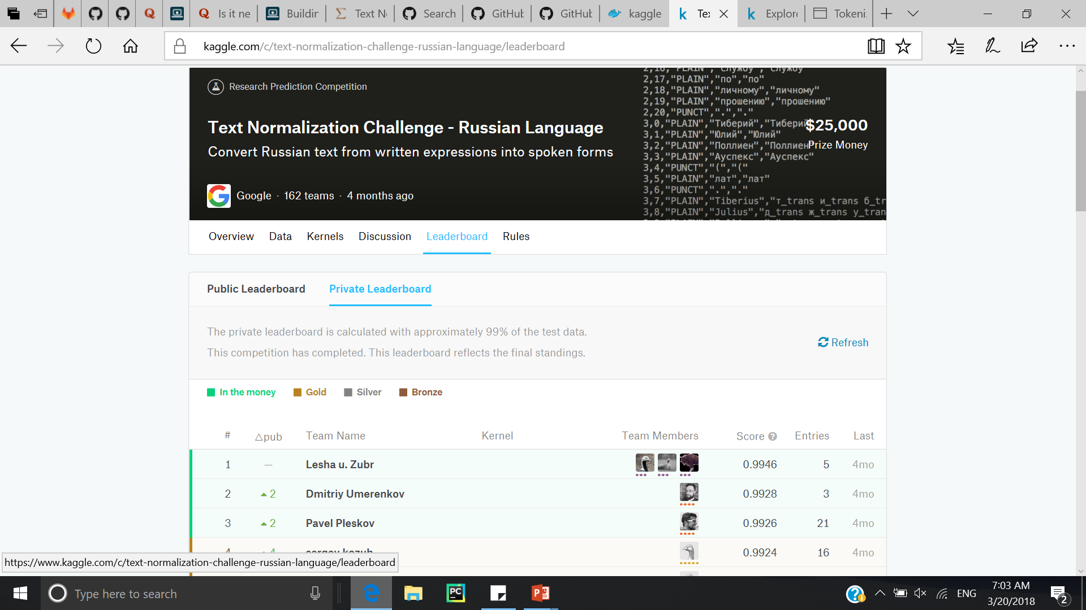

Slide 15
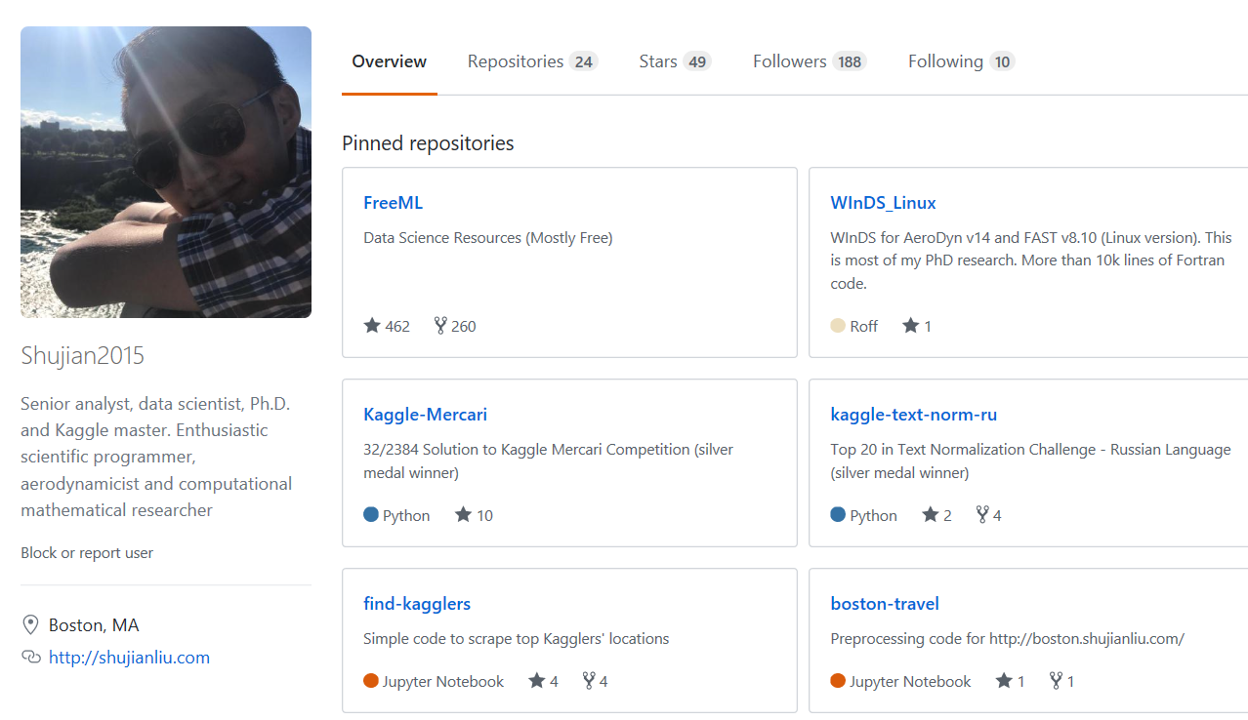

Slide 16
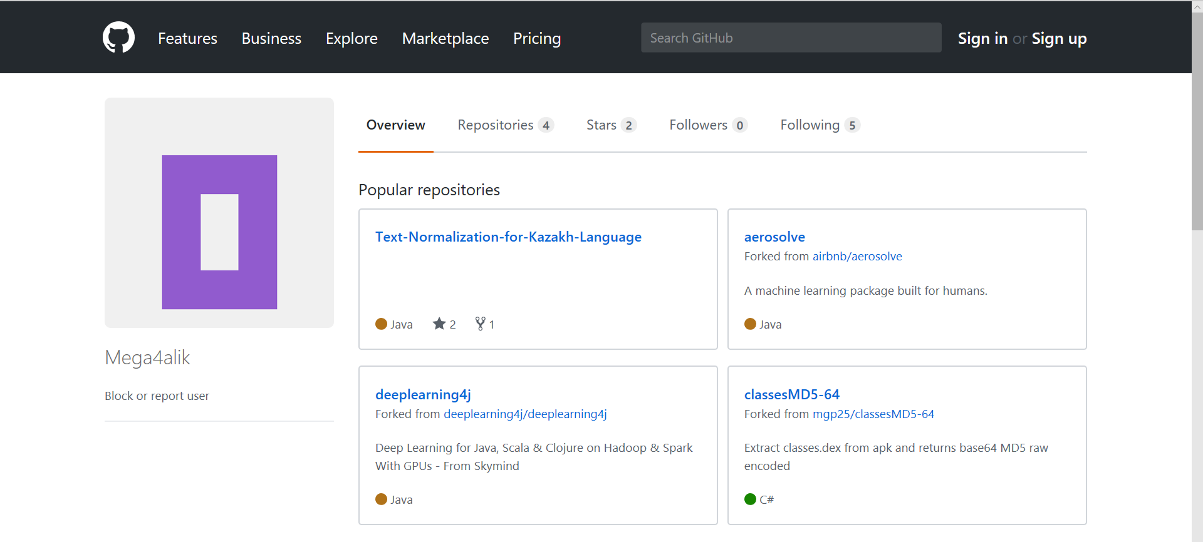

Slide 17
